Slide 1
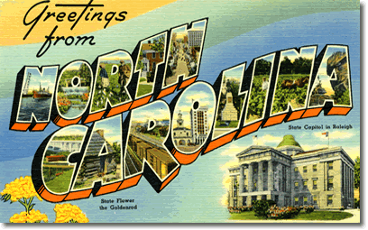
Geography
1-2 Mapping North Carolina

Slide 2
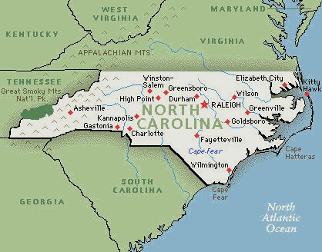
Warm Up
Grab a Blue Text from the bookshelf in the back of the room.
If you have colored pencils have them out as well.

Slide 3
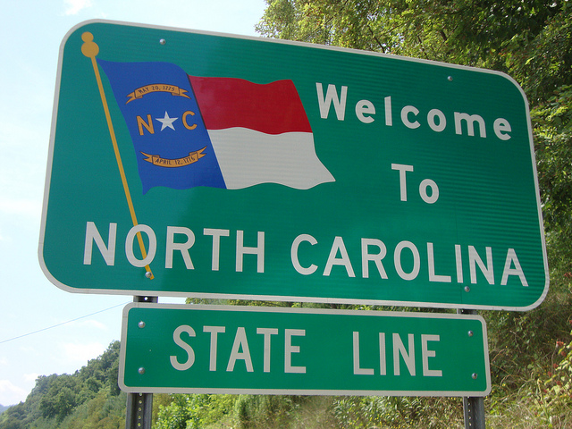
Why do we love North Carolina?

Slide 4
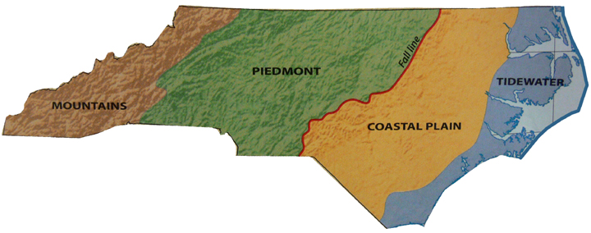
Mapping
Using the Blue Text you will
label and color the map
1) Label every item on the back of the map, cross them off as you label them.
2) Color the regions in 4 different colors… And yes... The water must be blue…
3) It must be neat and you must use only a pencil and colored pencils, no markers!
***Hint: Use maps on pages A14, A15, A16, & A17

