Slide 1
North Carolina
1-4 Famous Historical Landmarks

Slide 2
Carowinds
Carowinds – A theme park sharing a border of North Carolina and South Carolina, Carowinds has been open since 1973. The theme park has roller coasters and kids rides, as well as a kid park. Each fall it is open as “Scarowinds”, meant to for Halloween and is open at night, greatly increasing visitors.
Fun fact: Carowinds was built intentionally on the border of both states to bring the two states together, as they have been quite competitive with each other in the past.

Slide 3
Mount Mitchell
Mount Mitchell - Part of the Appalachian range, this mountain lies about 30 mostly north of Asheville. Mount Mitchell sees an average of 90 inches of snow a year, which is 80 more than we average in Charlotte, but it is a mile higher in altitude. The top is easily accessible by car, though there is great hiking in the area.
Fun fact: Mount Mitchell is the highest peak east of the Mississippi River, standing at an amazing 6, 684 feet! (Charlotte is at 770 or so.)

Slide 4
Tweetsie Railroad
Tweetsie Railroad – Situated just north of Blowing Rock and south of Boone, this kid aged theme park is a major attraction in the North Carolina mountains. This “Wild-West” theme park also has a petting farm, arcade, and three mile ride with a cowboys and Indians shootout.
Fun fact: The train is an actual steam locomotive engine, which means it uses coal, and explains why the place is so expensive!

Slide 5
Chimney Rock
Chimney Rock – Located South of Asheville and only about 1 ½ hours from here, this state park offers beautiful views of the Blue Ridge Mountains. Famous Native-American movie The Last of the Mohicans had many of its most memorable scenes filmed near here. It didn’t become part of the North Carolina State Parks system until 2005, oddly.
Fun Fact: The stairway was built in 1885, and there are an elevator and tunnel leading to the summit (top).

Slide 6
Sliding Rock
Sliding Rock - Literally a slide that you can travel down, Sliding Rock waterfall travels 60 feet down the Looking Glass Creek into 7 foot pool at the end of the falls. This is only about an hour and a half away from the LKN area.
Fun fact: It costs $2.00 per person to go down the slide, but I’m sure it’s worth it.

Slide 7
Hanging Rock
Hanging Rock – A popular destination only 1 ½ hours north of here, this beautiful mountain top is near the border of NC and Virginia, 30 miles north of Winston-Salem. The park is actually free (tax dollars at work!), and very popular with families since there are quality facilities and a lake, as well as easier to climb than other area mountains. It is part of the Mountains-To-Sea-Trail, connecting what you can guess, the mountains to the ocean in NC.
Fun fact: Copperheads and timber rattlesnakes live in the park, but won’t mess with you unless you mess with them, and you don’t want to.

Slide 8
Pilot Mountain
Pilot Mountain – The very iconic and visible mountaintop north of Winston-Salem (you can see it traveling on I-77), was known as the “Great Guide” by local Native Americans. This very easy to climb park is again only about 1 ½ hours from here, and you can mostly drive up to the top. The mountain was used as a refuge or safe haven for many hiding from other groups during fighting.
Fun fact: The town of Pilot Mountain was believed to be the fictional basis of the really old TV show, The Andy Griffith Show, just ask your grandparents…

Slide 9
Lake Norman
Lake Norman (LKN) – That’s not supposed to look too familiar, but this is part of Lake Norman, believed to be past Jetton Park and the “Peninsula” area. Built and dammed from the Catawba River and finished in 1964, LKN was built by Duke Energy, who had a keen business sense in mind. LKN is the largest manmade body of fresh water in the state.
Fun fact: LKN has 520 miles of coast line, which is the same distance to drive from Charlotte to Cleveland, OH, or down to Orlando, FL.

Slide 10
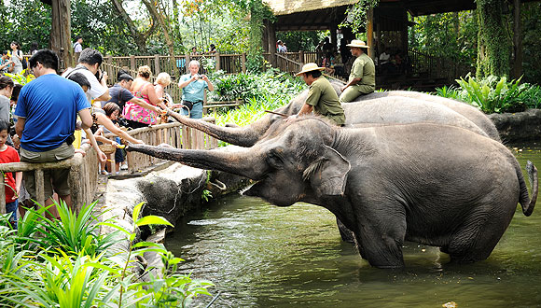
North Carolina State Zoological Park
North Carolina State Zoo - Located pretty centrally in our state, the NC State Zoo is in Asheboro, and about 1 ½ hours from here. The zoo has two parts, “North America”, and “Africa” as the more exotic animals would be in the African section. The NC Zoo has the largest collection of chimpanzees in the country, and is only closed one day a year.
Fun fact: Following the invasion of Afghanistan in 2001, the NC Zoo led the effort to rebuild and maintain the zoo in Kabul, a main city there.

Slide 11
Pinehurst
Pinehurst Golf Club – The upscale private golf club located in the center of the state has been the home of 3 U.S. Opens. There are two main courses, but it is also home to croquet and lawn bowling (what is that???). It’s definitely a “who’s who” place to be.
Fun fact: The lowest membership to join is $16,000, or about how much a year’s tuitions is at UNC public colleges.

Slide 12
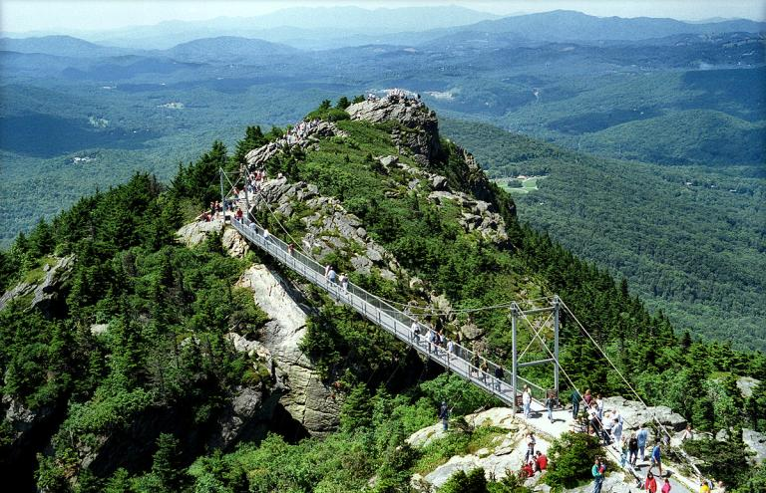
Grandfather Mountain
Grandfather Mountain – About 2 ½ hours away along the Blue Ridge Parkway, Grandfather Mountain is near Linville and is pretty amazing (hard to argue). With an iconic mile-high swinging bridge, this is easily one of the state’s most popular visitation destinations. There is ample hiking, a visitor’s center, small animal habitat, and some of the best views east of the Rockies.
Fun facts: Wind speeds of 200 mph have been recorded in the area, believed to be some of the fastest EVER recorded.
Charlotte is visible on the clearest of days (more than likely in the fall.)
A famous scene in Forrest Gump was filmed on the curvy entrance to the top.

Slide 13
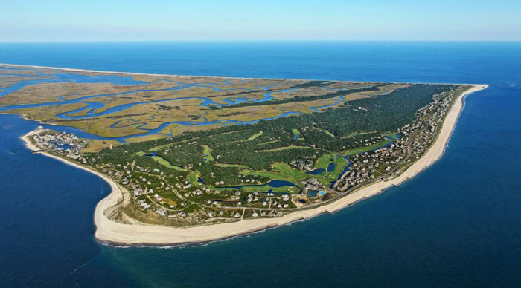
Cape Fear River
Cape Fear River – Carving out one of North Carolina’s best cities to visit, Wilmington, the Cape Fear River begins near Greensboro (Haw River), and meanders for 202 miles, dumping out into the Atlantic Ocean. The river has been used for centuries for a mode of transportation, and is the largest river basin in the state.
Fun fact: Wilmington is the center of many movie shoots, mostly for its proximity to the picturesque river.

Slide 14
Bentonville Battlefield
Bentonville Battlefield – The battle was the last full-scale action of the Civil War in which a Confederate (Southern) army was able to mount a tactical offensive (victory). The largest ever battle fought in NC, was the only attempt to defeat the Union and marauding general William Sherman on his destruction of the South.
Fun fact: The three day battle saw the Confederacy defeat the Union, though they were outnumbered 3:1 (60K to 20K).

Slide 15
Fort Bragg
Fort Bragg – Established in 1918 near Fayetteville, Fort Bragg is home to one of the largest military bases in the country. Home to U.S. Army Airborne and Special Forces, Fort Bragg was originally constructed for World War 1, and named after a famous Confederate General in the Civil War, Braxton Bragg.
Fun Fact: With a normal population of 5,400, during World War II the camp’s population swelled to 159,000 as it served as a main training site.

Slide 16
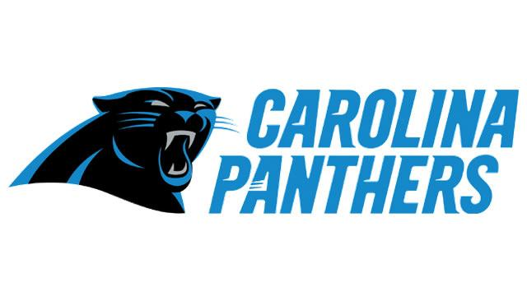
Bank of America Stadium
Bank of America Stadium – Home to the NFL’s Carolina Panthers (notice Carolina, not Charlotte…), opened in 1996 and recently underwent major renovations and the construction of a new scoreboard and escalators. Also used for mostly college football games, the stadium rarely sees concerts there, rare for a football stadium. The Panthers played their first season in 1995 three hours away in Clemson, SC.
Fun fact: The 2012 Democratic National Convention was supposed to have its final event there, the nomination of Barack Obama, but was moved indoors due to the threat of thunderstorms. It never even got that cloudy…

