Slide 1
North Carolina
1-4 Famous Historical Landmarks

Slide 2
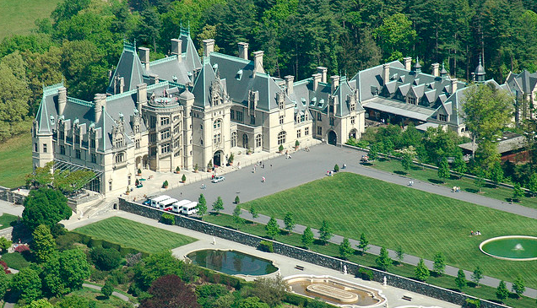
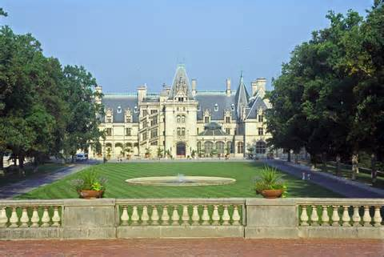
Biltmore Estate
Biltmore House – Located in Asheville, the majestic estate built by George Vanderbilt, it was once the largest privately owned home in the country A massive tourist attraction for people all over the country, the Biltmore Estate also has pristine gardens, has been the location for many high-profile gardens, and is widely regarded as one of the most beautiful homes in America.
Fun fact: During World War II many paintings and sculptures were moved from Washington, D.C., to the Biltmore for safe keeping.

Slide 3
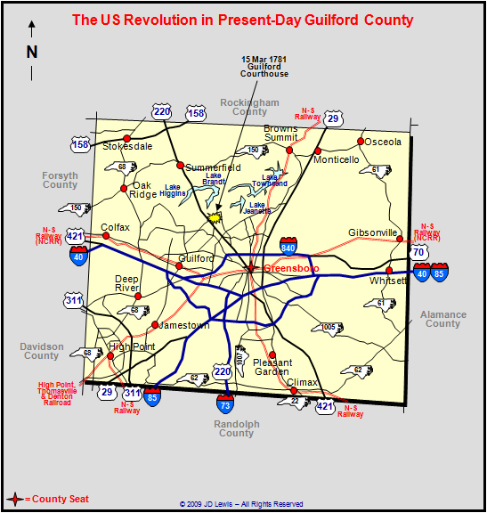
Guilford Courthouse
Battle of Guilford Courthouse – Just over an hour away near Greensboro, this massive one day battle of the Revolutionary War was a turning point to “American” victory against the British in 1781. Though the Americans “lost” the battle, the heavy number of British casualties was a win for the Americans fighting for independence. The movie The Patriot portrays this battle towards the end, as of the most epic encounters of the war.
Fun fact: Every year, on or around March 15, the date of the battle, a re-enactment occurs of the battle.

Slide 4
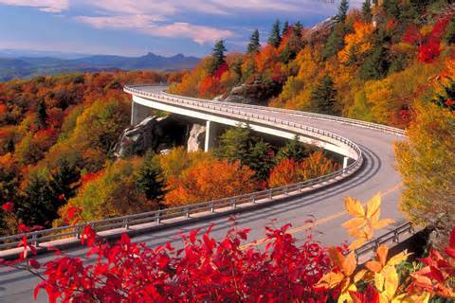
Blue Ridge Parkway
Blue Ridge Parkway – A national parkway dubbed “America’s Finest Drive” travels for almost 500 miles of North Carolina and Virginia. Known for its beauty as it traverses through the Appalachian Mountains, the parkway is most often visited in the fall, as you can see why to the left. Traffic is very heavy along the parkway, and you can access it very easily.
Fun fact: Though it’s not a national park, it’s been the most visited unit of the park system for every year the last 65 years!
FYI, if you think living in North Carolina is boring, I’m sorry!

Slide 5
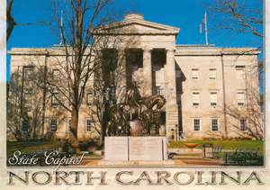
Raleigh
State Capitol – In Raleigh (you all knew that), the capitol building was complete in 1840 after 7 years of construction. It’s fairly bland, but the greenish copper top of the dome is fairly well known.
Fun fact: It replaced a building destroyed by fire in 1831, as there wasn’t really a capitol building.

Slide 6
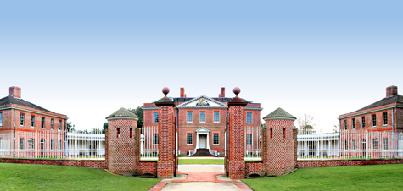
Tryon Palace
Tryon Palace – Named for a British soldier, William Tryon, it served as his base of him being governor of NC (province) from 1765-1771. A fire ruined the majority of the home in New Bern, along the coast, though much was rebuilt.
Fun fact: Tryon left NC in 1771 to become governor of NY, only living in the house for just over a year.

Slide 7
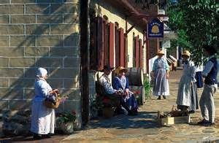
Old Salem
Old Salem - Located in Winston-Salem just an hour away, this one-time true Moravian Village is now the home to a look at how life used to be. A National Historic Landmark, Old Salem was home to many from the area of what is now the Czech Republic. You can visit for a true representation of the simplicity of life from the mid-1700s.
Fun fact: Italian sports car maker Fiat filmed a well-known commercial at Old Salem in April 2013.

Slide 8
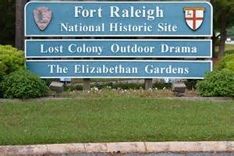
Fort Raleigh
Fort Raleigh - Home to what is known to be the first English settlement in the United States, this fort rich in history and mystery is along the edge of the Outer Banks near the town of Manteo. Today there are historic gardens, the Elizabethan Gardens, as well as an outdoor theater. It is most definitely a National Historic Site.
Fun Fact: This is the home of the “Lost Colony”, as original settlers from John White’s colony disappeared, as well as Virginia Dare, the first English person born on American soil.

Slide 9
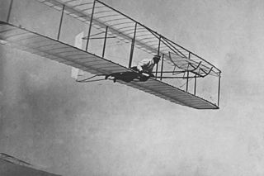
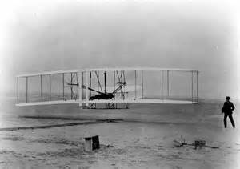
Kitty Hawk
Kitty Hawk – On the Outer Banks occurred quite possibly the most substantial event in the world of travel, flight. Orville and Wilbur Wright moved to the NC coast from Dayton, OH, to try their hands at being the first to fly. It was believe the wind on the coast was a reason for choosing North Carolina.
Fun Fact: The first flight actually occurred in Kill Devil Hills, but it didn’t exist in 1903, thus Kitty Hawk earning credit.

Slide 10
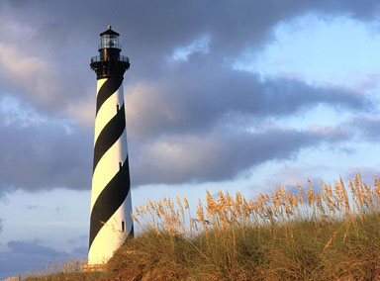
Cape Hatteras Lighthouse
Cape Hatteras Lighthouse – Possibly the most iconic landmark on the Atlantic coast, this lighthouse built in 1802 was made in an effort to help those navigating the rough coast off North Carolina’s Outer Banks, known as the “Graveyard of the Atlantic”. Destroyed from a heavy storm, in 1879 a new lighthouse was built, standing at 208 feet tall, the tallest lighthouse in the country.
Fun facts: There are 268 steps, entrance fee is $8, and you can see about 25 miles out on a clear day across the ocean.

Slide 11
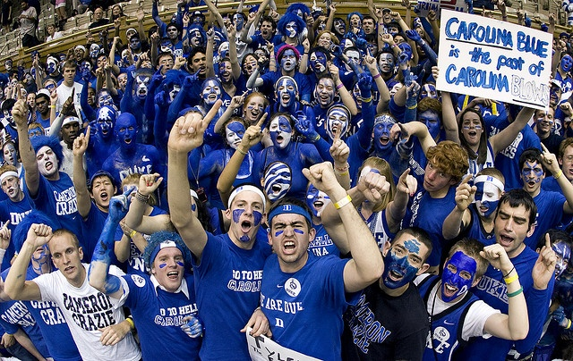
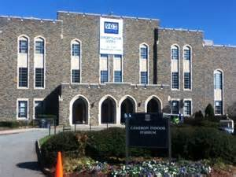
Cameron Indoor Stadium
Cameron Indoor Stadium – Located on the almost gothic-like campus of Duke University in Durham, this college basketball mecca has a storied past. Known to be absurdly hot at all times, the louder than imagined basketball “stadium” finally got air conditioning in 2002! Tickets are very hard to come by, and students camp out in “Krzyzewskiville” for weeks for bigger games.
Fun fact: Cameron Indoor only seats 9,314, about 13,000 less than UNC’s “Dean Dome”.

Slide 12
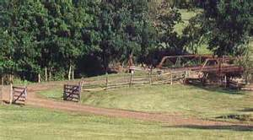
Battle of Moore’s Creek Bridge
Battle of Moore’s Creek Bridge – This event in the very eastern part of NC signaled the end of the British reign in our state. This brief battle near Wilmington strengthened the Patriots cause to break away from the strong hand ways of British rule. A sneaky barrage by Americans desiring freedom shortly before sunrise caught the Brits off guard, using the bridge as a location to throw off the British.
Fun Fact: Loyalists not only deterred the Brits from gaining more strength in NC, but only had one soldier killed and another injured.

Slide 13
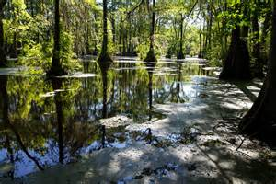
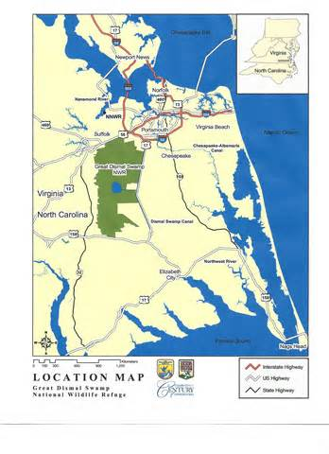
Great Dismal Swamp
Great Dismal Swamp – Bordering NC and Virginia, this swamp is very rare for this part of the country. From Native Americans to runaway slaves, the swamp was a haven for those looking to avoid the evils of the world. The swamp today isn’t very recreational, due to efforts to preserve its sanctity and beauty.
Fun Fact: A canal was built by NC and Virginia in 1805 for the harvesting of timber, and is the oldest operating artificial waterway in the United States.

Slide 14
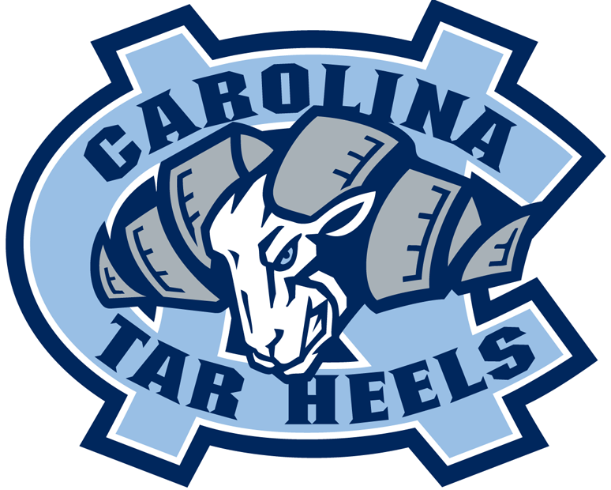
UNC Chapel-Hill
UNC Chapel-Hill – The first public college in the state, UNC Chapel-Hill is home to the famous Tar Heels, and anchors one of six UNC system schools (Asheville, Charlotte, Greensboro, Pembroke, Wilmington). Known for it’s beautiful campus and famous alumni, UNC is a top destination for scholars globally.
Fun Facts: UNC is the #5 ranked public college in the country, and their women’s soccer team has won an UNBELIEVABLE 21 of 31 women’s college soccer championships.

Slide 15
Lake Mattamuskeet
Lake Mattamuskeet – This extremely shallow lake, as seen in the pictures beside, is quite small. Located near the coast and the Pamlico Sound, the lake is a winter home to many larger birds looking for warmer water due to its shallowness.
Fun Fact: Lake Mattamuskeet is the largest natural lake in the state.

Slide 16
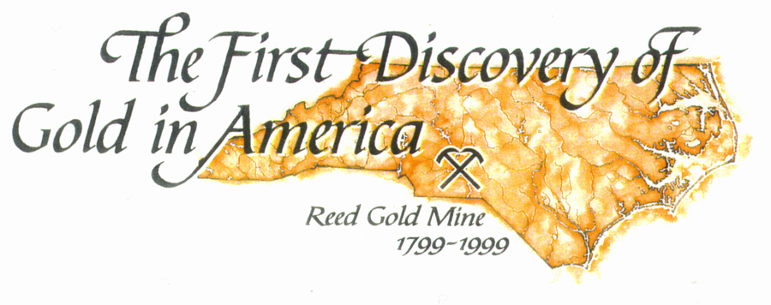
Reed Gold Mine
Reed Gold Mine – Only about 45 minutes away past Concord, this gold mine is the first documented find of gold in the country. The first gold found I the Little Meadow Creek weighed 17 pounds and was bought for $3.50, when in reality the value back then in 1799 was $3,600!
Fun Fact: The 17 pound gold nugget was used for three years as a door stop.

Slide 17
Edward Teach Home
Edward Teach Home – Commonly known as Blackbeard, the most infamous of all pirates on the coast, Teach had an impact on the Carolinas, though smaller in NC. Always a target due to his horrible tactics and penchant to cause trouble on the sea disrupting trade and commerce, Blackbeard was killed by Virginia governor Alexander Spotswood in 1718.
Fun Fact: He was famous for marooning a crew he thought may be rebellious, once leaving 25 men behind on a small island off the coast of NC.

Slide 18
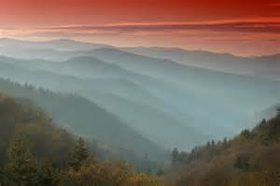
Great Smokey Mountains
Great Smoky Mountains – Bordering Tennessee and NC, but more famously in Tennessee, these mountains get their name from the natural fog that often times begins each day in the mountains. Home to many types of very wild animals, the mountains capitalize off their beauty with an ample amount of tourism and commercial aspects.
Fun Fact: It is the most visited national park in the country, with over 9 million visitors a year! That’s roughly the population of NC.

Slide 19
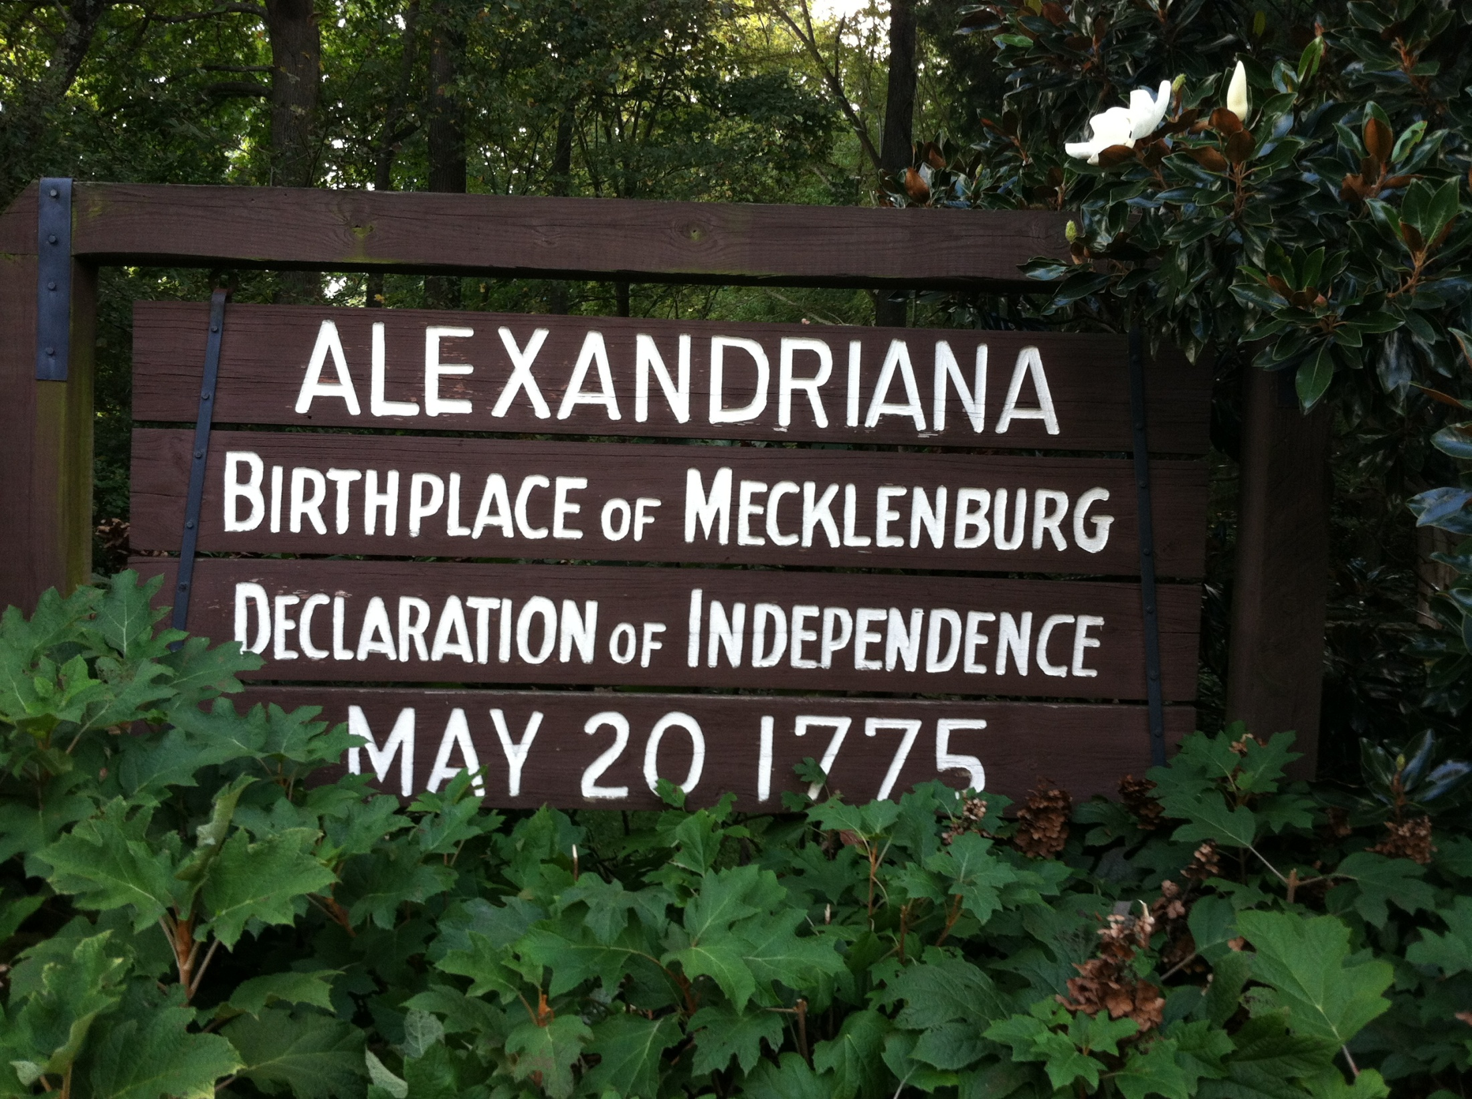
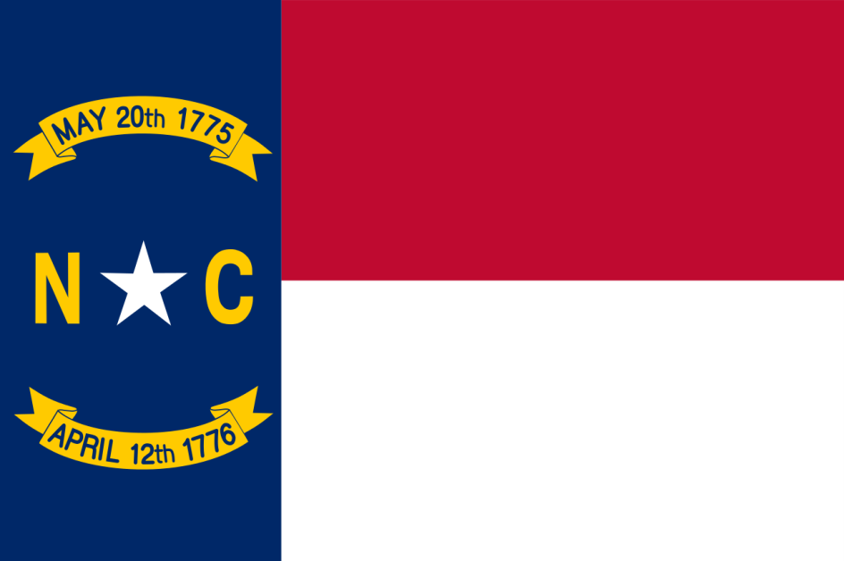
Alexandriana Park
The Mecklenburg Declaration of Independence is claimed by some to be the first declaration of independence made in the Thirteen Colonies during the American Revolution. It was supposedly signed on May 20, 1775, at Charlotte, North Carolina, by a committee of citizens of Mecklenburg County, who declared independence from Great Britain after hearing of the battle of Lexington. If the story is true, the Mecklenburg Declaration preceded the United States Declaration of Independence by more than a year. The authenticity of the Mecklenburg Declaration has been disputed since it was first published in 1819, forty-four years after it was reputedly written. There is no conclusive evidence to confirm the original document's existence, and no reference to it has been found in extant newspapers from 1775.
Fun Fact- supposedly written and signed right down the street!!!

