Slide 1
1-7: History’s Stereotypes
Examine Your Beliefs

Slide 2
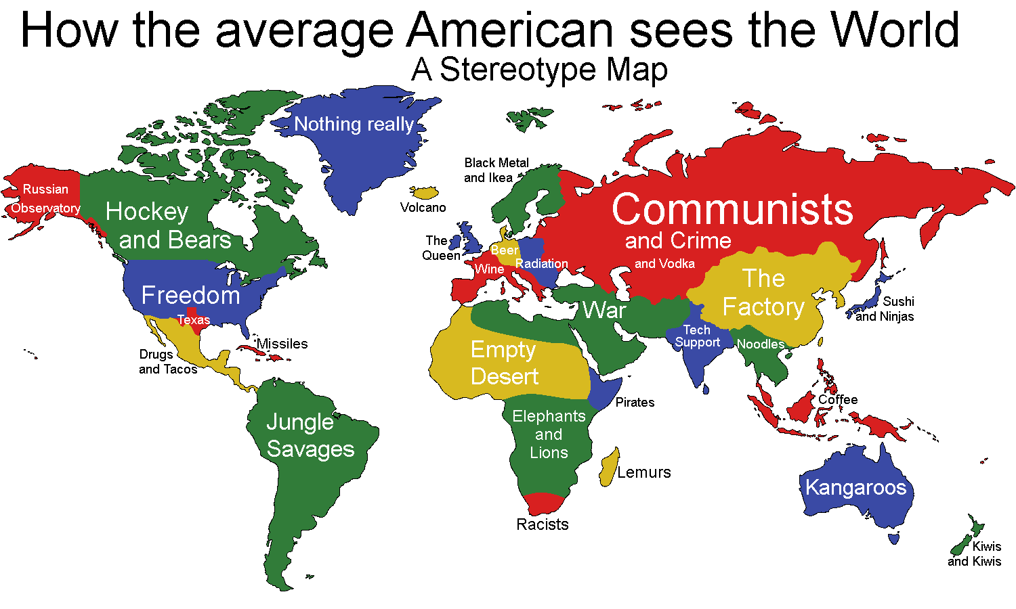
Warm Up
In what ways are these labels false?

Slide 3
What Comes to Mind???
3 Minutes…
“Native Americans”
Draw and Label 3 Pixs
Don’t Think!!!
1st Things that POP in your Head
LIST

Slide 4
“Sure You Can Ask Me A Personal Question?”By:Diane Burns
How do you do?
No, I am not Chinese.
No, not Spanish.
No, I am American Indi—uh, Native American.
No, not from India.
No, not Apache
No, not Navajo.
No, not Sioux.
No, we are not extinct.
Yes, Indian.
Oh?
So that’s where you got those high cheekbones.
Your great grandmother, huh?
An Indian Princess, huh?
Hair down to there?
Let me guess. Cherokee?
Oh, so you’ve had an Indian friend?
That close?
Oh, so you’ve had an Indian lover?
That tight?
Oh, so you’ve had an Indian servant?
That much?
Yeah, it was awful what you guys did to us.
It’s real decent of you to apologize.
No, I don’t know where you can get peyote.
No, I don’t know where you can get Navajo rugs real cheap.
No, I didn’t make this. I bought it at Bloomingdales.
Thank you. I like your hair too.
I don’t know if anyone knows whether or not Cher is really Indian.
No, I didn’t make it rain tonight.
Yeah. Uh-huh. Spirituality.
Uh-huh. Yeah. Spirituality. Uh-huh. Mother
Earth. Yeah. Uh’huh. Uh-huh. Spirituality.
No, I didn’t major in archery.
Yeah, a lot of us drink too much.
Some of us can’t drink enough.
This ain’t no stoic look.
This is my face.

Slide 5
It’s Just the Name of a Mascot!?!
What’s the Beef?
Why are they upset?
How would you feel?
Is there a Counter-Argument?
Why are they fighting so hard to keep it?

Slide 6
What Comes to Mind???
3 Minutes…
“Muslims”
Draw and Label 3 Pixs
Don’t Think!!!
1st Things that POP in your Head
LIST

Slide 7
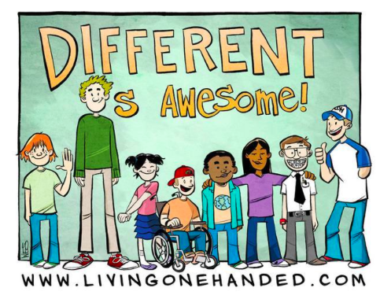
Do U See the Connection???
BOTH are examples of…
Cultural Biases
R These Common?
R Their Others?
WHY???????
Fear of Unknown or Different
R They Seen in America Today?
Media
Parents
How About Bailey Middle?
What Can U Do About It?
Perpetuate the Cycle
Stop It in Its Tracks
“Those who fail to learn history are DOOMED to repeat it!”

