Slide 1
9/11/01
We Will Never Forget

Slide 2
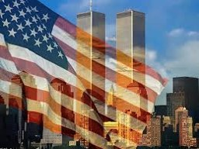
Warm up
What do you know about the attacks on 9/11/2001?
1) Warm Up!

Slide 3
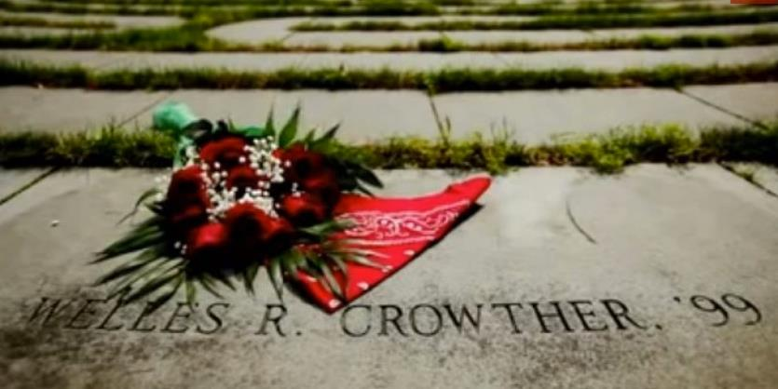
The Man in the Red Bandana
ESPN OTL: The Man in the Red Bandana (13:29)
Notes:
ESPN OTL: The Man in the Red Bandana (13:29) LINK ON IMAGE

Slide 4
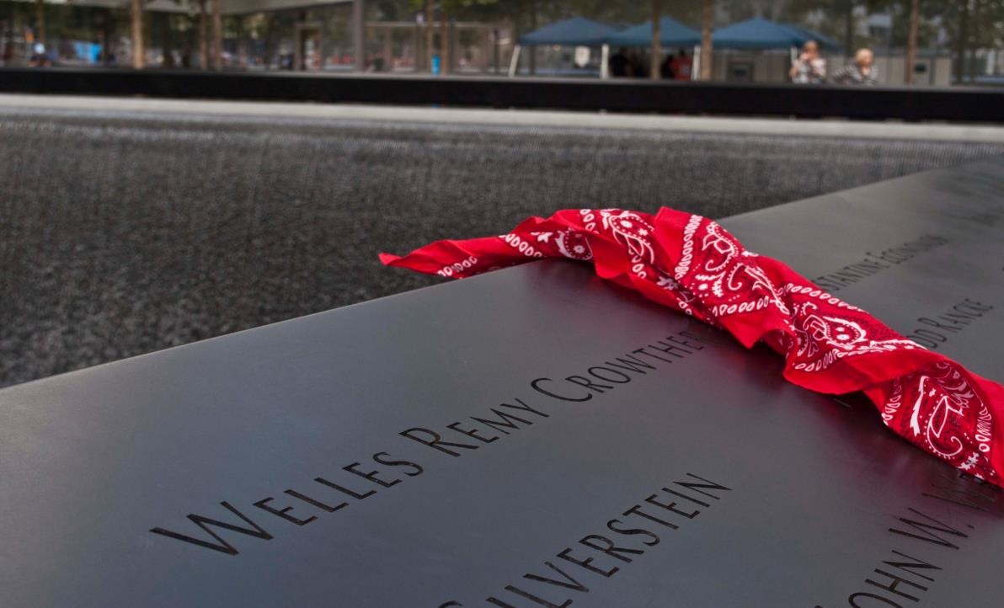
Reflect…
3)How do you think his family felt?
2)How did you feel after watching?
4) What word can be used to describe Welles?
5) What are examples of memorials

Slide 5
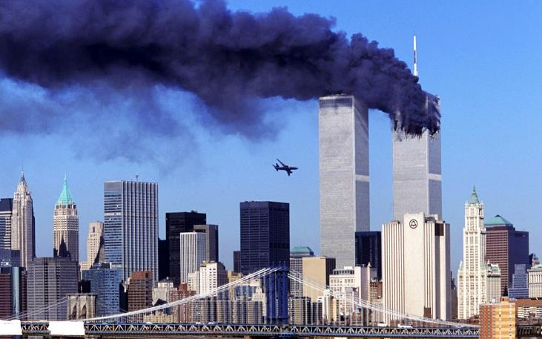
25 Most Powerful Images of 9/11
6) Describe the imagery in 3 words
Notes:
Yahoo 25 most powerful images of 9/11. Link on Picture

Slide 6
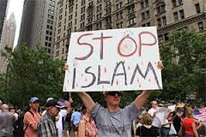
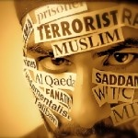
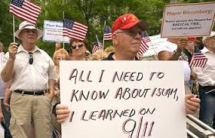
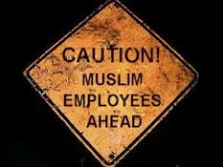
Stereotyping
7)Define
Stereotype
[ster-ee-uh-tahyp]
To characterize a person or group regardless of the truth
8) 9/11 stereotypes?

Slide 7
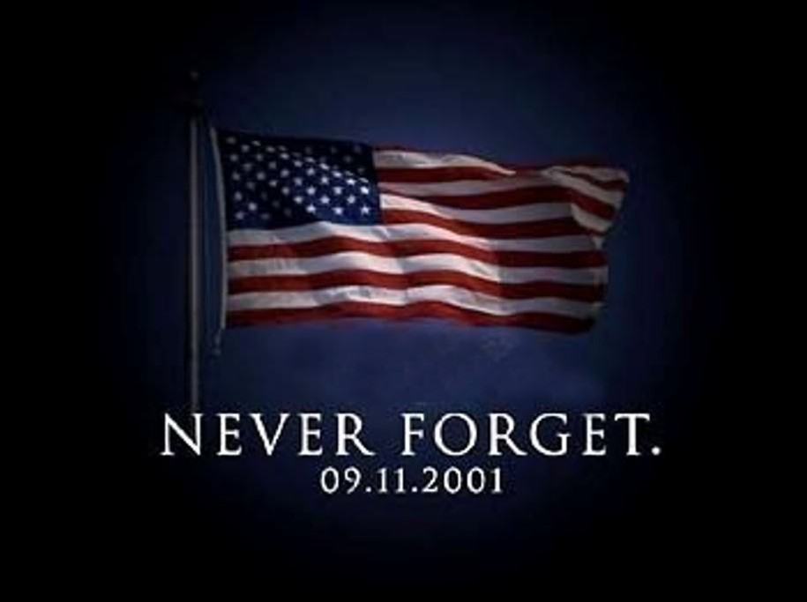
Personal Stories
Lets share any personal stories we may have as a class…

