Slide 1
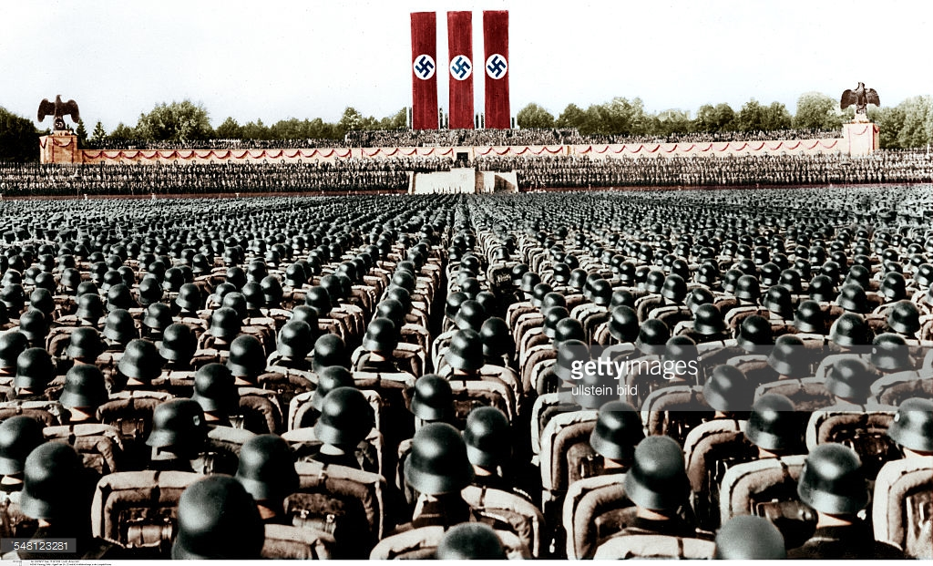
Warm Up:
1) What do the “The Wave” and Nazi Germany have in common?
2) Define “Propaganda”

Slide 2
World War II
10-10 Propaganda Posters

Slide 3
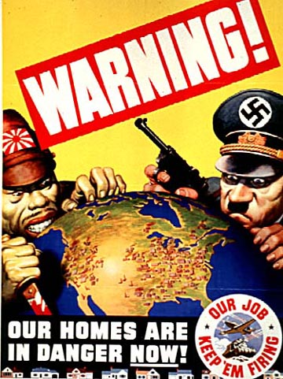
1

Slide 4
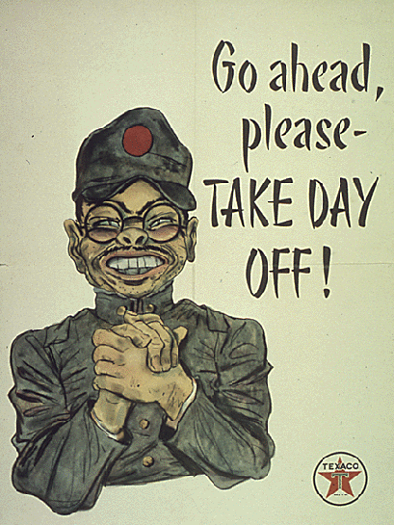
2

Slide 5
3

Slide 6
4

Slide 7
5

Slide 8
6

Slide 9
7

Slide 10
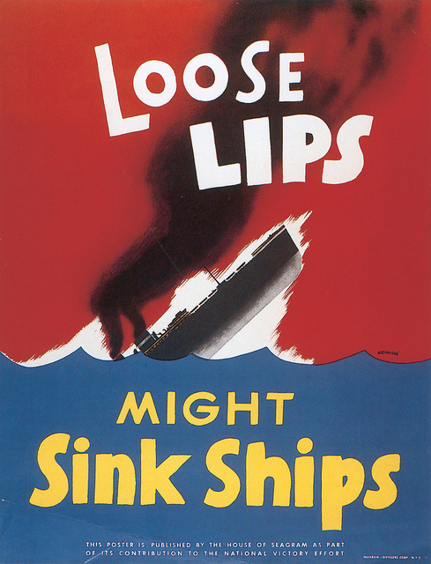
8

Slide 11
9

Slide 12
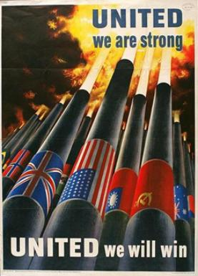
10

Slide 13
11

Slide 14
12

Slide 15
13

Slide 16
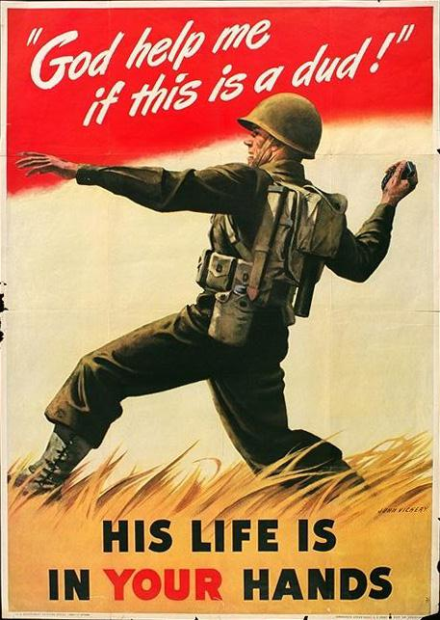
14

Slide 17
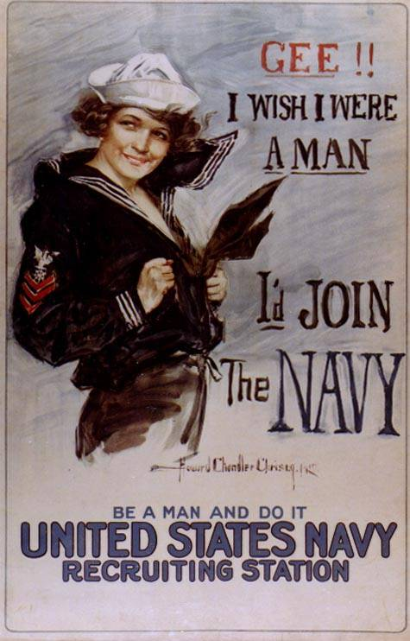
15

Slide 18
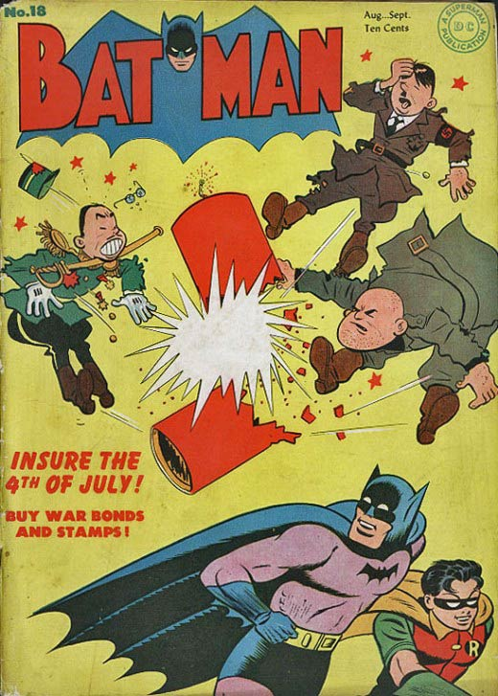
16

Slide 19
Exit Ticket
Why did governments create these propaganda posters?

