Slide 1
Warm Up
What is your “3rd Quarter” grades in your classes???
  Don’t know…
    LOOK IT UP, Y’ALL!!!
1) Warm Up!

Slide 2
World War II (1939-1945)
10-11 War on the Western Front… Europe and Africa

Slide 3
Setting the Stage
2) Define Blitzkreig
Background
The Fall of Europe
German tanks & armored troop carriers swept into Poland
Poland resists, but…
  Polish army unprepared for such modern, mechanized warfare
    Polish Calvary: men on horseback
    German Calvary: tanks
Nazi attack so fast and devastating, called blitzkrieg
  Lightning-fast warfare
USSR attacks Poland on other side
  Remember… Nazi / Soviet Non-Aggression Pact?
In just week…
  Poland wiped from map altogether!!!
  Divided b/t USSR & Nazi Germany
Signal of what’s to come!
April 1940- Hitler leashes blitzkrieg again
By May…
  Denmark, Norway, Belgium, Luxembourg, & Netherlands all fall to Nazi’s
Nazi’s turns toward France
Italy declares war on Allies, too!
  Attacks France from south
  Nazi troops take Paris, and France surrenders
By July, only Britain unconquered & willing to fight
  New Brit PM, Winston Churchill vows to “fight on,” and “never surrender!”
  Brit RAF fought German Luftwaffe to standstill
Hitler forced to give up plans of attacking Britain across English Channel
Britain remained, but Hitler controlled rest of Europe!
3)Nazi/ Soviet Non- Aggression Pact says…

Slide 4
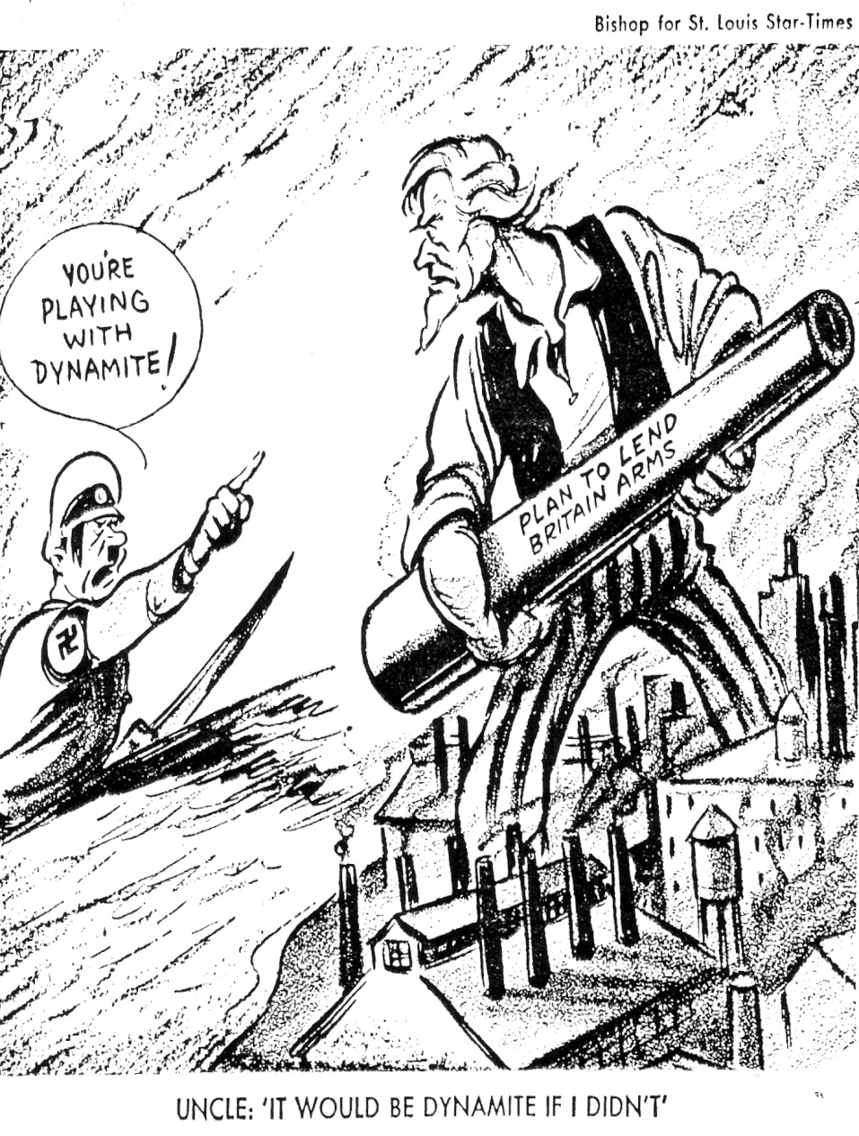
Isolationism No More
As Nazi’s roll Europe in ‘39 and ‘40
  Rest world takes sides
Isolationism strong in US, but…
  FDR convinced have to help Allies
  Stays course though, asks Americans to stay neutral even if can’t in heart
FDR does get Congress to tweak Neutrality Acts though
  Allows for sale of arms to Allies
Also pushes through the Lend-Lease Act in 1941
  Said US could lend or lease raw materials, equip, soldiers, and weapons
  Under LLA, US sent $50 billion worth of war goods to Allies
4) Lend Lease?

Slide 5
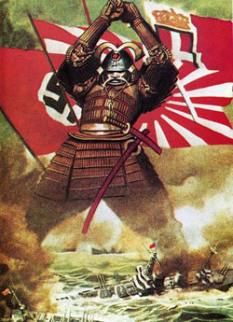
Japan Joins the Party
5) Define Embargo
War starts in Europe in 1939, but…
  Going on in Asia for 2 years!
  1937- Japan declared all-out war on China
1940- Japan sees opportunity to expand further when France falls
Sept 1940- Japan joins Axis of Eee-vil
  Immediately invade French Indochina (modern-day Vietnam)
  Take it all by July 1941!!!
FDR tries to get them to stop by places embargo on Japan
  Forbids any trade of US goods to Japan… including oil!
Doesn’t work…
  Japan invades oil-rich Dutch East Indies
New military gov’t controlled by Gen. Hideki Tojo
  Japanese strategists know only one who can stop Japan is US Navy
    To guarantee success… must destroy US Pacific Fleet at Pearl Harbor in Hawaii

Slide 6
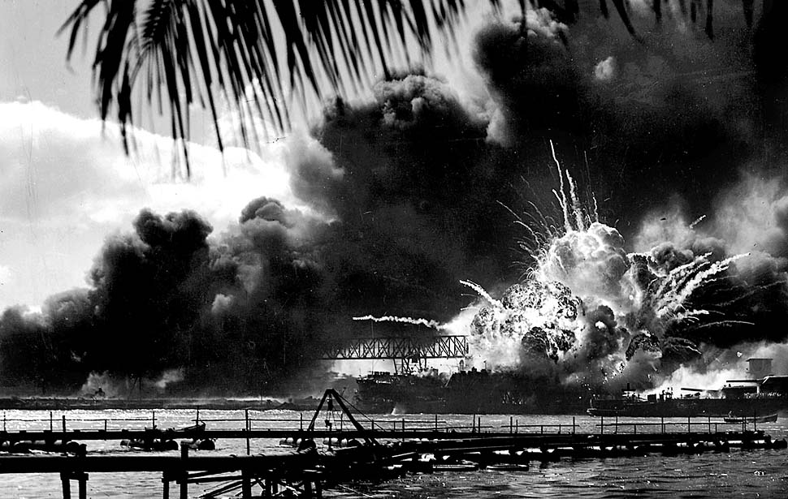
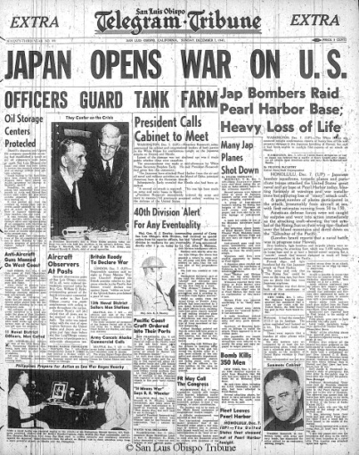
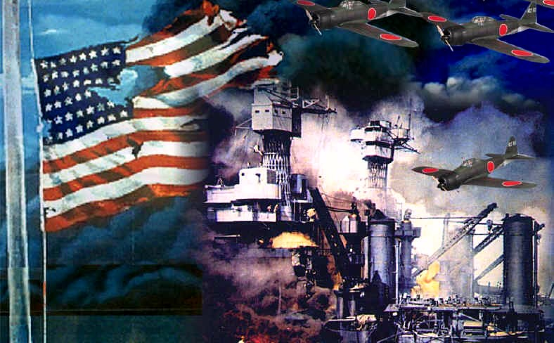
“A day which will live in infamy…”
6) America attacked when and where?!
Morning of 7 Dec 1941
  Japanese “Zero’s” launch all-out attack on US Navy base at Pearl Harbor, Hawaii
B4 over…
  2,400 sailors die
  Most planes & ships destroyed
  Everything else damaged
Luckily… (conspiracy theory here)
  All aircraft carriers were at sea!
FDR reports this to Congress
  Calls for Congress to declare war on Japan
11 Dec 1941-
  Hitler & Mussolini declare war on USA to support their ally Japan
  USA finally pulled in to WW2!
US rushes to prepare for war
  FDR & Churchill plan strategy
  Agree to concentrate on Europe first, then take on Japan
  Also agree to bring in another…
    USSR
Notes:
Pearl Harbor Attack Scene (6:53)

Slide 7
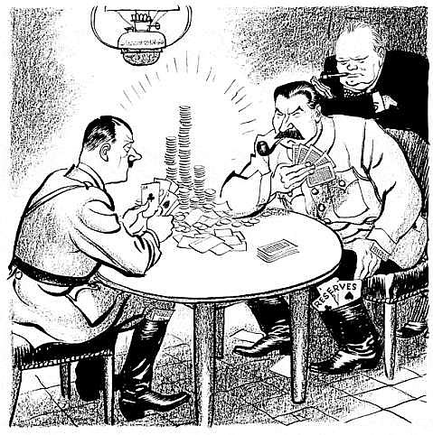
Hitler Pokes “the Bear”
7) How did the Nazis fair against the Soviets?
When Hitler couldn’t take Britain…
  22 June 1941- Turns toward USSR
Blitzkrieg very effective against Soviets
  Heavy casualties
  Early success
In fall rains turn ground to mud
  Blitzkrieg slowed to crawl
By December, freezing Russian winter grinds Nazi’s to halt
  Only 18 miles from capital, Moscow!!!
Germans split troops attacking N and S
  Leningrad in north, Crimean oil fields in south
  Nazi’s spend 2.5 years trying to take Leningrad
    1 million+ die (mostly starvation though), but…
    City never falls!
1942- Hitler turns toward Stalingrad
  Ends in disaster
  1943- USSR defeats Nazi’s in largest ever tank battle
  Signals failure of Hitler to take USSR
Allies helped by sending supplies constantly
  Wanted Hitler busy on east while they attack on the west

Slide 8
Battles in Africa & Italy
While Germans dealt w/ USSR, Britain & US turn toward North Africa!?!
  Why???
    Control Suez Canal
      separates Europe from Asia
    Jump-off point to attack Nazi-controlled Europe from south
May 1942-
  Allies control N. Africa
Summer 1943-
  Allies take Sicily & invade Italy
  Italy soon collapses
    Mussolini is arrested
Nazi’s forced to turn attention to help Italy
  While Germany turns to help Italy…
    Allies plan another invasion of Europe
8) Europeans had land in Africa because…

Slide 9
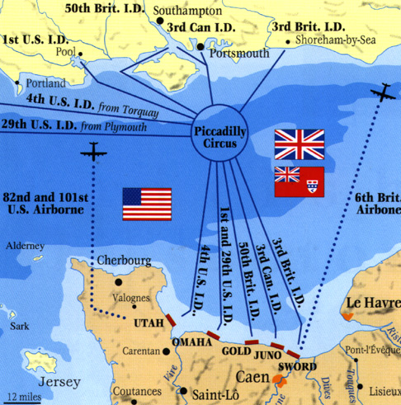
Allied Advance…
9) Describe D-Day
6 June 1944-
  5,000 Allied ships
  130,000 soldiers cross English Channel to coast of Normandy, France
    US, British, & Canadian forces
  Largest sea invasion in history!!!
  Allied Gen. in Command Dwight D. Eisenhower planned it
  Code-named… D-Day
  Faced horrific task
    10,000+ died when landed but…
    By end of the day they had the beaches and could move inland
    By July… 850,000 Allied troops had arrived
25 Aug 1944- Allied troops freed Paris from Nazi control
  Allied forces push Nazi in from west
  USSR pushing Nazi in from east
  Allied troops pushing Nazi in from south through Italy
Germans make final attempt in Belgium
  Battle of Bulge caught Allies by surprise, but quickly regrouped and defeated the Nazi force again
  Feb 1945- Nazi’s retreating everywhere
10) Battle of the Bulge?
Notes:
Saving Private Ryan- Omaha Beach Scene (4:35)

Slide 10
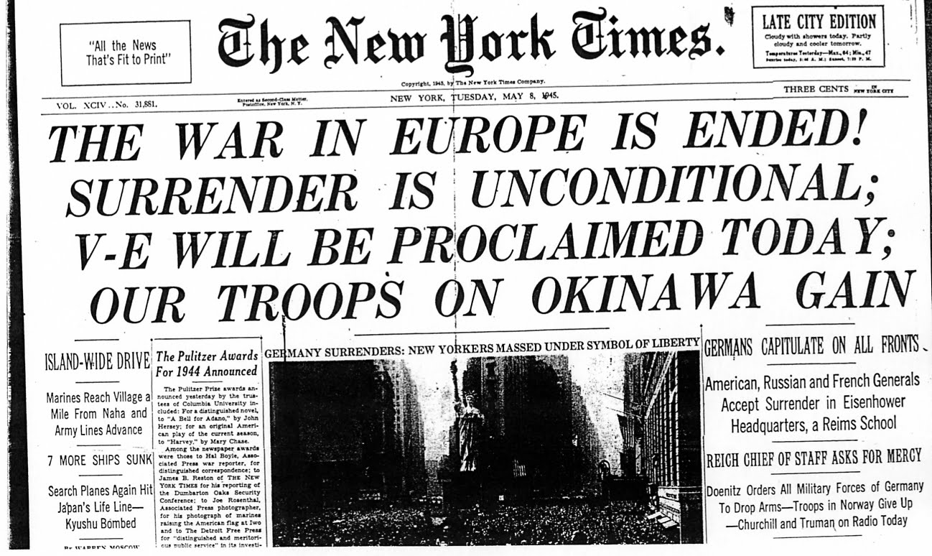
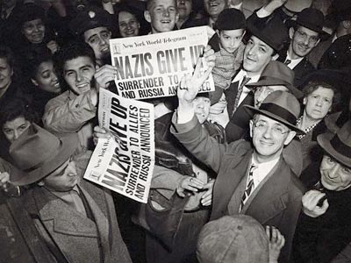
V-E Day
April 1945- FDR dies
  VP Harry S. Truman takes over
  Truman quickly picks up war effort
Late April- Soviets reached Berlin, the German capital
  Hitler hid in under-ground bunker and…
    30 April 1945- Hitler commits suicide
2 May 1945-
  USSR takes Berlin
7 May 1945-
  Nazi leaders sign unconditional surrender @ Eisenhower’s HQ in France
8 May 1945-
  Declared V-E Day!!!
    Victory in Europe Day
War in Europe finally over!!!
11) V.E. day means… and how did it happen?

Slide 11
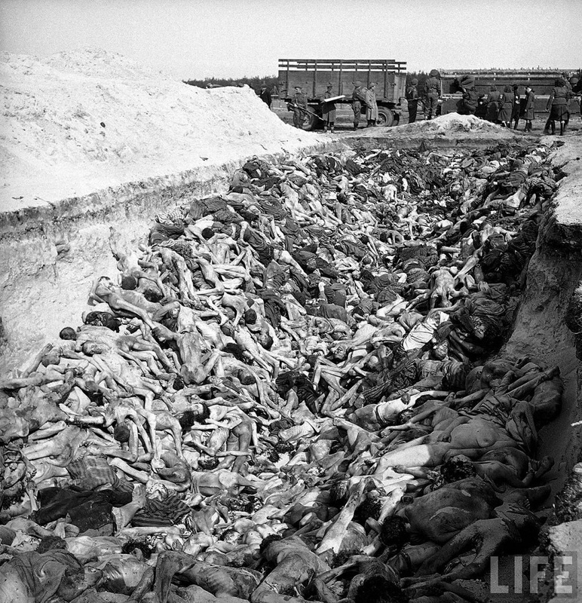
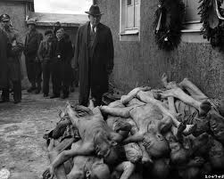
The Horrors of the Holocaust
As Allies fought toward Berlin
  Horrifying discovery… Nazi Death Camps
    Jews, Gypsies, & homosexuals
    All gathered up from German controlled lands
    Sent to these camps to be worked, beaten, starved, gassed, or burned to death
Est. 11,000,000 killed in these camps!!!
Hitler started these in 1941
  Called these the “final solution of the Jewish problem”
  Really called a genocide- killing off of an entire race
Hitler’s SS Officers rounded up and hunted down every Jew in Nazi Empire
  Kill 100’s at a time in gas chambers, large ovens, or buried in enormous open graves
After Allies freed camps…
  Put Nazi leaders on trial
Called Nuremberg Trials
  Charged w/ crimes against humanity
12) Describe the horrors of the Holocaust

