Slide 1
Warm-Up: Spiral Review-
What events lead to V-E Day?
1) Warm Up!

Slide 2
World War II (1939-1945)
10-12 “War in the Pacific Theatre”

Slide 3
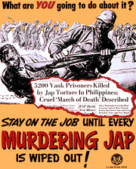
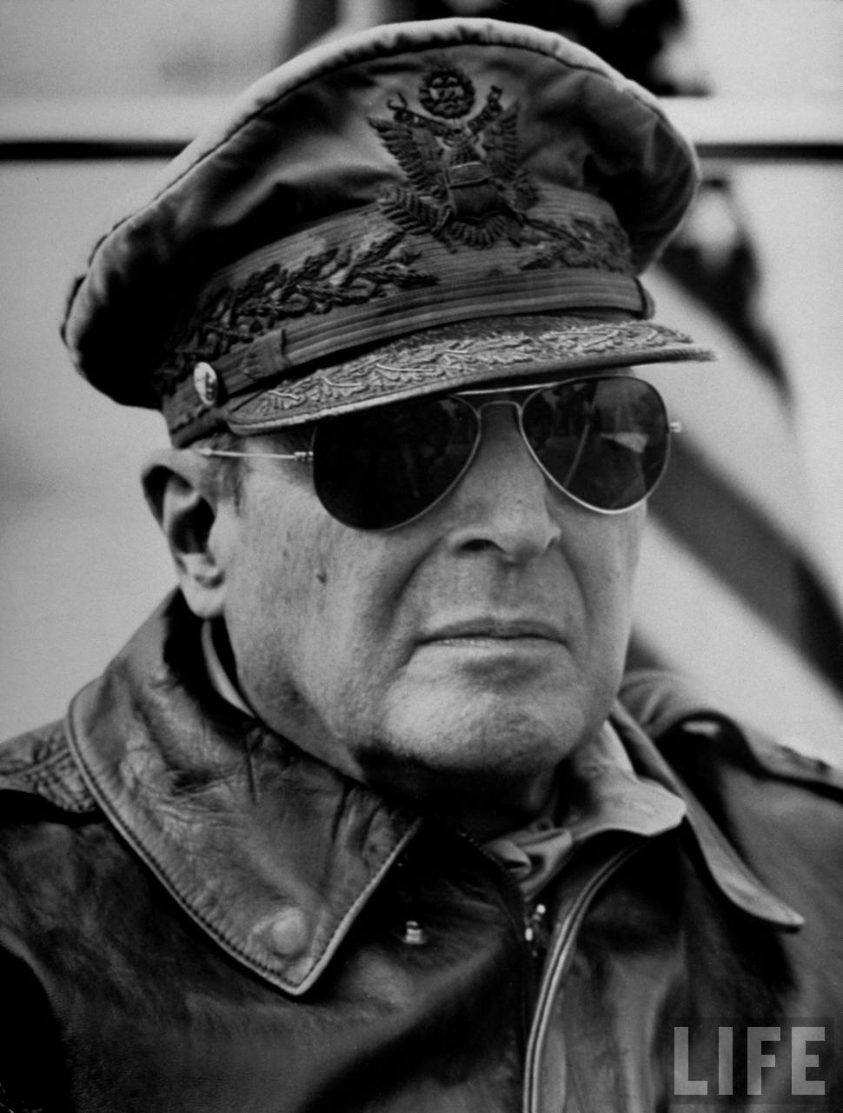
The Philippines
2)Bataan!
@ same time of Pearl Harbor…
Japanese also attacked Brit, Dutch, and US territories in Pacific
By spring 1942-
Japanese troops had taken Hong Kong, Thailand, Myanmar, Malaysia, Guam, and Wake Is.
Also invaded Philippines
US Gen. MacArthur & troops w/d to Bataan Peninsula
FDR feared Japanese attack Australia
Ordered MacArthur to go set up Australia
He does, but vows, “I shall return.”
April 1942-
70,000 Filipino & US troops forced to surrender after MacArthur leaves
Japanese march soldiers 60 miles to prison camp
10,000+ die on the way from shootings, beating, beheadings, or starvation
Known as Bataan Death March

Slide 4
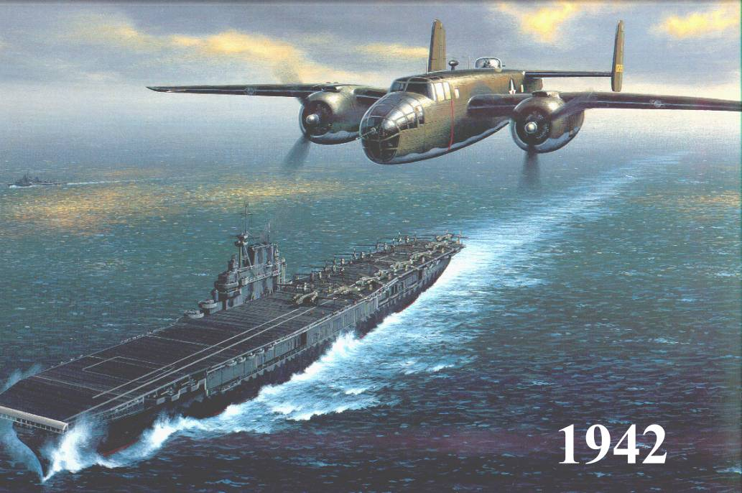
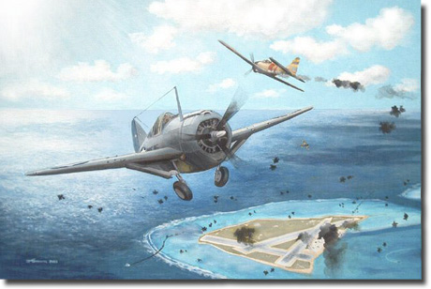
Turning the Tide…Battle of Midway
3) Midway Video Facts!
Despite fall of Philippines…
Allies starting to turn the tide
April 1942-
Lt. Col. James Doolittle leads daring raid against Japanese cities
Did little damage, but…
Shocked Japanese & raised Allied morale
May 1942-
US Navy able to block Japanese advance on Australia
June 1942-
US Navy gains decisive victory over Japanese fleet threatening Hawaii
Called the Battle of Midway
w/ Hawaii safe…
Now Allies can go on the attack!
Notes:
Doolittle Raid from Pearl Harbor (9:00)
Battle of Midway (8:00)

Slide 5
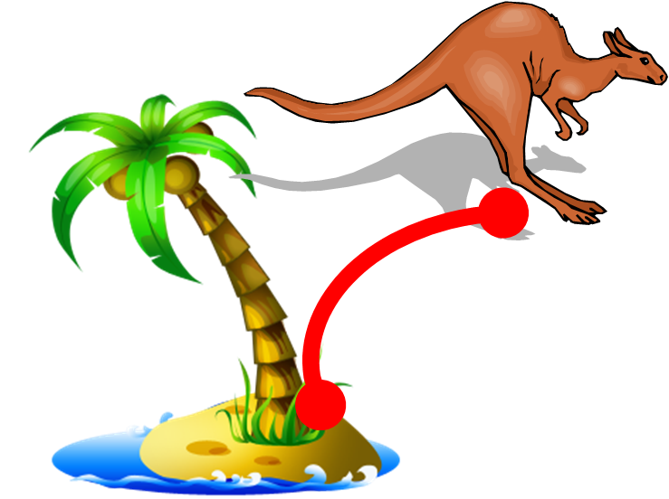
Allies Advance… Island Hopping
4) Define Island Hopping
Adm. Chester Nimitz develops brilliant strategy to win back Pacific
Instead of trying to retake all islands Japan took…
Decided to take easy islands
Use them as bases to stage further attacks
Called… Island Hopping
Trying to get close enough to attack Japan itself
1st major victory like this was Island of Guadalcanal
Kept moving island to island, finally return to Philippines in Oct. 1945
The Philippine invasion lasted 6 months & many battles
Massive naval battle, Battle of Leyte Gulf
Allies beat down Japanese fleet so bad… no longer a threat
March 1945-
MacArthur returns and leads ground troops to free Philippine capital
Japanese lost, but…
Increased their use of kamikaze tactics, suicide pilots

Slide 6
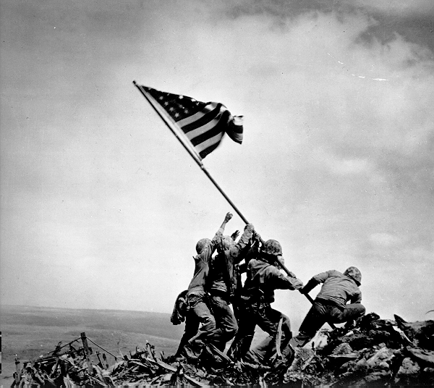
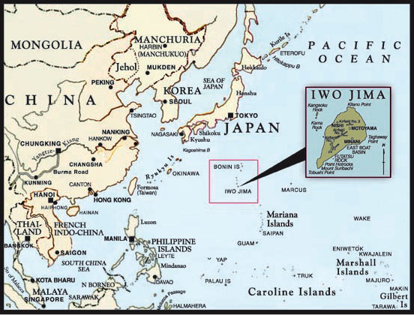
Two Jima & Okinawa
5) Where?
6) What?
Early 1945-
Allies begin bombing Japan
To increase the frequency…
Needed bases close to Japan
Chose islands of Iwo Jima & Okinawa
Feb 1945- Marines invaded Iwo Jima
Japanese fought even harder than b4
23 Feb 1945- famous pix of Marines placing flag on Mount Surabachi
Signals victory of the island
April 1945- Marines invade Okinawa
In just 3 months…
Marines had secured the 2 islands
18,000+ Marines died taking just these 2 islands
120,000 Japanese died defending them

Slide 7
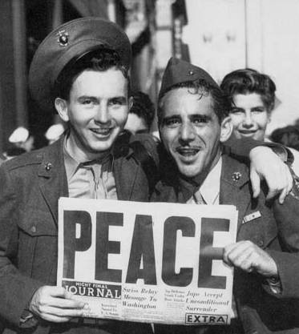
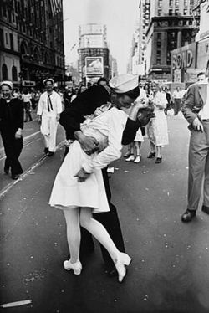
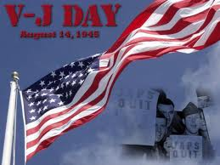
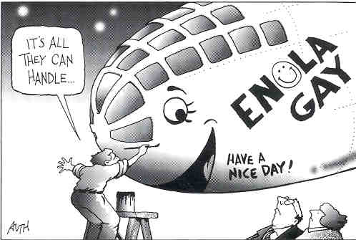
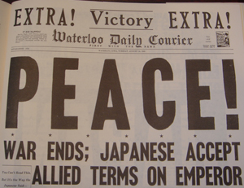
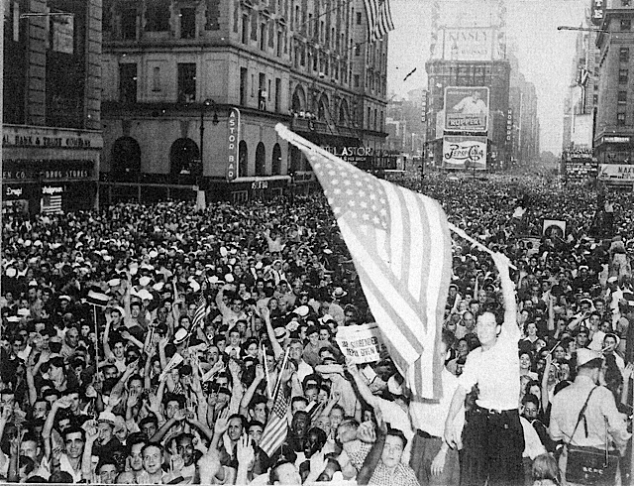
New Type of Warfare
8) What would U Do?
7) JAWS!
Allies plan invasion of Japan for Nov 1945
After huge casualty count @ Iwo Jima & Okinawa…
US fear military invasion & conquering of Japan will cost 200,000+ US lives!!!
Got to be another way…
1942- US began Manhattan Project
Top-secret program to build world’s 1st atomic bomb
Team led by Robert Oppenheimer & Einstein
After 3 years… finally successful
President Truman warned Japan if they didn’t surrender… faced “prompt and utter destruction”
Japan didn’t know what they meant… and refused
6 Aug 1945-
Enola Gay drops atomic bomb “Little Boy” on Hiroshima (Japanese city)
Explosion killed 70,000 immediately
Turned 5 square miles into wasteland
Not to mention unknown aftereffects!!!
Japanese still refuse to surrender
9 Aug 1945-
“Fat Man” dropped on Nagasaki
Killed another 40,000
Japanese surrender on August 14th
2 Sept 1945- meet for formal signing of documents
V-J Day!!! WW2 was officially over!!!
Notes:
USS Indianapolis Scene from ‘Jaws’ (4:30) Little Boy text
Atomic Bombs of Hiroshima and Nagasaki 1945 (5:03) Enola Gay Pic

Slide 8
9-18 U Decide!

