Slide 1
Warm Up!
1) Warm Up
What events ended the war in Europe. What about Japan?
Would you drop the bomb? Why? (Discuss with partner when instructed)

Slide 2
World War II (1939-1945)
10-13 Impact of the War on the Home Front

Slide 3
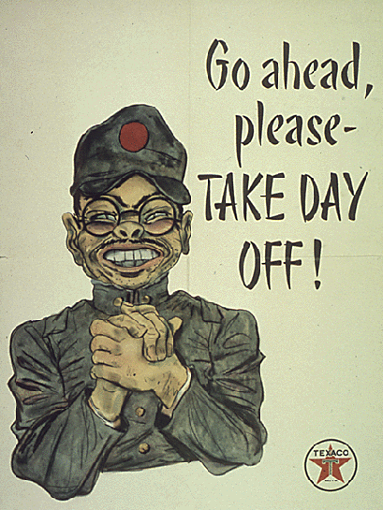
Wartime Production Ends the Depression
2)Who kept factories working
Huge impact on US lives
15 million men & women served
All races, creeds, colors, religions, etc.
To ensure victory…
Economy & industry built to support war effort
Allies needed planes, tanks, guns, ammo, parachutes, etc.
War Production Board made sure factories churned out as many as possible
Huge need provided all the jobs for the out-of-work Americans
Unemployment completely disappeared
Profits sky-rocketed as US companies sold war supplies to the Allies
The “defense boom” ended the…
3) War ended what?

Slide 4
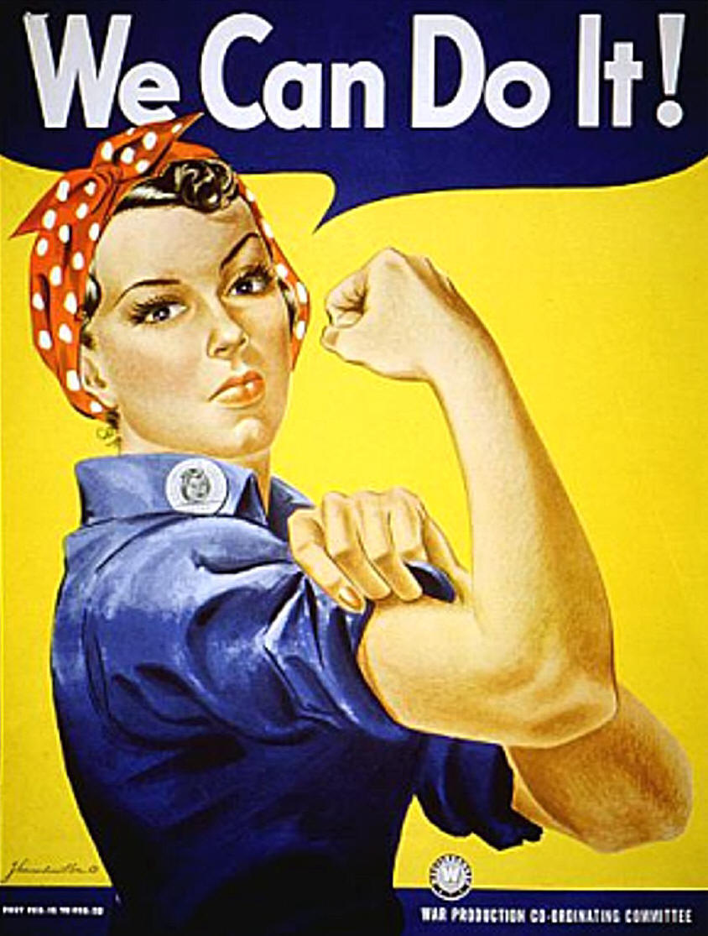
Changes in the Workforce
w/ men fighting overseas…
Women had to step into the workforce
By ‘45, women made up 40% of workforce!
“Rosie the Riveter”
Good place and time for women to prove their equality
Same for minorities!!!
New jobs aided in large-scale migration to west coast
War manufacturing factories could ship products easier to Pacific from there
Same for east coast factories
Sending goods to Europe
Some 46,000 Native Americans left their reservations to assist in war effort as well
4)Who is this on the poster?

Slide 5
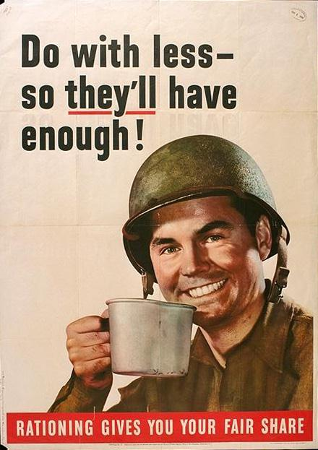
Wartime Restrictions
5)Americans asked to do what?
b/c military needed so many materials…
Americans were asked to…
“do with less, so they’ll have more”
Americans were asked to ration certain goods and materials
System in which families were allowed to have of fixed amounts of certain goods each month
Ration Books
Other ways we conserved
Auto manufacturers did not produce any cars b/t 1940-1945
Use steel, gas, & rubber from tires for military needs
Tanks jeeps, planes, tires, gas, etc.

Slide 6
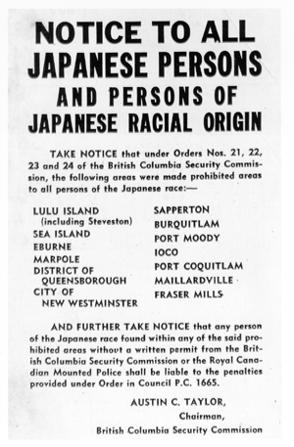
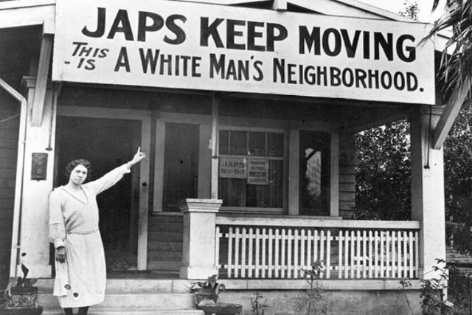
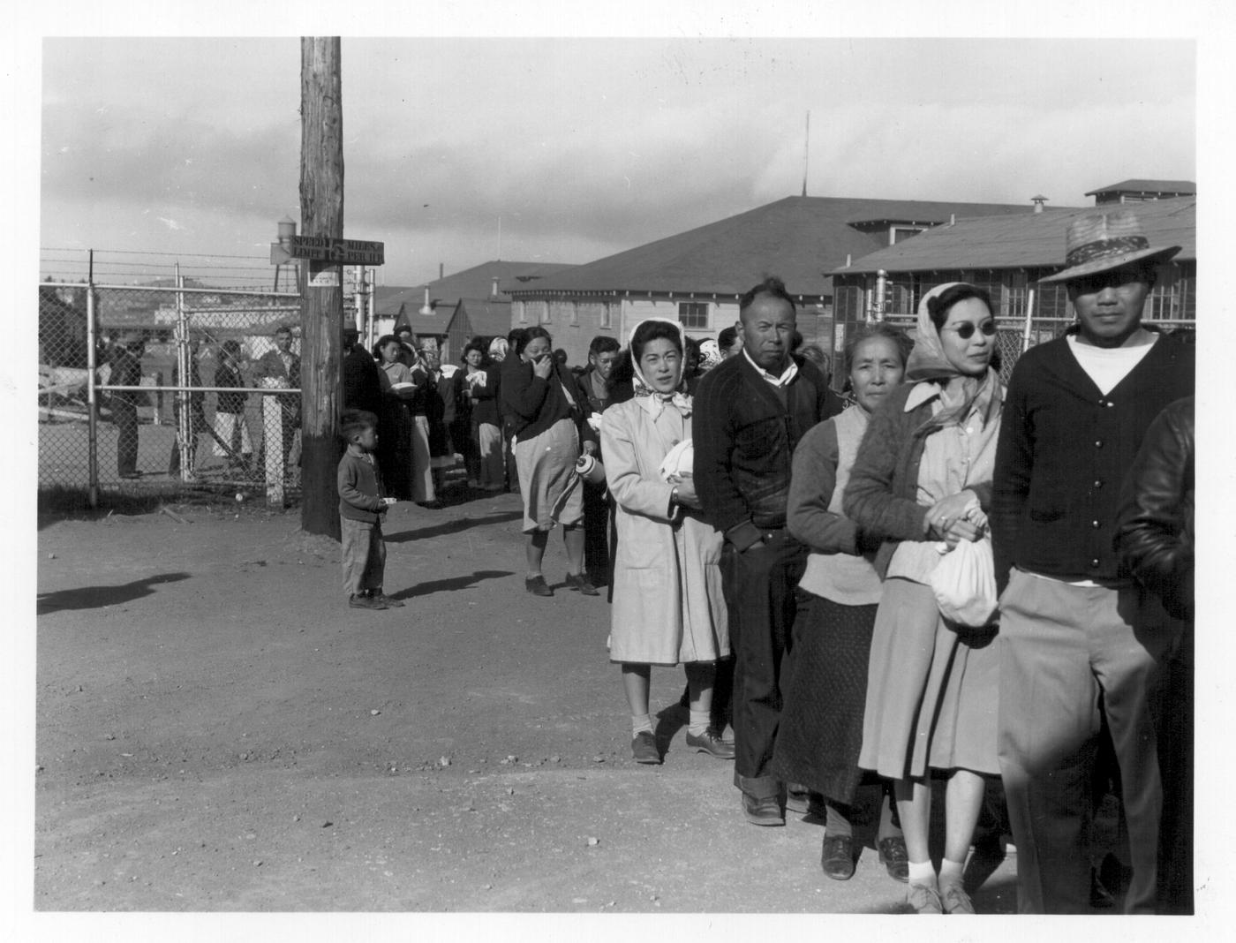
Internment of Japanese-Americans
6) Why more fear on the west coast?
War also raised level of fear for Americans
Attack on Pearl Harbor made clear oceans no longer shield USA
Fear greatest on West Coast
Why???
Made people view Japanese-Americans w/ suspicion
Many believed they were a security threat
FDR responded by ordering all Japanese and Japanese-Americans be moved inland to internment camps
What!?!
110,000 were rounded up, & forced to leave everything!!!
Placed in camps… sound familiar???
67% were born in USA!!!
Fears about them were ridiculous
33,000 volunteered for military service, but…
Even they were segregated
Kept in All-Japanese units
442nd and 100th Infantry fought in Europe
Among most decorated units in the war!!!
7) Interment camps… kind of sounds like…
Notes:
Japanese Interment Camps 3:52

Slide 7
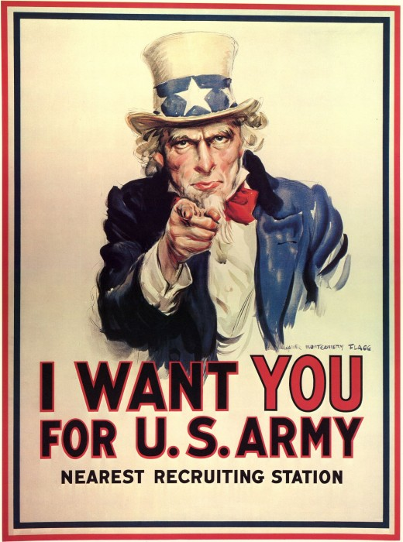
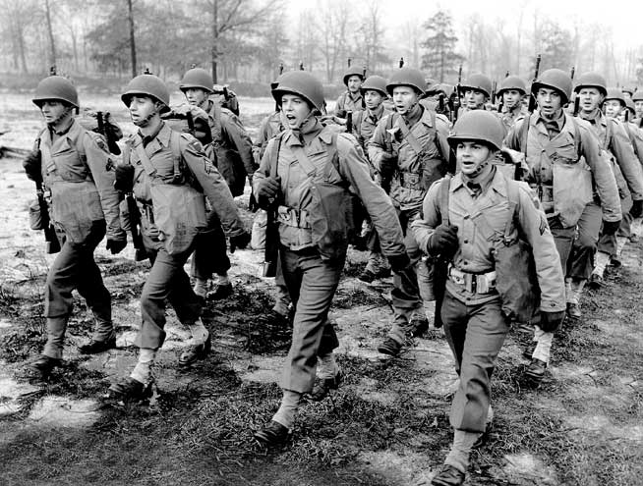
Effect on North Carolina
8) How did the war effect N.C?
The war in NC
Waters off Cape Hatteras called Torpedo Junction b/c of all German U-Boat activity
Tar Heels in the Armed Forces
350,000+ Tar Heels served in military
Army, Navy, Marines
Women’s Army Corp
Support Staff
Nurses & Doctors too
NC’s Training Bases
22+ bases state-wide
Training, Depots, Launching Points
By end, more soldiers trained at NC bases than anywhere else!
NC’s War Industries
Defense boom hit NC too!
2 billion in federal contracts
Shipyards to make destroyers, minesweeper, sub chasers, etc
NC textiles made everything from sheets to parachutes
Factories switched from making peace-time goods to war goods
Farmers grew as much as possible
War Bonds
Like everyone else, Tar Heels bought these
Essentially loans to gov’t to be paid back w/ interest
NC’s Future
Many reforms made after war
Saw what women and minorities could do
Given many more opportunities!

Slide 8
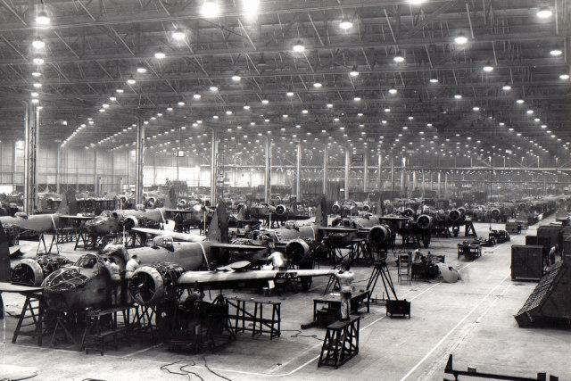
Exit Ticket
9) Exit Ticket
How did the war affect those who did not enlist in the military?

