Slide 1
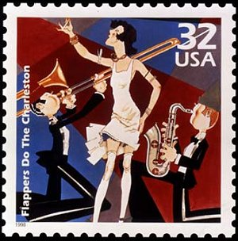
10-1

Slide 2
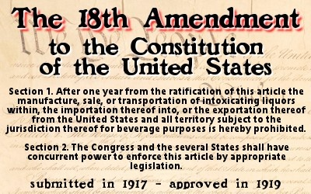
Warm Up
What does the 18th Amendment say, and when was it passed?
1) Warm Up!

Slide 3
The Roaring 20’s
3)Define
Setting the Stage
The ‘Red’ Scare
Post-WWI… US distrusted other nations
Limited immigration
Shut out foreign ideas
Questioned other US citizenship
Once distrust began to lift… life got good!
Young men and women began living the high life
Dancing, drinking, listening to the newest thing in music… jazz!!!
In 1920- the 18th Amendment is passed
Made drinking, selling, or producing alcohol illegal
Time becomes known as “Prohibition”
Leads to…
Speakeasies (illegal bars)
Moonshine, Rum-Runners
Mob-Controlled illegal businesses
Many in US feared we would be taken over by communists, like Russia did
The “Red-Scare” made headlines throughout the 20’s
Political and business leaders became the target of bombings, blaming the “Reds”
Some groups used these as an excuse to accuse US citizens of being Communists
By 1925-
Most Americans become disgusted with these false accusations
The Red Scare starts to die down… but it’ll be back
2)Video Facts
4)Video Facts
Notes:
Mob and prohibition 7:30 / Red Scare video 5:00

Slide 4
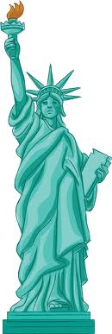
Setting Immigration Limits
Some felt immigrants would spread communism
Or take away jobs from US workers
1921-
Congress passes laws limiting immigration
Set a # that could come to US
# per country too
For a while, Asian immigrants weren’t allowed at all!
Sorry Y’all… we’re closed!!!
5)Term that native born>immigrants

Slide 5
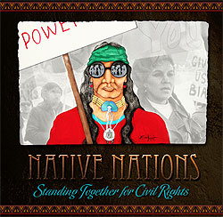
Citizenship for Native Americans
As US shunned “Reds” & immigrants… its own people were fighting for rts
African Americans
Women
Native Americans
During war, 1000’s of natives volunteered for service
Even though not citizens
Once war ended, thought they deserved citizenship
Its not like it was all their land or something!?!?!
Kansas Senator, Charles Curtis helped native men receive citizenship in 1924

Slide 6
Civil Rights for African Americans
Many AA’s fought bravely too!
When war ended… still faced discrimination
Many were fired from wartime jobs
AA’s returning from war couldn’t even find work
Couldn’t live where they wanted
Children couldn’t even go to school of choice
The NAACP-
Fought for AA’s to gain civil rts.
Helped bring lawsuits against those who discriminated
Fought for rts of all Americans
6)NAACP?

Slide 7
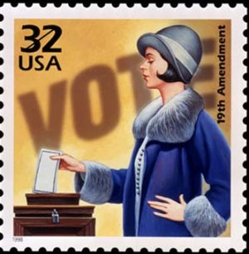
Voting Rights for Women
7) Right to vote called…
1920- 19th Amendment is passed
Gave the rt. to vote to women
Struggle began years b4
Women like…
Elizabeth Cady Stanton
Susan B. Anthony lead the charge
By 1914- 13 sates had given rts. to women
Becomes official in US in 1920
Notes:
Music video on the stamp

Slide 8
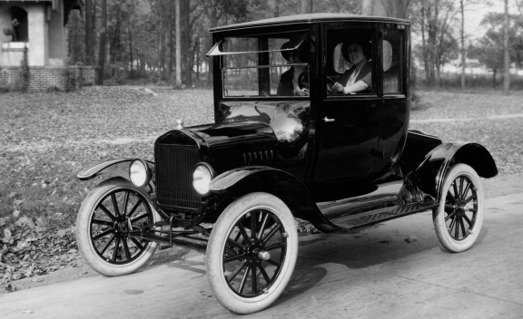
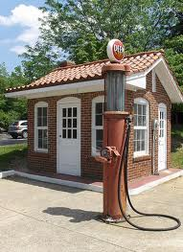
Beginning of the Consumer Age
8)Growth of Factories came from…
During 20’s-
Business & industry boomed
Provided good jobs
Good wages
Demand 4 factory-made goods grew
Leads to economic boom
Factories poured out
washing machines, irons, vacuums, toasters, suits & dresses, make-up, soaps, and toothpaste
Cars took a huge share of consumer market
From 1919-1929, the # of cars rose from 7 mil to 23 mil!!!
Auto-factories and parts factories rushed to be build
Roads and highways were pushed forward too
New businesses started from cars too
Gas stations, service stations, repair shops, motels, etc.
All in all…
4 mil new jobs were created b/c of the car
9)List 3 ways car changed lives

Slide 9
Buy Now… Pay Later
10) Risks and rewards of credit?
1920’s- more and more were buying on credit
Paid small amount each month until paid off
Each payment also included interest, charge that covered the time of the money borrowed
b/c all this was new…
Many were spending more than they earned
But times were great… this can never end!!!
Soon the economic bubble would burst!

Slide 10
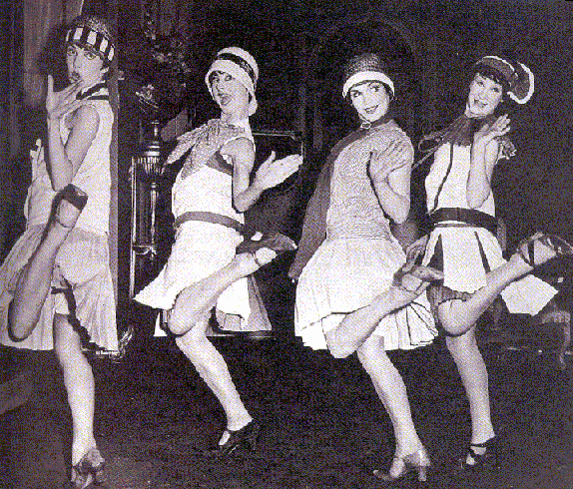
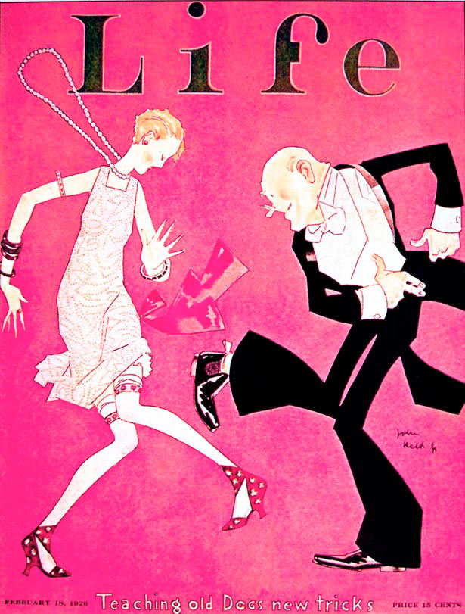
The Roaring 20’s in North Carolina
11)Compare youth…
1920’s brought so many changes to south
Some embraced them, some thought it was a time of loose morals, and people
Craziness like
women cutting their hair!
Wearing skirts that exposed their calves!
Smoking, drinking, and dancing to the “devil’s music”… jazz!!!
Cars and speakeasies began giving the youth of American more freedom than their parents wanted!!!
12) Video Facts
Notes:
Roaring 20’s video summing up on pink pic

Slide 11
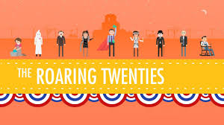
Exit Ticket
13) Recap!
What made the “Roaring Twenties” so “roaring”?

