Slide 1
10-4 The Great Depression
C.C.R Stations activity

Slide 2
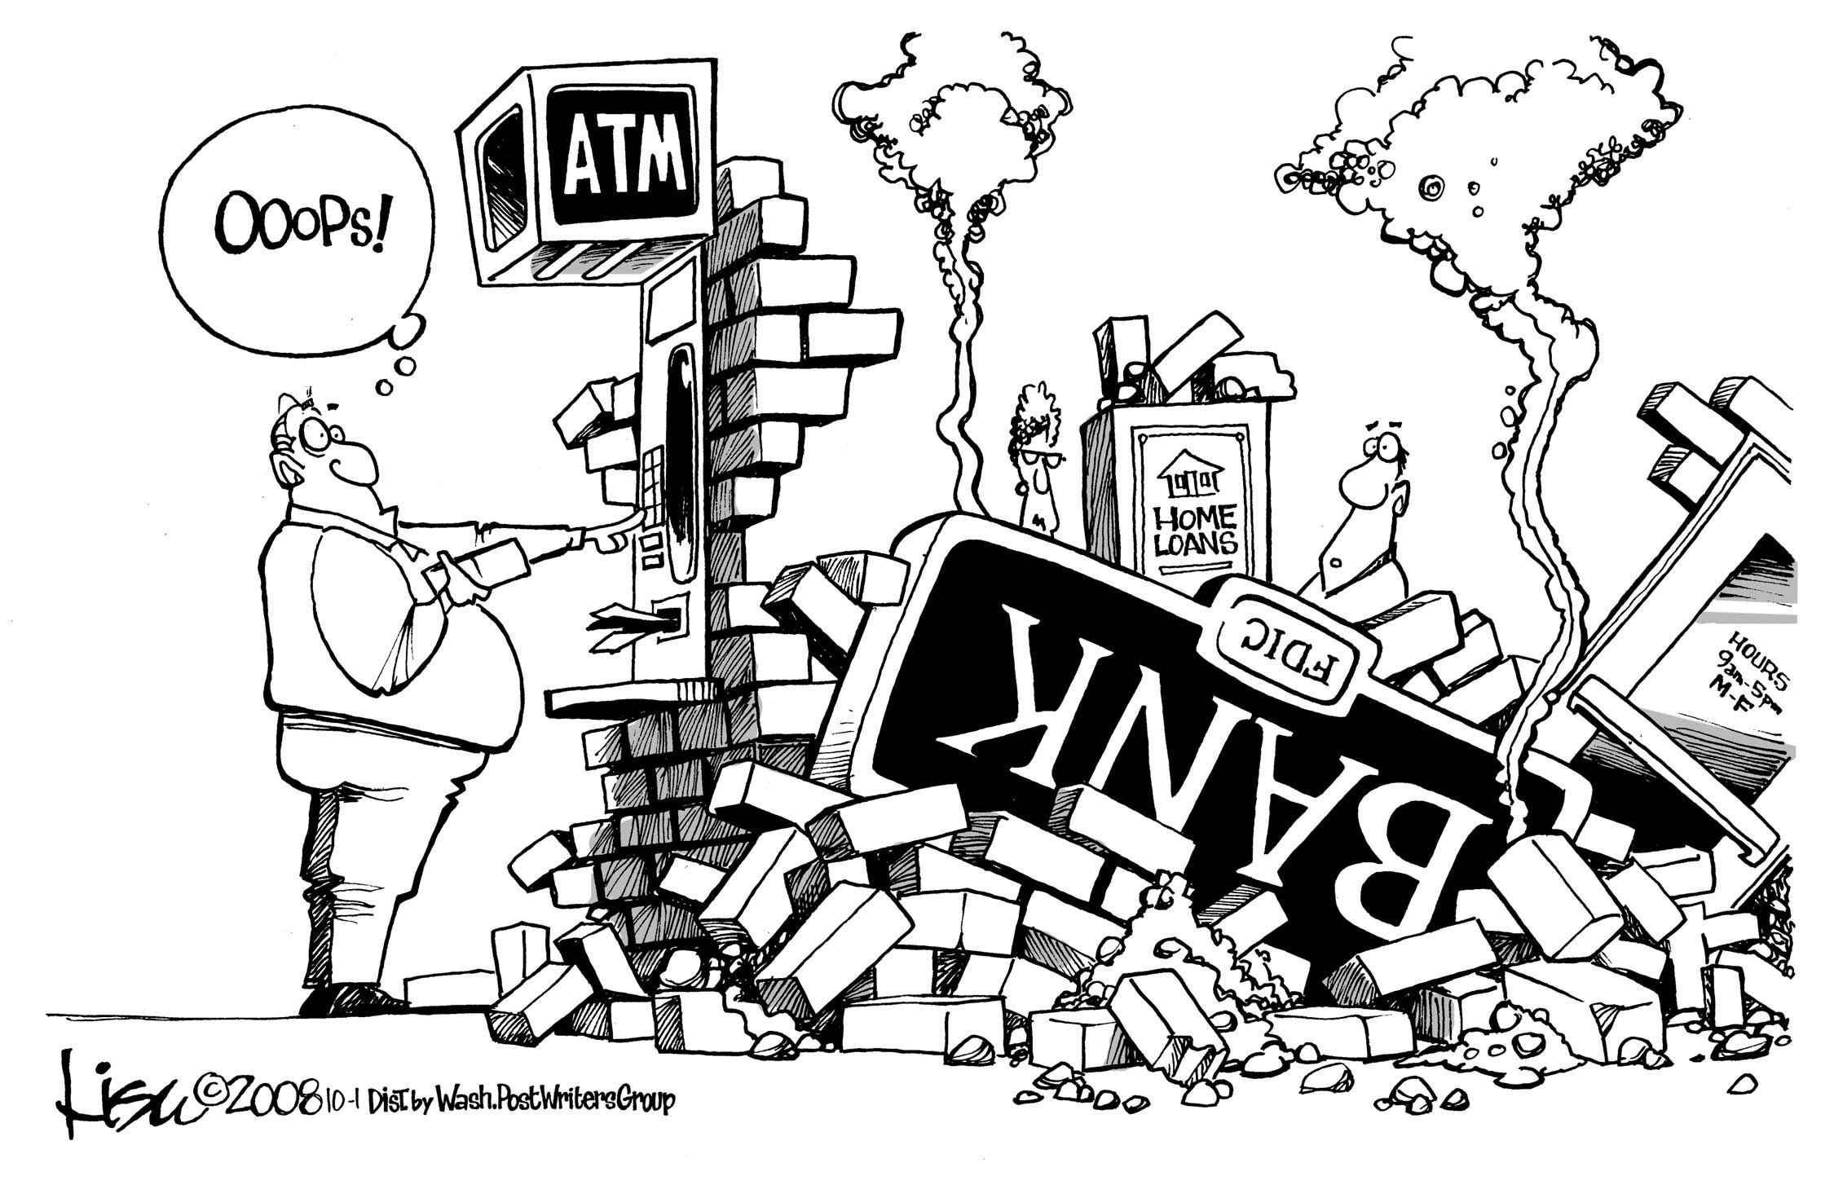
Warm up
How could this political cartoon symbolize an issue we learned about as a cause of the great depression?

Slide 3
And… ACTION!
We will perform a 5 scene play reenacting the issues causing the great depression.
I will ask for volunteers before each scene to be the actors and actresses.
As each scene is performed you need to pay attention (computers at 45 degrees)
After each scene record the event shown into the chart on goformative

Slide 4
C.C.R. Stations
At your group you will work together to complete the station’s sheet.
You have 5 minutes to do so.
There are 6 stations.
When the time goes off, rotate the papers to the right.

