Slide 1
10-5 The New Deal:
FDR’s Solution and Its Impact

Slide 2
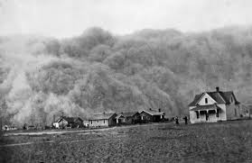
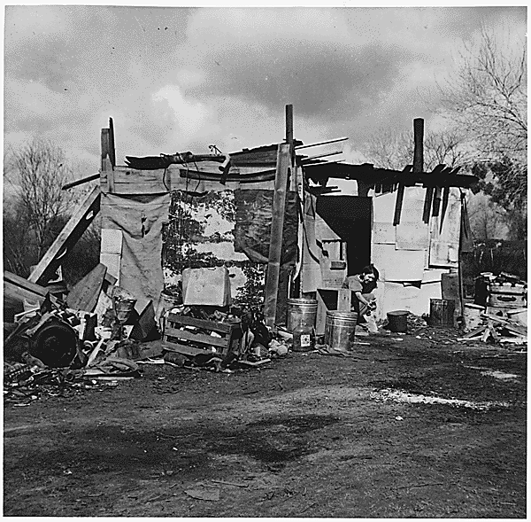
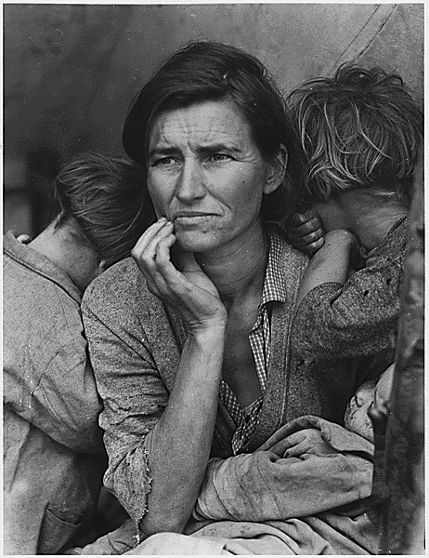
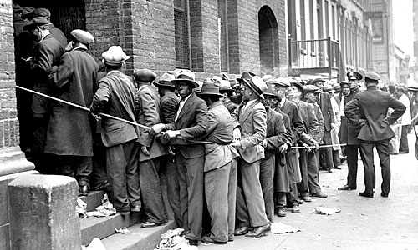
Warm Up
1) Warm Up
Describe the events and average American’s life in 1929- the 1930’s…

Slide 3
Setting the Stage
3) Define Bonus Army and results…
Background
Reaction to the Bonus Army
Summer 1932- 20,000 WWI vets arrive in DC
Promised bonus $$$ for war service, but…
Not supposed to be paid until 1945
Vets unemployed and desperate… want $$$ now!
Become known as “Bonus Army”
Hoover’s reaction adds fuel 2 the hatred many Americans had 4 him already
Many blamed him for the Depression (not true though)
Congress agrees to only pay for vets trip home
Protests continue
Hoover orders US Army to remove vets from site
Gen. Douglas MacArthur drives them out of town completely!!!
Threw tear gas, prodded soldiers, and their families to move w/ bayonets…
1 vet was even killed!!!
Doesn’t help Hoover’s public image
Hungry vets being attacked by US Army
Hoover didn’t order MacArthur’s action, but he took the blame for it
As election neared… no way Hoover would be re-elected!
2) Public opinion on Hoover

Slide 4
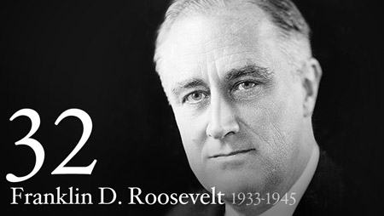
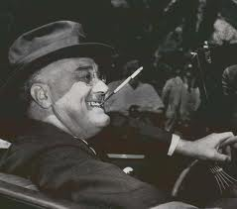
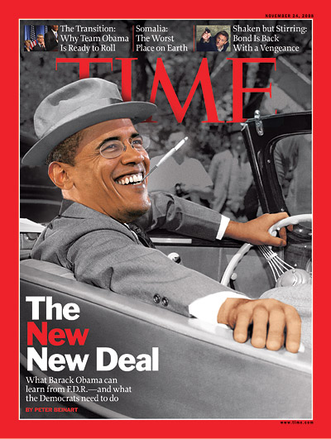
Roosevelt Takes Charge
4) FDR’s full name
Election of 1932
Americans hear the hope the so desperately desired
Voice of Franklin Delano Roosevelt
FDR
Governor of New York
Democratic Candidate
Promised… “Change”
Sound familiar???
He pledged a “new deal” for the American people.”
Easily swept the election in 1932
6) Video facts: What stands out?
5) Elected promising…
Notes:
1st Inaugural (7:21)

Slide 5
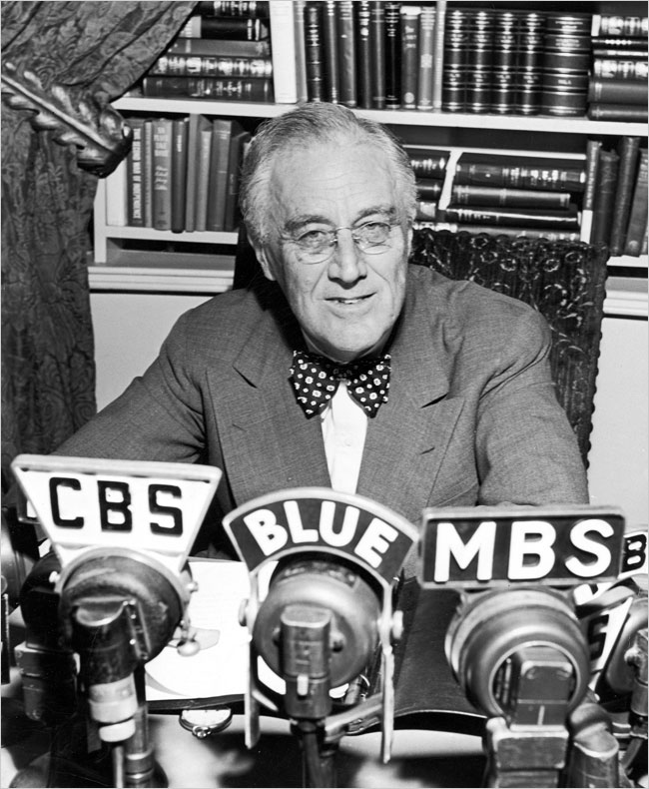
Roosevelt’s New Deal
7) Define Fireside Chats, your thoughts…
FDR knew people needed sense of hope to survive
Not just w/ new laws, but… speaking to them directly
“Fireside Chats” were a way for him to do this
Warm; friendly talks
Tell the people directly what plans were
what gov’t doing to fix this
did it all in plain language everyone could understand
He was willing to try new ideas
Change the way things done
Old way got us into this mess
Try something; if it works … great!
If not, admit it, and change it!
Set up “Brain Trust”
Advisors who were experts in their fields
1st Step- declared a 4-day “Bank Holiday”
Temporary shut down of all banks
Promised when banks re-open, they would be in sound shape and have the support of Congress
People began to trust banks again
8) Set up what to help advise him
Notes:
FDR Economic Recovery Plan, Fireside Chat #4 1933/10/23
3:45

Slide 6
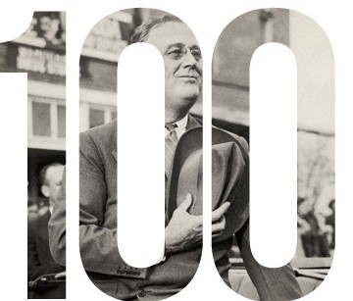
The Hundred Days
9) The first laws he passed had 3 goals…
Bank holiday only 1st step in FDR’s New Deal
9 March 1933- called Congress into special session lasting 100 days
During “100 Days”
FDR sent 15 bills to Congress
All designed to help tackle the Depression
Congress passed them all
Laws had 3 goals, known as the “3 R’s”
Relief for hungry and jobless
Recovery for farming & industry
Reform the way economy worked so doesn’t happen again
FDR wanted to not only ease suffering, but make sure never happened again
10) Video Facts!!!
Notes:
100 days (2:06)

Slide 7
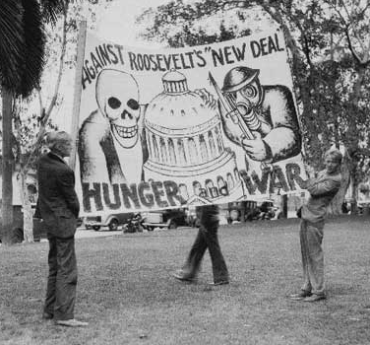
Responses to the ‘New Deal’
Some thought New Deal went too far
Feared growth of federal gov’t and spending
Feared New Deal moving country toward Communism
Others felt didn’t go far enough
More should be done to fix this
Some proposed gov’t hand-outs for everyone over 60
Voters liked it enough…
They sent more Dems to Congress to give FDR the support he needed to keep his plan moving forward

Slide 8
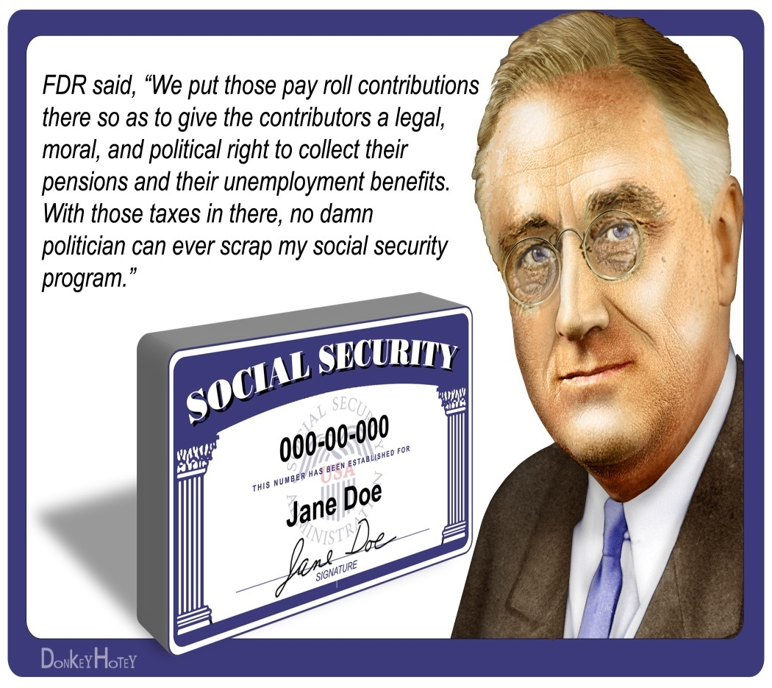
Social Security Act Becomes Law
FDR wanted to help the elderly and those unable to help themselves
August 1935- got Congress to pass Social Security Act
Workers and bosses made payments into special fund…
When retired everyone would get a pension from the fund
Fund also helped laid-off, disabled, and those w/ needy children
1936- FDR runs for re-election
Business owners opposed him b/c feared giving fed. gov’t too much power
But…
Working class and middle Americans loved him and his ideas
On election day, he won every state except Maine and Vermont!!!
11) What is social security and how does it work?

Slide 9
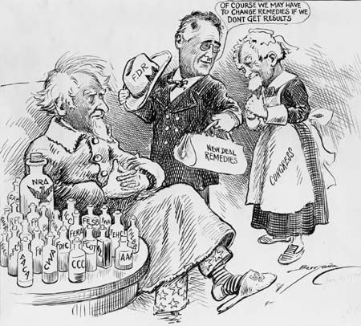
The New Deal Programs
1 of most popular New Deal programs… NRA, or Nat’l Recovery Administration
Regulated working conditions, hours, wages, regulated prices by eliminating wasteful spending
Industries began to recover
By 1934 in NC, 142,000 workers rehired at textile mills
By 1937, furniture companies were back to Pre-Depression levels!!!
Agriculture Adjustment Act (AAA)
Tried to help farmers
Required farmers to grow fewer crops, to increase demand
Increase demand meant higher prices = more $$$ for farmer

Slide 10
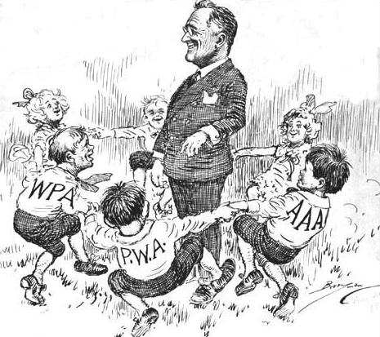
Popular New Deal Programs
Most-Popular New Deal program in NC was…
Civilian Conservation Crops, or CCC
Set up 81 camps in NC and employed 16,000 men b/t 18 – 25
Job was to plant trees, restore eroded land, build hiking trails and parks, etc for the state
Paid by US gov’t though
Nat’l Youth Administration, or NYA
Provided funds for part-time jobs for kids to pay for college
Works Progress Administration, or WPA
Provided funds for the arts
NC Symphony, artists, and writers
Despite all New Deal programs,
NC and rest of USA deep in the Depression throughout the 1930’s, but…
On the right track
We’re getting there
Need 1 event to put us back up top
12) Give me 3 New Deal programs and what kind of jobs did they provide?
Notes:
Crash Course US History “New Deal” (14:56)

Slide 11
Exit Ticket
What did FDR do to help address the Great Depression?

