Slide 1
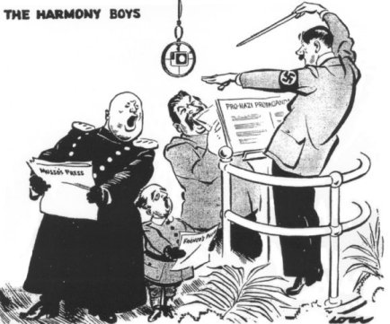
Warm-Up: Spiral Review
Analyze this political cartoon…
Identify the Main Idea
STEPS-
Tell me What U See!
INFER What These Things Mean!!
Use Inferences to Identify Main Idea!!!
1) Warm Up

Slide 2
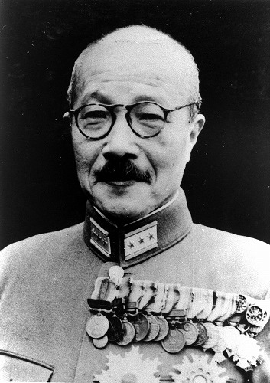
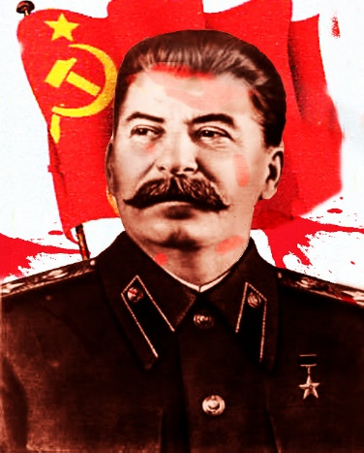
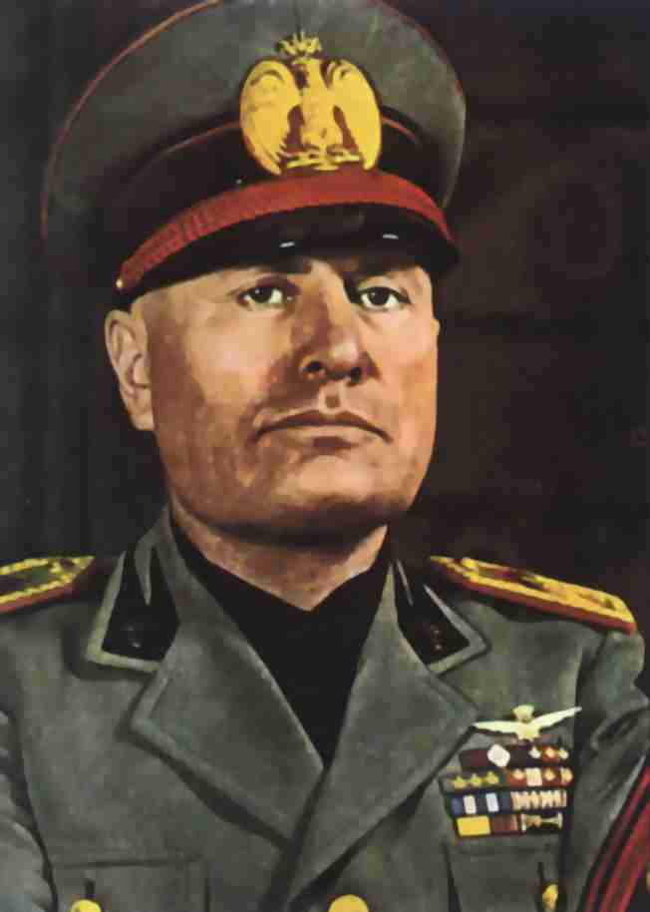
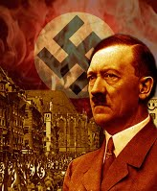
World War II (1939-1945)
10-7 Rise of the Dictators / Road to War

Slide 3
Background
2) Define Totaliarianism
Totalitarianism Emerges
Setting the Stage
1930’s- Europe suffered from Great Depression too!
Some Europeans believed the treaties signed @ Versailles were to blame for their problems
Germans complained bitterly about this
Said Germany was @ fault for WWI
New leaders appeared…
Played to the peoples’ fears, prejudices, and dreams of glory
Ridiculed democracy & capitalism
Called for strong gov’ts that would take total control over peoples’ lives
Claimed only these gov’ts could save these people & restore prosperity and security
Called Totalitarianism
Soon totalitarian dictators threatened the peace of the world
Throughout 1930’s…
Americans escaped the depression into theatres
For a dime or less these could slip into Hollywood fantasies & out of the Depression
By end of the 30’s…
New faces emerged
Faces of dictators and high-stepping armies on newsreels
Rumors of violence and war grew
Americans grew panicked at state of the world
For most, the newsreels were as close as they wanted to get to the world’s problems

Slide 4
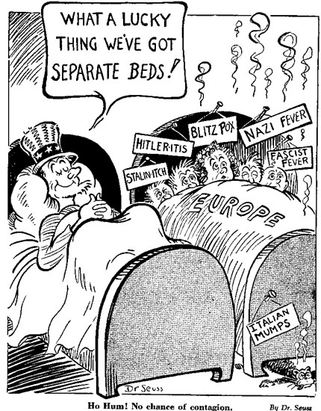
American Isolationism
3) What is this political cartoon showing?
Devastation, death, & cost of WWI…
Convinced many that USA should not get involved in problems of other countries
During 1920’s and 30’s Americans preferred isolationism, or avoiding involvement in foreign affairs
Huge oceans could keep us isolated from their problems
To make sure…
Isolationists in Congress passed series of “Neutrality Acts”
Prohibited making loans or selling weapons to warring nations
By 1930’s though…
USA linked to rest of world in too many ways to be isolated really

Slide 5
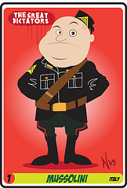
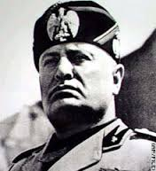
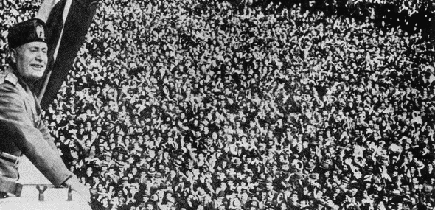
Mussolini Takes Control of Italy
5) Record Mussolini
1922- Benito Mussolini
Former Socialist leader
Became Prime Minister by threatening 2 lead an armed revolt w/ his Italian Fascist Party
Fascism- believed the nation was more important than any 1 individual
Should control the lives of individuals 2 make sure their actions were what was best 4 the state
Extreme form of nationalism
State controls all
Including economy
State controlled by 1 absolute ruler-Mussolini
1925- Italian Fascists est. dictatorship
Mussolini takes title of Il Duce, or “The Leader”
Fascists construct their ideal state, and crushed all who opposed them
4) Define Fascism
Notes:
Rise of Mussolini 7:00

Slide 6
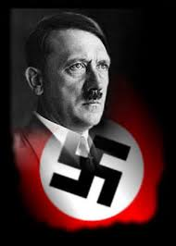
Hitler Rises to Power
7) Record Hitler
1933- Germany turns to dictatorship
German people voted in Nat’l Socialist German Workers’ Party or Nazi Party into power
Leader… Adolf Hitler
Quickly assumes full dictatorial power
Called… der Führer, or “leader”
Proclamed the est. of German Third Reich, or Third Empire
Like Italy, Nazi’s soon controlled all aspects of life & crushed any who opposed them
Hitler and Mussolini were fascists, extreme nationalism
But… Nazi defined nationalism in racial terms… as well as political and cultural
Believed the Aryan , or German race was superior to all others
Germany lost WWI only b/c the German people had been betrayed by leaders, capitalists, bankers, and… the Jews!!!
Hitler saw Jews as greatest danger to German superiority
Nazis begin official campaign of discrimination and persecution of Jews
6) Nazi = ?
Notes:
Hitler’s rise to power 9:08

Slide 7
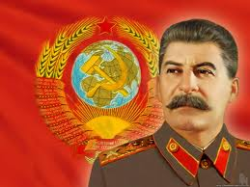
Stalin’s Rise in the USSR
9) Record Stalin
1924- Josef Stalin becomes head of Communist party
Brutally murders all opponents & est. his own totalitarian dictatorship!!!
He claimed the dictatorship was necessary to complete the Communist revolution in USSR
Once in power… he was ruthless!
Abolished private property
Took all the land for the state
Forced all farmers to work on communes, or state-owned farms
All crops owned by state, then divided among people and sale
By mid30’s-
Millions of poor farmers who refused to give their land up were shot
Result…
Collapse of USSR agriculture system
Caused widespread famine!
Some say over 20 million died, mostly of starvation!
8) Results of communes
Notes:
Stalin’s rise to power 5:00

Slide 8
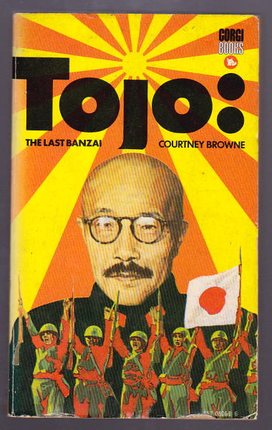
Military Dictatorship in Japan
Dictatorship also came to Japan
Emperor Hirohito in control in 1926
Military run by most trusted general, General Tojo
Small island nation
Lacked own natural resources
Japanese military believed that for Japan to survive… needed own supply of raw materials
Take them through conquest if necessary!!!
1931- Japan attacks Manchuria
Province in north China
Rich in nat’l resources
Conquered region in only a month
Victory and the raw materials made many Japanese people support military’s ways
Emperor Hirohito puts military in complete control of gov’t
10) Record Tojo

Slide 9
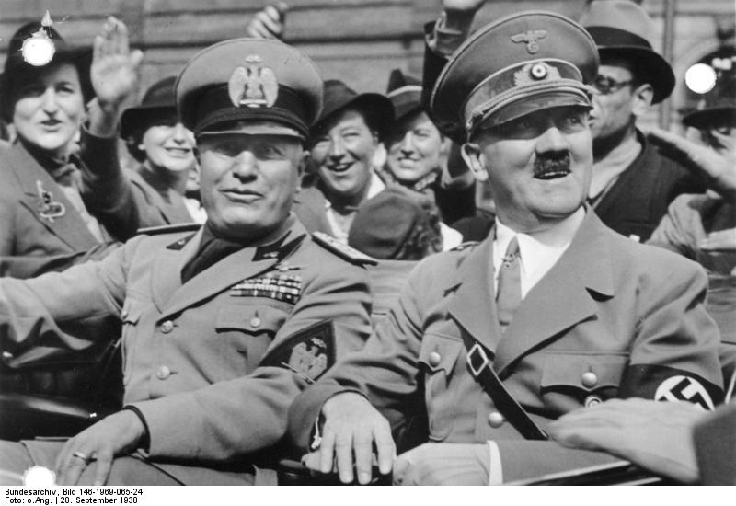
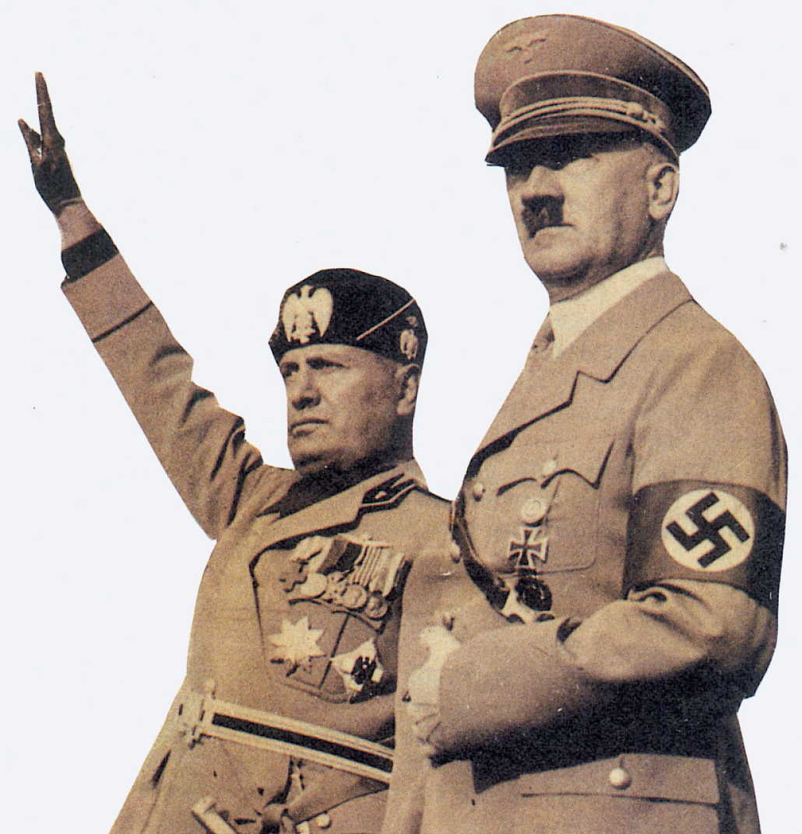
Totalitarianism Leads to Aggression
11) Explain!
Fascists, Nazis, & militarists share common idea
Life constant struggle and…
Only strong survived!!!
Strong nations took what they needed through warfare and conquest
1936- Italy conquers Ethiopia (last free kingdom in Africa)
Hitler thought bigger…
Step 1: Recover territory stolen from Germany in Versailles Treaty
Step 2: Bring all German-speaking people into 1 country
Step 3: Expand east into USSR and conquer it
1936- Hitler & Mussolini sign alliance treaty, Rome-Berlin Axis
Same year…
They support Spanish General Francisco Franco in civil war in Spain
w/ their help, money, & guns he est. a dictatorship in Spain
Totalitarianism was spreading!!!
Notes:
Prelude to War: The Dictators' Plans For Conquest 4:48

Slide 10
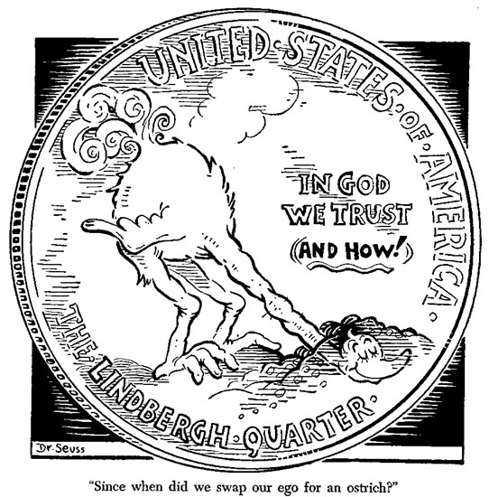
Appeasement at Munich
13) Why appease Hitler?
1938-
Hitler takes over Austria & unites 2 German-speaking states
Next demanded Sudetenland be returned
now part of new Slavic nation Czechoslovakia
France and USSR vow protection if Hitler attacked
Desperate to avoid war…
Democracies give in to his demands
Called… appeasement, or giving in to avoid conflict
Sept. 1938-
Brits and French meet Hitler in Munich, Germany
Agree to give Hitler what he wants w/ his promise that he would go no further
Czechoslovakia had no say it the agreement!!!
Brit Prime Minister said he had achieved peace
Many in British Parliament believed this was cowardly though
Winston Churchill condemned appeasement and warned of its’ consequences
War was coming!!!
12) Define
Notes:
Munich Agreement 5:51

Slide 11
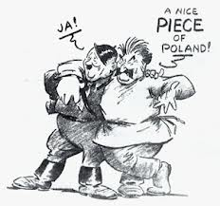
Germany Starts a War
Churchill was right!
Spring 1939-
Hitler took rest of Czechoslovakia!
Next made plans to conquer Poland
USSR & Germany hate each other but… neither wanted to fight… yet!!!
Decide to split Poland
Sign Non-Aggression Pact, agreement not to fight
Europe’s democracies cry out…
“hey you promised no more conquering!” & “that’s not fair!”
England and France warn Hitler that attacking Poland could mean war
Hitler was not worried
They appeased him b4
1 Sept 1939- Hitler sends troops into Poland
3 Sept 1939- Great Britain & France declare war on Germany
WWII had begun!!!
14) What forces France and G.B to declare war?

Slide 12
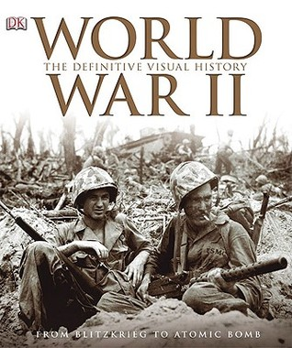
Essential Question: Exit Ticket-
15) Define and why appease Hitler?
What do you foresee happening with the Allied treatment of Hitler and the dictators in general?
What is this going to lead to?

