Slide 1
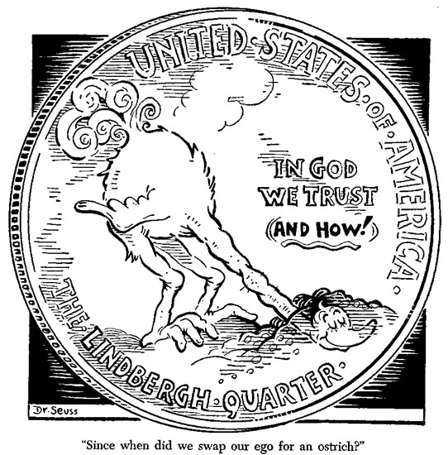
Warm Up: Spiral Review
1)Warm Up
How did appeasing dictators such as Hitler, Mussolini, Stalin, and Tojo, lead to World War II?

Slide 2
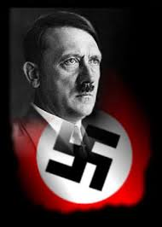
10-8 Adolf Hitler
From Man to Monster!?!

Slide 3
Hitler’s Youth
2)Describe Hitler’s younger years
The Boy
The Soldier
Born in Braunau am Inn, Austria
April 20, 1889
Described as…
Moody
Lazy
Unstable in Temperament
Deeply Hostile to his strict authoritarian (possibly Jewish) father
Deeply Loved his mother
Resented her for not standing up to abusive husband for herself or children
Was not raised Jewish!
Leaves home for Vienna, Austria at 16 to become a painter but…
Rejected by Viennese Academy of Fine Arts
Hitler leaves Vienna for Munich, Germany
When WWI breaks in 1914 at 25 yrs. old…
Joins the 16th Bavarian Infantry Regiment
Able-bodied, courageous soldier
Receives ‘Iron Cross’ for bravery
Wounded twice
Badly gassed at in final battles
Spends 3 months recovering
Temporarily blinded
Driven to rage when informed of Germany’s surrender
When healed, convinced that …
“fate had chosen him to rescue a humiliated nation from shackles of Versailles Treaty, Communists, and the Jews.”

Slide 4
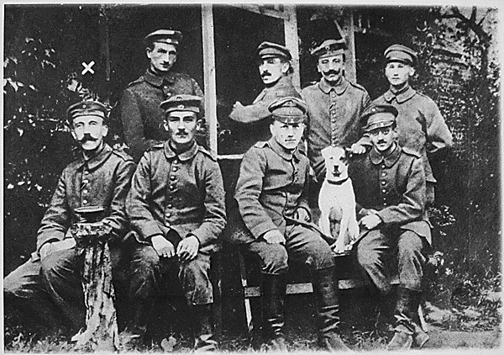
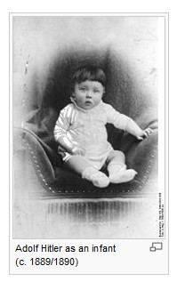
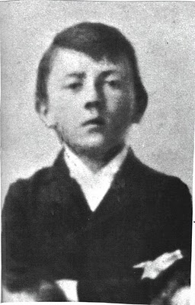

Slide 5
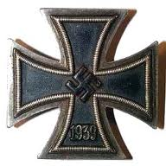
Moving to the Forefront
1919-
Assigned as a spy of political parties in Germany
Sent to investigate the German Workers’ Union
Sept 1919- actually joins the party!
Imposes himself as its Chairman by 1921
Renames it…
Nat’l Socialist German Workers’ Party
Soon discovers a talent for oratory, or public speaking
Also provides symbols to the party…
The Swastika
The Iron Cross
3)Symbol of Nazi party, and origins of the symbol

Slide 6
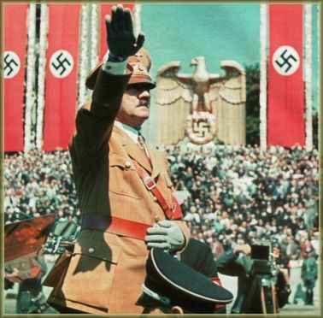
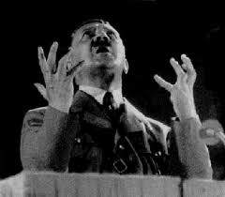
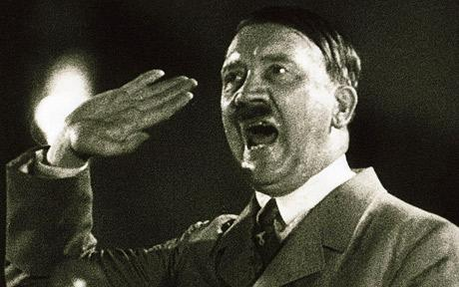
Hitler’s Use of Propaganda
4)Focus of his propaganda
Hitler focused his speeches against…
the Treaty of Versailles
Its writers
Refers to them as “November Criminals”
Communists
Internal Enemy #1…
the Jews
Claimed Jews were responsible for all German problems
24 Feb 1920-
Announced the existence of Germans as the Aryan Race
Provides idea of extreme nationalism, or fascism
Calls for a “systematic extermination of the Jewish infestation in the German state.”
5) Extermination of a race is called…
Notes:
Hitler Speaks About the Jews (1:21)

Slide 7
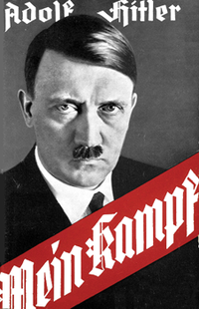
Hitler Takes Control
6) What is Mein Kampf?
By Nov 1923-
Hitler convinced he could overthrow German gov’t
Attempts to…
Arrested leading over 3,000 followers
Writes Mein Kampf (My Struggle) in jail
Becomes “the Bible” of the Nazi Party
Upon release in 1925-
Goes rt. back to work
Speaking to people convince them of his ideas
Expressed how his way would restore the pride of the German people
Fix the wrongs done to them
And…
Convince them of his absolute leadership
Played on the resentments, feelings of revolt, and desire for leadership
Used speeches to present himself as “the Savior”

Slide 8
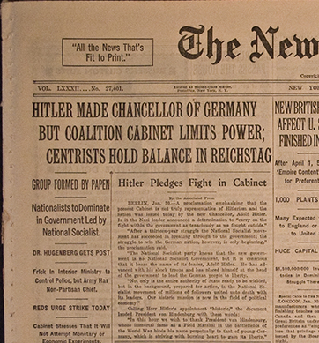
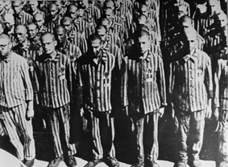
Chancellor Hitler
7) What was the point of concentration camps?
30 Jan 1933-
Under huge pressure…
Hitler is appointed Chancellor
Once in power moves quickly to remove his rivals and crush his doubters
July 1933-
Abolishes five (5) trade unions
Keep jobs in Germany
Removes (forcibly) all Communists, Democrats, & Jews from the gov’t
Places them all in Concentration Camps
To be worked, beaten, or starved to death!

Slide 9
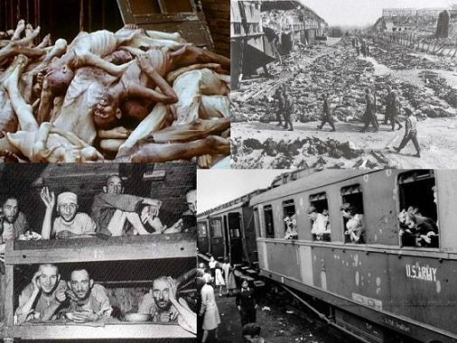
Next Step to the “Final Solution”
8) Define Nuremburg Laws
June 1934- Hitler confirmed as Supreme Dictator of Germany
Used whole gamut of persuasion, propaganda, terror, & intimidation to hold power
1935- declares Versailles Treaty void!
Begins to build up army, navy, & air forces
Rearmament (rearming)Program leads to full employment for the German people
Puts $$$ back into the hands of the German people
Institutes racial laws within the state against the Jews
Nuremberg Laws
Begin to round up Jews and place them in Concentration Camps
9)20 video facts!!!
Notes:
Nazi Concentration Camp Horrors (13 movies)

Slide 10
10) Yertle Hitler?

