Slide 1
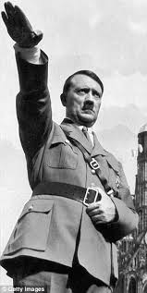
Warm Up
How did Hitler rise to power in Germany?

Slide 2
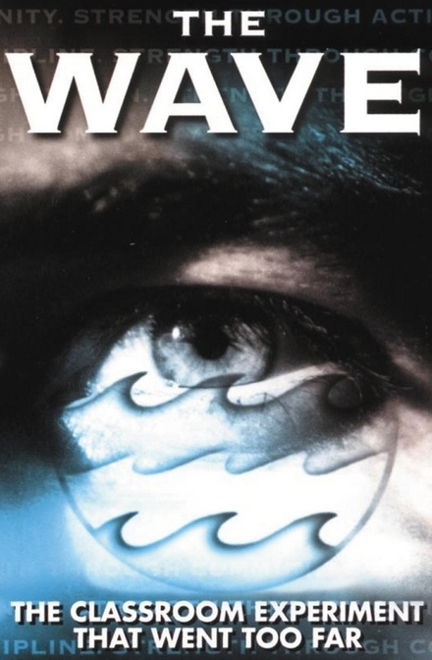
10-9 The Wave

Slide 3
Deeper Thought Questions
Characterization.
When Mr. Ross says, “Discipline and power- it’s almost contagious,” he means…
A.) he is getting sick
B.) he is getting caught up in the experiment
C.) he is afraid of those forces

Slide 4
Deeper Thought Questions
Conflict.
What kind of conflict is shown in the following exchange and throughout the movie?
Mrs. Saunders: “It sounds militaristic to me…”
Mr. Saunders: “What’s wrong with cooperation?”
A.) person vs. person
B.) person vs. nature
C.) person vs. society

Slide 5
Deeper Thought Questions
Symbolism.
What does Mr. Ross say the Wave sign represents?
A.) change and impact
B.) water and wind
C.) community and action

Slide 6
Deeper Thought Questions
Climax.
Which scene is the turning point in the action?
A.) Eric punches another boy under the Wave banner
B.) the principal confronts Mr. Ross
C.) David hurts Laurie

Slide 7
Deeper Thought Questions
Theme.
Which theme rings most true for this play?
A.) following a leader blindly can be dangerous
B.) power always corrupts
C.) everyone can be persuaded to join a group

