Slide 1
Warm Up: Context Clues
1) Warm Up
In a meeting in 1964, having been told that the South Vietnamese cannot fend off a communist invasion, President Johnson responded:
“I don’t think it is worth fighting for but I don’t think we can get out.”
Using context clues what can you say Johnson felt our role was in Vietnam?

Slide 2
The 1970’s
11-10 Involvement in Vietnam

Slide 3
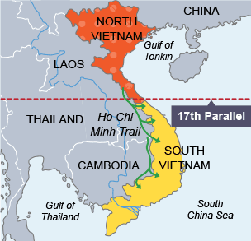
Origins of the War
2) Situation in ‘Nam similar to what
Origins can be traced back to WW2
French controlled Vietnam, Japanese tried to take it over but lost the war
Ho Chi Minh (Communist) eventually captured French capital
Geneva Accords
Allies during WW2 split Vietnam like Korea
Communist in the north, democracy in the south
Plan was to hold elections to unite… sounds familiar
No luck there…
Prez of the south, Ngo Dinh Diem tries to oust commies… these communists become known as the Vietcong

Slide 4
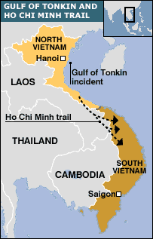
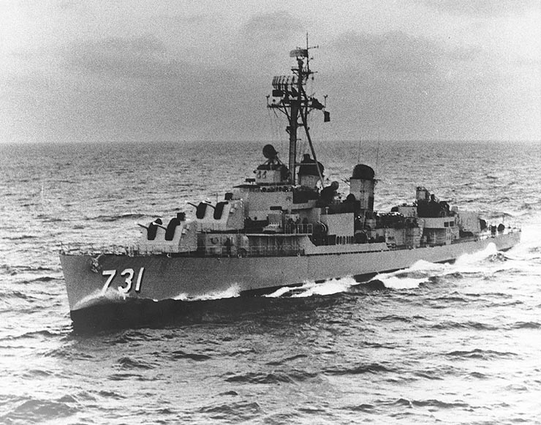
The Gulf of Tonkin
3) Thoughts on LBJ’s actions
By time JFK died 16000 “advisors” in the region
Reason being south needed help to protect themselves from the reds
LBJ wants more support from congress…
stop the Domino Theory from happening
Happens when in August of 1964 the USS Maddox is “attacked”
Reports later find out this was not really the case
1st incident: claimed they were being shot at but they shot 1st
2nd incident: claimed they were being attacked but shot at false blips on their radar
These reported attacks allowed LBJ to:
“take all necessary measures to repel any armed attack against the forces of the United States”
Issues Gulf of Tonkin Resolution
Gave LBJ authority to use force in Vietnam (just like he wanted)
Notes:
Fake Attack that started Vietnam 3:00

Slide 5
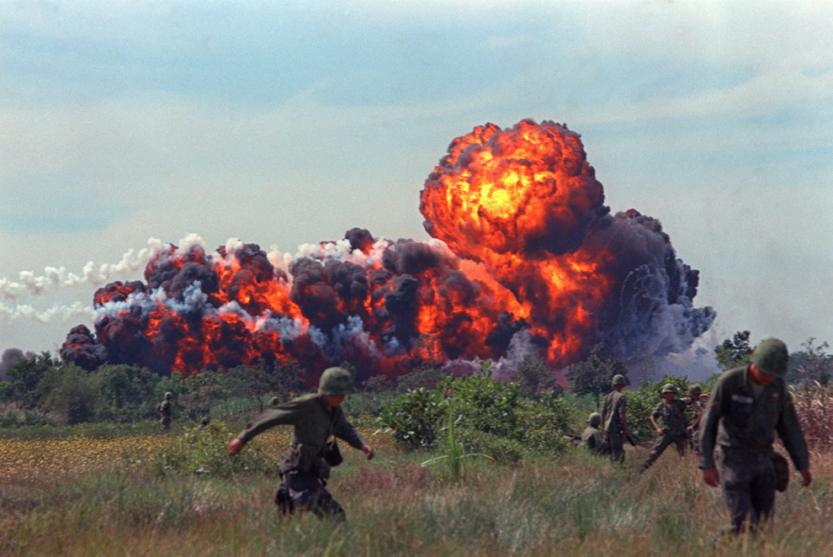
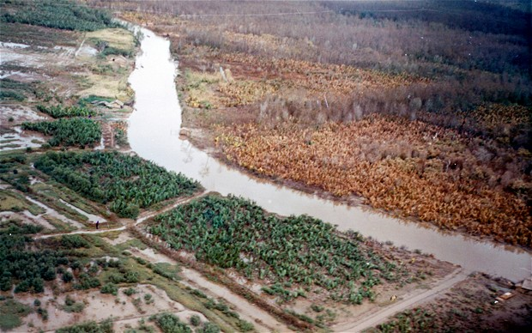
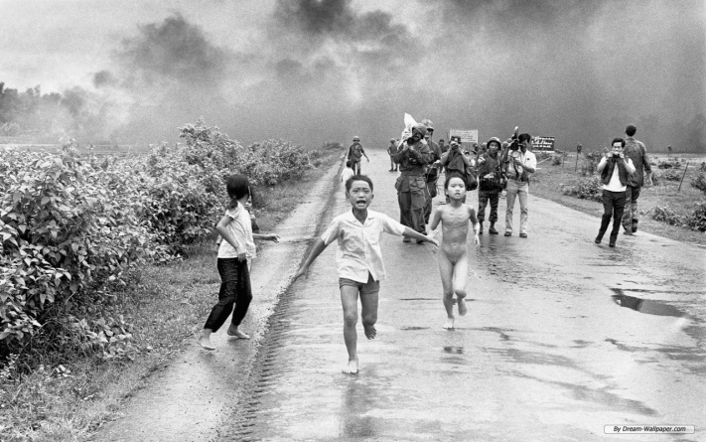
Fighting the War
4) Describe the tactics…
After the Gulf of Tonkin Resolution LBJ began to escalate involvement in Vietnam
180K men by end of ‘65
400k men by end of ‘66
Half a million by 1968!
Operation Rolling Thunder
Intense bombing campaign
Targeted many spots on the Ho Chi Minh Trail
Network of roads and paths all over the region used by Vietcong
Dense jungles led to Guerilla warfare tactics
US soldiers found it hard to tell friend from foe
Used search and destroy tactics to hunt out enemy units/bases
Helped by air support
Helicopter used to quickly move troops and supplies in and out as well provide machine gunfire
Fighter jets used to supply heavy air support
Fired missiles and dropped bombs
Napalm
Fire bomb to burn down dense forest
Agent Orange
Chemical Herbicide to cut back on the dense trees and grass
Caused serious health issues
Notes:
Napalm Girl 40 years later 2:38 (on pic of girl)
We Were Soldiers (7/9) Movie CLIP - Napalm Air Strike 2:04

Slide 6
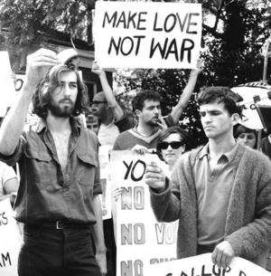
Opposition at Home
Not everyone supported the war
In fact most did not
Many part of the counterculture
Movement the rejected traditional American values
Fueled by music, drugs and peace
The gov’t instituted the draft to enlist men
Many protested the draft
Deferments given to college students
War increasing became fought by child of blue color families
Topic of Credence Clearwater Revival- Fortunate Son
In protest people burned their draft cards
The Doves and Hawks
Those who supported the war were referred to as hawks
Those who opposed were the doves
Opposition continued to increase and protests even turned violent as the war drug on.
A credibility gap formed
Less and less people trusted the gov’t’s reports of the war
5) Explain the symbolism and which would you have been… why?
Notes:
CCR-Fortunate Son (on song title)

Slide 7
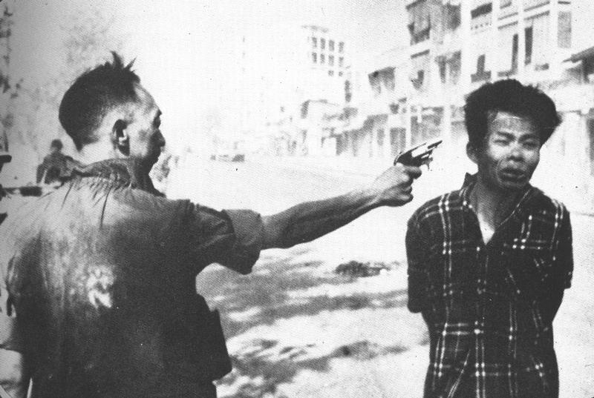
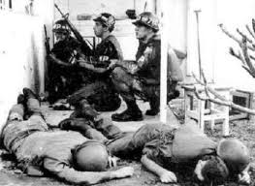
The Tet Offensive
31 January 1968
Northern Vietcong launch series of attacked in the south
Attacks began on Tet, the Vietnamese New Year
Became known as the Tet Offensive
Targeted major cities and US military
Attacked ancient capital Hue
Raided US embassy
Although US and South Vietnam troops held off the attack for the most part the TV coverage tore the war effort apart
Showed Vietcong killing Americans among other things
What little support was left began to crumble
***Turning point of the war***
President even started to question the war by halting bombs dropped on North Vietnamese cities…

Slide 8
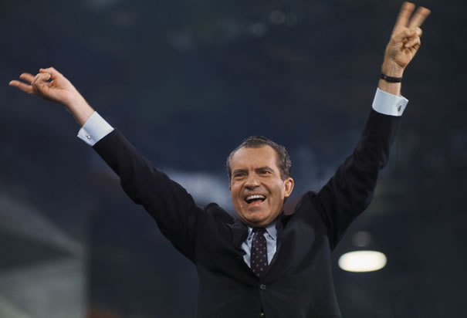
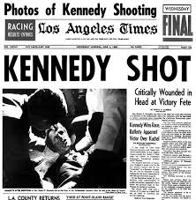
Election of 1968
With the opposition to the war effort LBJ decides to not seek reelection
Robert F Kennedy (RFK), bro of JFK fighting for Democratic party nomination against V.P. Hubert Humphrey
After winning a primary in California he was assassinated…
Anti war protests rocked Chicago during the Democratic Convention
Turned violent when police attacked the crowd to settle things down
This tarnished the democratic party’s and Humphrey’s imagine
Republicans nominated Richard Nixon, a former VP.
Claimed to represent the silent majority
The vast amount of Americans who did not go out and protest.
Promised to restore order
Remained vague on Vietnam though…
3rd party candidate George Wallace
Promised to halt protests
Against integrating schools
Against government telling people how to live
Nixon wins the electoral votes easily
Become the next president with only 43% of American votes
Notes:
Disney The American Presidents: Richard Nixon 5:02
-Optional with time

Slide 9
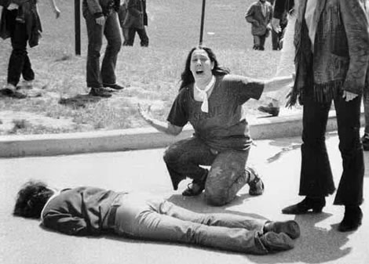
Things Get Ugly
War opposition continued to grow
Vietnam’s Neighbor Cambodia plunges into a communist civil war
Nixon orders an invasion to stop communism
Sparked outrage at home
Kent State
Protest over invasion of Cambodia
Got violent when students burned military building
3000 nat’l guard members sent in
4 May 1970
Students and guards shout at each other
Some students throw rocks at them
For reasons unclear troops opened fire at several students.
4 dead 9 injured
Topic of Crosby, Stills, Nash and Young- Ohio
Jackson State
15 May 1970
Violence flared up during protests
2 students killed
Kent and Jackson State shootings prompt national student strikes and suspension of classes
Nixon took hard stand saying:
“[Kent State] should remind us once again that when dissent turns to violence it invites tragedy”
6) Using context clues what is Nixon saying…
Notes:
Kent State Shootings- Ohio – Neil Young 5:37

Slide 10
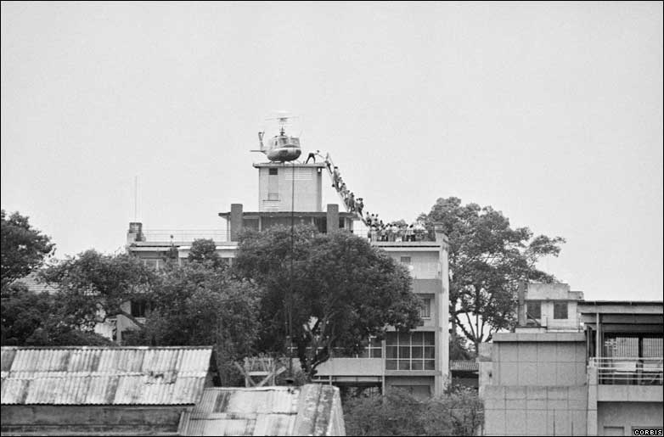
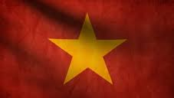
The End is Near
7) Result of war?
Ever since the Tet Offensive there had been negotiations to end the fighting
US began to withdraw troops slowly
Plan called Vietnamization
Allow for the South Vietnamese army to take larger role in fight
The Vietcong intensified attacks with less US troops to defend
Nixon resorts to bombing Hanoi (capital of north) and other cities
Bombing intensified in ’72
Caused outrage home and abroad
27 January 1973
Paris Peace Accords signed ending U.S involvement in Vietnam
Did not end the war…
Northern troops closed in on Saigon (capital of south)
Last Americans scramble to flee
Large scale evacuation of these troops and thousands of Vietnamese who supported US
Called Operation Frequent Wind
Largest Helicopter evac.
30 April 1975 Saigon falls to the communists
Shortly after South Vietnam surrenders and becomes united under communism
Notes:
Vietnam War: Fall of Saigon (1975) 4:00

Slide 11
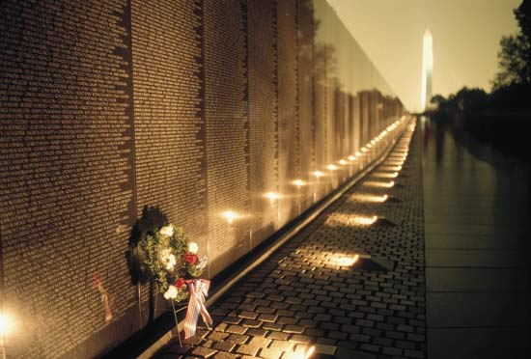
The Legacy
8) Why no welcome home parade… is it fair?
The Cost
58,000 U.S. Soldiers dead
300,000 wounded
Many permanently disabled
$150 billion spent in war effort
2.7 million U.S. troops served during the war
They received no welcome home parade
No thank you
Most ignored the vets and many had issues finding work
Remembrance
Vietnam Veterans Memorial
Washington D.C.
Dedicated in 1982
246 feet 9 inches of black granite
58195 names

