Slide 1
The 1970’s: a Search for Stability
11-11 Nixon’s, & Ford’s, and Carter’s… Oh My!

Slide 2
Warm Up: Inferences
1) Warm Up
“The greatest honor history can bestow is the title of peacemaker.”
- Richard Nixon
What can you infer Nixon believes his duty is in regard to Vietnam?

Slide 3
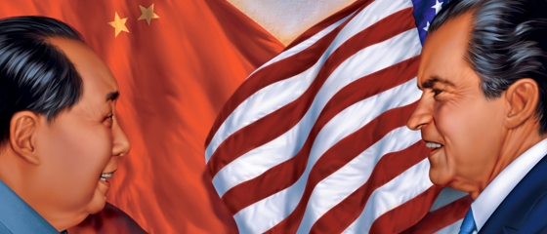
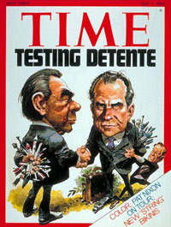
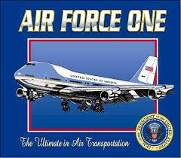
Nixon’s Foreign Policy- Easing the Cold War
2) Define
Nixon comes in promising to be the peace-maker
Reaches out to USSR and China
Wants to find areas of commonality & cooperation
Formulates foreign policy of détente
Idea was to relax tension and confrontation as defaults
Begin working together to resolve issues that divide
Only work though if there is balance
“if we have a strong, healthy US, Europe, USSR, China, Japan- each balancing the other, not playing one against the other.”
Recognizes People’s Rep. of China
China invites US Ping-Pong Team for exhibition
Feb 1972- Nixon 1st Pres to visit China in over 25 yrs!
May 1972- Nixon heads to Moscow
US shares “dwarf wheat” technology
USSR agrees to Strategic Arms Limitation Treaty (SALT 1)
Restricts the amount of nukes
Doesn’t end Arms Race, but… greatly reduces tensions
Notes:
Forrest Gump- 1:41 (words US Ping-Pong)

Slide 4
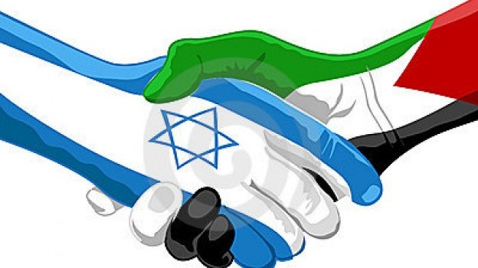
Richard M. Nixon- The Middle East
Nixon’s idea was to maintain world stability w/o getting drawn into regional disputes
Doesn’t want another situation like Vietnam
US will help our friends, but…
Not allow US to run / take on war
Arab – Israeli Tensions test this
Israel founded in1948
War w/ Arabs erupt in ‘48, ’56, & ‘67!
War result in Israel controlling much of Holy Land / Middle East
Leaves many Arab refugees
They demand a nation of their own
Leads to more fighting (still to this day)
6 October 1973- Yom Kippur War
Arabs attack on Jewish holiday- Jews fight back
US urges Israel to sign cease-fire
They do but not B4 taking more Arab land from Syria & Egypt
Arab nation impose oil embargo- ban on sale of oil to US b/c we R friends w/ Israel
Embargo leads to huge oil shortage in US
Nixon tries to regain trust of Arab nations
Next 2 years keeps Nat’l Security Advisor, Henry Kissinger in the Mid East
Called Shuttle Diplomacy
Goes back and forth from Israel to Arab nations to broker agreement
Agreement comes in 1974
Tensions reduce, but another “band-aid”
3) Explain- Band-Aid?

Slide 5
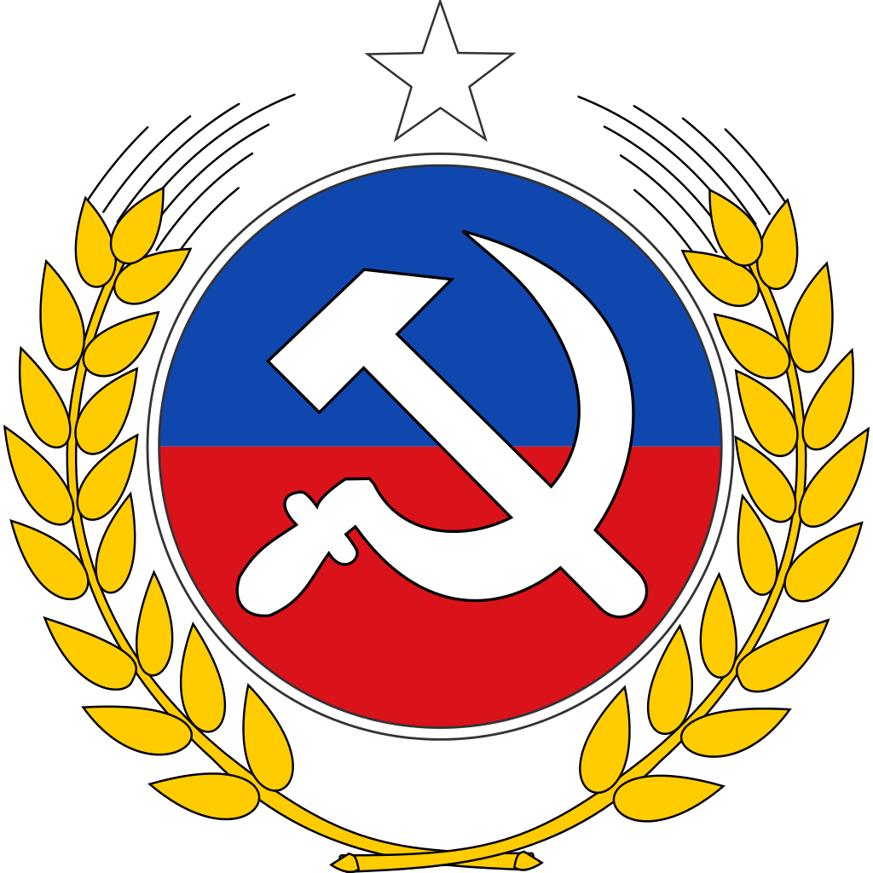
Richard M. Nixon- Communist Chile?!?
Nixon still wants to stop spread of Communism in Americas
1970- Chile elects Salvador Allende
Communist
Communist-lead gov’t take over US businesses in Chile
US gets mad
CIA and Chilean military plan a coup d'état
Overthrow of in-power gov’t
Coup works and Allende is killed
Military leaders install dictatorship
US recognizes new gov’t and restores aid to Chile
Shows that even though Nixon willing for détente in China & USSR… not going to allow Communism to spread in our backyard
4) Define

Slide 6
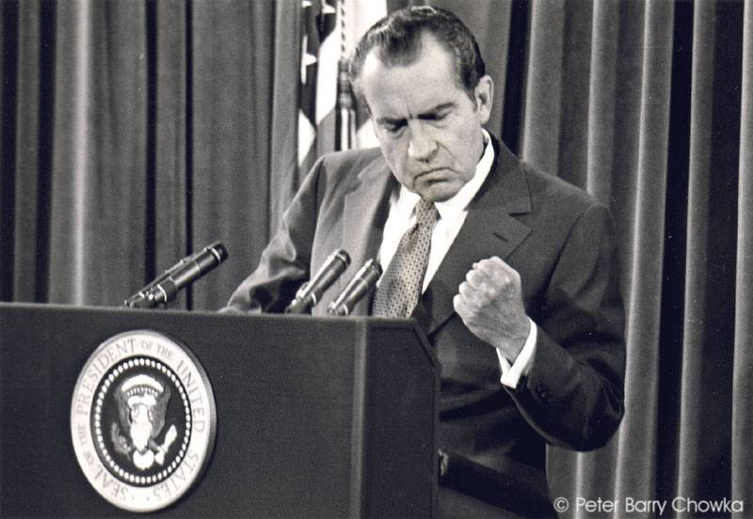
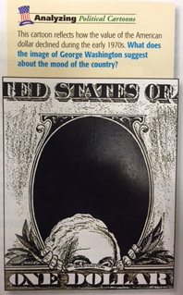
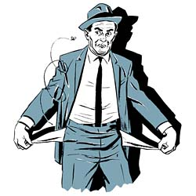
Richard M. Nixon- Domestic (@ Home)
Back in 1968- Nixon promises to bring “order” back to US society
Crack down on crime
Impose stiffer penalties
Uses US funds to supply local police
He puts 4 new Judges on US Supreme Court
Hopes they will instill stiffer penalties on criminals
New Federalism
Part 1- share tax $$ w/ states
Called revenue sharing
Part 2- cut or reduce social programs
Abolishes Office of Econ. Opportunity
Previously helped fight War on Poverty!!!
Part 3- civil rights
ended busing blacks into white neighborhood schools
Appealed to Southern whites
But… forced integration in schools
Created Affirmative Action
Give preference to blacks in jobs previously excluded
Economic Problems
While attempting 2 change gov’t direction… has to deal serious econ. Issues
US industry on massive decline b/c of foreign competition
Leads to inflation
General price increases
Slow econ. growth
High unemployment
Seeking Stability of Economy
1st Tries to reduce spending
Doesn’t’ work
2nd Tries to freeze wages and prices
Helps, but still in recession
3rd Tries to stimulate econ by increasing gov’t spending
Nothing helped
Problem that will continue throughout
5) Describe Econ Mood

Slide 7
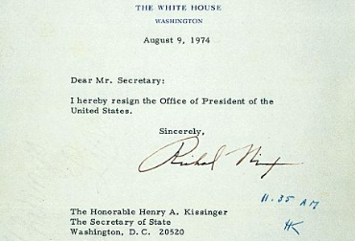
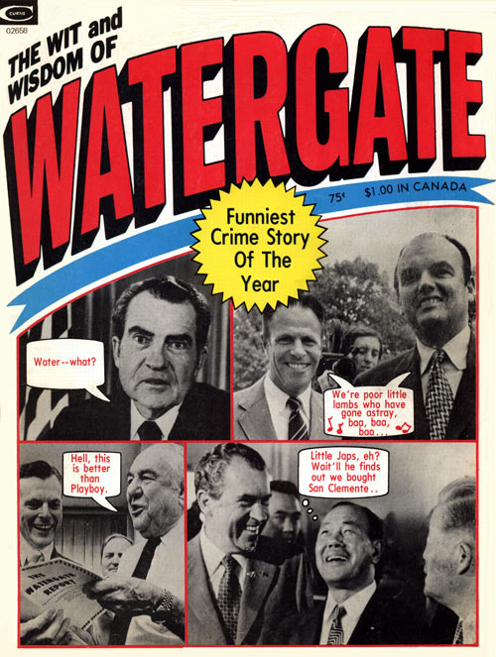
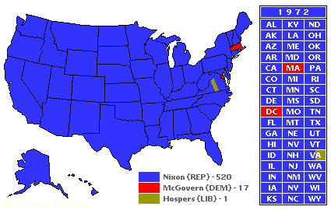
Richard M. Nixon- 2nd Term
Election of 1972
Nixon doubts his chances
To win does several illegal things
Creates enemies list-
FBI watches them
IRS investigates them
Nixon justifies as necessary to maintain nat’l security
Collected millions to employ “plumbers”- payoff those that may leak information against him
Nixon not caught… yet!
Wins in landslide!!! 520 – 17!!!
Energy Crisis
Major econ problems, but worst is cost of fuel
US needed foreign oil, but now Arabs have embargo on us for oil
What we can get is grossly overpriced
Lead to gas lines, and rationing
Watergate Crisis
Watergate Hotel / Office Complex
17 June 1972- Nixon orders “plumbers” to plant bugs in Dem. HQ in Watergate
Caught doing this
Investigation leads to all info gathered illegally on opponents during election, info on other illegal activity, documents of the “plumbers” paying off people, info about illegal wiretaps on the Dems
Worst of all- found paid for by Nixon using White House funds!!!
H of R begins Impeachment process
8 August 1974-
Richard M. Nixon resigns before Impeachment Trials begin
Only US President to resign in disgrace
6) Nixon what???
Notes:
August 9, 1974: President Richard Nixon Resigns - (1:52)

Slide 8
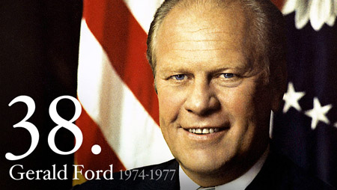
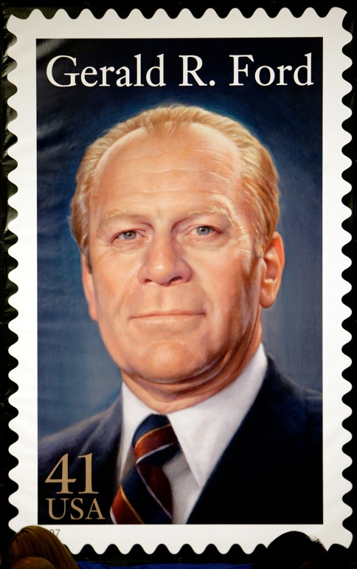
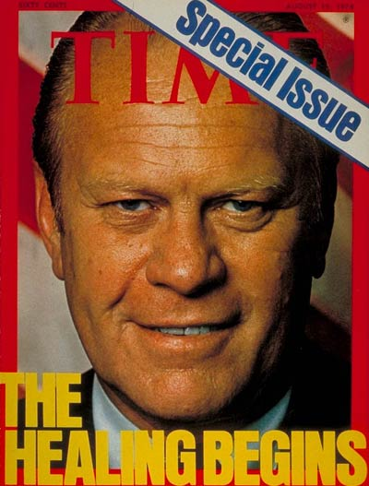
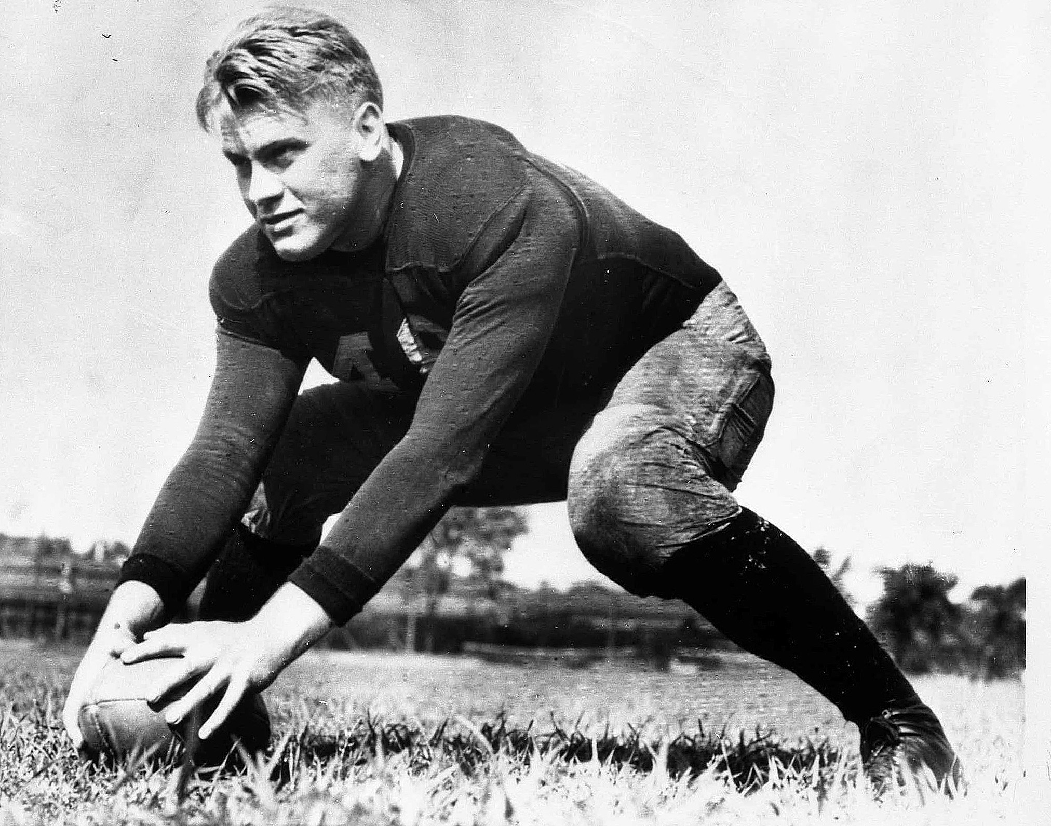
Gerald R. Ford: A Time For… Controversy?
Provided the feeling of, “Our nightmare is over” until…
8 September 1974-
1st act as POTUS- pardon Richard M. Nixon of all criminal charges!
Hoped it would help heal, but…
Leads to more conversations of cover-up!
Never fully re-gained trust of Americans
Controversy #2- Spying
US told FBI & CIA had files on US citizens- that they had been spying on own people
This doesn’t help
Ford opens up investigation of both agencies
Controversy #3- Ford offers amnesty for Vietnam “Draft Dodgers”
Met w/ mixed emotions
Controversy #4- Foreign Affairs
Didn’t know jack about int’l issues
Allows Kissinger to control foreign policy
Sec. of State has free reign!
All in all- doesn’t do much as POTUS
7) FORD???

Slide 9
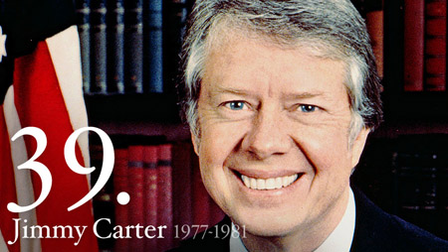
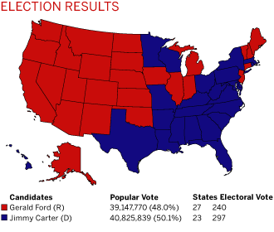
Jimmy Carter- The Election of 1976
Ford hoped to be re-elected
Tried to stress his achievements as President
but…
Watergate still on people’s minds
He even pardons Nixon!!!
What are people doing to Ford?
Equating Ford w/ Nixon
Even though Ford helped restore trust in gov’t… people still not there yet
Want someone who wasn’t a “politician”
Enter Jimmy Carter
Stresses integrity, religious faith, and his being an outsider
Not corrupted by politics…
He’s a peanut farmer from Georgia!
It’s close, but…
Carter becomes 39th President of the United States
Notes:
The Presidents- Jimmy Carter (12:01)

Slide 10
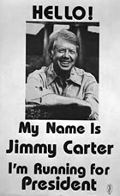
Jimmy Carter- An Informal Presidency
“Outsider” no experience in nat’l politics
Not necessarily a bad thing
Said he was “just a peanut farmer from Plains who wanted to serve his country.”
Wanted to be seen as average American
Struggling w/ Economy
When takes office- nation still suffering from high inflation & unemployment
Tries to jump-start econ by increasing gov’t spending & cutting taxes
Makes things worse so, does opposite
Makes him look weak and uncertain
Energy Crisis
Causing half of econ problems
April 1977- unveils Nat’l Energy Plan (cool new ideas?)
Nope- Use less energy! No Duh!
Prove his point- orders White House thermostat turned down
That should do it!
Creates Dept. of Energy
Coordinate plans, and research energy alternatives
Nuclear Power- maybe not the answer
Use Nuclear energy for good, not evil
Until…
Three Mile Island
Nuclear power plant in PA has melt down!
Pro- Nuke people- nuclear energy is completely safe
When given proper safeguards
Anti-Nuke people- nuclear energy is just asking for more of this!!!
Nation torn on idea
Notes:
Three Mile Island- 1:49

Slide 11
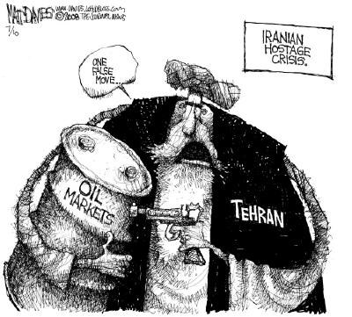
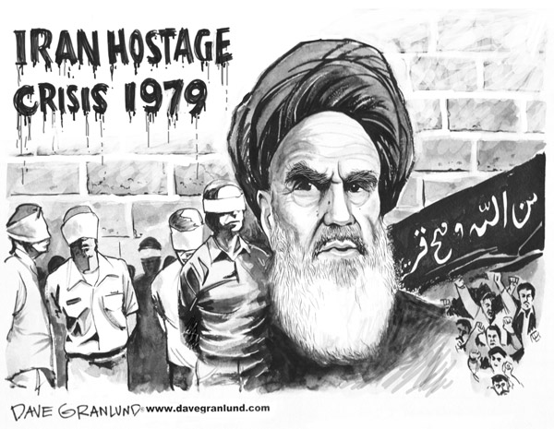
Jimmy Carter- Foreign Affairs
Main Idea- Human Rts
Concern that gov’ts around world should grant greater freedom & opportunity to their people w/o persecution
Honoring nations that protect their people
Punishing countries that did not
Withdraw aid
Economic sanctions
Etc.
Panama Canal
Bitterness in Latin Amer b/c of US ownership & control
Turned over ownership to the people of Panama
Carter was giving away US property, but helped relations
Middle East
Sought to bring peace to region
Invited leaders from both sides to Camp David to discuss
Camp David Accords
Another Band-Aid
Still works with this today- his legacy
Soviet Union
Peace still going
About to sign SALT 2
USSR is becoming ally until…
USSR invades Afghanistan
US imposes sanctions on USSR
US starts econ embargo against them
UN Nations refuse to participate in Moscow Olympic Games
Iran
Beginning Iran was US’ biggest ally in ME
Jan 1979- religious coup
Islamic fundamentalists called, “Ayatollah’s” take control
Ayatollah Khomeini becomes leader
Death to American Imperialists
November 1979-
Islamic fundamentalists attack US Embassy in Tehran
Take 52 US citizens as hostages
US outraged
Attempt to negotiate but fail
Try to rescue but fail (8 soldiers die trying)
Hostages held for over a year!!! (444 days)
Released minutes after Carter leaves office as POTUS
8)What would you have done?
Notes:
What caused the 1979 US Embassy Hostage Crisis in Iran? (9:47)

Slide 12
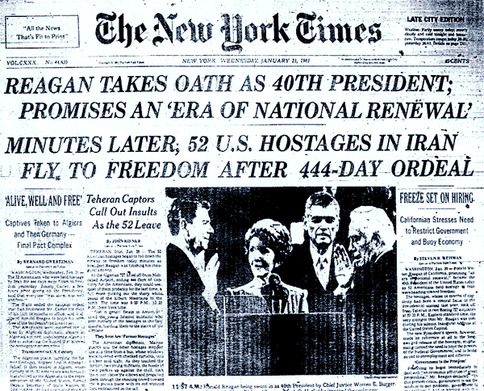
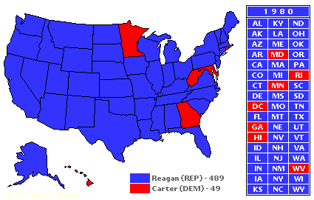
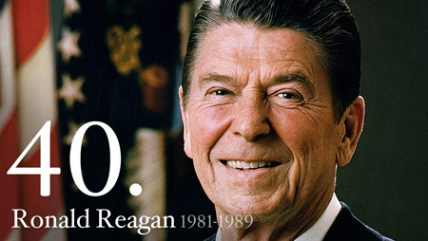
Jimmy Car… Ronald Reagan The Election of 1980
Iranian Hostage Crisis damaged Carter’s political image
Carter’s popularity drops massively
Republicans offer California Governor Ronald Reagan…
The actor?!?
Obvious differences b/t Reagan & Carter
Reagan radiated Charm and Confidence
Conservative Message-
Lower taxes
Reduce (social program)spending
Create Stronger Military
Restore American Pride
Appears to most!
Reagan sweeps Electoral College 489-49!
Carter now left with nothing as legacy, but empty promises
Since retirement though has done so much to help world
Habitat for Humanity
Mid East Peace Conference Delegate
Nobel Peace Prize
9) Foreshadow
Notes:
Back to the Future- (0:08) on “the actor?!?”
1980 Presidential Election for Dummies -- Reagan vs Carter vs Anderson (14:10)

