Slide 1
Warm-Up
1.) Warm-Up!!
What were the sportSCenter highlights of your Weekend? Did you “Sharpen the Saw?”
Tell me about it!
1 Paragraph
What were we talking about prior to the weekend?
Who won?
Who Lost?

Slide 2
The Post-War Years: 1945-1959
11-1: Origins of the Cold War

Slide 3
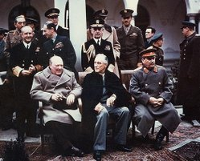
Happy Days are Here Again!!!
2.) Foreshadow!!
Yalta Conference
4 February 1945-
In closing months of WWII… Big 3 meet
Brits and US feel USSR still threat
Make a deal w/ Stalin
USSR would help in Pacific Theatre in exchange for…
Territories in Asia
Division of Germany into “4 Zones”
France, Great Britain, US, & USSR each control a quarter
Supposed to be temporary
Until “Democratic” elections occur and new German Gov’t can decide down future
Band-Aid Compromise?!?
Sound Familiar?!?
Can you see…
where I’m going…
with ha this?!?
BIG 3
Winston Churchill, British Prime Minister; Franklin D. Roosevelt, US President; Joseph Stalin, Soviet Premiere
Notes:
History Short - The Yalta Conference (2:31)

Slide 4
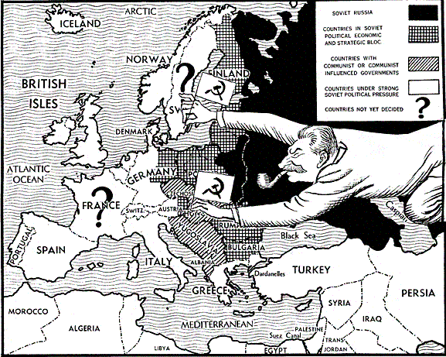
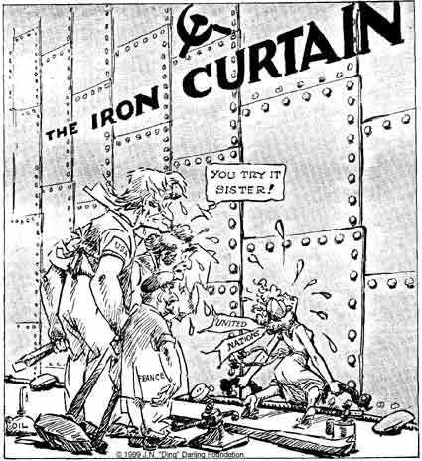
“…an ‘Iron Curtain’ has descended on Europe”
3.) Title & Symbolism?
Stalin breaks Yalta promises for free elections
Takes Eastern Germany, Poland, Czechoslovakia, Hungary, Romania, Yugoslavia, Bulgaria, & Albania
Forces them under Soviet Control
Est. Communist gov’ts in each
Creates an ‘Iron Curtain’ separating Eastern and Western Europe
Distrust b/t Communists and Democratic Nations Leads to Another War?!?
Referred to as… ‘the COLD War’
a what?!?
War w/o Violence
Referred to as ‘Cold’ b/c of this
Goal was to…
Intimidate the other nations into submission
Birth of the United Nations
Based on…
Wilson’s “League of Nations”
World governing body; a congress if you will
Goal…
to settle disputes b/t nations prior to violence

Slide 5
Truman Doctrine
“ I believe that it must be the policy of the United States to support free peoples who are resisting attempted subjugation by armed minorities or outside pressures.”
~US President Harry S. Truman-
Speaking to Congress in March 1947
4.) Stop & Jot!!
This quote identifies the true purpose of the Truman Doctrine. Upon reading this quote, what do you believe the doctrine’s goal will be and who can you infer is its’ target ?

Slide 6
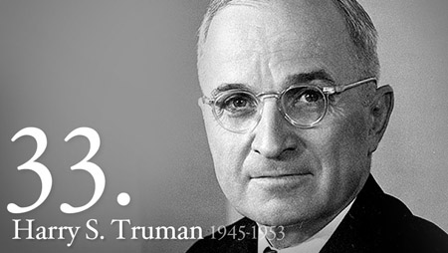
Truman Doctrine
The Truman Doctrine
A commitment made by the United States to…
STOP the spread of Communism in any country that does not want it
The USSR was imposing its’ Communist ideas on smaller, weaker nations

Slide 7
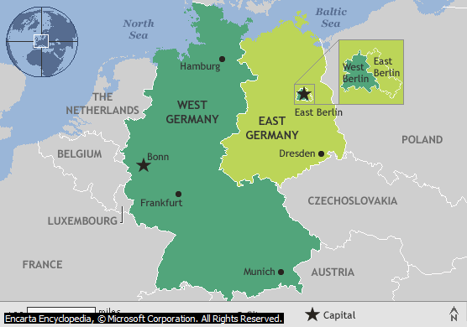
Help Arrives… to Divide the Nation!?!?
5.) Describe Germany!!
Post WW2- Europe in Shambles…
Everything destroyed
Communism appeals b/c promises equality… housing & employment for all
Best way to keep Europe free…
Restore their economies
The Marshall Plan
George Marshall; US Sec. of State
Proposes massive economic aid program used to help Western European countries get back on their feet
$13 billion given b/t ‘48-’51
Used to rebuild, physically and economically
Result-
NO Western European countries fall to Communism
7 June 1948
US, Brits, French decide to unite our 3 parts of Germany into 1 FREE Democratic Nation’
Federal Republic of Germany
Stalin answers w/ Berlin Blockade
Block all supply traffic coming from Communist East going to Dem. West
USSR hopes drive Dems from Berlin
Doesn’t Work
Berlin Airlift
To aid split of Berlin-
Dems. air-drop supplies into Democratic West Berlin
Lasts 10 months
USSR realizes Dems not leaving…
Stalin has to come up with new plan
Creates own country … East Germany
Notes:
The Marshall Plan (1:39)

Slide 8
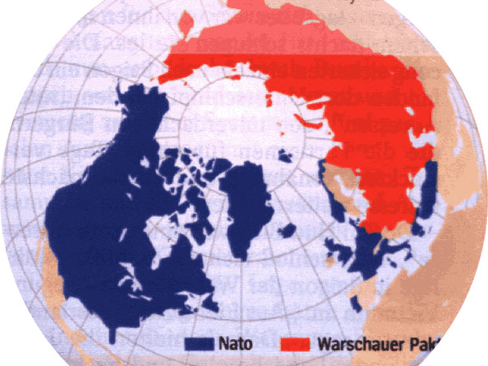
2 Sides of the Same Coin
6.) Purpose??
To Protect against potential Communist attacks…
Create alliances
NATO-
North Atlantic Treaty Organization
“an armed attack against one or more of them [member nations] shall be considered an attack against all.”
Created large military force
Ex. Like the Allied Army in WW2
The Warsaw Pact
Soviet answer to NATO…
Same thing as NATO,
but a Communist version
Communist Alliance System

Slide 9
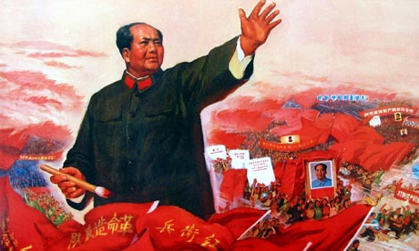
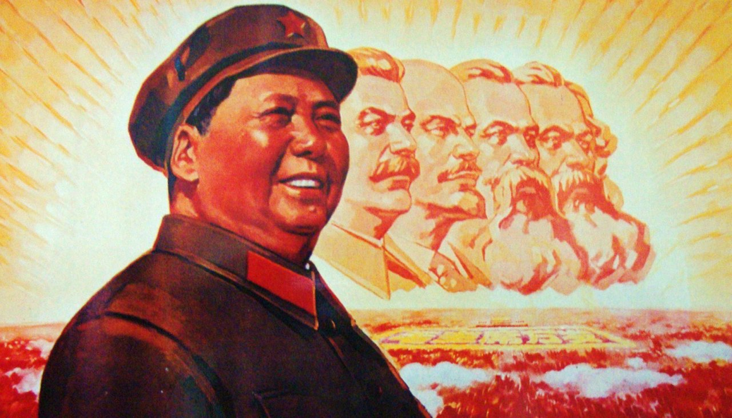
China Goes to the ‘Dark Side’
8.) Symbolism?
Like Russia… Civil War leads to Communist Revolution in 1949
Communist forces, lead by Mao Zedong defeat legitimate Chinese gov’t
Legitimate Chinese Gov’t retreats Taiwan, island off coast of China
Start own nation there called Republic of China
Believe themselves ‘the real China’
Mao takes mainland China making it a Communist state called…
The Peoples’ Republic of China
USSR now has powerful ally in Asia
B/C of major power shift… US is fearful
Want to know what is going on in other nations
USA creates CIA, Central Intelligence Agency
Covertly gather info on other nations, evaluate it, pass it on to the President for determination of action
7.) Imagery??
Notes:
Mao's Communists Take Over China (1949) (1:55)

Slide 10
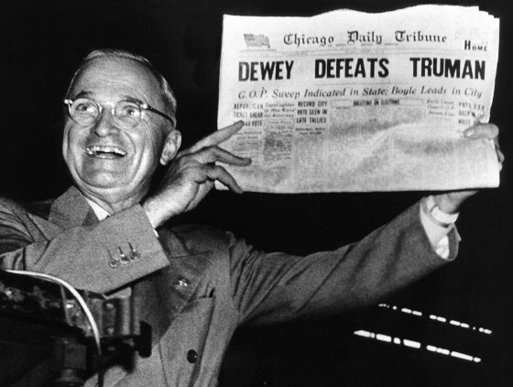
Election 1948
While this is all going on… Truman has to run for re-election as Dem. Candidate
Not Popular b/c of economic issues, but…
Popular b/c of his foreign policies and strength
Truman blames Congress for problems in USA
Thomas Dewey- Republican candidate
Seen as Front-Runner
Everyone believes will win easily
Newspapers even print headlines
Reality…
Truman Defeats Dewey
First order of business…
Reintroduce The ‘Fair Deal’
Creates and raises Minimum Wage
Expands Social Security
Provides funds for Low-Income Families

Slide 11
Exit Ticket: Analogies
a·nal·o·gy
əˈnaləjē/
noun
a comparison between two things, typically on the basis of their structure and for the purpose of explanation or clarification.
"an analogy between the workings of nature and those of human societies"
9.) Analogy??
Fill in the blank…
The ___________ is to World War II as The Treaty of Versailles is to World War I.

Slide 12
Digital Poster Board Project
10.) Topic!!
6 Weekly Projects
NO homework
Except Project Work
1 In-Class Work Day
Daily Incentive
Broken Up by Decades
1950’s
1960’s
1970’s
1980’s
1990’s
2000’s

