Slide 1
Warm-Up
1.) Warm-Up!!
Describe America’s greatest fear leading into the 1950’s?
Hint:
Spread of a certain governmental / economical ideology
1 Paragraph:
What?
Why?

Slide 2
The Post-War Years: 1945-1959
11-3 “Fear of Communism & the Wars it Leads To”

Slide 3
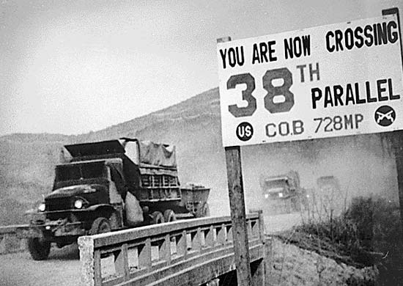
The Korean War
1.) Stop & Jot!!
During WW2-
Korea owned by Japan
Result of war leads to division of Japan’s empire (like Germany)
Allies take Korea
Split @ 38th Parallel
USSR takes north
USA takes south
Adopting Philosophies
Communist ideas leak into North Korea from USSR & China
Trickle-Down Effect
Democratic ideals dominate South
Both sides hate each other b/c of this
1949-
BOTH sides agree to remove military allow Korea to unify themselves
When USSR & USA remove troops…
25 June 1950- Communist North invades Democratic South
Try to reunite nation under communism
Quickly capture Seoul (capital of Dem. South)
US President Truman believes all a ploy by USSR
w/o Congress- Truman orders US troops to Korea
Necessary for containment of Communism (Truman Doctrine)
UN agrees & supplies some troops to assist

Slide 4
The Korean War
3.) Define & Draw!!
Goal of War…
Push North Koreans back into North
Free South for Democracy
Goal met by 1 October 1950
Based on quick success…
MacArthur sees this as opportunity to take all of Korea from Communists
Truman and UN give him the ‘GREEN’ light
19 October 1950-
MacArthur captures Pyongyang (N. Korean Capital)
China warns US & UN to don’t do that again or else…
Oooooh! We’re shaking in our army-boots!!!
Truman believes they are bluffing
Tells Mac to keep it up!
26 November 1950-
Communist China not bluffing…
Sends troops to North Korea
w/ China’s help…
North forces US & UN troops back and recaptures South Korean capital w/I just few weeks!
Anyone else getting sea-sick?!?!?
By January-
UN & US stop retreat and push back and recapture Seoul (again!)
Becomes a stalemate @ 38th Parallel
Notes:
The Korean War: Every Day (2:01)

Slide 5
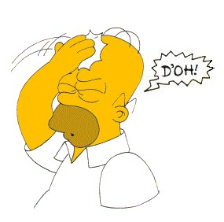
Ending the Conflict
4.) Stop & Jot!!
Stalemate will continue for 2 more years!!!
During that time…
MacArthur says ‘poop or get off the pot!’ to Truman
Either invade China or bomb troops stationed in North
MacArthur tattles on Truman dragging his feet
Tells Congress Truman is reason we are stuck
Keeping me from doing my job
Truman fires him b/c he is undermining Presidency
US people get mad at Truman!!!
MacArthur seen as hero
Supported him over the President
July 1951- negotiations begin
Talks & Fighting will continue until armistice signed
After 3 years of WAR…
54,000 American deaths
103,000 Americans wounded
2,000,000+ Korean & Chinese killed!!!
We are right back to where we started!!!
N & S Korea are the same now as in 1949!!!
Same gov’ts
Same boundaries
38th Parallel
Only difference…
Creation of Demilitarized Zone (DMZ)
Region b/t North and South where no military can enter
2.5 miles wide
Despite name…
Most heavily militarized border in the world!!!
Notes:
Dmz NOW (2:41)

Slide 6
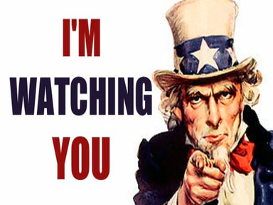
The ‘Red Scare’
5.) Define & Draw!!
Much like 1920’s… Red Scare is
Fear of spread of Communism
Feared ‘REDS’ were guilty of spying & subversion
Communist sabotage
‘REDS’ had penetrated US society & gov’t
Example- USSR had developed own atomic bomb technology
Only logical answer…
RED spies had stolen info
Therefore; RED spies in America
Leads to hunt for ‘REDS’ w/in American society
NO ONE safe from accusations…
Even US President accused of being ‘soft’!!!

Slide 7
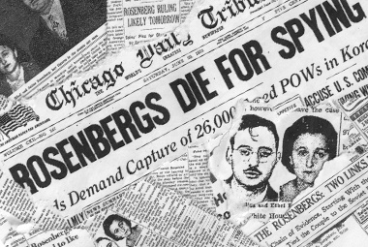
Investigations
6.) Reflect!!
Businesses, colleges, & local gov’ts began to take action
Require members taking oaths of loyalty
Refusal means U must B a Communist!!!
1947- Congress starts House Un-American Activities Committee (HUAC)
Hunt for Communists and Communist sympathizers
Arrests made, hearings held, hysteria created!!
1950- Congress creates McCarran Act
Communist orgs. in US must register w/ US gov’t and give list of members
Truman vetos
Says attacks 1st Amendment
“Ina a free country, we punish men fro crimes they commit, but never for the opinions they hold.”
Congress overrides Veto
Blacklists Created
Lists of individuals whose loyalty was suspicious
Banned them from getting or keeping jobs
NO evidence mind you!!!
Spies Reveled
Most famous…
Julius & Ethel Rosenberg
Members of Communist Party
Accused of plotting to provide atomic bomb info to USSR
Sentenced to death for Treason
Judge calls their actions “worse than murder”
19 June 1953-
Executed via electric chair
Notes:
Rosenberg's Trial (2:51)

Slide 8
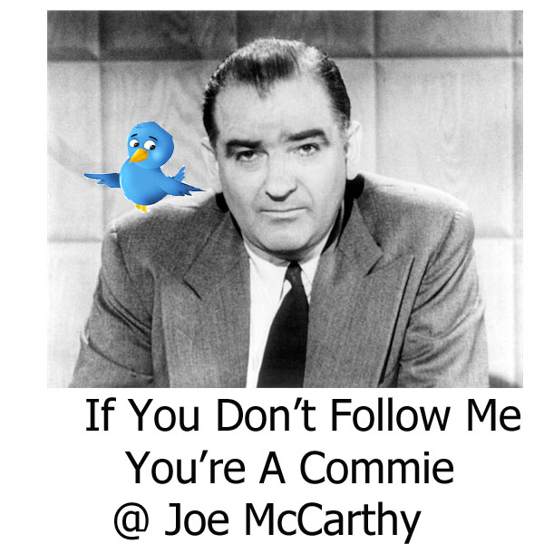
McCarthyism
7.) Create Analogy!!
1950-1954
Hunt 4 Communists lead by Senator Joseph McCarthy of Wisconsin
Comes to power overnight
In speech says, has a list of 205 State Dept. employees that were Communists!
Publically attacked and accused w/o proof!!!
Many resigned or were fired w/o proof
Anyone who opposed him… obviously a Communist!
Only a ‘RED’ would not want to cooperate
Rep. Party uses this to attack Dems. saying soft
Need to be replaced by Strong Anti- Communist Repubs!
McCarthy goes so far a publically accusing high ranking & extremely well respected military officials!!!
Holds televised hearings
Hearings drag on for weeks
People able to see how crazy, cruel , and unjustified his attacks were
Appears as a cruel bully, trying to smear the names of his and his party’s enemies
December 1954-
McCarthy is censured
Must publically admit that he was wrong
Seen more a s a symbol for embarrassment
Loses all public support
Never re-elected
Hysteria dies back down, just as before!
Notes:
McCarthyism Digital Story (4:38)

Slide 9
Exit Ticket: Analogies
a·nal·o·gy
əˈnaləjē/
noun
a comparison between two things, typically on the basis of their structure and for the purpose of explanation or clarification.
"an analogy between the workings of nature and those of human societies"
8.) Analogy??
Fill in the blank…
During the Cold War, the United States is to the Soviet Union, as __________ is to Bradley Middle School.

