Slide 1
Warm-Up
Using the analogy you wrote at the end of 11-3… Write a description of the analogy outlining the relationship displayed.
1 Paragraph:
Relationship
a·nal·o·gy
əˈnaləjē/
noun
a comparison between two things, typically on the basis of their structure and for the purpose of explanation or clarification.
"an analogy between the workings of nature and those of human societies"
1.) Warm-Up!!

Slide 2
The Post-War Years: 1945-1959
11-3: The 50’s at Home

Slide 3
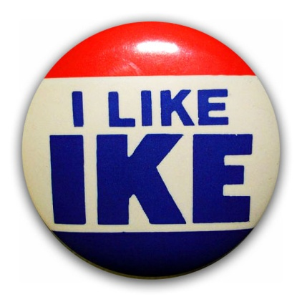
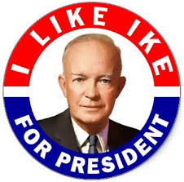
Republicans Take Back White House
Election of 1952
The Candidates
Both sides wanted war hero Dwight D Eisenhower
Not registered w/ either party
Chooses Republicans
Liked idea of smaller gov’t
Richard M. Nixon running–mate
After being DE-NIED…
Dems choose Ill. Gov. Adlai Stevenson
Landslide Victory
First Repub President in 24 yrs!!!
Eisenhower wins easily!!!
Guy won WW2 for goodness sake!!!
Despite not being politician… becomes a great one!
He’s a Moderate
Conservative in regards to $$$
Cut wasteful gov’t spending, while increasing social programs for people
When leaves office in 1961- US Gov’t actually in surplus 300+ million!!!
Social Programs
Liberal in Terms of People
Refuses to cut $$ for social aid to people
Expands Social Security
Provides Unemployment Insurance
Increases Funding for Public Housing
Increases Minimum Wage
Creates Dept. of Health, Education, and Welfare
Names Oveta Culp Hobby as Secretary
1st Female Cabinet Member Ever!!
2.) Define!!
Notes:
Dwight Eisenhower Presidential Campaign Ad "IKE FOR PRESIDENT“ (1:00)

Slide 4
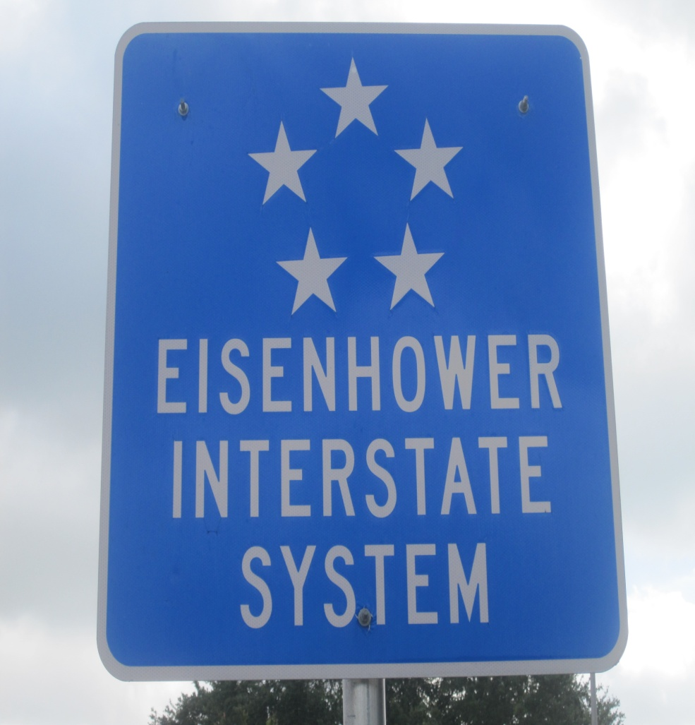
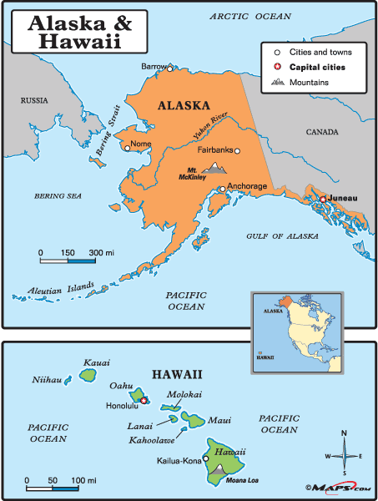
Bring the Nation Closer; While Making It Bigger!?!
Nation Expands
Federal Highway Act
June 1956 passes this into law
40,000 miles of interstate highways built
Connects the nation
US becomes a “National Community”
Largest public works project in history
Spurred economy
Everything having to do w/ highways
Cars, motels, gas stations, service stations, etc.
Alaska & Hawaii
1959 Both enter Union
Brings total to 50 US States
3.) Idiom!!
Notes:
Newsreel Alaska Becomes State (1:00)
Newsreel Hawaii Becomes State (:54)

Slide 5
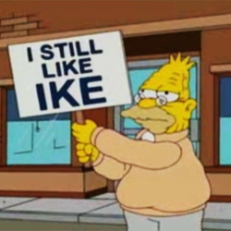
I Still Like Ike
Election of 1956
Ike’s Moderation and Leadership lead to even bigger win in re-elect!
Not bad for a guy who wasn’t even a politician!!!

Slide 6
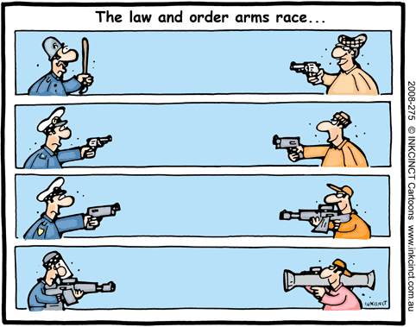
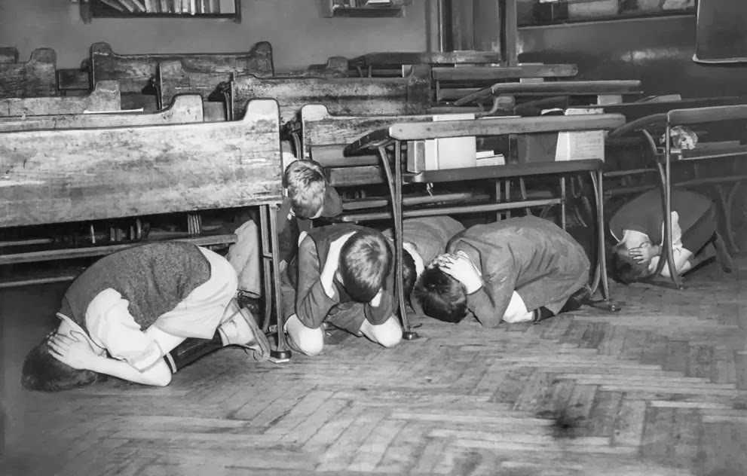
Ike & the Cold War
USA vs. USSR
This WAS US Foreign Policy!!!
All foreign affairs dealt w/ Cold War actions
Sec. of State- John Foster Dulles
Hates Truman’s Containment idea
Proposes massive shift
Instead of trying to put out a 1,000 little fires 1 at a time…
Destroy Source!!!
Any Communist action seen as threat will result in nuclear retaliation by US
Reliance on nukes means
Lessen amount of actual soldiers, reduce defense spending on soldiers
Nukes mean “more BANG for you Buck!”
The ‘ARMS’ Race
Competition b/t US & USSR to make bigger, better, and BADDER!!!
Idea is save $ by not needing as many soldiers, but…
In reality spending more to develop better weapons and bombs
Examples-
H-Bomb- Hydrogen Bomb-
same idea as A-Bombs, but 1000x more devastating
IRBM’s- Intermediate Range Ballistic Missile-
hit targets up to 1,500 miles away!
ICBM’s- Intercontinental Ballistic Missile-
hit targets anywhere in world!
Fear of Nuclear Fallout
Civil Defense Admin-
educates public about nuclear fallout
People build bomb shelters
Duck & Cover
Schools hold nuclear bomb drills
4.) Explain!!

Slide 7
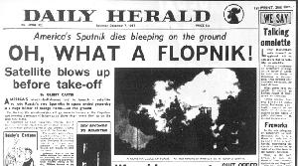
The SPACE Race
4 October 1957
USSR launches world’s 1st satellite
Sputnik
Could be used to spy on USA even drop nukes on us from space!!!
Fear launches US into Space Age
December 1957-
US tries to launch our 1st satellite
Vanguard
Gets only few ft up and…
EXPLODES!!!
w/ world press watching, by the way
US laughing-stock
Press dubs Vanguard
Flop-Nik
Stay-Put-Nik
Prompts US to create National Aeronautic and Space Administration (NASA)
Purpose was to get USA back even w/ Soviets
January 1958-
NASA launches Explorer
1st US satellite in space
Need to take next step to pass USSR
Put man in space
Project Mercury
Encourages teaching science and technology in schools
5.) Meaning??
Notes:
Sputnik, 1st Space Satellite Launched by Soviets (:46)

Slide 8
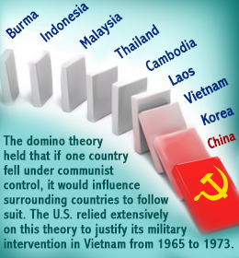
Foreign Policy Issues
Not just USSR…Other problems around world, too
Crisis in Middle East
Israel created as place 4 JEW’s to be safe
Create nation by taking land from Muslims
Muslims mad and attack
Communist Revolt in Hungary
People try to kick out REDS, Communists crush them instead
Communist Revolution in Vietnam
Same situation as Korea started
RED ideas leaking in from China
US sends $$, but not troops
Split country Communist North and Democratic South
See where this is going!?!
Leads to Domino Theory- one nation in region falls to Communism, leads to another, and another, etc.
Pretty soon whole world will be Communist!
Cuba becomes Communist
Fidel Castro leads revolution
Promises democracy, but chooses Communism instead
Now, Communist country 90 miles off coast of USA!!!
Changes in USSR
When Stalin Dies…
Nikita Khrushchev takes over
Calmer head than Stain
Hopes for Peace b/t 2 Nations
Leads to Peace Summit
But…
USSR catches and shoots down USA’s U-2 Spy Plane that was spying on Soviets
Peace Summit Ends next day!!!
6.) Explain!!
Notes:
The Cold War & the Domino Theory (1:12)

Slide 9
Booming Economy
After WW@- experts said US economy would level off or even drop
Why?
Decline in war goods production
In reality…
Economy Increases by Over 250%!!!
Cold War
Arms Race
Space Race
Increase in Social Programs
Housing
Schools
Welfare
Highways
Etc.
Technology Advancements Help Too!
New technology & production methods result in greater productivity
Ability to produce more w/ same amount of workers
Birth of Computer
Early versions were HUGE!!!
Weighed b/t 2,500-4,000 lbs!!!
By 1955- Become leader in new technology
Higher Incomes
Economic BOOM raises standard of living
Measures overall wealth and quality of life
b/t 1945-1960 standard of living literally doubles!
By 1959- USA has highest standard of living in the world!!!

Slide 10
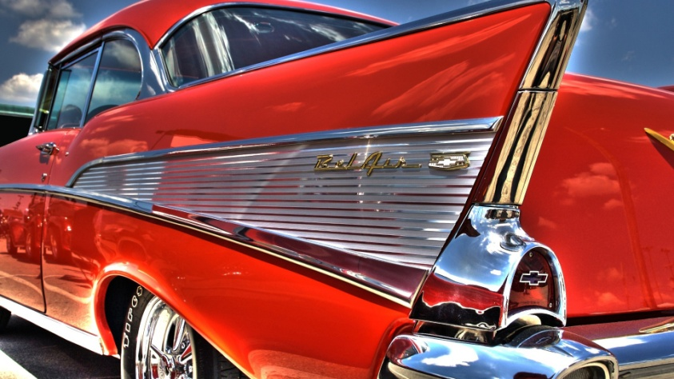
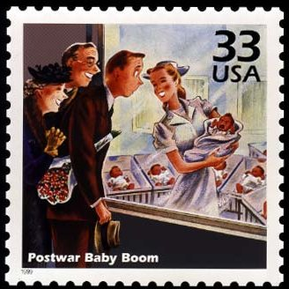
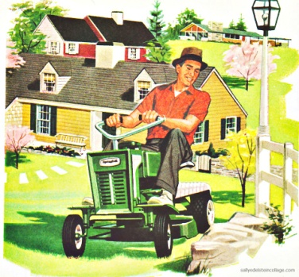
The Baby Boom
The Baby Boom
Like economy… families BOOM too!!!
In 10 yrs. Population increases by 25%!!!
Why??? Before…
People held off during Depression, then…
Husbands off to war
Now…
People have money
Better health care, and medical technology
Housing Boom
Same as Baby Boom, B4 didn’t have $$$
75% of new home construction took place in ‘burbs’
Neighborhoods allow for quicker and easier construction
1,000’s identical homes
Offered affordable options w/o problems of urban life
Crime
Minorities
Car Boom
Cars made suburban life possible
Starts the ‘Car Culture’
Drive-ins
Fast-food
Service stations
HotRods
Etc.
Air Travel Boom
Travel by plane now “taking off!”
Jet-Engines perfected in 50’s
Airliners were on way to overtake railcars, and ocean liners
7.) BOOMS??

Slide 11
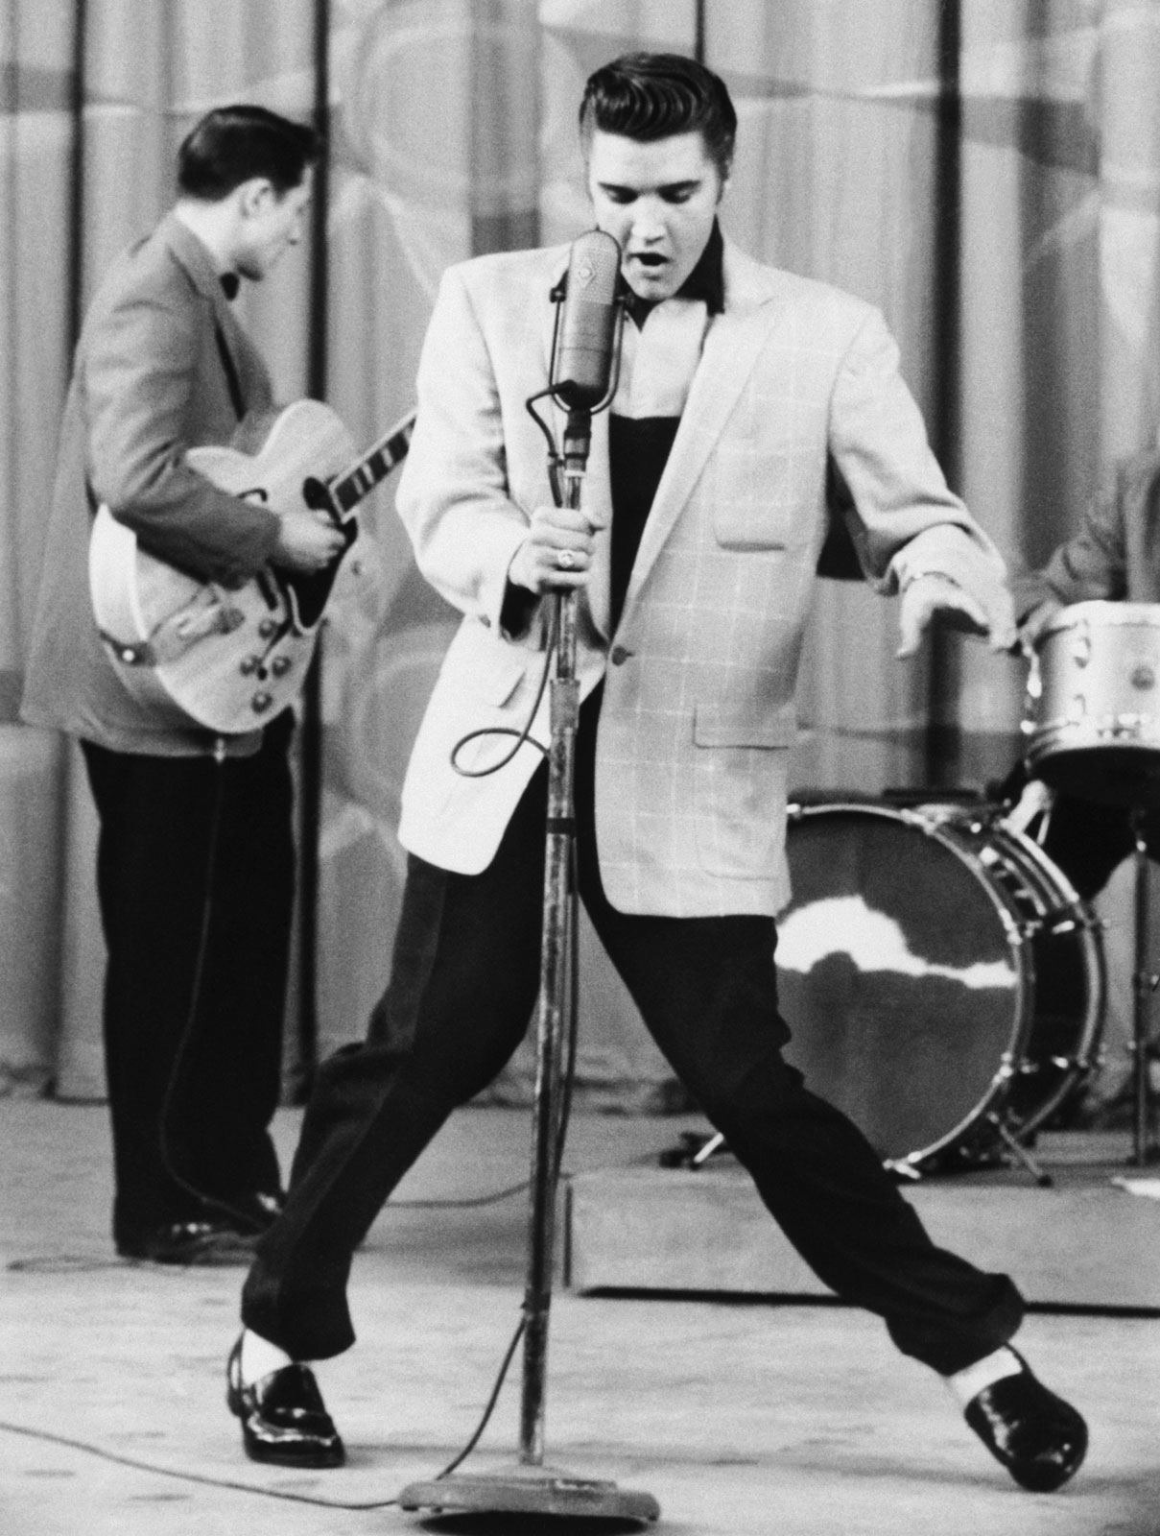
New American Culture
A Consumer Society
1950’s Americans went on spending spree!
Wanted the newest and fanciest products and appliances
Dishwashers, TV’s, Stereos, Washing Machines, & cars
Each company kept trying to outdo the next forcing families to keep upgrading to newer, & better
TV Culture
Programs, Commercials & Billboards set culture
Characters and actors told you what they used…
You had to have it!!!
Everyone watched same programs-
$64,000 Question, Mickey Mouse Club, Howdy Doody, I love Lucy, Leave it to Beaver, Father Knows Best, & American Bandstand
Images depicted perfect white, suburban middle-class families
Soon became expectation of all American homes
Birth of Rock ‘n Roll
Teens begin to reject mellow tones of parents music…
Wanted something that would make you move!!!
Rock ‘n’ Roll mixed early Blues, Doo-Wop, & Jazz
Sped it up and but it to a heavier beat using new electrified instruments
Early stars took influence from black R&B performers
First major hit- “Rock Around the Clock” by Bill Haley & the Comets
Other Stars followed
Little Richard, Chuck Berry, Buddy Holly, Jerry Lee Lewis, &…
Elvis Presley
Generation Gap
Teenagers shared experiences leads to common culture
Different from parents
Different attitudes toward Popular Culture
Leads to “Generation Gap’
8.) G-Gap??
Notes:
Overall 50’s (2:35)
Elvis (2:12)

Slide 12
Exit Ticket: Analogies
9.) Analogy??
a·nal·o·gy
əˈnaləjē/
noun
a comparison between two things, typically on the basis of their structure and for the purpose of explanation or clarification.
"an analogy between the workings of nature and those of human societies"
Fill in the blank…
Elvis Presley is to rock n’ roll of the 1950’s, as __________ is to music of today.

