Slide 1
The 1960’s
11-6: The Civil Rights Era

Slide 2
Warm-up
Separate but equal was a legal doctrine in United States constitutional law that justified and permitted racial segregation, as not being in breach of the Fourteenth Amendment to the United States Constitution which guaranteed equal protection under the law to all citizens, and other federal civil rights laws. Under the doctrine, government was allowed to require that services, facilities, public accommodations, housing, medical care, education, employment, and transportation be separated along racial lines, provided that the quality of each group's public facilities was equal. The phrase was derived from a Louisiana law of 1890, although the law actually used the phrase "equal but separate."^{[1]}
The doctrine was confirmed in the Plessy v. Ferguson decision of 1896, which allowed state-sponsored segregation. Though segregation laws existed before that case, the decision emboldened segregation states during the Jim Crow era, which had commenced in 1876 and replaced the Black Codes, which had restricted the civil rights and civil liberties of African Americans with no pretense of equality during the Reconstruction Era. 17 states had various institutionalized separation laws.
The doctrine was overturned by a series of Supreme Court decisions starting with Brown v. Board of Education in 1954. However, the overturning of legal separation laws in the United States was a long process that lasted through much of the 1950s, 1960s and 1970s involving many court cases and federal legislation.
Read the above statement…
In a concise, well-written paragraph… explain what you believe to be the Main Idea
1.) Warm-Up!!

Slide 3
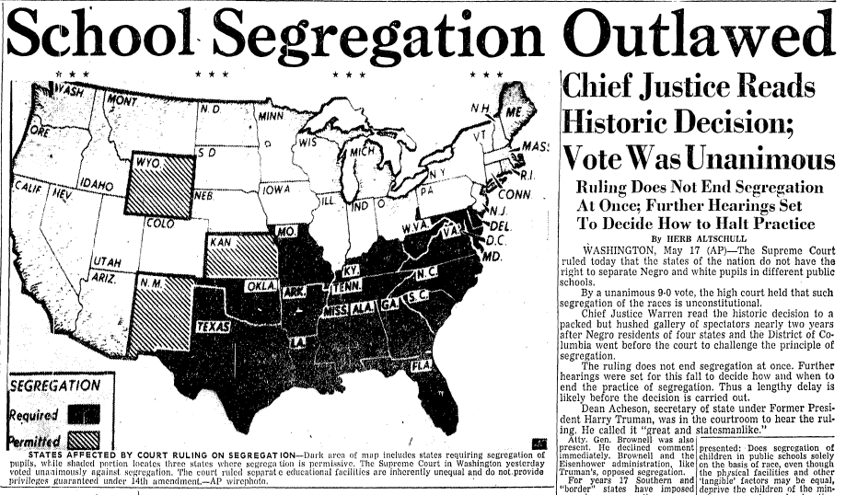
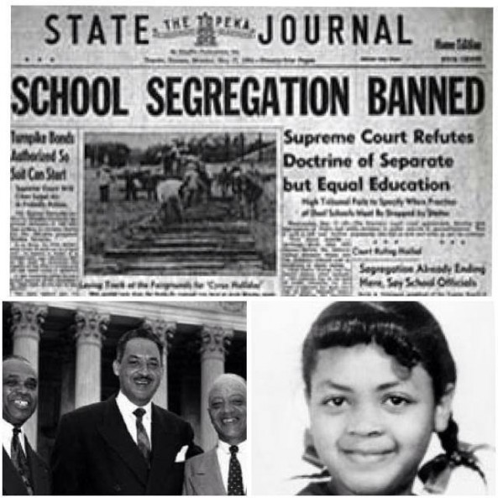
Starting a Movement
Segregation Continues
Since reconstruction…
Life was separated along racial lines
1896- Plessy v. Ferguson
US Supreme Court said “separate, but equal” is legal
Grounds for segregation
Problem is… it’s anything but equal!!!
Brown v. Board of Education
Bkgd- black girl lives next door to white school
Not allowed to attend b/c she’s AA
Family sues BOE for her right to attend
Makes it all the way to US Supreme Court
NAACP Lawyer- Thurgood Marshall Pushes issue
Ruling- segregation is unconstitutional w/I school setting
Leads to…
Integration
Mixing of races in all public school settings as fast as possible
Some do this right away
Some (esp in South) refuse to do this until forced to
2.) 5 Video Facts!!
Notes:
Brown v. BOE (5:00)

Slide 4
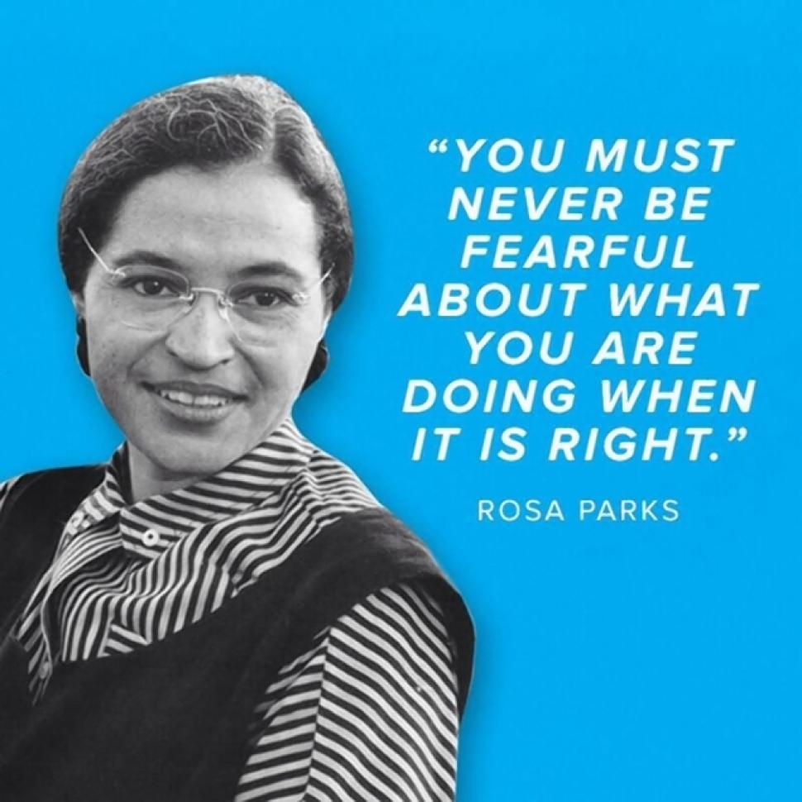
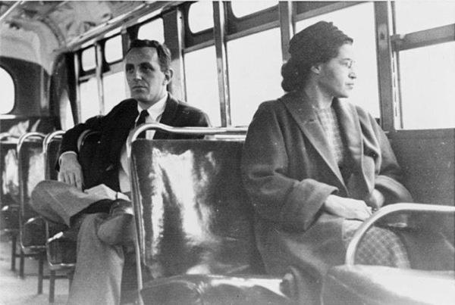
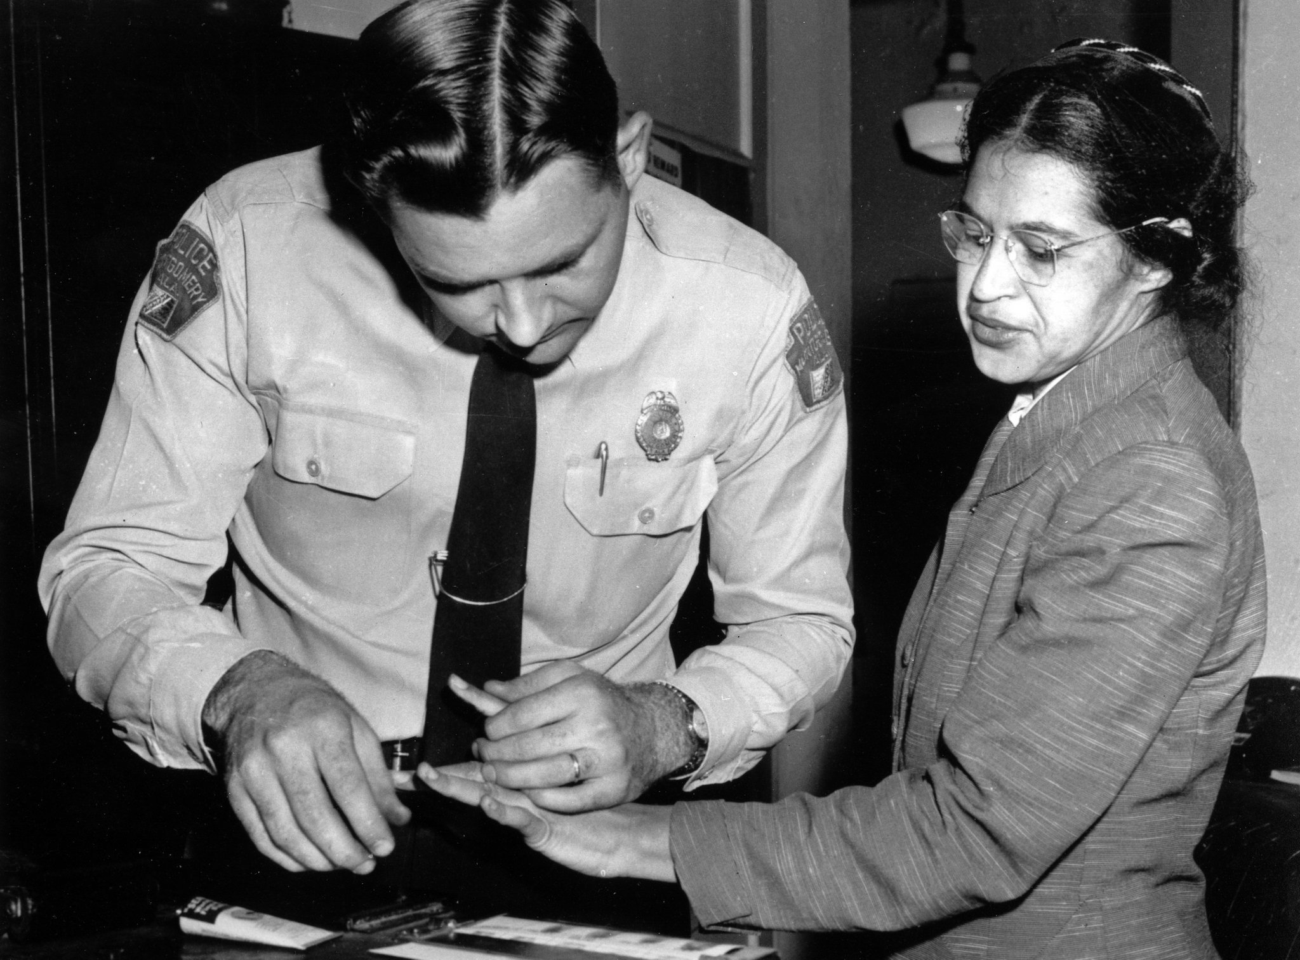
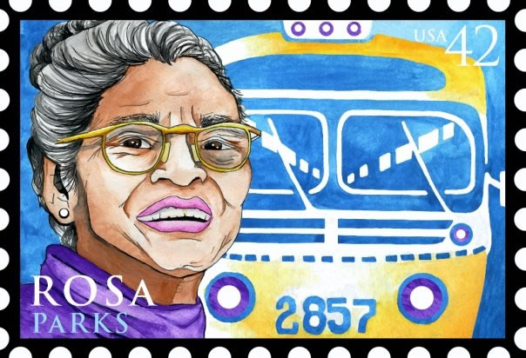
Movement Continues
Little Rock 9
Central high school In little rock, Arkansas
Refused to integrate students… judge orders it
Arkansas Gov. Orval Faubus sends troops to stop A.A’s from entering the school.
1st time since civil war the south has disobeyed the federal gov’t
Eisenhower won’t stand for this and sends 100’s of soldiers to patrol the school and to allow them to safely enter.
The students become known as the little rock nine
Montgomery Bus Boycott
Due to segregation A.A’s were forced to sit in the back of the bus, while whites sat in the front.
1 December, 1955
Rosa parks enters the bus
Finds a seat in the white section and sits
Bus driver asks her to move so whites can sit…
She refused… at the next stop she was removed and arrested
This all could have ended there… but it didn’t…
AA’s take this as symbol and organize a boycott of all public transportation
75% of all riders were AA’s so they clearly have upper hand!!!
December 1956- Bus segregation declared unconstitutional
Non-Violent Bus Boycott is a success!
Nonviolent Protest
During bus boycott in Montgomery, new leader emerges
Martin Luther king jr.
Strongly influenced by Gandhi’s ideas of non-violent protests
Allows them to keep upper hand w/ moral high ground
Preaches idea of Civil disobedience
Refusal to obey laws they felt unjust
January 1957
Southern Christian Leadership Conference (SCLC) is started
Organizes peaceful protests
Trains AA’s for the violence that will be directed at them in response
3.) Stop & Jot!!
Notes:
Little Rock 9 (3:41)
Rosa Parks Mini-Bio (4:40)

Slide 5
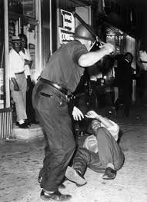
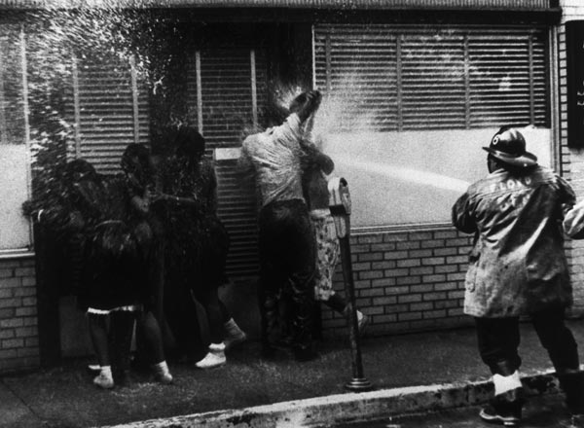
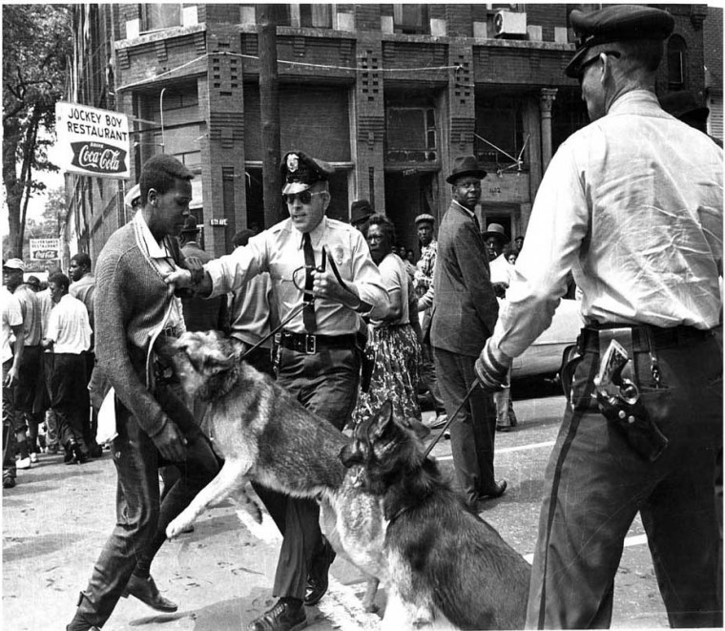
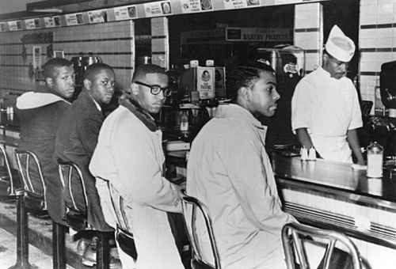
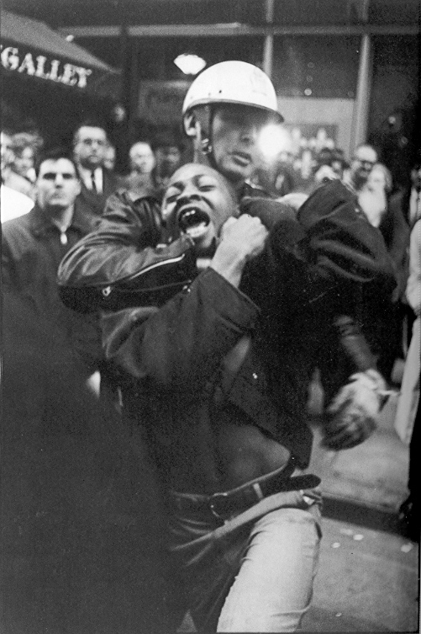
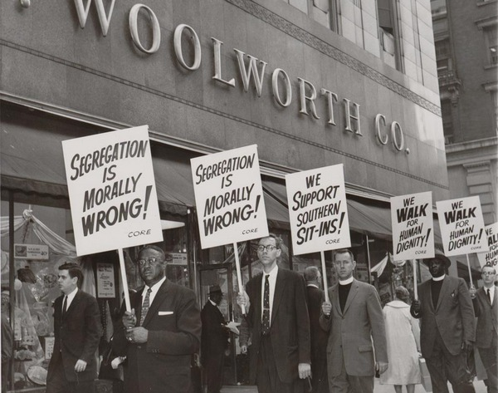
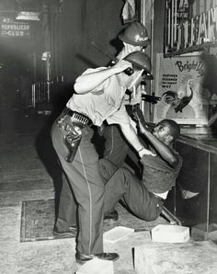
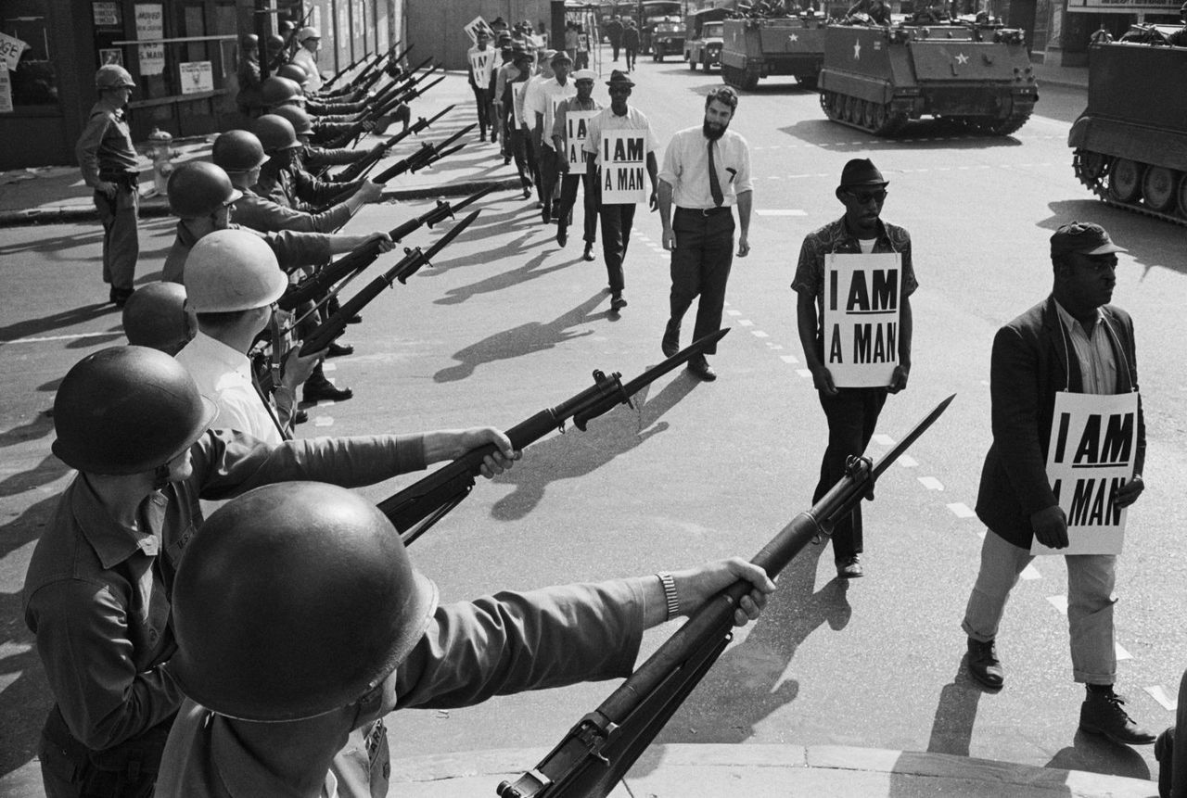
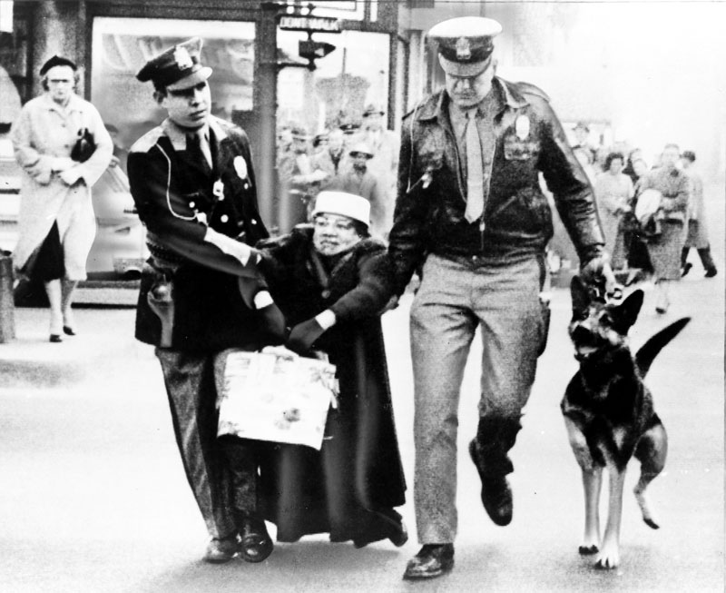
Movement grows
Greensboro Sit-In
1 February 1960
Only 1 hr from here!
4 aa’s sit down at a “whites only” lunch counter
Refused service but sat there until the store closed
Making a point about equality
By week’s end hundreds joined the nonviolent protest by simply sitting
Whites verbally assaulted and dumped food on them
This spread to nearly 80 cities!!!
Started by college and high school students…
spurred the creation of the Student nonviolent coordinating committee (sncc)
Freedom Riders
Remember… The bus boycotts led to segregation on busses being banned…
A group called the congress of racial equality (Core) decides to test this out
4 May 1961
A group of aa’s and whites ride busses from d.c. to new Orleans
All went smooth until they reached the south…
In Alabama the riders were stoned and beat.
Attorney general Robert f. Kennedy (rfk) said to stop the rides so things can “cool down”
Core is not happy…
AA’S HAVE BEEN “COOLING OFF FOR 350 YEARS!”
Violence & Arrests
Despite RFK’s warnings the riders con’t their protests
In the south Police began arresting aa’s for using white facilities
TO CALM THINGS DOWN THE FEDS MAKE SEGRATION ON INTERSTATE TRANSPORT AND BUS STATIONS ILLEGIAL
4.) Define!!
Notes:
Woolworth Lunch Counter (6:11)

Slide 6
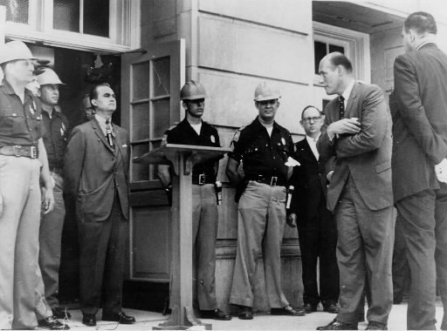
By Force if necessary
University of Mississippi (1962)
Federal court orders Mississippi to integrate its 1st aa college student
James Meredith- AA Man just wants to attend university
Gov. Barnett and the police stop him
Feds send troops and riots erupt… guns, rocks, tear gas, nightsticks…
2 killed !!!
Meredith allowed to attend but troops need to protect him until he graduates.
University of Alabama (June 1963)
Gov. George Wallace vows “I will stand in the schoolhouse door” to stop integration
Yet again…
Feds send troops… Wallace backs down and aa’s allowed to attend
Birmingham, Alabama (Spring 1963)
Mlk targets Birmingham for next desegregation protests.
100’s arrested… including king
As expected….Protests turn violent towards to aa protestors
All caught on t.v cameras…
Police dogs attacking peaceful protests
Fire hoses used to knock protestors down
Yes, you got it… feds send in the troops… 3000 of them…
Then the NAACP field secretary murdered…
Forces JFK. TO MAKE A CALL
Declares all Americans must be served in all public places and no discrimination in jobs
Notes:
Innocent Forrest Gump (1:49)

Slide 7
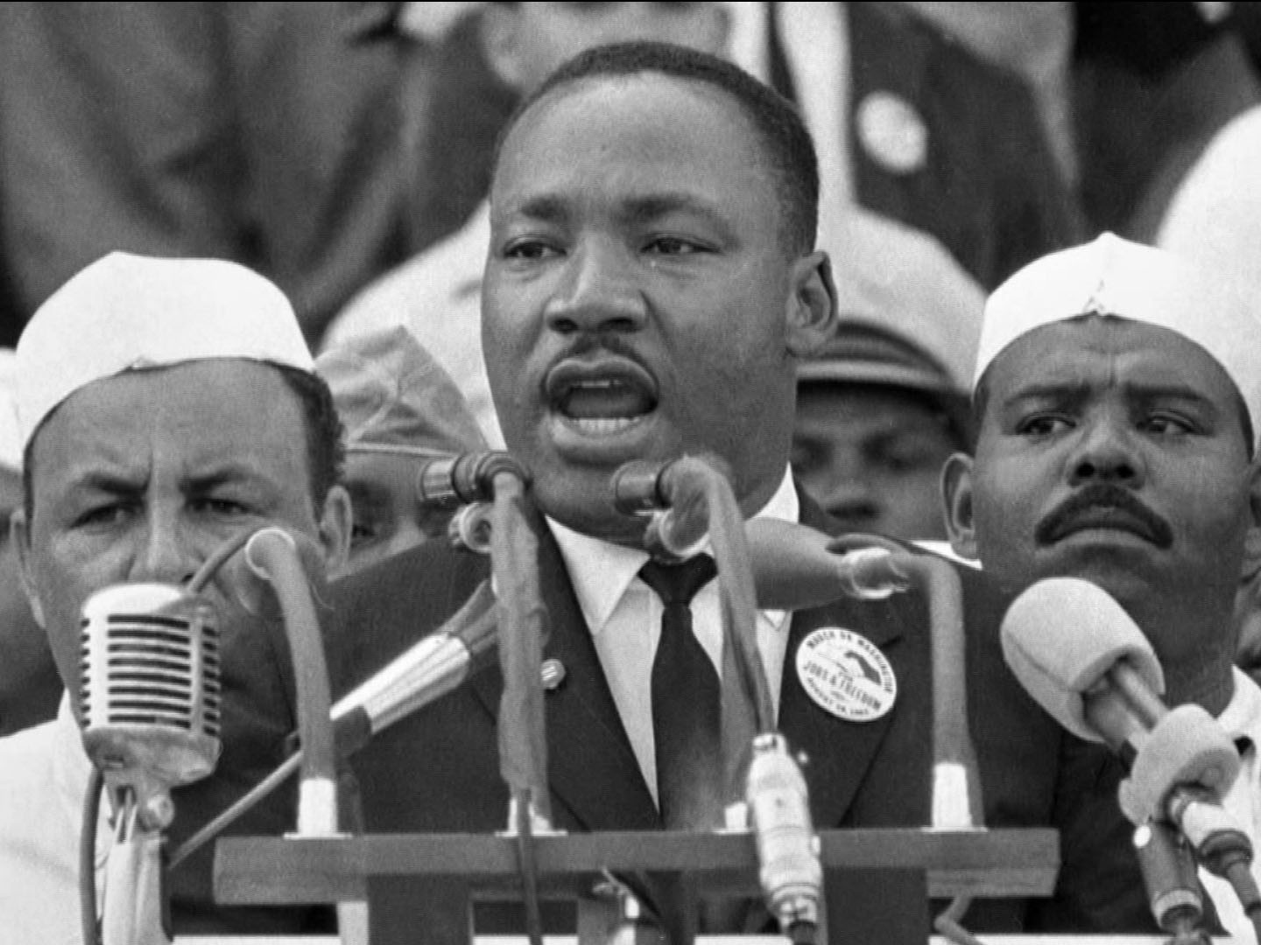
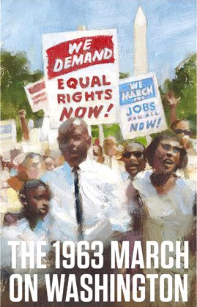
We Shall Overcome…
28 August 1963
March on Washington
Mlk plans huge march in d.c.
200,000 people show up!!!
All Races, creeds, colors, Religions
Provided sense of hope for people
6,000 cops there to keep order but remember…
This is nonviolent protest
Held signs, sang songs, asked congress for equality
It IS HERE KING GIVES HIS FAMOUS “I HAVE A DREAM” SPEECH
5.) R We There Yet???
Notes:
History Specials: King Leads the March on Washington (3:21)
Bet You Didn't Know: March on Washington (2:33)

Slide 8
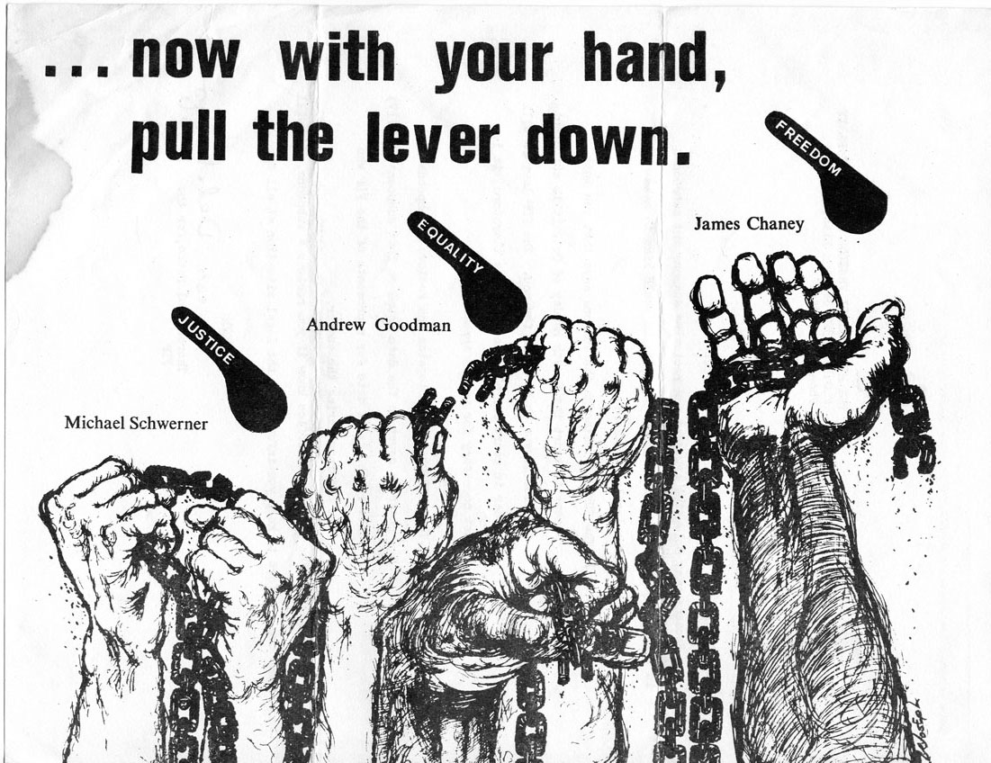
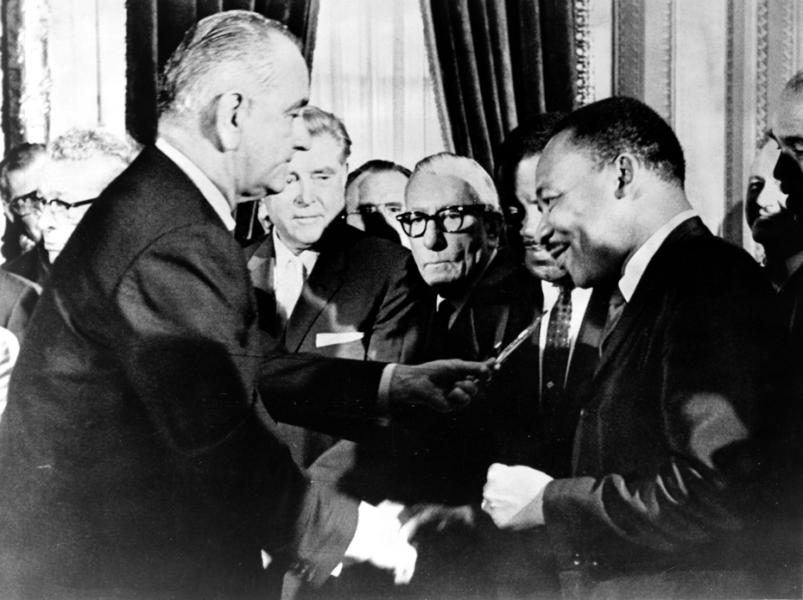
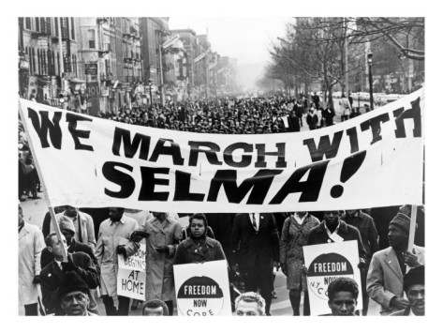
Civil Rights Legislation
Civil Rights Act
PROPOSED BY JFK BUT NOT PASSED BY CONGRESS WHILE JFK IS ALIVE
Lyndon b. Johnson finally gets it passed
States that all discrimination in hiring, stores, hotels, restaurants, etc… illegal…
Yay! Progress!
But…
Many a.a’s still cannot vote in the south
Selma, Alabama (1965)
Major demonstration to protest lack of voting rights
Police attack PEACEFUL protestors!!!
Underlines problem
15 March 1965- Lyndon Johnson steps in
Televised speech calls for Voting rights bill to guarantee rights for all citizens regardless of skin tone
August 1965- President Johnson signs “Voting Rights Act” into law
Federal gov’t can force local authorities to allow AA’s the right to vote
Huge impact
1966- 100 AA’s in office in during south
1972- 1,000 aa’s!!!
10x in only 6 years!!!
6.) Main Idea!!

Slide 9
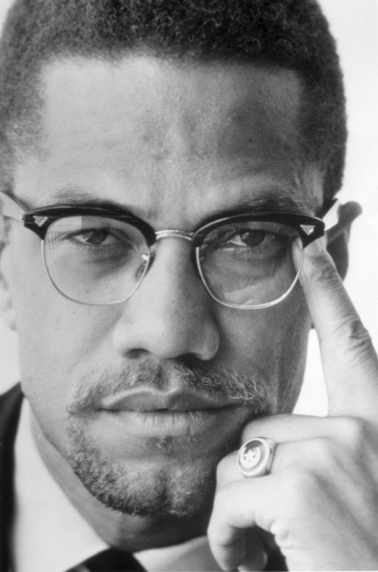
Violence the answer?!?
1960’s Civil Rts. Had many victories… but slow
People grew tired of waiting
Malcolm X
Leader of nation of Islam (black Muslims)
Was the militant side to MLK’s peaceful methods
Important new voice
Criticized civil rts goal
What???
Best way to achieve justice was to completely separate
Becomes 1st step to more radical approach
Later assassinated
Black Power
Some took Malcolm x’s words and took them much further
Said blacks should create entirely new culture and society… have nothing to do with the white man
Idea rejected by NAACP- work to become equal members of current society
2nd step to more radical approach
Black Panther Party
Oakland, ca started by radicals tired…
Of waiting
Of abuse
of mistreatment
Take young, angry- arm them and say whites are cause of problems
If want freedom and equality… take it… by force!
Lead to rioting in urban neighborhoods
Watts Riots (summer of 1965)
Neighborhood of Los Angeles, CA
Last over a week
34 people die, while most of watts burned to ground
1st of many
b/t ‘65-’67 more than 40 major cities dealt with the riots, looting, and burning
7.) Main Idea!!

Slide 10
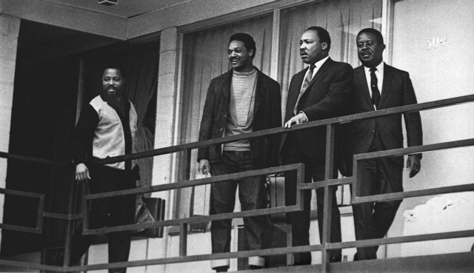
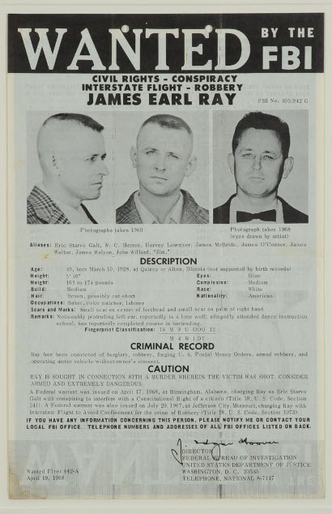
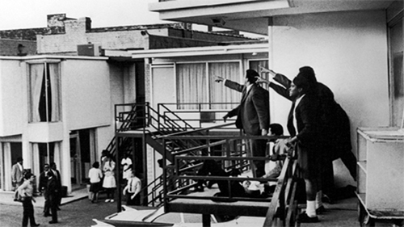
Hero has fallen
4 April 1968
Racial tension gets worse
Memphis, TN
Dr. Martin Luther king jr. assassinated!!!
Assassin- James Earl Ray
Death sets off riots in 100+ cities!!
Irony ? !?
1,000’s attend funeral, millions watch on TV
Night b4 death says…
“God has allowed me to go up to the mountain, and I’ve seen the promised land. I may not get there with you. But I want you to know tonight, that we, as a people, will get to the promised land!”
8.) Irony??
Notes:
Crimes of the century: MLK assassination (5:59)

Slide 11
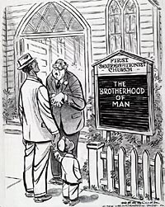
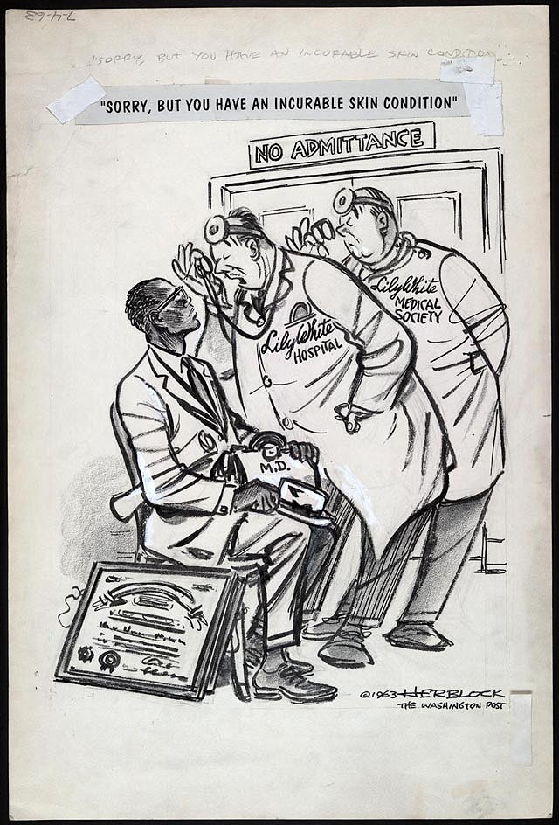
Exit Ticket
main idea
Noun
1.the most important or central
thought of a paragraph or larger section of text, which tells the reader what the
text is about:
Find the main idea in each paragraph.
Choose from 1 of the two political cartoons that will appear.
In a concise, well-written paragraph explain the main idea and meaning of the cartoon.

