Slide 1
the 1960’s
11-7: From Camelot to the Tall Texan

Slide 2
Warm Up
1) Main Idea!
Think back to the “I have a dream speech”…
What is the main point of this speech?
Notes:
I have a dream speech snippet (5 mins)

Slide 3
Kennedy and Camelot
2) Kennedy provided what?

Slide 4
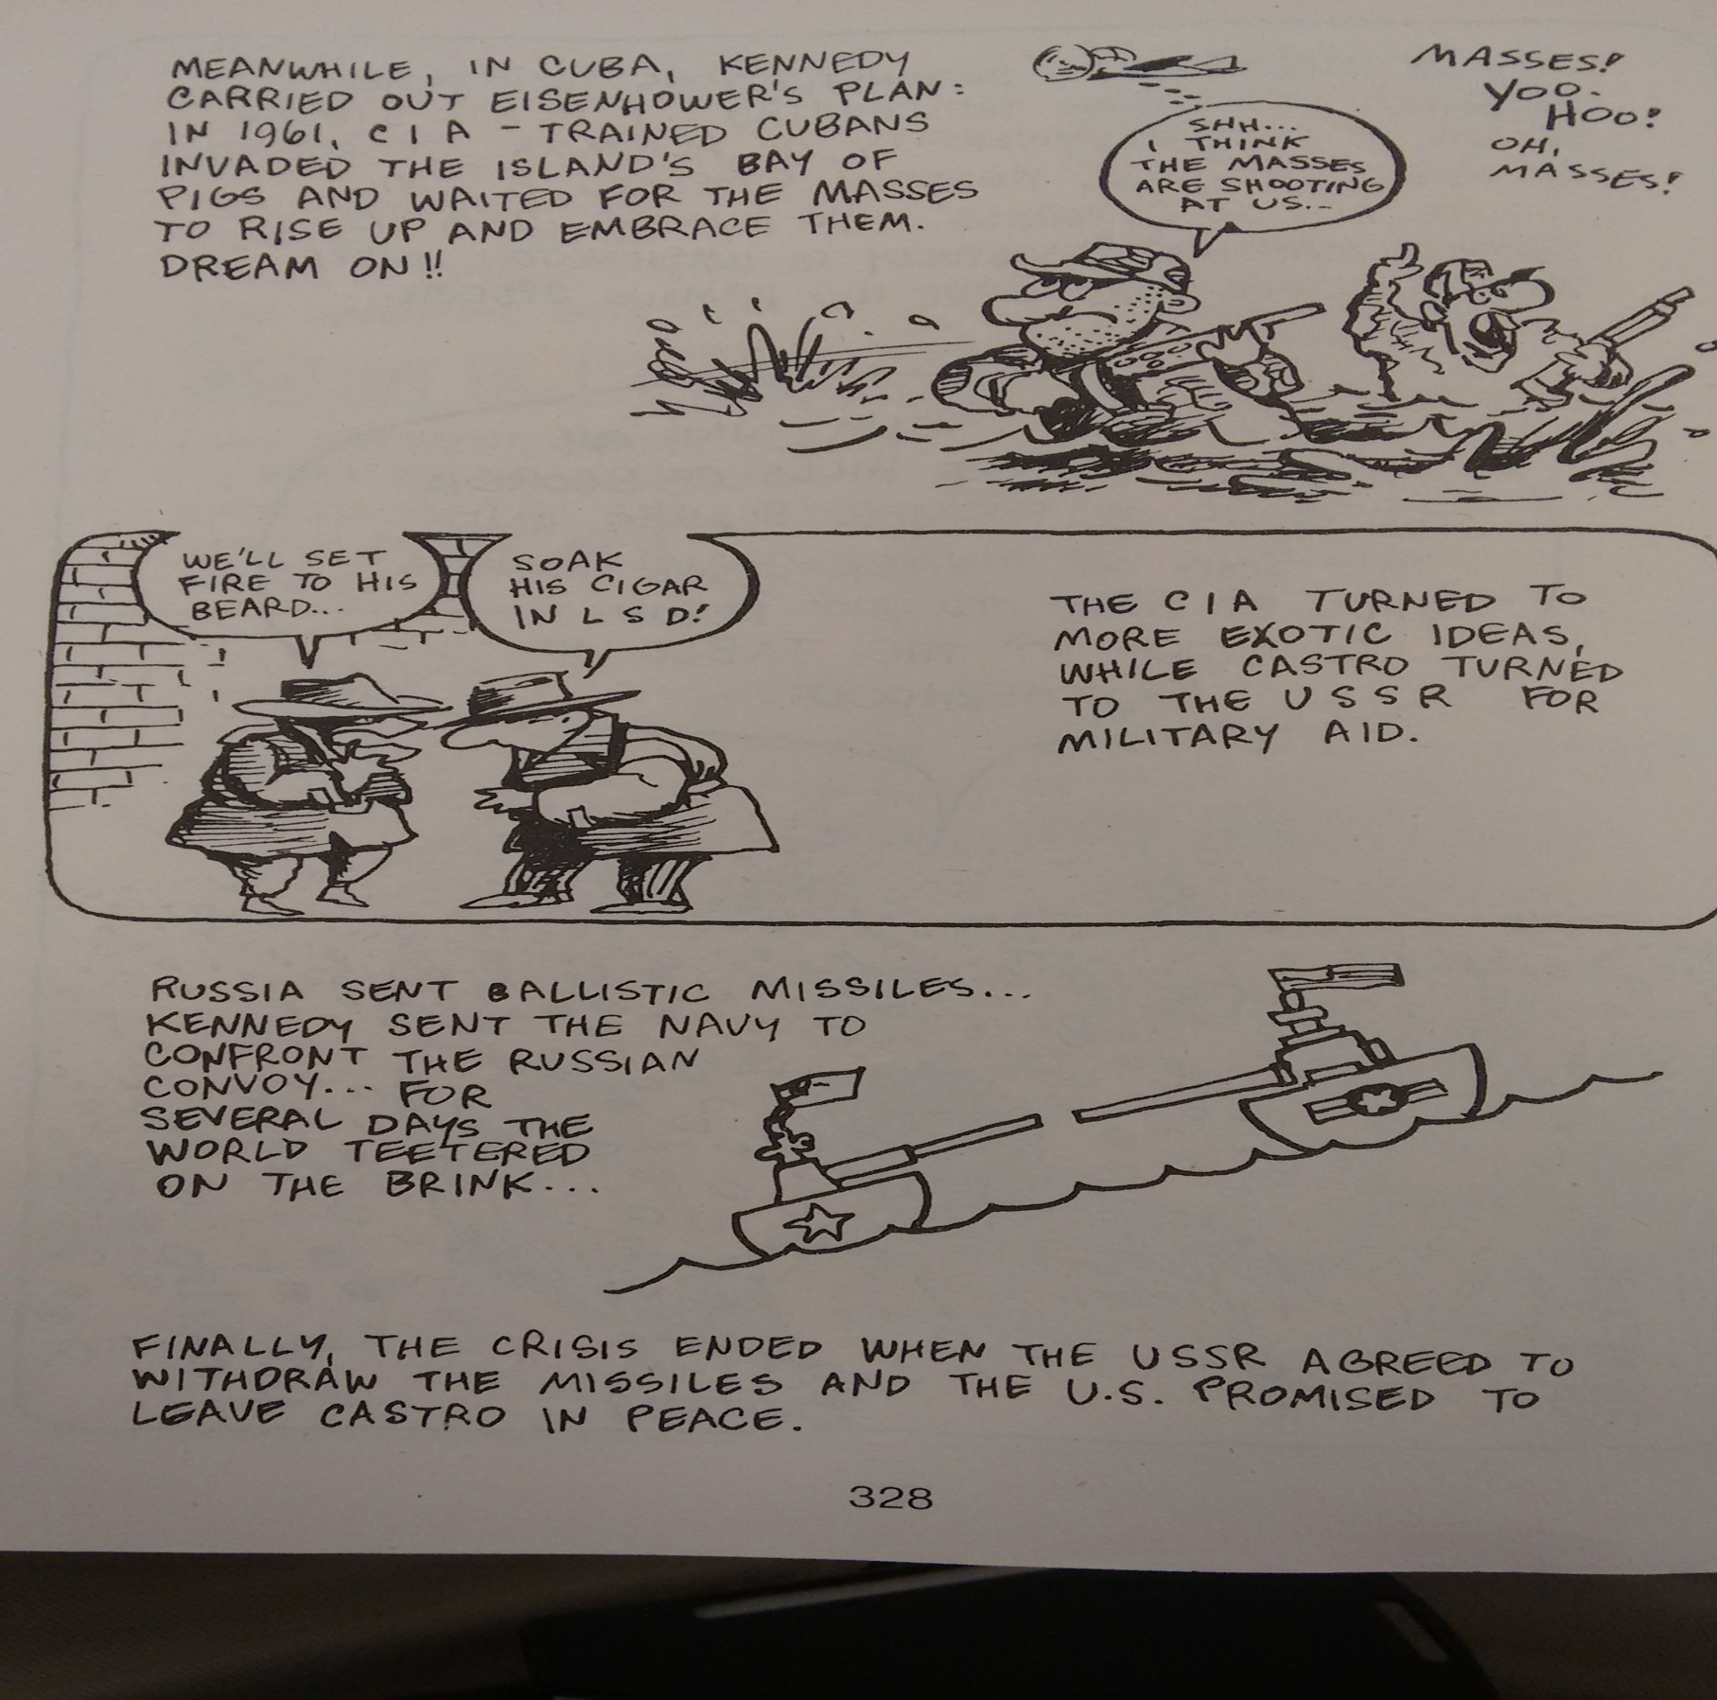
A Crisis in Cuba
3) Relations with Cuba? Reflect…
Notes:
Cuban Missile Crisis in 5 minutes: 6.15

Slide 5
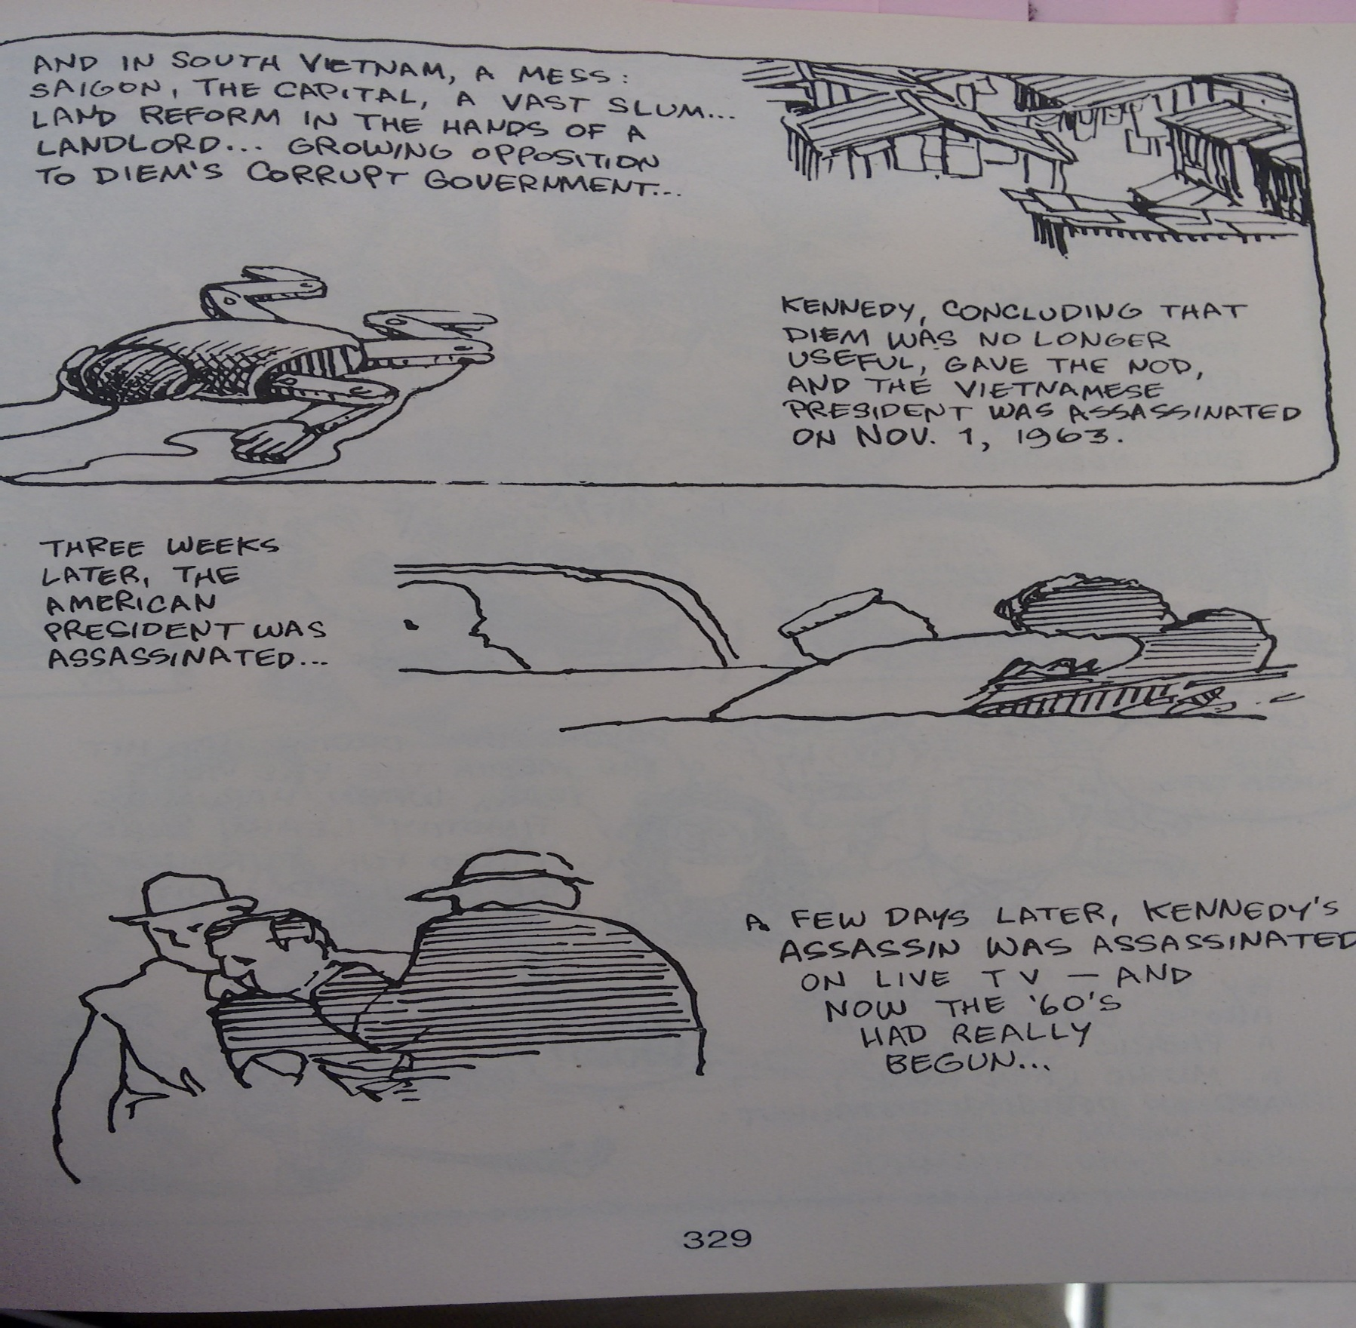
Camelot has Fallen
4) JFK… killed… Your feelings as an American?
5) Video Facts!
Notes:
Zapruder Film (0:45)- on the #4 Star
JFK Assassination in Five (1963): 4:35 on the #5 star

Slide 6
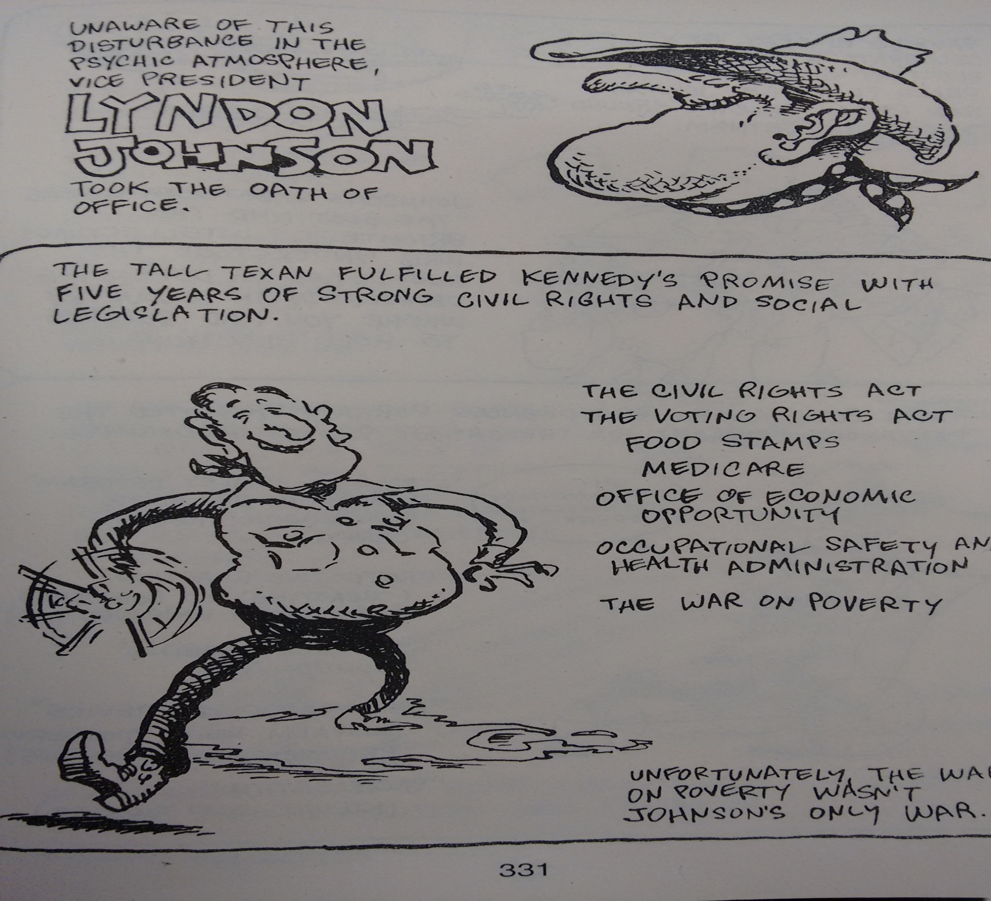
The Tall Texan
6) Predictions?

Slide 7
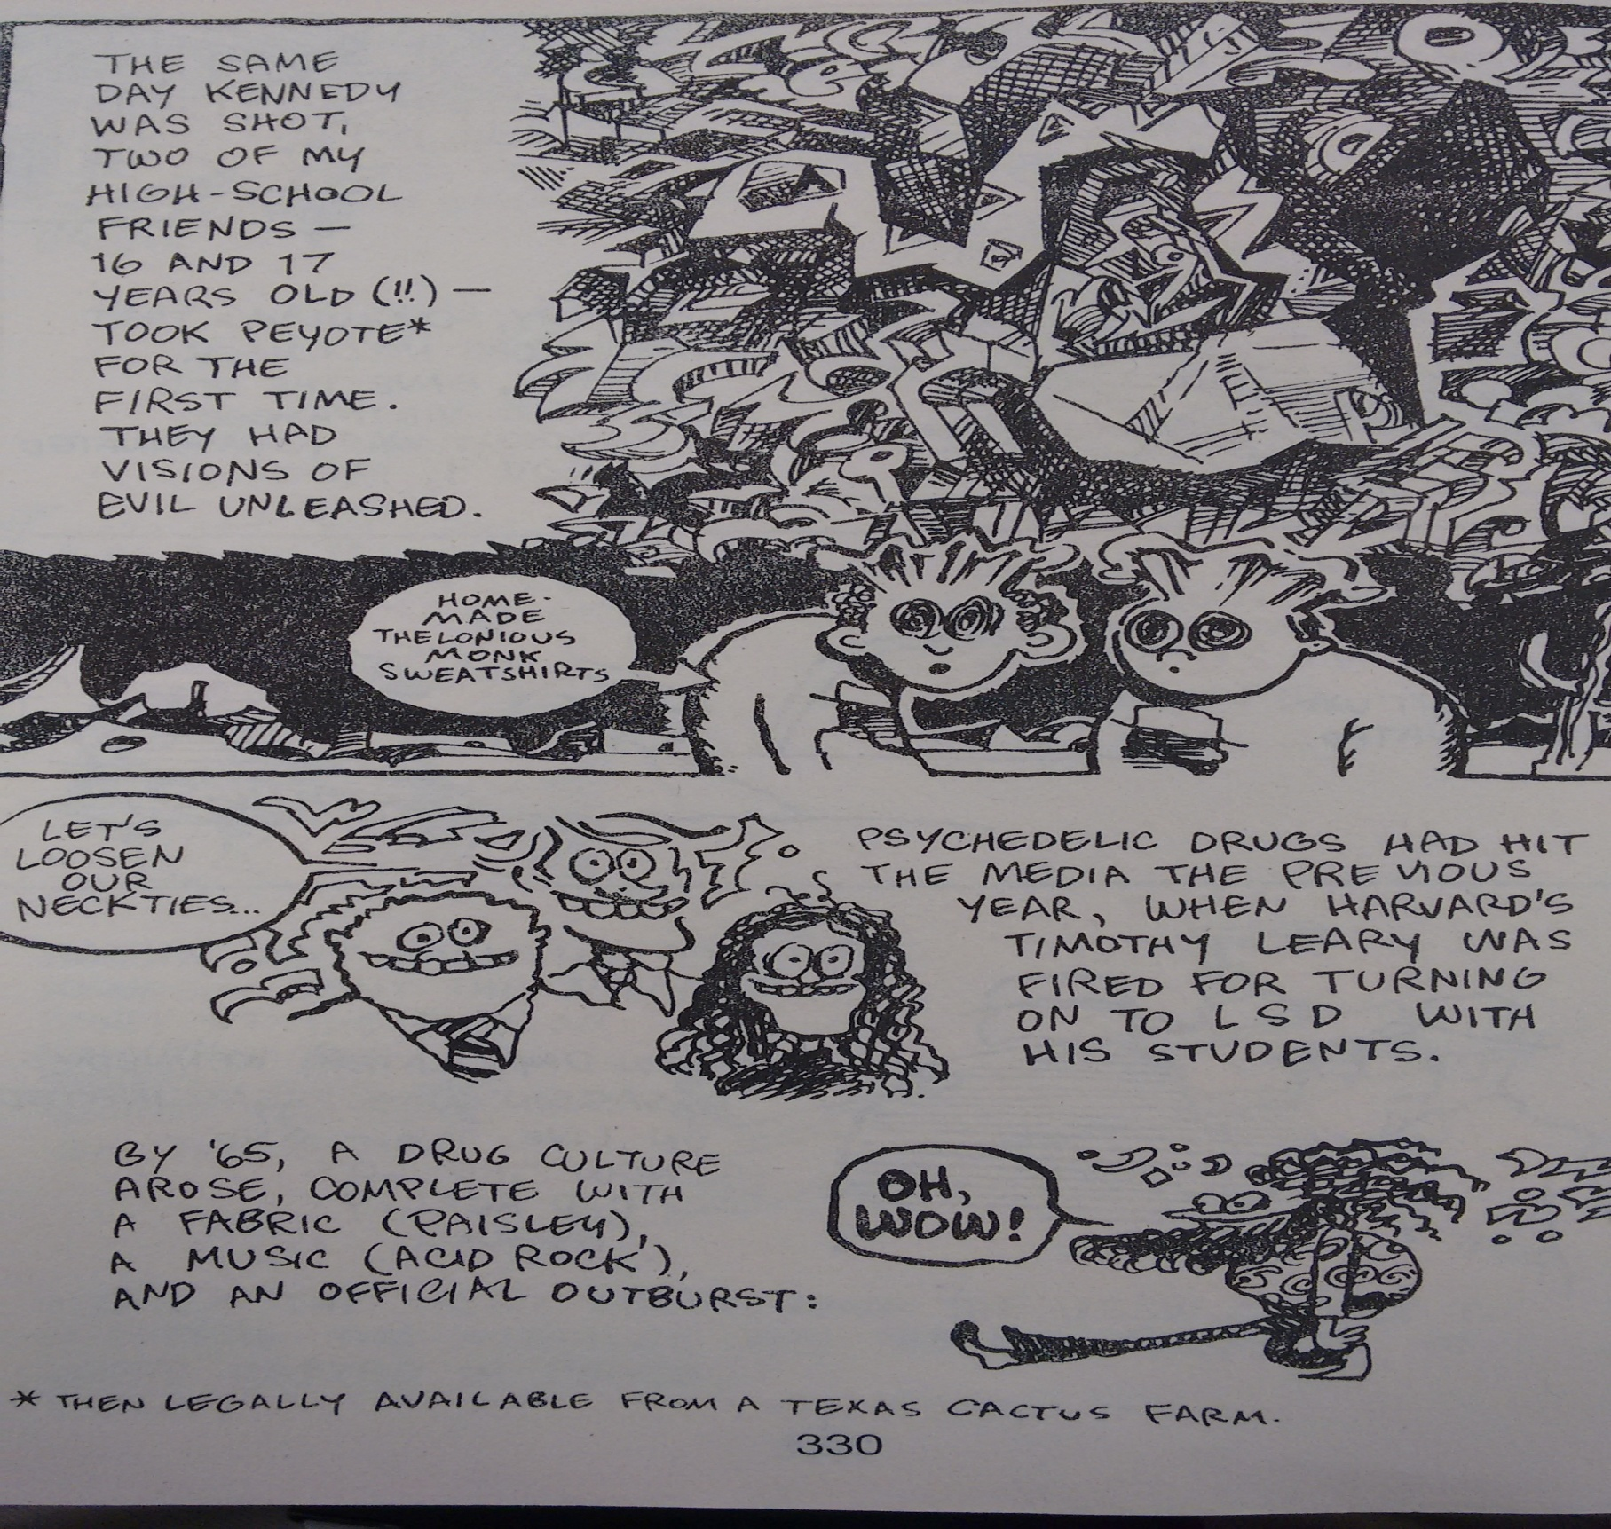
A Counter Culture is Born

Slide 8
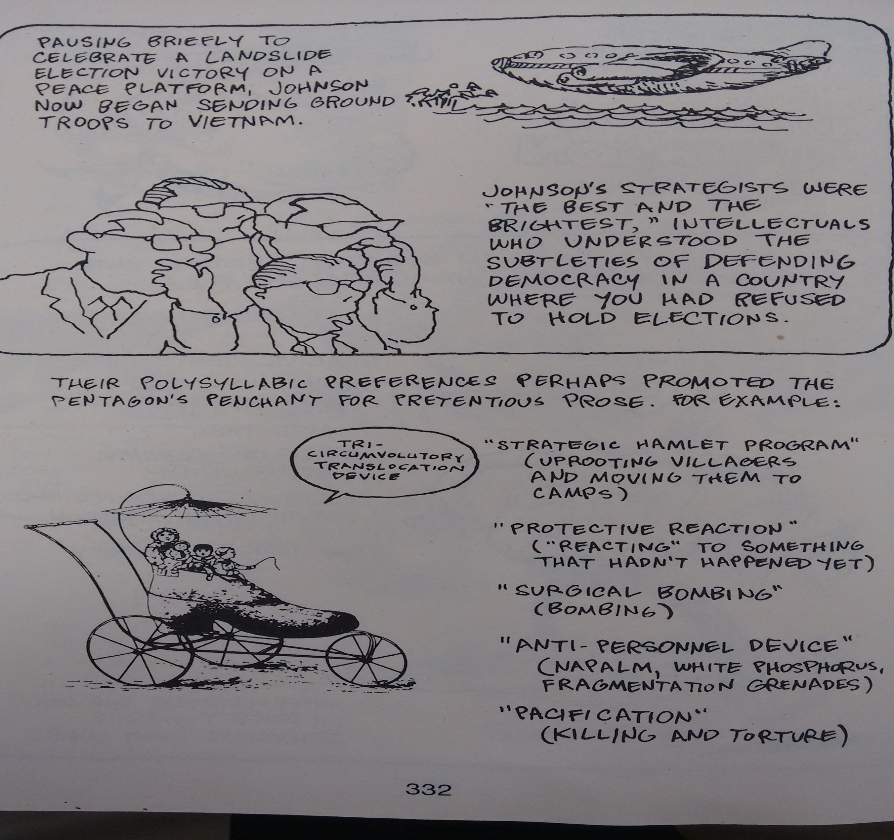
Sending “Advisors”
7) Advisors… Really?
8) Main Idea?

Slide 9
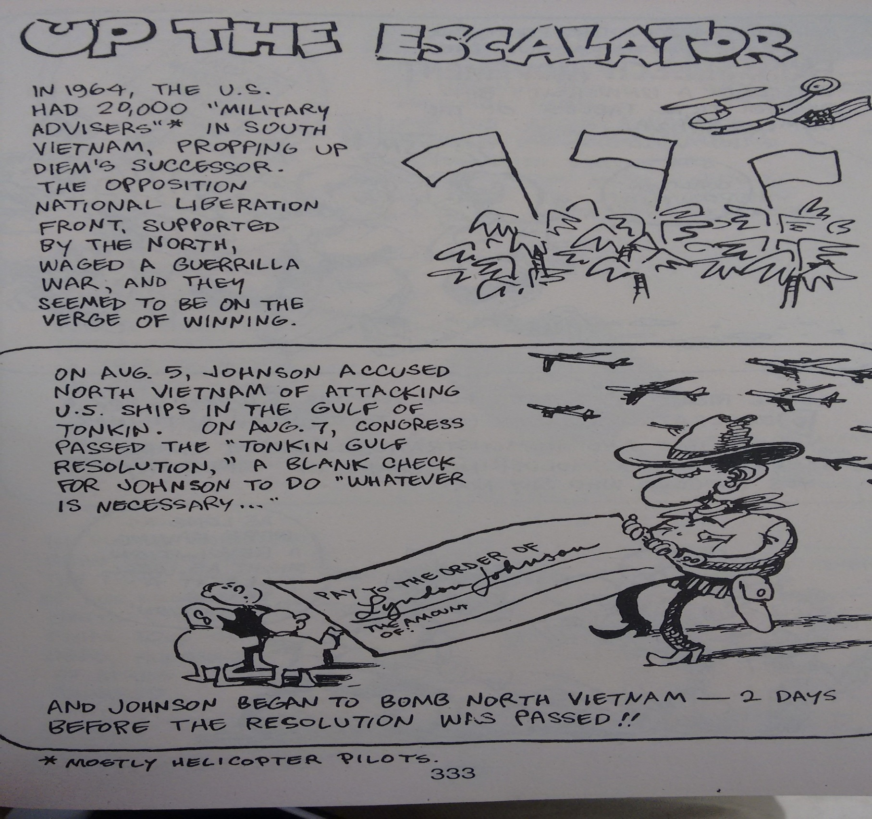
Up The Escalator
9) Vietnam Analogy
Notes:
The Fake Attack That Started The Vietnam War 3:00

Slide 10
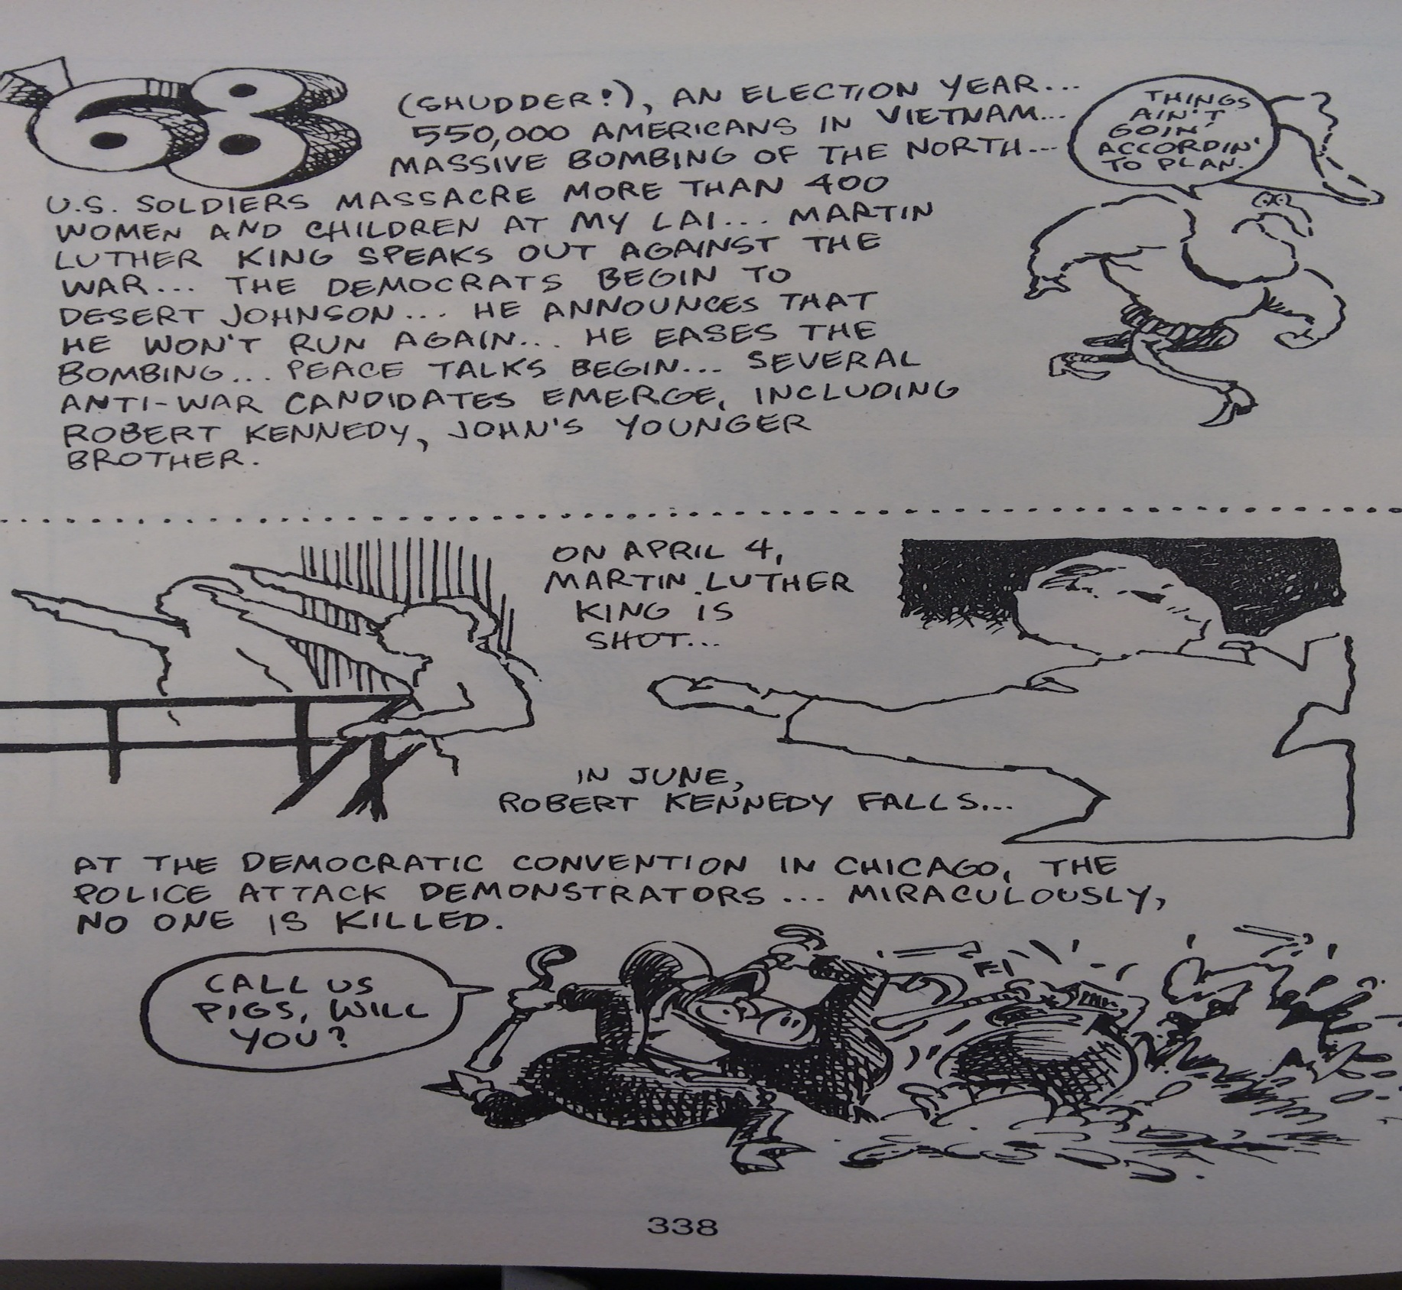
A Rough Time in the 60’s

Slide 11
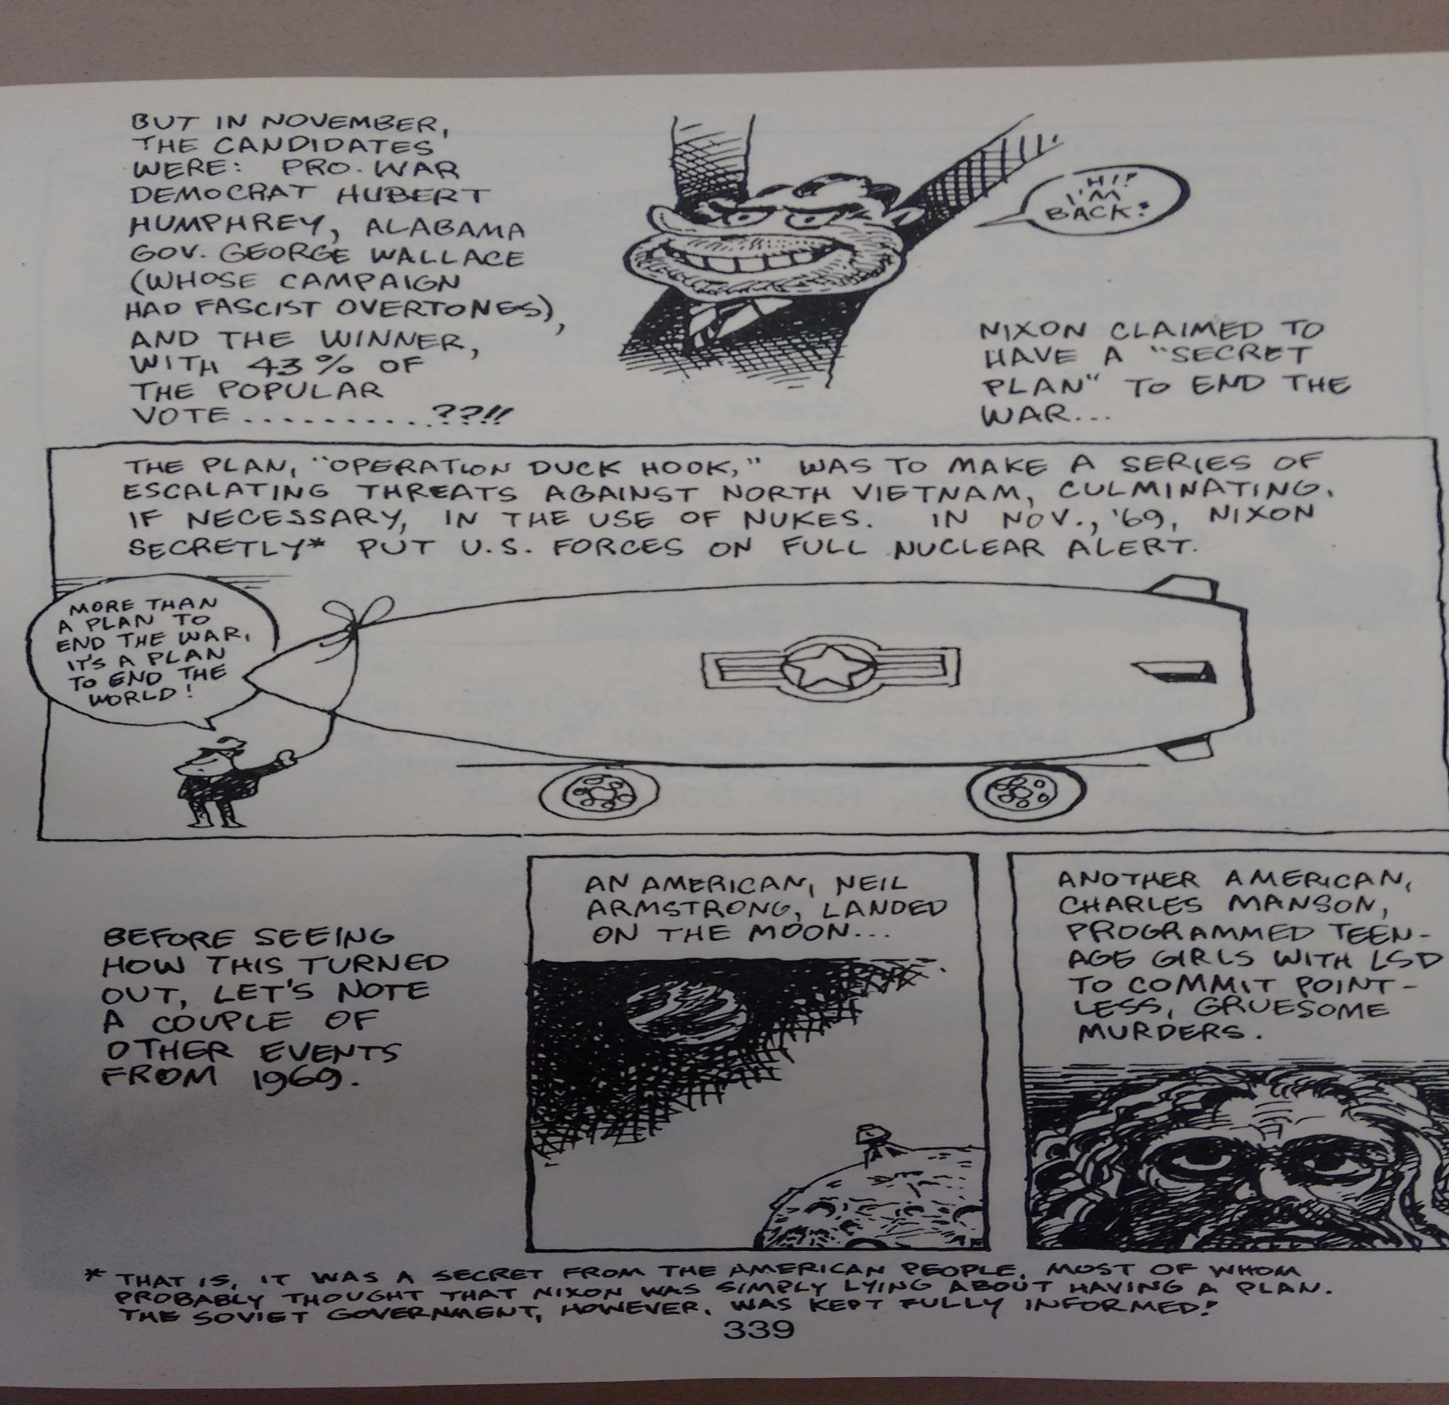
Nixon Takes the Reigns
10) Why?

Slide 12
Exit Ticket: Main Idea
11) Exit Ticket?
main idea
Noun
1.the most important or central
thought of a paragraph or larger section of text, which tells the reader what the
text is about:
Find the main idea in each paragraph.
What was the “main idea” of the reasoning behind the Vietnam War?

