Slide 1
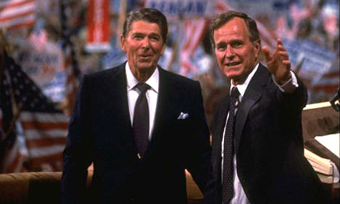
New Challenges: the 1980’s
12-2 Decade of Republican Power

Slide 2
Warm-Up: Spiral Review-
1) Warm Up!
“Mr. Gorbachev, Tear Down This Wall”
-President Ronald Reagan
What wall is President Reagan referring to?
What do you think is causing President Reagan to say this?

Slide 3
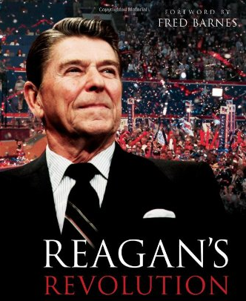
The Reagan Revolution
2) Define!
20 Jan 1980- Revolution Begins
Marked significant change toward Conservativism
Called for return to “Traditional American Values”
Back to the 50’s ideas
Emphasis on family life, hard work, respect for the law, & patriotism
Believed too much fed gov’t involvement in lives of people
Too many rules
Collect too many taxes
Spent too much money on social programs
Designed to help others who can’t help themselves
To take care of this…
Deregulation
Cutting rules & regulations for businesses
Making money became 1st
Everything else becomes 2nd
Like What?
‘the Supremes’
Reagan put stamp on Supreme Court
Appoints 3 justices that shared his ideals
Sandra Day O’Connor (1st woman)
Antonin Scalia
Anthony Kennedy
Notes:
Reagan 1980 Are you better off than you were four years ago? (1:05)

Slide 4
“Reaganomics”
3) Reaganomics? Thoughts?
Core of the Reagan Revolution
Believed lower taxes would allow corps. to invest in smaller businesses
Pay workers better or…
Keep $$$ for themselves
Less taxes collected mean less money 4 fed gov’t so…
Pair it w/ less spending
Called… Supply-Side Economics
1981- Congress lowers taxes
Balance it out cuts $40 million from needed programs
School Lunches
Student Aid
Welfare
Low Income Housing
Food Stamps
Greatly hurt poor and working class
While he cut programs at home…
Sharply increased military spending
National Debt
w/ lower taxes and higher military spending
Leads to massive nat’l debt increase from 300 jillion to 900+ million!!!
By time he leaves office debt triples to 3.2 trillion!!!
While most of nation sinking economically; business leaders makers money hand over fist!
4) Explain
Notes:
Reaganomics Explained (0:53)

Slide 5
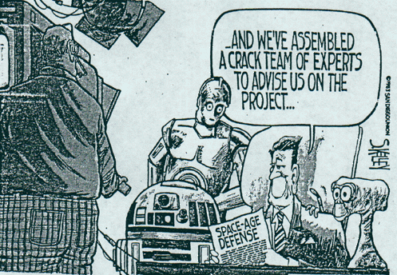
Ronny’s Foreign Policy
Reagan justified the massive spending by citing the Cold War necessities
“To be prepared for war is one of the most effective means of preserving peace.”
Expanded military by 3x over!!!
Proposed antimissile defense system nicknamed “Star Wars”
Satellite in space that would detect missiles and use laser beam to destroy them b4 reaching target
Scientists nowhere near able to do this!
Cost 100’s of millions and never existed!!!
Latin America
Ron committed US troops to stop spread of communism in Nicaragua and tiny island of Grenada
$$$ and troops to help Contras - fighters of Communists
Becomes source of disagreement b/t Reagan & Congress
Middle East
Reagan less than successful in Mid East to bring peace
1982- Reagan sends troops to war-torn Lebanon
Soon US caught in web of violence
300+ US soldiers killed in Beirut
Reagan soon just pulls all US troops out leaving Lebanon to fall to Islamic extremists

Slide 6
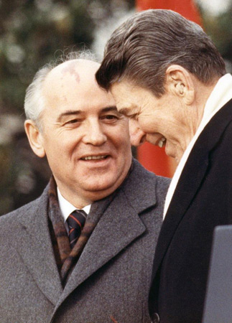
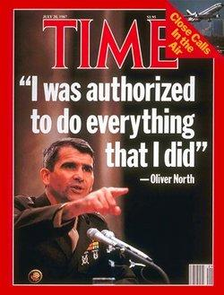
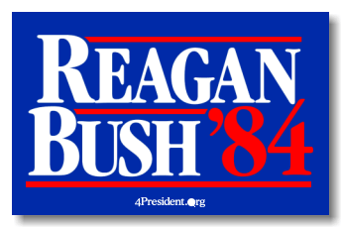
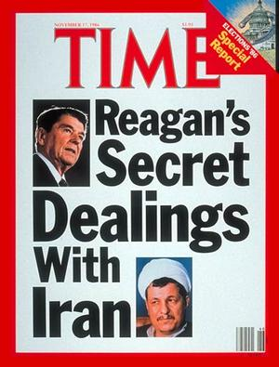
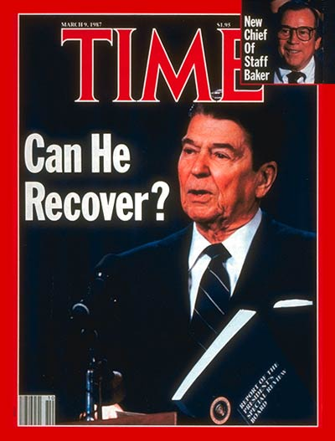
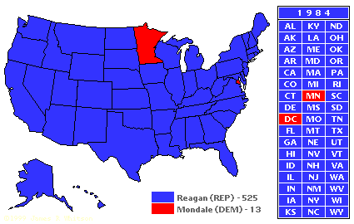
Reagan / Bush Redux
5) Thoughts on Iran-Contra
Election of 1984
Economy booming- everyone making $$$
Except for poor, working, & middle classes
Becomes a dominant election for Reagan & Bush
Take 49 of 50!!!
Iran-Contra Affair
Iran takes US hostages from Lebanon
In exchange for their release…
US arranges sale of weapons to Iran
Wait… thought we didn’t negotiate w/ terrorists?!?
We certainly do sell them a massive weapons package!!!
Marine Lt. Oliver North is the point man for US
North also ordered to funnel $$$ to Contras in Nicaragua and secret arms deal there, too!
News of these “deals” leaks
Causes major uproar!!!
Hearings, and charges fly around like moths to a flame
Becomes known as Iran-Contra Affair
Casts dark shadow over Reagan
A Changing Soviet Union
Mikhail Gorbachev takes over USSR
Surprises everyone w/ wanting to reforming USSR gov’t
Calls policy, “glasnost”
Meaning, Open to new ideas
Allows for people to start control of economy
Policy called, “perestroika”
Changes needed as USSR failing quickly
Gorbachev & Reagan strike up strong friendship
Work together to end Arms Race
Get USSR back on its feet
Notes:
Iran – Contra Affair (2:42)

Slide 7
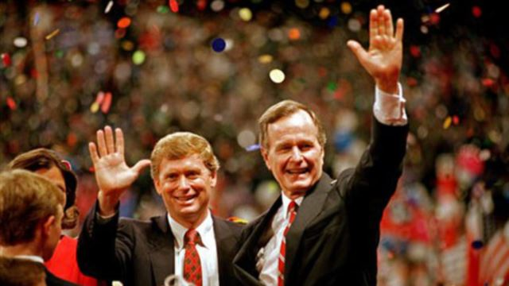
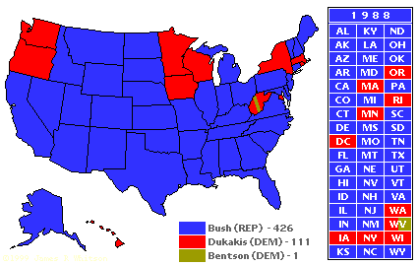
It’s Georgey’s Turn!!!
Election 1988
Ronny 2nd term drawing to close
Repubs want to con’t success of Reagan
VP George HW Bush logical choice
Bush wins easily, but…
Dems carry Congress
Uphill battle to get his policies passed
Notes:
Headline News on the 1988 Election!! (5:04)

Slide 8
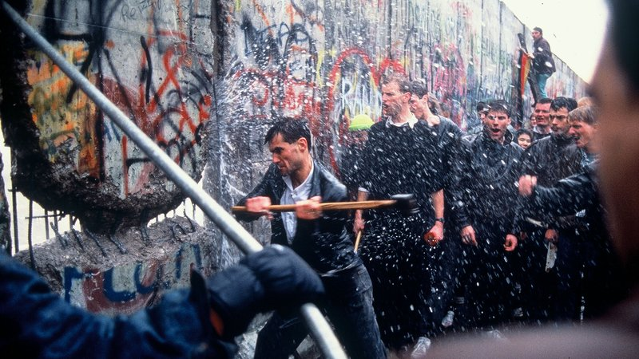
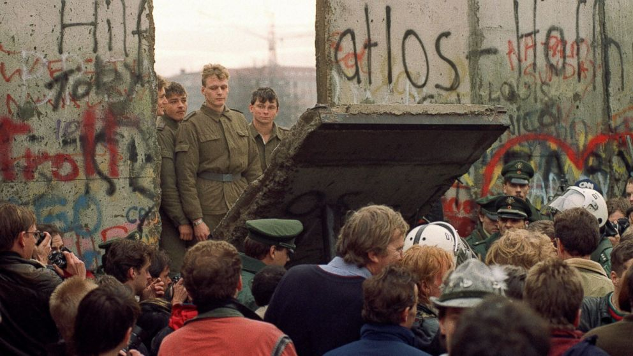
New World Order
6) Significance of wall falling
Changes in USSR
December 1988- Gorbachev declared at UN, a New World Order
“people wanted independence, democracy, & social justice.”
Bush and Gorbachev work together to bring this to world
End the Arms Race for good
Sign Strategic Arms Reduction Treaty (StART)
Unrest in USSR
Gorbachev’s policies were working and helping the economy
People starving, no more, no jobs
Policies working but slowly
February 1990-
1000’s march on Moscow for end of Communist rule
Republics in Soviet Union begin declaring for independence and democratic rule
Eastern Europe Goes Democratic
Many of those republics begin breaking away
Moving toward independence and new democratic gov’ts
Berlin Wall Falls
Germany becomes one of the first
Wall dividing Berlin (demo & comm) is brought down
Reuniting the nation
Notes:
Scorpions - Wind Of Change (4:35)

Slide 9
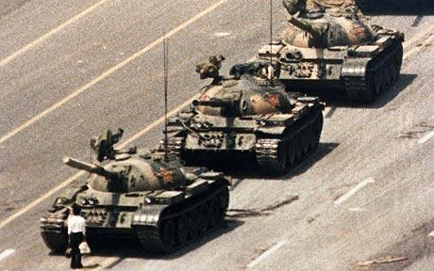
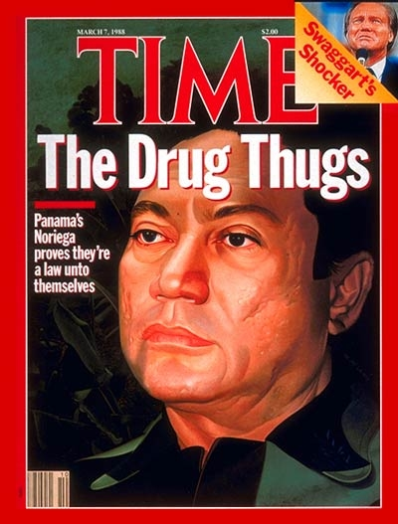
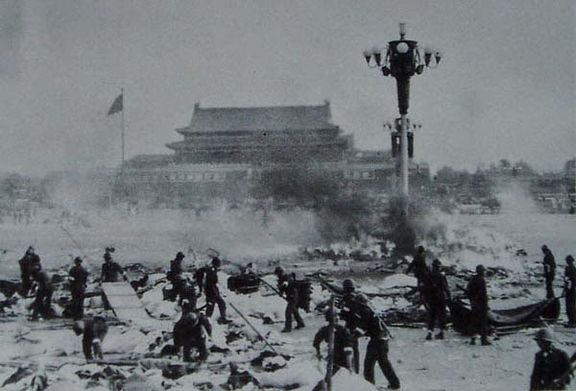
A New Foreign Policy
Panama
Bush declares a war on drugs
Major foreign policy for S.A.
Panama controlled by Gen. Noriega
Charged with drug trafficking by U.S courts
US Military goes in and overthrows him
Endara becomes new prez and Noriega is convicted
China
Bush was the foreign envoy to China when relations 1st started to improve
Bush seeked to improve relations as the prez, then…
Tiananmen Square
Students protest for political change
Communist government will not allow and crushes it
Sends in the tanks…
Kills several hundred
This slows progress towards relations as it was condemed worldwide
Notes:
Tiananmen Square- the guardian (5:04) Need to preview*

Slide 10
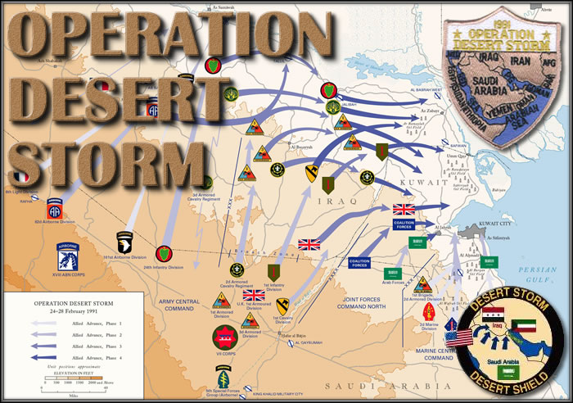
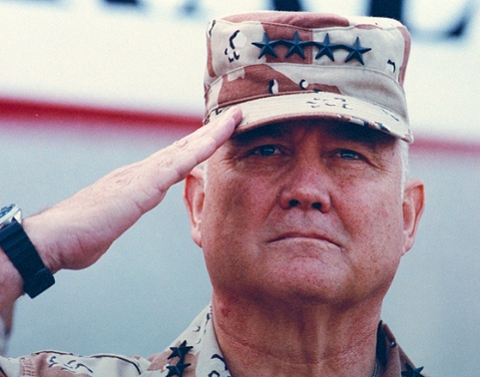
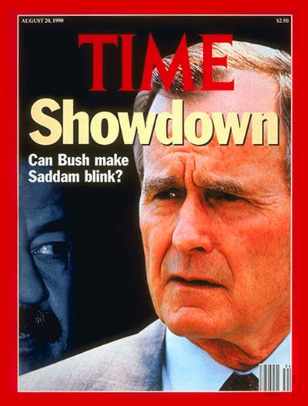
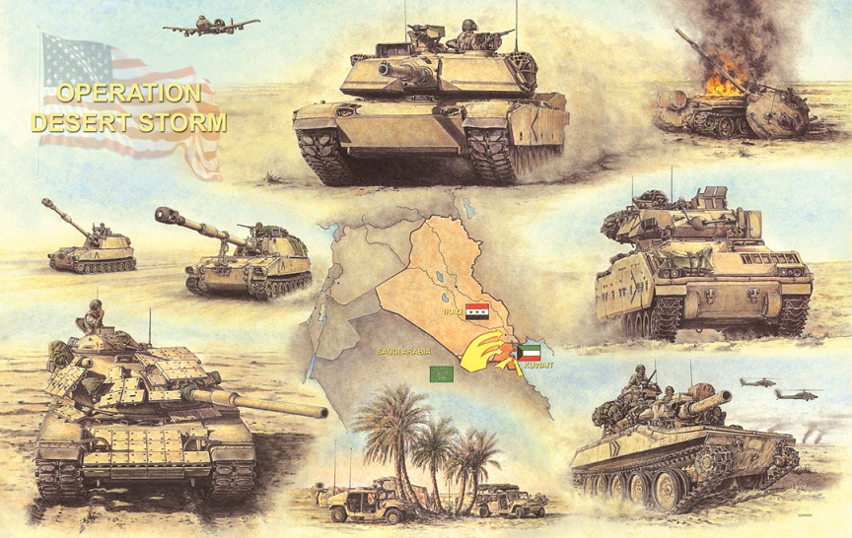
Problems in the Persian Gulf
7) Desert Storm is often linked to…
Operation Desert Shield
Iraq- controlled by Saddam Hussein
Invades oil rich Kuwait
Fears he will invade Saudi Arabia next
UN send hundreds of thousands of troops in to protect
Like a shield
Under control of US Gen. Norman Shwartzkopf
Set deadline for Saddam to pull troops from Kuwait… or else…
Operation Desert Storm
Iraq refused to leave Kuwait
US drops the hammer
Laser guided missiles destroy military and civilian targets
After 6 weeks Iraq still won’t back out!
Send in the troops
After only 100 hours Kuwait is liberated
Saddam signs a cease fire and pulls his troops out
Helped rebuild Kuwait and put out oil fires
Americans praised the troops, Colin Powel, and Bush
Prez approval rating soared over 90%!!!
Notes:
Persian Gulf War: Timeline of Operation Desert Storm 5:00

Slide 11
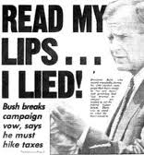
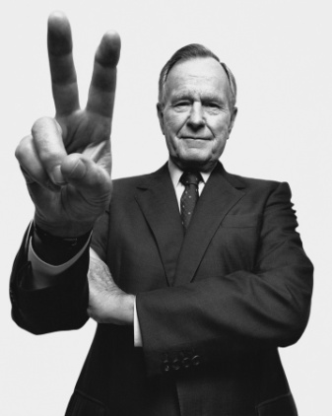
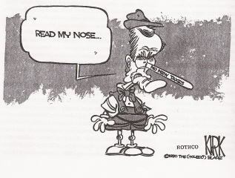
Domestic Issues
S&L Bailouts
Savings and Loan Associations
Regulations eased under Reagan
Risky loans and investments made
Many borrowers not able to repay these loans when values of real estate drops
Many S&Ls fail
Gov’t has to shell out almost $500 BILLION
Does this to cover lost investments and to to “fix” other S&Ls to stop failure from spreading…
Economic Downturn
Heavy borrowing and debt from the 80’s continued to build
Country into a recession
People and businesses start declaring bankruptcy
Miltary cuts from end of Cold War adds to unemployment
Bush extends unemployment but not other programs
Accomplishments
Clean Air Act
Americans with Disabilities Act
Created National Drug Control Board
Oversees war on drugs
Notes:
The Presidents- George Herbert Walker Bush (6:45)

Slide 12
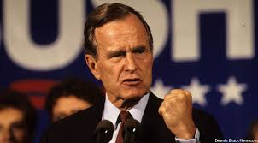
Essential Question: Exit Ticket-
Do you think Bush will be reelected?
Why or Why not?

