Slide 1
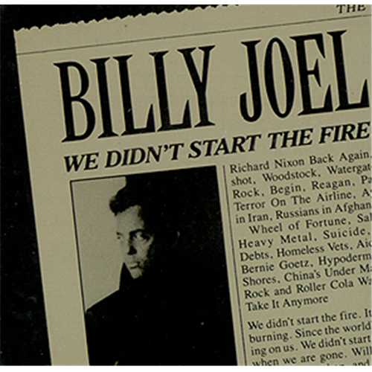
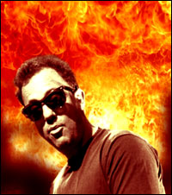

Slide 3
“We Didn't Start the Fire" is a song by Billy Joel. Its lyrics include brief, rapid-fire allusions to more than 100 headline events between January 1949 (Joel was born on May 9 of that year) and 1989, when the song was released on his album Storm Front. The song was a No. 1 hit in the US.
Your 1st Task….
Figure out what the heck Billy is talking about???
Identify the headline’s topic and tell why it’s important in the timeline of world events

Slide 5
“We Didn't Start the Fire" is a song by Billy Joel. Its lyrics include brief, rapid-fire allusions to more than 100 headline events between January 1949 (Joel was born on May 9 of that year) and 1989, when the song was released on his album Storm Front. The song was a No. 1 hit in the US.
Your 2nd Task….
Choose a year from the song and create a visual illustrating the its’ important events and headlines
As a class period, we will then combine them to make a visual of the song itself

