Slide 1
Warm up: Cause and Effect!
By increasing gov’t spending was effects can be noticed?
By increasing taxes what effects can be noticed?
What about cutting taxes?
1) Warm Up

Slide 2
The 1990’s
12-4 A New Era- The Clinton Presidency

Slide 3
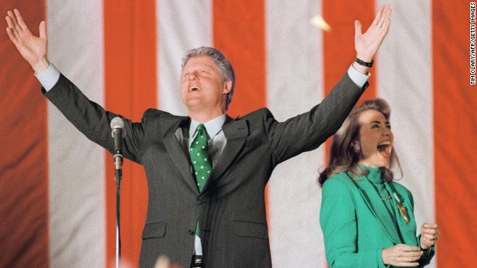
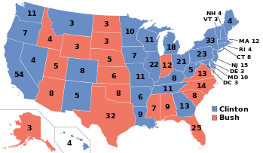
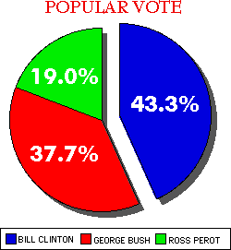
Election of ‘92
Republican Candidate was President Bush
Bush’s popularity soared after Desert Storm…
But a poor economy sinking his re-election chances
Democrats nominated Arkansas Gov. Bill Clinton
Focused on economy and reducing unemployment
Many did not want Bush or Clinton…
A grassroots movement started backing H. Ross Perot
Started by local groups and organizations
Perot had the most 3rd party candidate votes since Teddy Roosevelt!!!
Clinton wins with 43% of the votes!
Becomes 1st POTUS born after WW2
2) Huh?
Notes:
SNL Sketch- (10:43)

Slide 4
Clinton’s Domestic Programs
3) Gun Control…
One of Clinton’s main goals: Fix the economy
Reduce budget deficit
Amount spending exceeds revenue
To do this raise the tax on the middle and upper classes while cutting taxes for poor
Republicans opposed it
Narrowly passes
Healthcare Reform
Control rising costs
Provide coverage for ALL Americans
…sounds familiar huh?
Overall it did not pass as congress saw it as to reliant on the Gov’t
Some parts passed though… coverage for elderly and poor
Gun Control
Brady Bill of 1993
Background checks on handguns
Banned 19 kinds of “assault weapons”
Provided 100,000 additional police officers nation wide
Notes:
Brady Bill of 1993 (4:30)

Slide 5
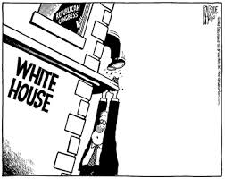
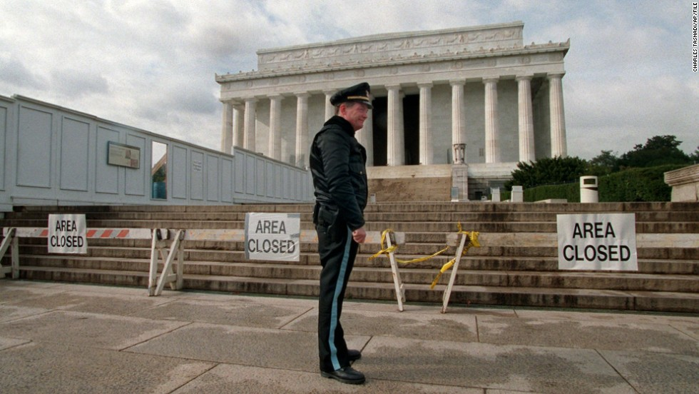
Clinton’s Presidency
Contract with America
Budget issues and a 2nd term
Republicans promised in a “Contract with America”
Return the nation to basic values, balance the budget and reform Congress
Resulted in strong Republican Congressional victories.
Republicans controlled both ‘Houses’
Fought on budget issues with the President
Disagreement on budget…
No budget passed in 1996
Gov’t shutdown for 27 days!
Both realized a compromise was needed
Planned a balance budget
Increase in min. wage
Set requirements for welfare benefits
4) Effects of shutdown?
Notes:
Gov’t Shutdown (1:28)

Slide 6
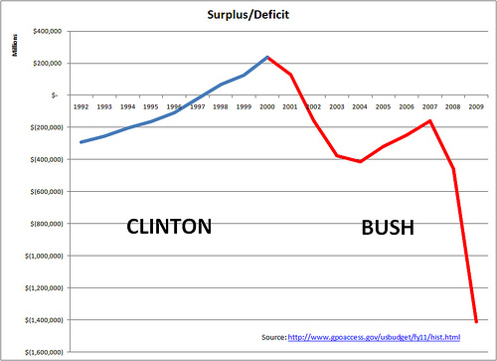
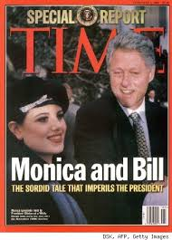
Clinton wins again… but…
Republicans hoped to regain the White House in ’96
But… things were good!
Low unemployment, healthy economy, fixing crime issues.
Clinton easily beats Rep. Bob Dole
In ’96 and ‘97 GDP increased 4%
Gross Domestic Product
Value of all goods and services produced in a nation in year
4% highest growth since WW2!!!
Then troubles come for Bill
1998- A scandal emerges
Affair with an intern- Monica Lewinski
Bill denies all allegations
Evidence suggests it happens
Uh oh, that means he lied under oath!
He becomes 2nd president to be impeached
Congress agreed he lied, but was this enough to fire him???
12 Feb 1999 Congress votes…
Bill survives the impeachment process!
5) Define!
Notes:
Bill & Monica (5:35)

Slide 7
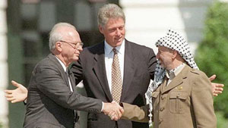
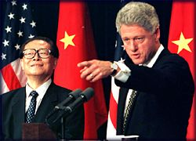
Foreign Policy
1993 Clinton pushes for North American Free Trade Agreement (NAFTA)
Eliminate trade barriers between US, Canada and Mexico
Mixed responses
Good because it lowers prices
Bad because low prices of Mexican products could force US companies to close
Middle East Peace Accords
Clinton brought the Israelis and Palestinians together for historic talks
Things were going decent…
Then Israeli Prime Minister Yitzhak Rabin assassinated…
Israel decided to put national security over peace from that point on
Middle East left as far from peace as ever before
Clinton oversaw the peace and protection of the ethnic cleansing of Muslims
Bosnia
Kosovo
Used NATO airstrikes to force peace talks
Notes:
NAFTA- Hip Hughes Explains (4:30)

Slide 8
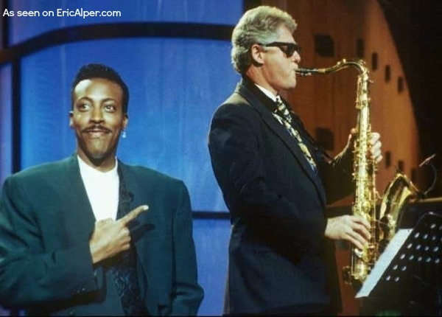
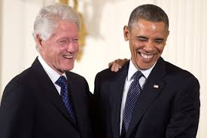
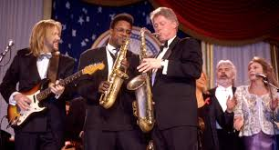
Legacy
6) Thoughts on Clinton?
Clinton served 2 terms as POTUS
People EXTREMELY pleased by economy and his foreign policy
BUT…
Some disappointed by his personal behavior
Clinton involved with UN giving speeches and providing as envoy to countries in need
Still works with POTUS’
Seen as the “Rock Star President”
Popular with the people
Played the sax
Parodied many times on shows like SNL
Notes:
The President- Bill Clinton (7:20)
SNL- Bill at McDonald’s (5:29)

