Slide 1
Top 20: Pop-CultureLists
1990’s Edition

Slide 2
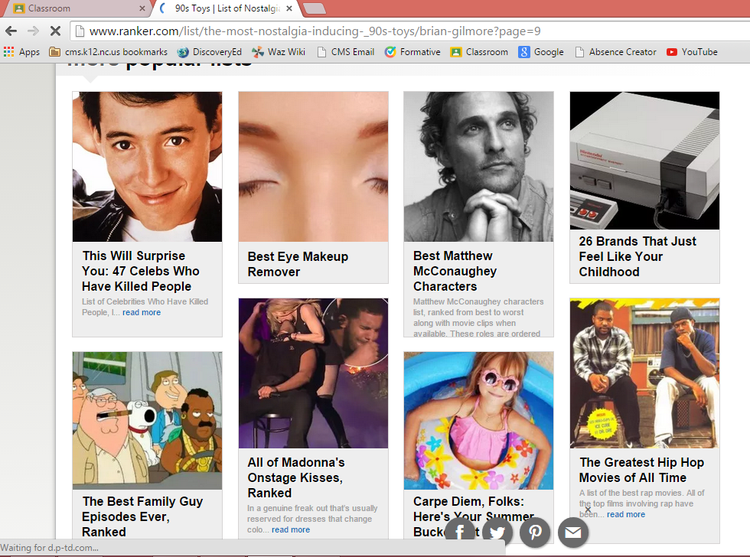
Rules…
Bkgd-
1990’s were the Greatest Decade of ALL-Time!!! It had the best of everything!!!
Your Task…
Examine the Best of the 1990’s by examining the Pop-Culture of the 1990’s
Format-
we’ve all seen the on-line lists that constantly pop up as we are browsing or using social media.
I want u to create a “Top 20” list from any of the categories on the next page
U will then look up these topics and look at the lists that are already created to formulate your list
Listen to the songs, watch the movie clips, look at the cars…
Requirements-
Using Google Slides or paper, create a top 20 list
At least 1 photo
Title
Date (where applicable)
4-5 sentence Summary (your Rational or reasoning behind its’ ranking)

Slide 3
Basic Info… FAQ’s
Due?
May 25th, 2015
11:59 pm
Work Days?
2-3 Days in-class
Points?
60 pts.
How? Or Using what platform?
You may use …
Google Slides
you may make it on paper
each event on a separate sheet making a flip book
Since it is a countdown you should start at #20 and work your way down to #1!

Slide 4
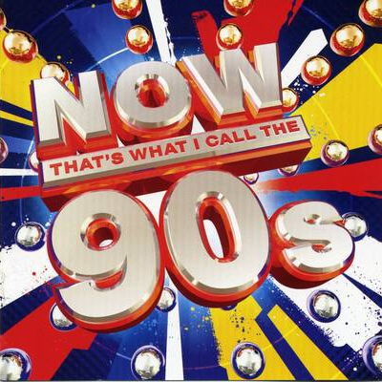
Topics to Choose From…
Coolest Toys of the 1990’s
Coolest Songs of the 1990’s
Coolest Bands of the 1990’s
Coolest Albums of the 1990’s
Coolest Fashion Trends of the 1990’s
Coolest Cars of the 1990’s
Coolest News Headlines of the 1990’s
Coolest Sporting Events of the 1990’s
Best Athletes of the 1990’s
Coolest Inventions of the 1990’s
Coolest T.V. Shows of the 1990’s
Coolest Sneakers of the 1990’s
Coolest Movies of the 1990’s

Slide 5
Examples

Slide 6
Top 20: COOLESTToys
1990’s Edition

Slide 7
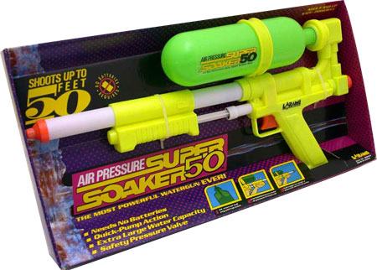
5.) Super Soakers
J,hgvlyfktdkhfxhhVSD’OU FGOUGFOUFHUODVUJLDBVLUJDBLCVJCBSDLJCBVDLJBC/LDJBCLJDBCljDBCVLJBXLcJB/Ldjbcv/lBJVLJbad/ljbzxjlbc/ljbzx/ljbcd/ljcbljefPIehcpHDLCBDLCGLCDLCPEP’HCLQECQELJCBLQECLQE/LQJC/Ljcb/ljcbl/jab/ljcbda/ljBDLJBADDCLJBC/LCBA/LJBC/JLBC/LJBLJAB
UV’Uvdljbv/lujdbvldbv/lwdbvljdb/cjlbd/ljcb/ljadbc/ljadbcljdbdcb/ljdbc/ljadbc/ljdbclejblejbclbj

Slide 8
Top 20: COOLESTSneakers
1990’s Edition

Slide 9
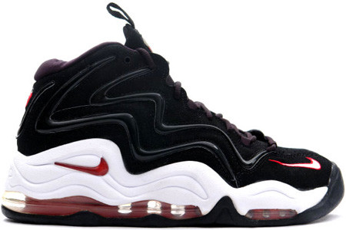
11.) NIKE Air Pippen (1997)
Scottie Pippen's first signature shoe from Nike was a hit to everyone but him. Scottie preferred lower-profile Zoom Air to the more pillowy Max, and Pip's personal size 16 PEs would feature Visible Zoom instead of the market version's full-length Max. But the Max bags balanced the wavy upper lovely, and the Pips made their mark on the streets as well as the courts.

Slide 10
Top 20: CoolestCars
1990’s Edition

Slide 11
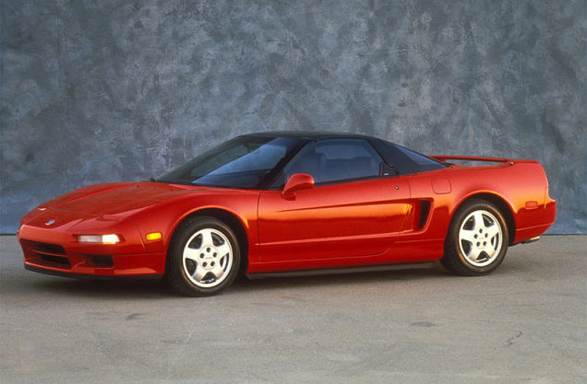
3.) Acura NSX (1992)
As with the McLaren F1, you sort of start running out of amazing things to say about the Acura NSX. With its straight edge, we-have-really-good-computers-now styling and Senna-tuned handling it's already a beast. It's the dream car of the era and, because it wore a Honda badge in Japan, it seemed almost attainable. The best thing we can say about it? When Gordon Murray drove the car he knew he wanted to build a car with the same spirit and so he designed the F1 around similar principles.

Slide 12
Top 20: CoolestBands
1990’s Edition

Slide 13
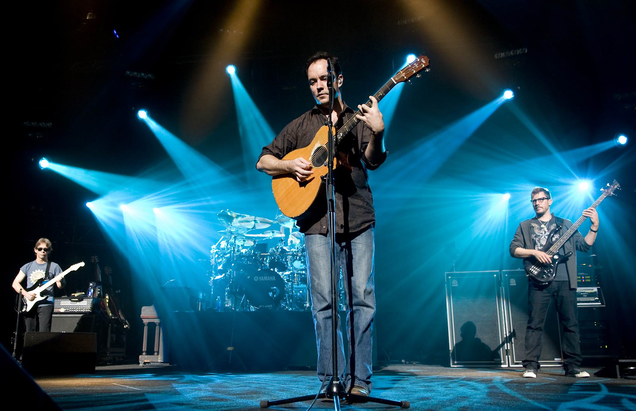
2.) Dave Matthews Band
Dave Matthews Band (often abbreviated to DMB) is an American rock band that was formed in Charlottesville, Virginia in 1991. The founding members were singer-songwriter and guitarist Dave Matthews, bassist Stefan Lessard, drummer/backing vocalist Carter Beauford and saxophonist LeRoi Moore. Boyd Tinsley was added to the band as a violinist soon after the band was formed. Moore died suddenly in August 2008 due to complications from injuries sustained in an ATV accident. Grammy Award-winner Jeff Coffin[4] of Béla Fleck and the Flecktones has since filled Moore's spot as the band's saxophonist. Rashawn Ross and Tim Reynolds have also become full-time touring members of the band. The band's 2009 album Big Whiskey and the GrooGrux King (the first album since Moore's death) debuted at number one on the Billboard 200, earning the band their fifth consecutive number-one debut. Their most recent album, Away from the World, released in 2012, debuted at number one on the Billboard chart — making them the only group to have six consecutive studio albums debut in the top spot.[5] As of 2010, the Dave Matthews Band has sold over 30 million records worldwide.[6]

Slide 14
Top 20: CoolestMovies
1990’s Edition

Slide 15
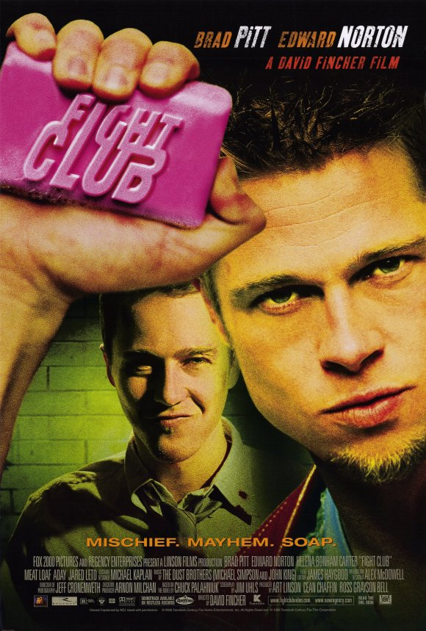
1.) Fight Club (1999)
An insomniac office worker looking for a way to change his life crosses paths with a devil-may-care soap maker and they form an underground fight club that evolves into something much, much more...
Director: David Fincher
Writers: Chuck Palahniuk (novel), Jim Uhls (screenplay)
Stars: Brad Pitt, Edward Norton, Helena Bonham Carter

Slide 16
Top 20: CoolestAthletes
1990’s Edition

Slide 17
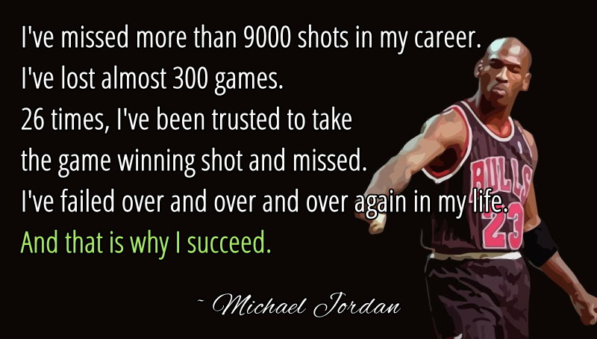
1.) Michael Jordan (1999)
Greatest of all time, nuf said!!!

Slide 18
Top 20: Coolestsongs
1990’s Edition

Slide 19
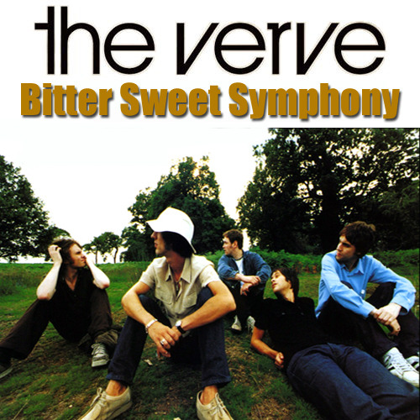
16.) The Verve- Bittersweet Symphony (1997)
"Bitter Sweet Symphony" is a song by English alternative rock band The Verve, and is the lead track on their third studio album, Urban Hymns (1997). It is based on an Andrew Loog Oldham orchestral version of The Rolling Stones' song, "The Last Time" from which it samples a main theme, and involved some legal controversy surrounding a plagiarism charge as a result. "Bitter Sweet Symphony" was released on 16 June 1997 by Hut Recordings as the first single from the album, reaching number two on the UK Singles Chart and stayed in the chart for three months.[1] The song's momentum built slowly in the U.S. throughout the latter months of 1997, ultimately leading to a CD single release on 3 March 1998 by Virgin Records America, helping the song to reach number 12 on the Billboard Hot 100.[2]
The song's music video, which received heavy rotation on MTV, focuses on Richard Ashcroft lip-synching the song while walking down a busy London pavement, oblivious to what is going on around and refusing to change his stride or direction throughout.[3][4] One of the defining tracks of the Britpop era, at the 1998 Brit Awards, "Bitter Sweet Symphony" was nominated for Best British Single, and at the 1998 MTV Video Music Awards, the song was nominated for Video of the Year, Best Group Video, and Best Alternative Video.[5][6] In 1999, the song was nominated for the Grammy Award for Best Rock Song.[7]

Slide 20
Top 20: Coolestinventions
1990’s Edition

Slide 21
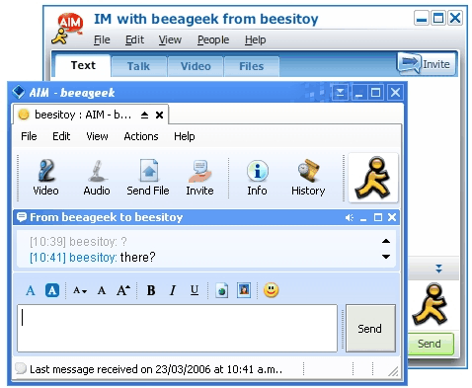
8.) AOL Instant Messenger (1992)
Remember when AOL instant messaging was all the rage? AOL was one of the first platforms that required us to create screen names. It trained our brains for all the names we have to make today for Twitter, Tumblr, Instagram — you name it.

