Slide 1
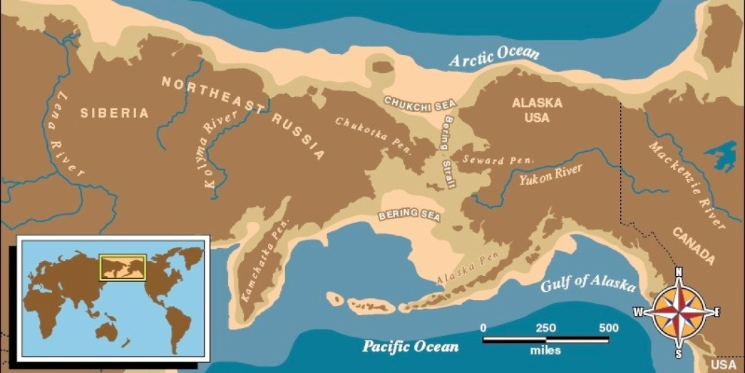
Warm up
What is the name of the land bridge that early humans are believed to have crossed into North America over?

Slide 2
Pre-History to Early People
2-2 Review Cube

Slide 3
Cube Directions
DO NOT cut the cube until everything is completed.
Write in complete sentences.
You will define/explain:
Agriculture, Birth of Civilization, Oral and Written History, Beringia
After each definition you will give an example of how they were important to North America
Draw a colored image to represent each term
Make your name clearly visible on the “Agriculture” side of the cube.
Each item must be placed in its proper spot!

Slide 4
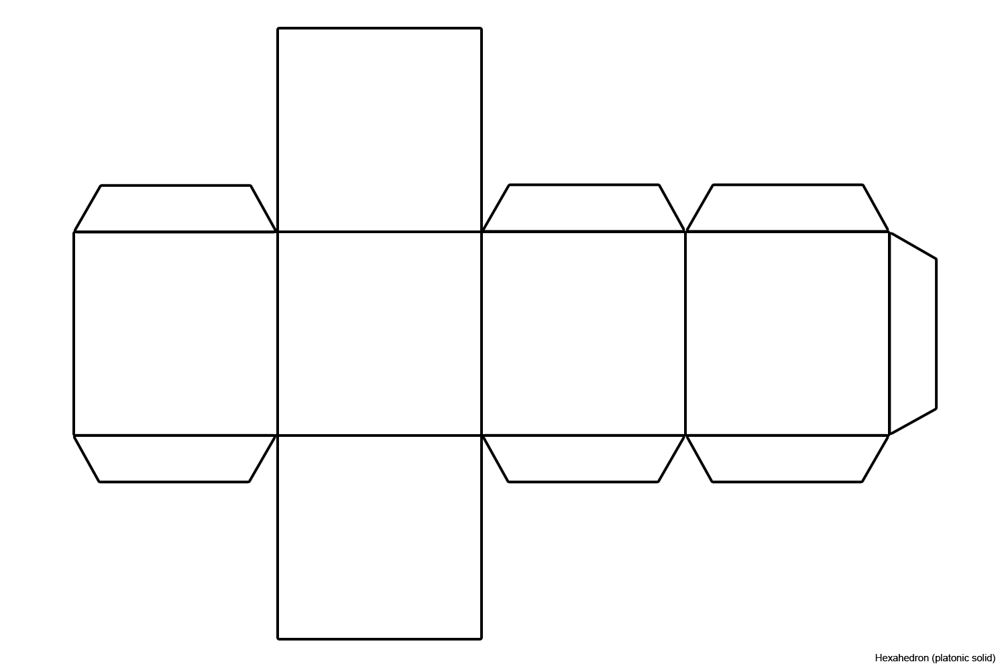
The Cube
Picture of Agriculture
Picture of Birth of
Civilization
Agriculture
Birth of Civilization
Oral and Written Language
Beringia
Picture of Oral/Written Language
Picture of Beringia

