Slide 1
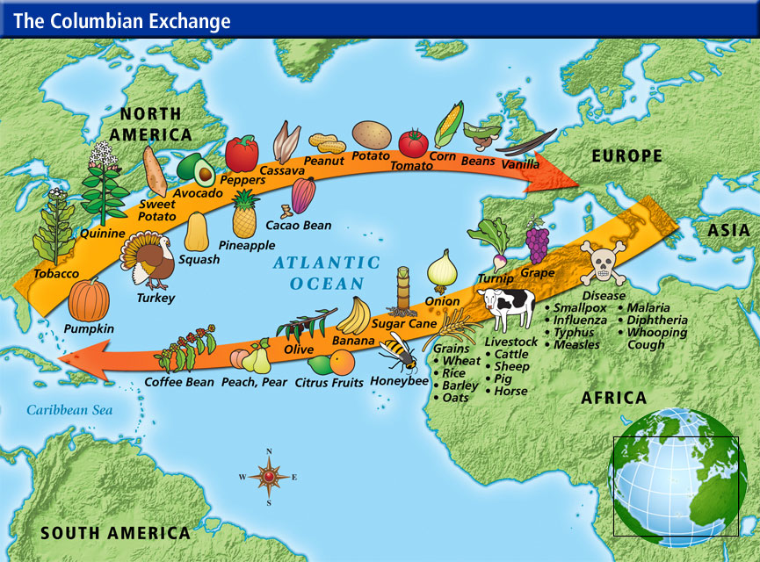
Warm-Up
Warm-Up
Describe how the 'Colombian Exchange affected both the natives of the Americas as well as the Europeans.

Slide 2
Colonial America: 1587-1770
3-1 Early English Settlements

Slide 3
England in America
Why So
Powerful?
1558- Queen Elizabeth I takes throne
  Begins to push for English colonization
Spain most powerful in world… so needed to be done cautiously
  Hired sailors to attack Spanish ships while at sea
    Encouraged them to cruise trade routes and attack
  Spain considered this act of “piracy”

Slide 4
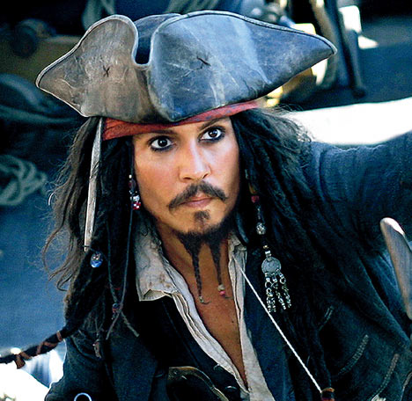
Sea Dogs
Sea Dogs?
Spain called them pirates
English called them “Sea Dogs”
  Sir Francis Drake- most famous
    1578- attacks Spanish galleon FULL of silver
    1580- he returns to England
      Spain’s King Phillip II demands he be turned over…
      Queen Elizabeth “knights” him instead
  Further attacks on their ships now have Spain ready for action
Rrrrrrrrr !

Slide 5
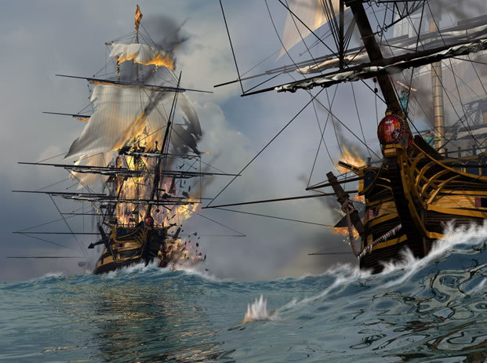
“Oh, How the Mighty
Spanish Have Fallen!”
b/c Drake & other Sea Dogs still attacking…
  Spain has to act!
    Spain sends 130 ships w/ 3,000 canons and 30,000 men to attack England
1588- Spanish Armada sets out to invade
  English ships smaller and faster
    English sank most of them, Whoo Hoo!
    The few that survived… too damaged to be effective
Now England has all the POWER!
Foreshadow
Result

Slide 6

Colony of Roanoke
1578- Queen Elizabeth I issues charter to Sir Humphrey Gilbert to start a colony
  But…
    Dies on the trip
1585- his bro Sir Walter Raleigh con’t charter w/ 100 men off coast of N.Carolina
  Named Roanoke…
    set up camp, fort, and agriculture
  Most settlers went back to England w/ Drake (visiting in 1586)
1587- try again w/ 118 others
  most knew nothing of setting up colonies
    Set up same place as B4
  Leader goes back for supplies
    comes back to deserted island!!!
No one knows or has ever found out what happened to “The Lost Colony”
  Discourages others from planning more English colonies
Charter? &
Colony?
Roanoke?

Slide 7
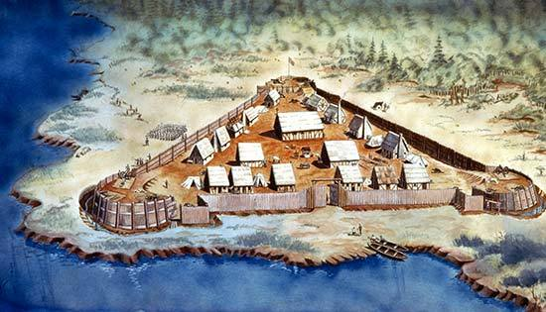
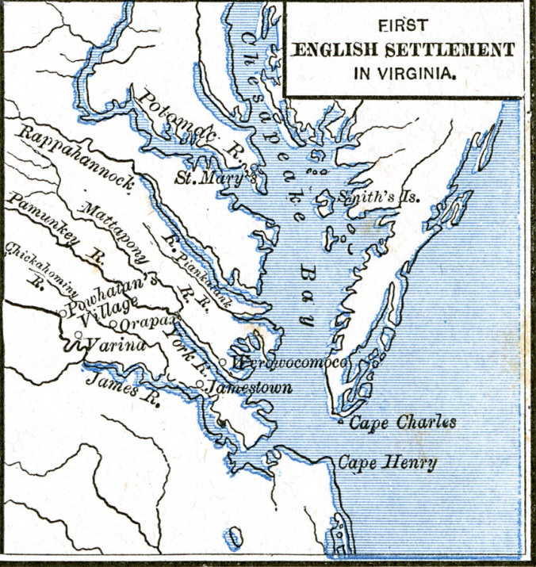
Jamestown Settlement
1606- the Virginia Company of London
  Receive charter “to make habitation…”
  Joint-Stock Company
    Investors buy stock in exchange for future profits
  Dec. 1606- send 144 settlers in 3 ships
    Look for gold attempt to trade fish and fur
    40 die in trip
April 1607- enter Chesapeake Bay
  Sailed up river (they named ‘James’ after King)
  Set up settlement named Jamestown (king)
    Swampy land, mosquitoes w/ disease
    Colonists not used to hard labor
      Looked for gold and silver instead of growing food
    Disease and hunger killed most
      Spring 1608- ships arrive w/ supplies and more settlers
      Only 38 settlers left!!!
Joint-Stock Company?

Slide 8
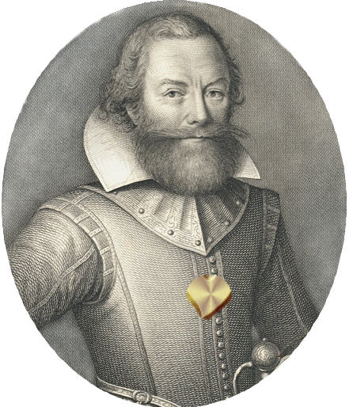
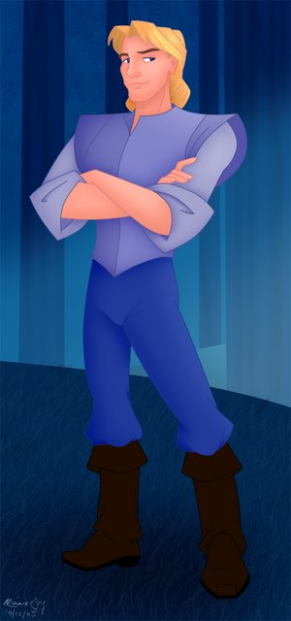
Captain John Smith
Governing the colony was tough
  Survived 1st 2 years b/c Capt. John Smith took control
    Experienced soldier and explorer
    Forced settlers to work, & explore
    Managed to get maize from Powhatan natives
August 1609-
  400 new settlers arrived and Smith returned to England
    w/o leadership, colony fails
    Can’t feed that many
      “The Starving Time”
      Begin fighting w/ natives that helped them B4
    When they returned, only 60 were left!

Slide 9
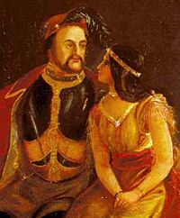
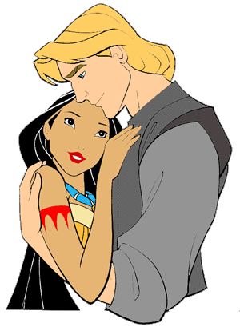
Farming the Land
No gold or silver, but find new way to make $$$
  John Rolfe
    Brings strain of tobacco from West Indies that grows extremely well here
      Sold in Europe… to rave reviews!
      Soon everyone selling it… colony begins to prosper and grow
    Relationship w/ natives improves
      Marries Powhatan princess “Pocahontas”
      Disney is wrong!!!
  1614- some colonists rent land begin selling crops and making $$$
    Encourages them to work harder
    1000’s of settlers were soon drawn to colony w/ acres of land and dreams of wealth
Why Disney Wrong?

Slide 10
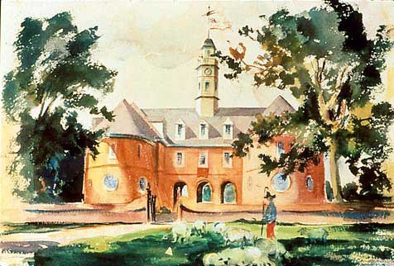
Representative Government
At first almost all men
  Worked for Virginia Company
    Strict rules
  Began complaining about being ruled from London
1619- company agreed to let them have some say
  10 towns in the colony sent 2 reps, called burgesses, to an assembly
    July 30, 1619- meet for 1st time (House of Burgesses)
    Had right to make local laws for colony
Burgess?

Slide 11
New Arrivals in Jamestown
1619- Virginia Company sends 90 women
“Colony can never flourish till families be planted”
  Colonists who wanted 1
    had to pay fee!!! (120 lbs. of tobacco)
1619- Dutch ship arrives
  20 Africans sold to planters to help in fields & as servants
    1st Africans came as indentured servants
      Became free, some even owned land
By 1660’s slavery recognized by law
Indentured Servant?

Slide 12
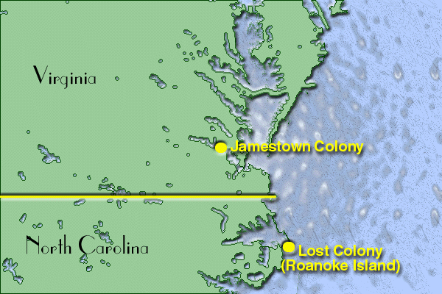
Essential Question-
Exit Ticket
Exit Ticket
The early English settlers were saved many times… describe at least three (3) ways they were saved, by whom, and with what.

