Slide 1
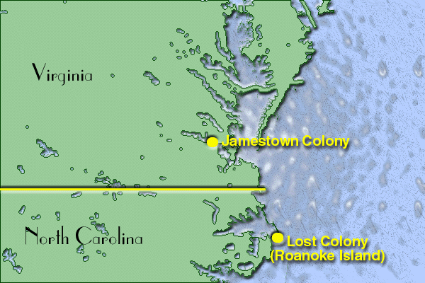
Warm- Up
Warm-Up
The early English settlers were saved many times… describe at least three (3) ways they were saved, by whom, and with what.

Slide 2
Colonial America:
1587-1770
3-2 The New England Colonies

Slide 3
Religion and Colonization (Bkgd.)
1517- Martin Luther
  German monk; publishes criticisms of Catholic Church (corrupt)
    1000’s support his attempt to reform Catholic Church
    protestors become known as “Protestants”
      Anglican Church or Church of England”
        King Henry VIII creates this…
          but keeps most of Catholic pieces
      Some Protestants think still too Catholic
        Want to “purify” Anglican Church
        Remove all traces of Catholicism’s corruptness
        Called them “Puritans”
      More radical Protestants…
        Want complete “separation” from both Catholic and Anglican
        Become known as “Separatists”
          Formed own version of Christianity
      Anyone not Anglican in England (Puritans, Separatists, and Catholics) were persecuted
      Many believe America only place to worship freely
Puritan &
Separatist

Slide 4
European Religion
CHRISTIANITY
CATHOLIC CHURCH
ONLY Christian religion at the time
PROTESTANTS
PURITANS
SEPARATISTS
Want to “purify” or fix the church
(good, but can be better)
What to completely “separate” from Catholic… start fresh but still Christian

Slide 5
Plymouth Colony
Separatists Persecuted in England
  So… go to Holland…
    still persecuted!
  Obtain charter from London Company’s grant in “Virginia”
  Sept. 1620- sail on Mayflower for Virginia
    35 Pilgrims
    67 “Strangers”
  11/9/1620- sight land BUT… not Virginia!
    b/c winter approaching settle outside of grant and its laws… they named Plymouth
    Draft “Mayflower Compact” to allow them to settle outside of grant and its laws
      Winter and disease wipe out half!!!
  Pilgrims get help following spring
    Natives teach how to survive
      How and when to plant corn
      Where and how to hunt and fish
      Arrange peace treaty with Wampanoag Tribe
      Celebration of Thanksgiving
Mayflower Compact?

Slide 6
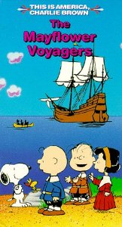
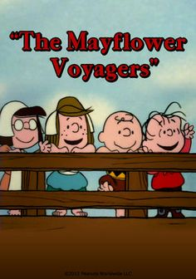
Video ?’s
Notes:
Video attached to 1st pic (24:34)

Slide 7
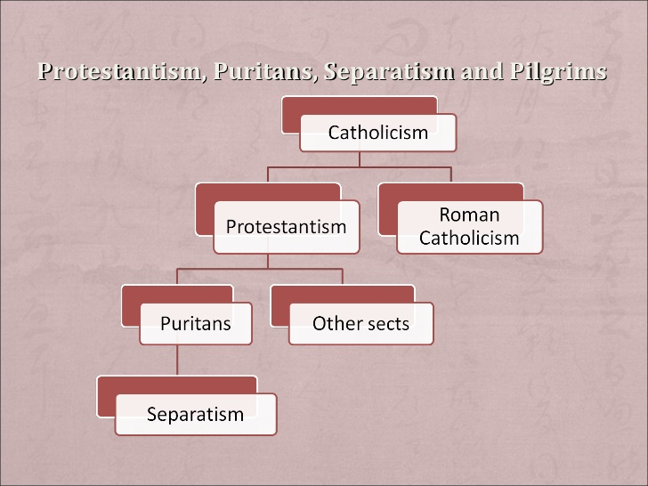
Essential Question-
Exit Ticket
Define
Define-
  PROTESTant
  PURItan
  SEPARATist

Slide 8
Puritans
Despite only wanting to reform Anglican church…
  Still heavily persecuted
1629- King Charles I (England) grants them charter in new Massachusetts Bay Colony
  1630- 17 ship convoy sets sail w/ 1,000 Puritans!!!
New England life different from Virginia
  Winters stop spread of malaria
  Tough 1st year but most still outlive people of England or Virginia
  Land very fertile
    Inland people- farmers
    Sea Coast people- merchants, fishermen
Want to spread out
  Receive large tracts from colonial gov’t
    Settle several all centering around chief town, Boston
By 1640- 20,000 had come to this “New England”
  Movement called “Great Migration”
Great
Migration?

Slide 9
Church and Community
Puritans believed formed covenant w/ God to build society based on Bible
  Sacred agreement
Church, fam., edu., and gov’t used to create and sustain “perfect Godly Community”
  Church most important aspect of life
  Encouraged families to emigrate
    Instill Puritan ideals
  Used education to sustain social and religious unity
    Had to be able to read (the Bible) to understand their ways
    Towns w/ 50+ families had to provide school
    1636 founded Harvard
      1st college in English colonies
Discussed comm. issues @ town meetings
  Political power in hands of “General Court”
  Then they gave people right to vote!
    More power than people in England
Covenant?
READ ME!!!
1st University?

Slide 10
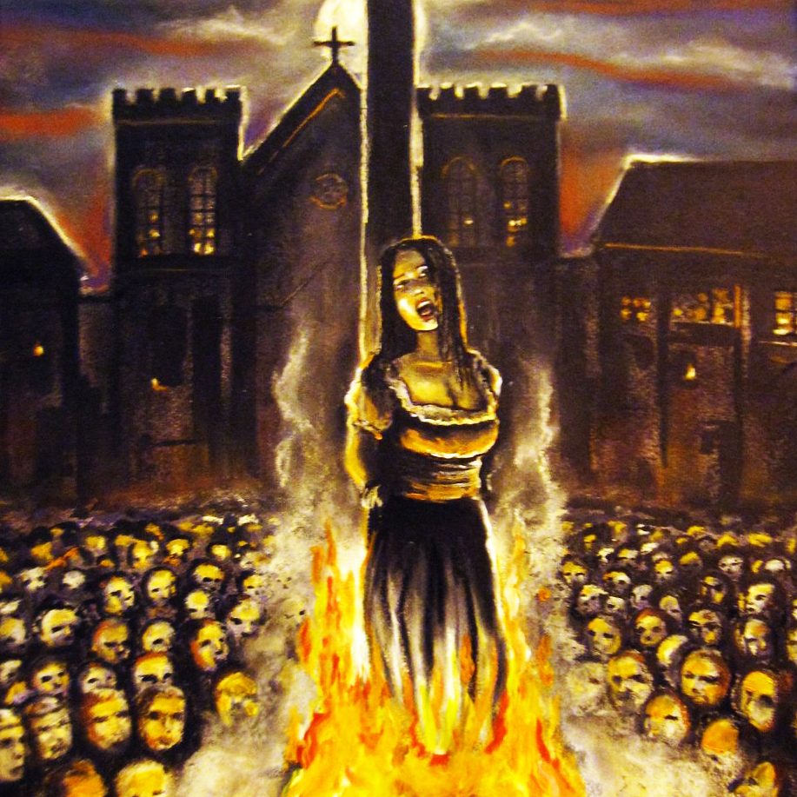
Conflicts in New England
Came to America for religious freedom
  BUT…
    Didn’t tolerate people who disagreed w/ Puritan opinions
Roger Williams
  Puritan minister who ?’ed Puritan ways
    Insisted colonists had no right to land outside of grants (Natives land)
      Either colonists or king pay natives for it
    Believed these actions would upset natives; who would attack
  Expelled in 1635
    Went south and founded new colony; Rhode Island
      Chartered in 1644
    Instilled ideals of fair treatment of natives and religious freedom
Anne Hutchinson
  Held mtgs. to discuss religious ?’s attracts large #’s
    Believed to be a threat to Puritan way b/c of #’s, ?’s and b/c women allowed
  Expelled in 1637
    She and followers go to Rhode Island
Salem Witch Trials
  Most Puritans believed in the occult
  Several girls start acting “strangely”
    3 charged w/ “bewitching” them
    Soon 100’s are accused of being witches
      30 found guilty
      19 either hung or burned at the stake
  Illustrates the worst of Puritan suspicion and intolerance!!!
Founded By…?
Irony?
Worst Example?

Slide 11
New Settlements
Founded By…?
Founded By…?
Connecticut
New Hampshire
Connecticut River Valley to the south more fertile than Massachusetts
  People begin to settle here
1636- Thomas Hooker; another Puritan minister
  Didn’t like way they ran the Massachusetts colony
  Led his congregation through the wilderness south, founded Hartford
    1639- Hartford and 2 other towns, agreed to form a colony
Adopted plan of gov’t called the Fundamental Orders of Connecticut
  1st written constitution in America
Others disliking Puritan ways
  like Williams in Rhode Island and Hooker in Connecticut
  begin to leave
1638- John Wheelwright led group north from Massachusetts
  Set up towns of Exeter, and Hampton
Colony becomes fully independent from Massachusetts in 1679
1st Written Constitution?
Notes:
Mr. Zoller’s Podcast: 13 Colonies- New England Colonies (14:37)

Slide 12
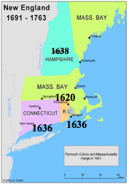
Essential Question-
Exit Ticket
Map / Table
Label the four (4) New England Colonies, and their date of settlement on the 13 Colonies Map.
Color all four (4) NE Colonies RED.
Fill-in the reverse-side table with date, town, reason, and founder.

