Slide 1
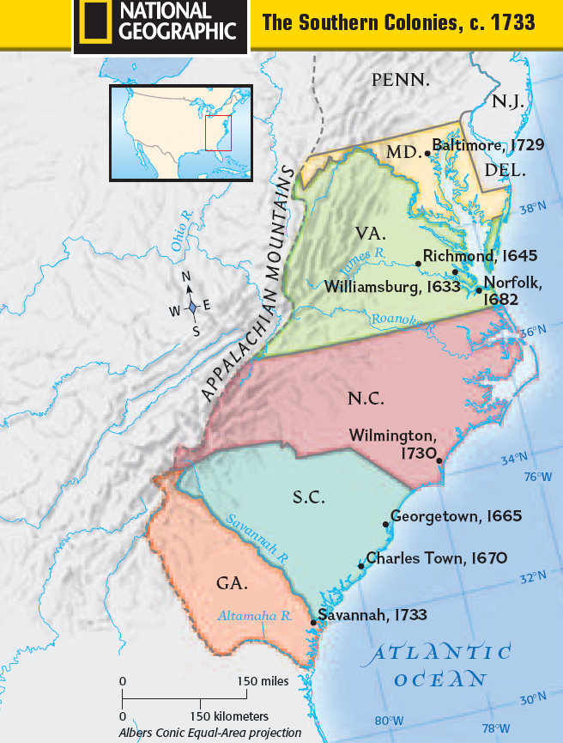
Warm-Up
Why were most of the Southern Colonies founded?
Warm-Up

Slide 2
The Colonies Grow:
1607-1770
3-4 Life in the Colonies
Part I

Slide 3
By the Numbers
Subsistence Farmer
Population Boom
New England Colonies
1700- 250,000 colonists
1770- 2,500,000 colonists
Black Population grew even faster
  28,000 to 500,000!!!
Why?
  Immigration
  Early Marriage & Large Families
    10-12 children!!!
Healthier Place to Live
Lived in organized towns
  Center of town was a Meetinghouse
    Place to meet
    Church
    Faced a piece of land called a Green or Common
      Cows to graze
      Citizen militia to train
Farming main source of economy in all colonies
  But… NE farms small
    Long winters and rocky soil
      Lg. farming impossible
  Most were subsistence farmers, grew only enough to feed the fam and pay few taxes
How make $$$ then?

Slide 4

Commerce In New England
NE Econ Based On???
Many small businesses and business owners
  Men
    Grind grain into flour and saw lumber
  Women & children made…
    Cloth / clothing, candles, soap, preserves
Lg. towns attracted skilled workers
  Blacksmiths, shoemakers, furniture makers, gun smiths, metal smiths, printers, etc.
Ship building
  Used lumber from forests, shipped down rivers to coast to shipyards
Fishing
  Made nets, hooks, rope, poles plus actual fish
    Cod, halibut, crabs, oysters, lobsters, whales (oil for lambs and bones)

Slide 5
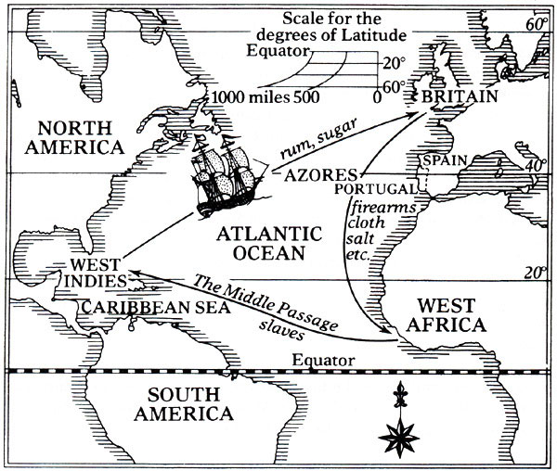
Colonial Trade
Steps of 2 Triangles
NE was center for shipping in America
  Linked northern & southern colonies
  Linked America to world
Traded colonies w/ West Indies (Caribbean Is.), Europe and Africa
  Some directly to Europe and back
  Others travelled on Triangular Trade Routes
    Took molasses and sugar from Caribbean to Colonies
      Made into rum in colonies
    Took rum and other goods from colonies to W. Africa
    Took slaves from Africa to Caribbean (the Middle Passage)
  Cycle starts over now adding slaves into mix to colonies
Notes:
<Triangle> Triangle Trade Basics (1:45) <Map> The Story of Us (1:26)

Slide 6
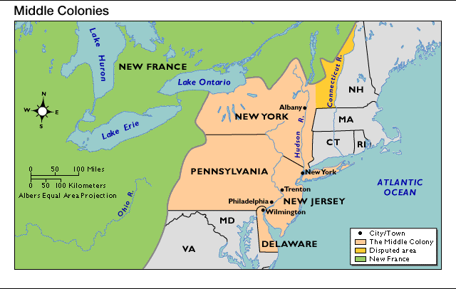
The Middle Colonies
Middle Colonies Econ Based On???
Enjoyed milder climate & much better soil than NE
  Larger farms
  Bigger harvests
  More $$$ farming
Fewer subsistence farmers and more Cash Crop farmers
  Crops sold on world market
Port cities like NYC and Philadelphia boom with shipping these goods
  By 1760… 2 largest cities in America!!!
Like NE, lots of industry
  Some home-based and crafts
  Mostly larger businesses
    Lumbering
    Mining
    Manufacturing
    Iron Mills

Slide 7

German Immigrants
Most of 100,000 German immigrants settled in Pennsylvania
  Using methods from home, become successful farmers
  Belonged to lots of Protestant groups
Together w/ Dutch in NY & Delaware, Swedish, and non-English
  Gave cultural diversity not found in NE
  w/ diversity came tolerance for religious and cultural differences

Slide 8
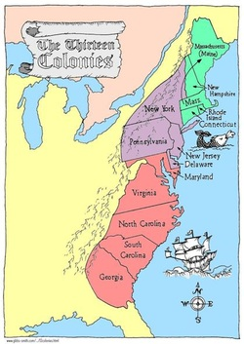
Essential Question-
Exit Ticket
Exit Ticket
NE Colonies’ Economy is based on what and why?
Middle Colonies’ Economy is based on what and why?

Slide 9
Warm-Up
Warm-Up
NE Colonies’ Economy is based on what and why?
Middle Colonies’ Economy is based on what and why?

Slide 10
The Colonies Grow:
1607-1770
3-5 Life in the Colonies
Part II

Slide 11
The Southern Colonies
Southern Colonies Econ Based On???
Characteristics of the South
  Rich soil
  Warm climate
  Long growing season
  Large plots of land to cultivate
    Add up to…
      “Cash Crop” farming
      Little to no need for industry

Slide 12
Tobacco & Rice
Tobacco
  Main cash crop of Virginia, North Carolina & Maryland
  Most sold in Europe
    Demand high
  Required good deal of labor to grow and prepare
    B4 used indentured servants
      Too expensive in long run
      Used enslaved Africans
  slaveholders got rich on tobacco
Rice
  Main cash crop in Georgia and South Carolina
  Grown along coasts
    Would flood when young
    Drained when time to harvest
  Harvesting hard
    Knee deep mud
    No protection from sun or insects
    Relied on slave labor
  Proved 2B more profitable than tobacco
  By 1750- SC and GA had fastest growing economy in colonies!!!
Main Cash Crops

Slide 13
Tidewater and Backcountry
Most plantations located in Tidewater, or flat, low plains along coasts
  Often located on rivers
    Easy to ship crops to market
Each plantation like own community
  Cluster of buildings and fields
    Main house (wife supervised house slaves)
    Slave cabins
    Barns
    Stables
    Kitchens
    Outbuildings housing blacksmiths, carpenters, etc.
    Lg. plantations may even have school or church!
West of Tidewater, was Backcountry, region of hills and forests climbing toward App. Mts.
  Settled by newcomers
    Grew corn and tobacco
  Smaller farms that may only have 1 or 2 slaves
  More backcountry farmers than lg. plantation owners, but…
    Plantations had wealth and power
    Controlled economic and political life in south
Tidewater & Backcountry

Slide 14
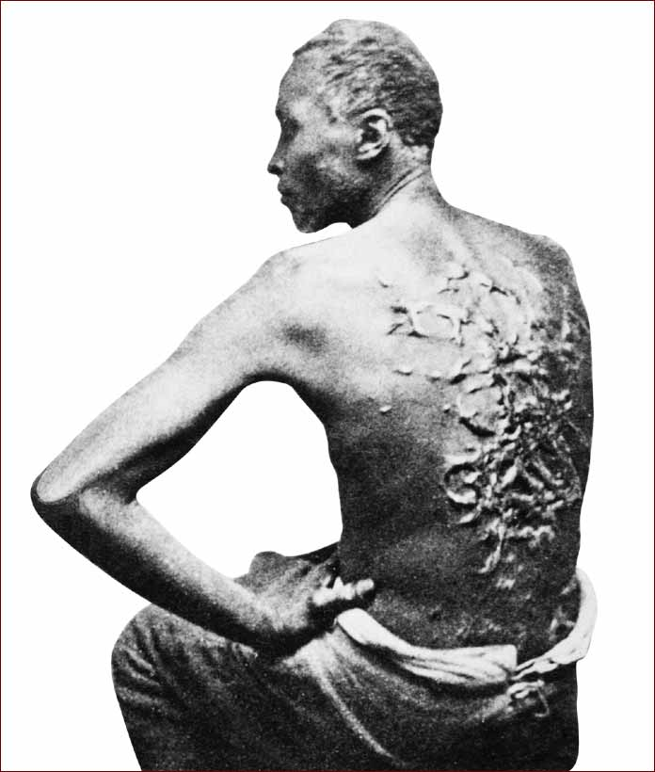
Slavery
Stop & Jot-
Lasting Impression of Slave Codes
Most lived on plantations
  Few did housework, but… most worked in fields
  Suffered great cruelty
  Owners hired overseers, to keep slaves working hard
By 1700’s many colonies had slave codes
  strict laws about behavior and punishment of slaves (Slave Codes)
    Slaves could not leave plantation w/o written permission
    Illegal to teach slaves to read or write
    Allowed slaves to be whipped for minor offenses
    Hung, or burned to death for serious crimes
    Runaways were caught and punished severely

Slide 15
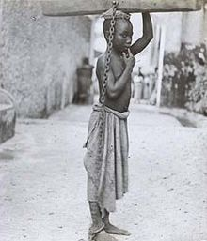
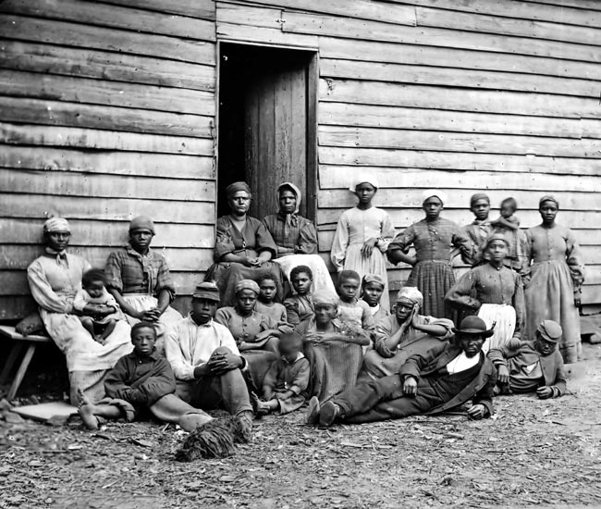
African Traditions
African Families
Strong family ties, but…
  Often torn apart and sold to other slaveholders
    Never seen again
Found source of strength in African roots
  Developed culture drew on languages and customs from Africa
Few learned trade like blacksmithing, carpentry, or weaving
  Skilled workers could sometimes set up shops
    Sharing profits w/ masters
    Some lucky enough to buy own freedom
    Become free African Americans
    Extremely rare!!!

Slide 16
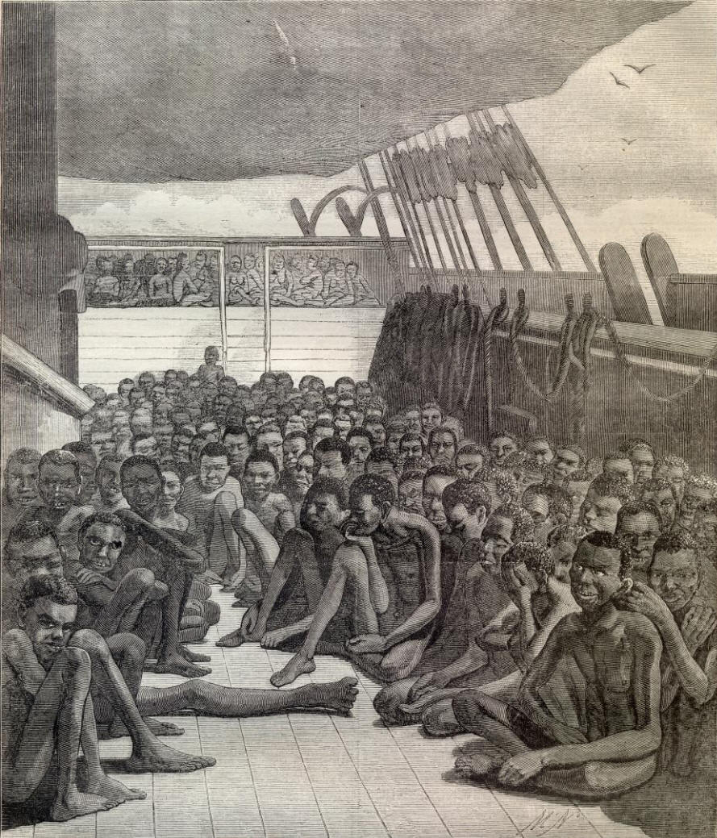
Criticism of Slavery
Slavery Plays Huge Role
Majority of white southerners were not slave owners
  Expensive, not b/c didn’t want
Played huge role in economic success of South
  Success built on idea that one human could own another
Many did not believe in slavery
  Puritans wouldn’t allow it
  Quakers condemned it
Many scared that south could not succeed w/o it though
  So it stayed for another 100+ years

Slide 17
Essential Question-
Exit Ticket
Exit Ticket
NE Colonies’ Economy is based on what and why?
Middle Colonies’ Economy is based on what and why?
Southern Colonies’ Economy is based on what and why?

