Slide 1
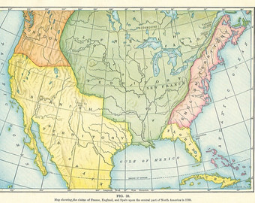
Warm Up
1) Warm Up!
What region of the New World does France hold? What about England?

Slide 2
The Colonies Grow:
1607-1770
3-8 France and Britain Clash

Slide 3
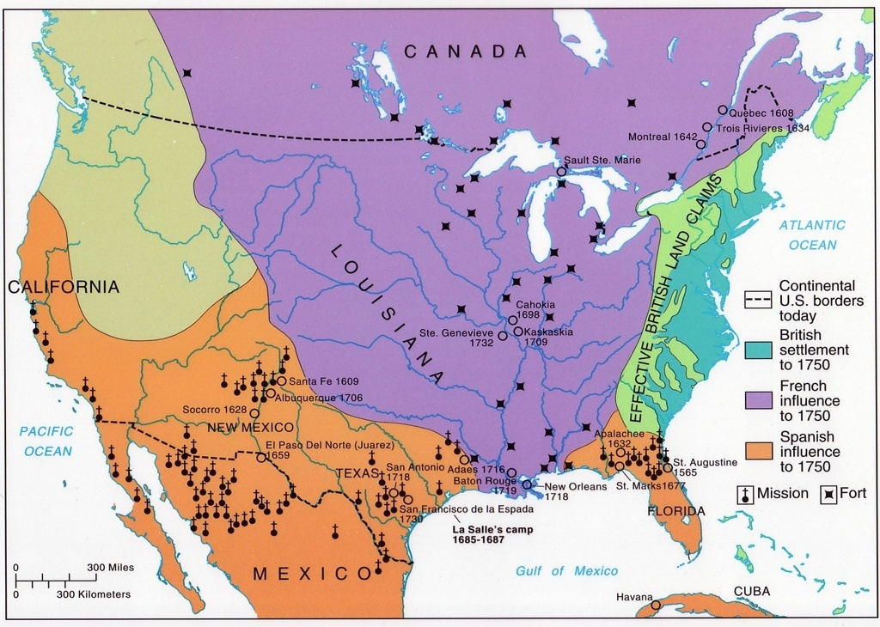
British – French Rivalry
2) What territory? What area today?
By 1700- 2 strongest powers in World!!!
  Rivalry trickled down to colonists
Growing population in English colonies begins to push up on French territory
  Hostility increases
  Brit land companies want in on land in Ohio River Valley
    French controlled… and not letting them in!
    Brits move in and set up Fort for fur trade
      French attack and drive out
  French set up string of forts along border b/t the 2
    2 heading for a showdown

Slide 4
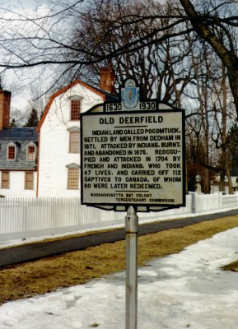
Native Americans Take Sides
3) Natives support who, why?
Both French fur traders and Brit colonists knew Natives could help
Side w/ natives would probably win control of NA
  French have many native allies
  French want furs; Brits want their land
  French just have better relationship w/ natives
During early fights, natives often helped French by raiding Brit settlements
  Example-
    1704- Abenaki Natives joined French attack of Deerfield, Mass.
      50 settlers killed!

Slide 5
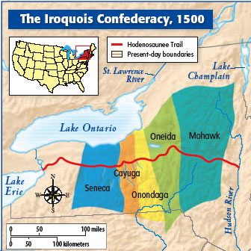
The Iroquois Confederacy
4) Why the Brits?
Most powerful group of natives in East!
  1st formed in 1570
Included 5 nations:
  Mohawk, Seneca, Cayuga, Onondaga, & Oneida
Remained independent… trading w/ both
  Played one against the other
    Dominated the area surrounding Great Lakes
By 1750’s, as Brits began moving up on them…
  eventually gave trading rights to Brits
  Reluctantly became ally
    Swings balance of power toward Brits
Notes:
Iroquois Confederacy (2:25)

Slide 6
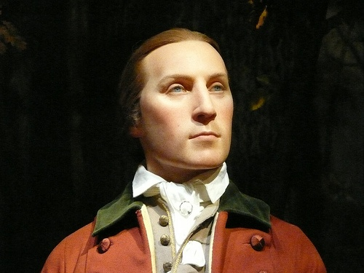
American Colonists Take Action
5) Visual Vocab: Militia
Bkgd.
  1753- Virginia Governor Robert Dinwiddie
    Sends 21 yr. old land surveyor to Ohio River Valley
      George Washington
    Mission:
      Tell French they were trespassing on Brit soil- demand they leave!
        French refuse!!!
1754- Dinwiddie makes Washington Lt. Colonel
  Sends him back w/ militia now!
    Civilian-trained volunteer army
  Instructions to build fort where Ohio and Monongahela Rivers meet
    Present-day Pittsburgh
  When arrived, found French already building fort there, Fort Duquesne
  Washington builds small fort near, names Fort Necessity (b/c it was needed)
  Greatly outnumbered, Washington attacks anyway
    French quickly defeat and capture them
    Returned later
  Washington’s bravery spreads throughout colonies and Europe!
  Regarded as hero who won’t take crap from French!
6) Video: Explain Washington’s Situation
Notes:
Washington and Fort Necessity (8:00)

Slide 7
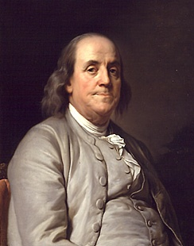
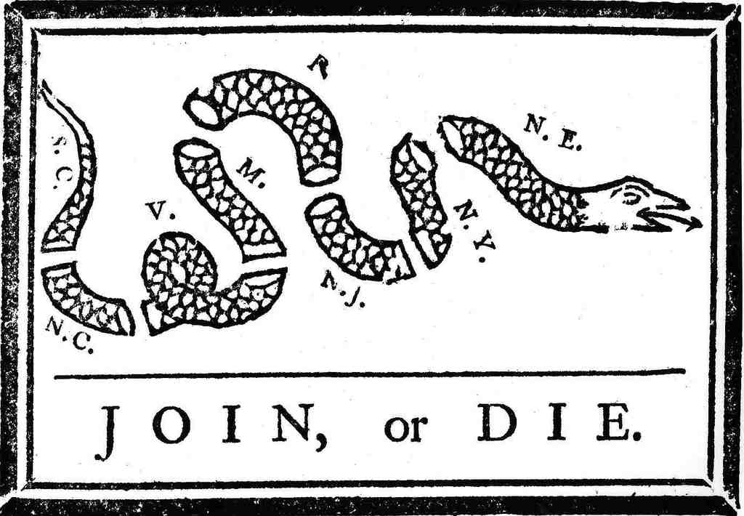
Albany Plan of Union
7) Stop & Jot
While Washington struggled w/ French…
June 1754- reps gather in Albany, NY
  Reps from NE, NY, PA, MD meet to discuss threat of war
  Find way to defend themselves from French
  Hoped to persuade Iroquois take side too
  Adopted plan created by Ben Franklin
    Albany Plan of Union
    Called for 1 general gov’t for the colonies
    Elected legislature would govern
    Have power to tax, raise troops, and regulate trade
  Not 1 Colonial Assembly approved the plan
    Not willing to give up any power w/in own colony
  1st attempt at uniting colonies!
Notes:
Ben Franklin- Bohemian Rhapsody (6:00)

Slide 8
What do you think this “Propaganda Poster” about the Albany plan of Union, is trying to say? What is its’ point?
8) Primary Source!

Slide 9
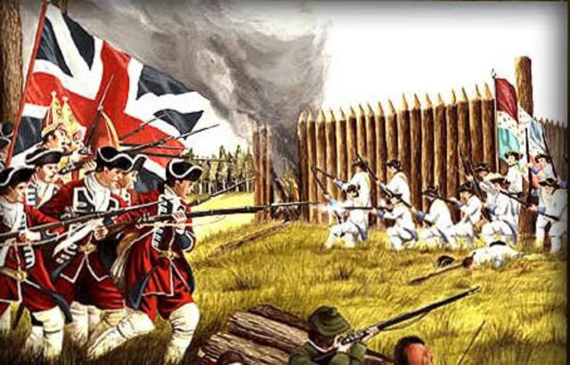
Exit Ticket: Essential Question
How did we get in a position for a big showdown between the “super powers?”
Who are their allies?
9) Exit Ticket!

