Slide 1
Warm Up
1) Warm Up!
What two sides are fighting over the Ohio River Valley, and who are their allies?
Are you ready to rumble?!?

Slide 2
The Colonies Grow: 1607-1770
3-9 The French and Indian War

Slide 3
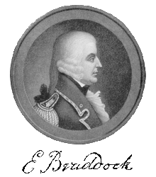
The British Take Action
1754- Gov. of Massachusetts declares…
“French are on their way to making themselves masters of this continent.”
Brits know French building well-armed forts in Ohio River Valley
Many alliances w/ natives
Allowed them to take control of land from St. Lawrence River to New Orleans
Pre-War early stages… colonists fought French and natives w/ little help from Britain
1754- London gets involved
Shocked at # of French forts in ORV
Fall of 1754- appoint Gen. Edward Braddock as Commander in Chief
Drive French out of OHR

Slide 4
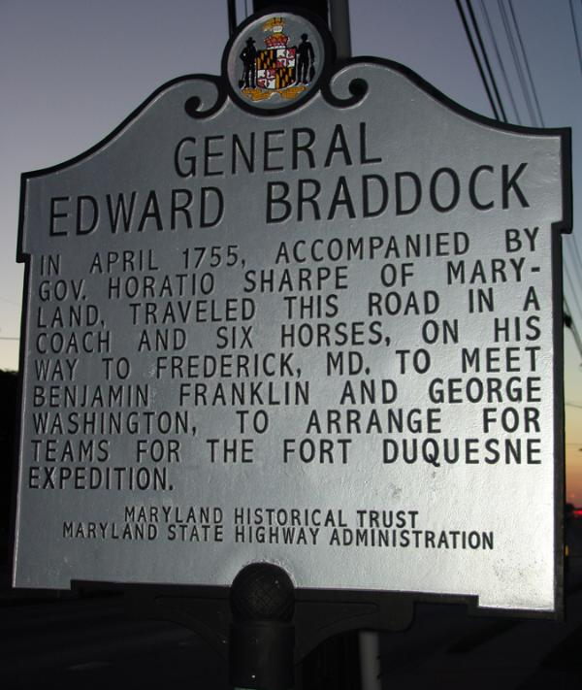
Braddock Marches to Duquesne
2) Redcoats, Bluecoats?
June 1755- sets out from VA for Fort Duquesne
1400 Brit Army (red-coats)
800-900 colonial militia (blue-coats)
Washington one of his aides
Tried to tell Braddock, army’s style not good for forests (rows)
Braddock ignores advice
Took weeks
July 9- natives & French ambush
French & natives hiding behind trees
Aim @ bright colored uniforms
Brits confused and frightened
Panic so great, Brits just run
Bitter defeat
Braddock killed
1,000+ casualties
Washington led survivors back to Virginia

Slide 5
Britain declares War on France
3) Other name for War, why?
Fighting in America leads to war in Europe
Seven Years’ War
Britain and Prussia fight French and allies in Europe
Britain fights France in Caribbean, India, and NA
1st years of war in NA were disastrous for Brits
French capture Brit forts
Natives stage raids on Brit settlements
Killed settlers, burned farms & crops, drove many back toward coasts
French forces from Canada take Brit forts on Great Lakes

Slide 6
Pitt Takes Charge
4) Fort Duq/Pitt are where?
War efforts improve when…
William Pitt becomes Sec. of State and Prime Minister
Skilled military planner
Oversaw war from London
Pitt takes on all the cost for war
Colonies pay for nothing
But…
Ran up huge debt
After war ran up colonists’ taxes to pay for it!
Didn’t just want ORV, wants it all!
Puts Jeffrey Amherst and James Wolfe in command
In 1758- lead assaults to recapture French forts of Louisbourg, Frontenac, Ontario, then finally Fort Duquesne
Renamed it Fort Pitt

Slide 7
The Fall of New France
5) Why is Quebec significant?
1759- so many British victories church bells in London wore thin!
Best yet to come!
Battle of Quebec
Quebec located high on cliff overlooking St. Lawrence
Impossible to attack… really!?!
Sept. 1759- Wolfe finds a way
Scouts find poorly guarded path up back of cliff
Sneak up it at night and set up for first light
Attack at dawn
Overwhelm the French and win the crown of New France!
Wolfe dies though… Awww!

Slide 8
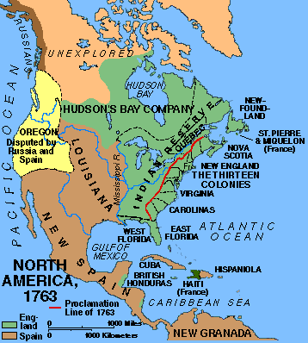
Treaty of Paris
Spain enters on French side just in time to see the end
Quebec and Montreal fall signal the end
Treaty of Paris signed in 1763
France gives up most of claims in Caribbean, all of Canada, & most of Miss. RV & ORV
Spain gives up Florida & Gulf Coast claims west of Miss. River
Marks end of France as power in NA
Continent now divided b/t England and Spain
Colonists happy- pushes French and Spanish further away
Natives unsure b/c what now happens to them?
6) Signals end of what…

Slide 9
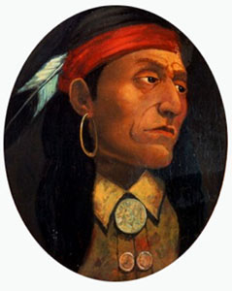
Pontiac’s War
“If you are French… join us. If you are English, we declare war against you. Let us have your answer.”
Brit victory hurts natives too
Lost ally
Lost trading partner
Still traded w/ Brits but…
Regarded them as enemies
Brits raised prices
Unlike France, refused to pay for use of land
Worst of all, began spreading out into new land gains
Pontiac, Ottawa Chief
Near present-day Detroit
Believed colonists threatened native way of life
Organized alliance b/t the native tribes
Attacked Fort Detroit
Captured most of forts in & around Great Lakes
Killed settles, and raided along border of colonies
Raids become known as Pontiac’s War
After Brits put stop to raids in July 1766
Pontiac is pardoned and signs peace treaty
7) Explain his quote

Slide 10
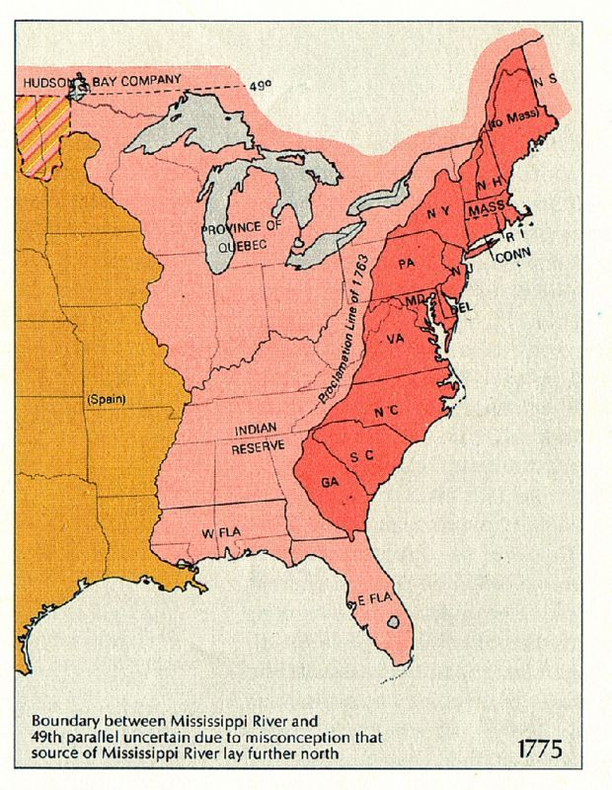
Proclamation of 1763
8) Why so upset?
To prevent more fighting…
King George III draws new line
Halts colonial expansion past the Appalachian Mts.
Angers many colonists
Some already bought land west of the new line
Furious that Britain ignored new land claims
End of war brought peace for first time in many years but…
More trouble is a brewin’…
can ya smell it???

Slide 11
Exit Ticket
9) Exit Ticket
Create an Analogy that shows how the colonists felt about the Proclamation of 1763

