Slide 1
Warm Up
Warm Up!
During the colonial period, the economic development of the South was most directly dependent on the labor of…
(a) factory workers (b) Irish immigrants
(c) wheat farmers (d) enslaved African

Slide 2
Road to Independence: 1763 - 1776
4-1 Taxation without Representation

Slide 3
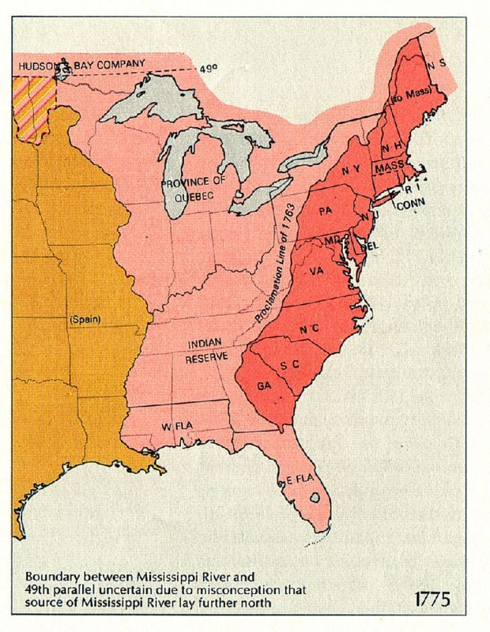
Relations w/ Britain
Post French & Indian War
Britain controlled Canada, NA to the Miss. River, and Caribbean
Proclamation of 1763- prohibited colonists from moving west of App. Mts.
Advantages for Britain
Allowed crown, not colonists to control expansion west
Orderly
Conflicts w/ natives maybe avoided
Slow colonists moving away from colonies
Important markets have more labor for more product
Allow crown to control lucrative fur trade
Alarmed colonists
Felt ‘Red Coats’ there to restrict them
Take away liberties
Restrict their freedom
Lead to feeling of distrust
Financial Problems for Britain
War put into huge debt
Need revenue, or incoming money
Felt only fair colonists should pay part
2) How could Britain Pay for war?

Slide 4
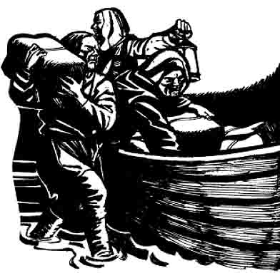
Britain’s Trade Laws
Visual Vocab!
1763- George Grenville becomes Prime Minister
Determined to reduce Britain’s debt
Take action against colonial smuggling
Smuggled goods avoided taxes
Could be used to reduce debt
Colonial juries often found smugglers not guilty
1763- Passed law saying smugglers sent to English courts instead
1767- authorized “writs of assistance”
Legal documents allowing Brits to search any location for smuggled goods
Even their homes!
Act Chart

Slide 5
The Sugar Act (1764)
Act Chart
Grenville tries to increase tax revenue
1764- passes Sugar Act
Lowered tax on imported molasses
Hoped lower tax encourage colonists to pay tax rather than smuggle
Also allowed Brits to seize goods from smugglers w/o going to court
New laws angered colonists
Rights as Englishmen being violated
Writs of Assistance violated right to secure their homes
British courts violated right to trial by jury
Guilty until proven innocent
Contradicted British law
Innocent until proven guilty

Slide 6
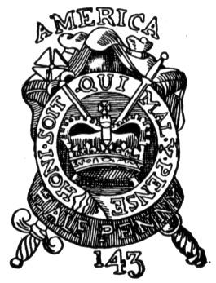
The Stamp Act (1765)
Act Chart
1765- pass the Stamp Act
Placed tax on all printed materials
Newspapers, pamphlets, wills, cards, etc. had to have stamp on it
Put on by British officials
So many items taxed, convinced colonists they must act
Why taxes wrong…
Interfered in colonial affairs by taxing directly
Taxed colonists w/o consent
No consultation w/ colonial legislatures
Why were colonists upset?

Slide 7
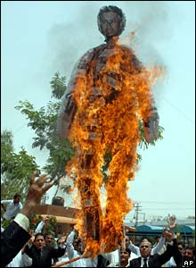
Protesting the Stamp Act
Patrick Henry, member of Virginia House of Burgesses
Convinces them to act
Pass a resolution, or formal expression of opinion against British tax
Only colonial legislature have right to tax colonies
Sam Adams in Boston starts “Sons of Liberty”
Took to streets to protest Stamp Act
People in other colonies did the same
Burned effigies
Rag figures representing tax collectors
Raided and burned homes of royal officials
Marched in the streets
Visual Vocabs!

Slide 8
The Stamp Act Congress
Oct. 1765- delegates from 9 colonies meet in New York
Stamp Act Congress
Draft letter to King and Parliament
Declares only colonial legislatures can tax colonies
Colonials begin to boycott
To refuse to use, or buy British goods
Signed Non-Importation Agreements
Pledge not to buy British imported goods
Spreads throughout colonies
British merchants begin to lose so much money they beg Parliament to repeal, or cancel the Stamp Act
Visual Vocabs!

Slide 9
The Repeal of the Stamp Act
March 1766- Parliament repeals Stamp Act
Whoo Hoo!!
Colonists win battle, but war far from over
Same day though passed another Act
The Declaratory Act of 1766
Says Parliament has right to tax and make all decisions regarding British colonies
Act Chart

Slide 10
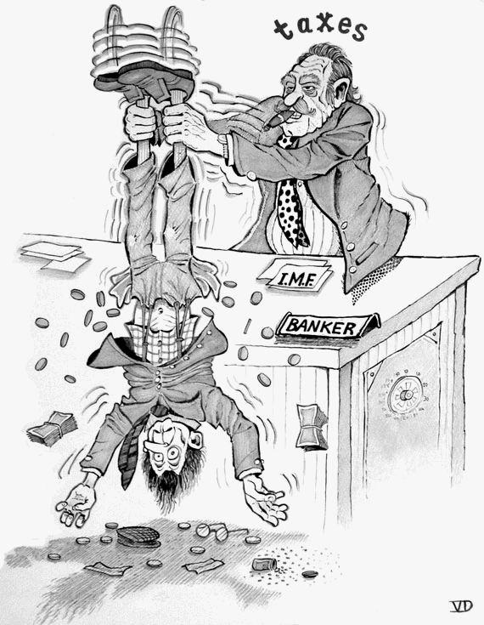
The Townshend Acts (1767)
Parliament passes Townshend Acts
Applied taxes only on imported goods
Goods taxed were basic necessities though
Had to import them b/c couldn’t produce them
Glass, tea, paper, lead, etc.
Colonists outraged!!!
Bring back the boycotts
Even more widespread this time
Act Chart

Slide 11
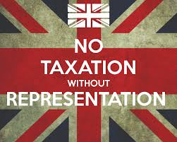
Exit Ticket
Foreshadow: What do you see the colonists doing next regarding the taxes?
Exit Ticket

