Slide 1
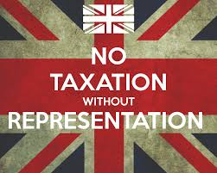
Warm Up
What does the term “Taxation Without Representation” mean?
1) Warm Up!

Slide 2
Road to Independence: 1763-1776
The “ACTS” of War

Slide 3
“Acts” of War
2) Colonial Perspective
The Navigation Acts (1673)
Outlawed direct trade w/ anyone other than Britain
Grenville Writs (1763-1767)
Smugglers tried not by jury of peers, but British courts
Writs of Assistance
Illegal searches of people and property now legal
Smuggled goods seized, smugglers jailed (no trial!)
Sugar Act (1764)
Taxed sugar and molasses imports
The Stamp Act (1765)
Tax on ALL printed materials
The Declaratory Acts (1766)
As part of British Empire, colonies subject to any and all laws and taxes placed by Parliament
The Townshend Acts (1767)
Taxed ALL imported goods
Goods colonists couldn’t produce so had to import
Glass, tea, paper, lead, etc.
The Quartering Act (1767)
Colonists required to house, feed, and supply British troops
Without pay!!!

Slide 4
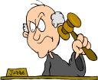
The Boston Massacre
3) Your thoughts?
Relations b/t ‘Red Coats’ & colonists grow very tense
5 March 1770
Red Coats in Boston
Colonists yelling and throwing things @ them
British soldiers panicked as crowd pushes toward them
Red Coats fire into the crowd!!!
5 colonists die as result
Soldiers put on trial in colonial courts
Receive fair trial
Found acted in self defense
I was fair and impartial!

Slide 5
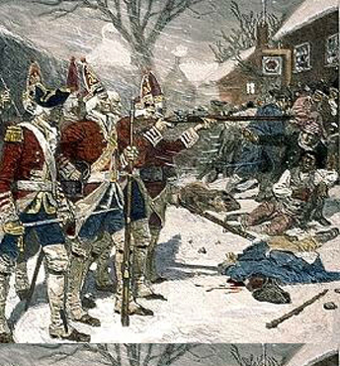
The Word Spreads
4) Killings used as…
Colonial leaders use killings to fuel stronger boycotts
Told story of orderly crowd and bloodthirsty Red Coats
Fuel to the fire
March 1770- repeal Townshend Acts (except tea tax)
Restores calm
Prime Minister promises not to raise money by taxing
Colonial radicals still think infringing on their rights
1772- Sam Adams creates Committee of Correspondence
Used to organize protests and spread word of misdealings
Brings colonists together
5) Committee of Correspondence

Slide 6
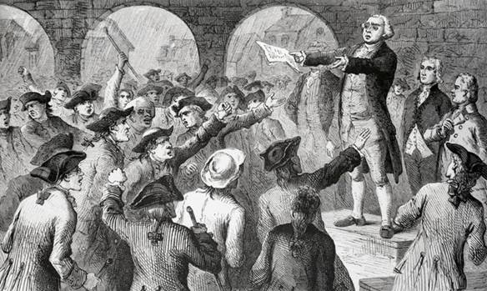
A Crisis Over Tea!?!
6) Goal of boycotts
Few years of peace but…
May 1773- tea tax left over from Townshend turns into “The Tea Act”
British East India Company will now sell directly to colonists
Bypasses colonial merchants
Lose huge amounts of money
Public protests soar
Colonists boycott BEIC tea
Sam Adams calls for boycott of ALL British goods!!!
Large public mtgs. in Boston and Philly
Vow to block unloading of BEIC tea
Shipments to NYC, and Philly forced to turn back
Shipment to Charles Town seized, but in Boston a showdown approaches
Dun, dun, duh!!!

Slide 7
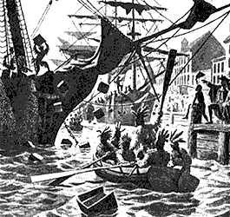
The Boston Tea Party
7) Boston Tea Party results
Massachusetts’ Royal Governor says Boston will take the tea
Tells ship captain to prepare to unload
Tension Grows
Ship stays loaded in harbor for 2 weeks
Samuel Adams leads crowds of angry colonists in protest
16 December 1773-
Colonists disguised as Mohawk Indians board ship @ midnight
In just 3 hours…
They opened and destroyed every single chest of tea on the ship
342 chests dumped overboard
Notes:
Liberty Kids: Tea Party 21:36

Slide 8
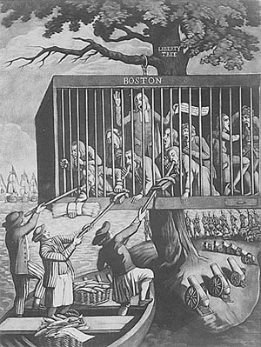
The Intolerable Acts (1774)
8) Coercive Acts - What are they? Other Name?
Word spread throughout the colonies
Colonists celebrated in the streets
When word hits London… reaction was very different!!!
British response is swift and severe
Pass 4 very harsh laws in spring of 1774
Called the Coercive Acts by crown
1.) closes Boston harbor until tea paid for (no ship in or out)
2.) cancels the Massachusetts Bay Colony’s charter
bans all public mtgs. w/o Governor permission
3.) law-breakers to be tried in London
4.) new Quartering Act instituted
Plan was to isolate Boston from rest colonies
Colonies stuck together sending food and provisions to Massachusetts
Colonists rename them the Intolerable Acts!

Slide 9
Exit Ticket
Analyze the political cartoon.
1) What is the cartoon showing?
2) Explain the imagery (what is going on, explain each part and what it symbolizes).
9) Exit Ticket: Primary Source

