Slide 1
The Declaration of Independence
4-7 Web Quest Activities

Slide 2
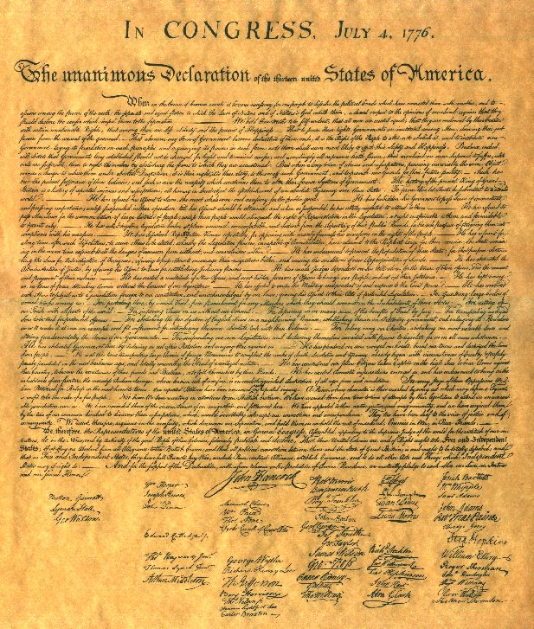
Preamble reading
You will use the worksheet you picked up on the way in the door to complete a group/individual reading an analysis of the Preamble of the Declaration of Independence.

Slide 3
The Preamble
When in the Course of human events, it becomes necessary for one people to dissolve the political bands which have connected them with another, and to assume among the powers of the earth, the separate and equal station to which the Laws of Nature and of Nature's God entitle them, a decent respect to the opinions of mankind requires that they should declare the causes which impel them to the separation.

Slide 4
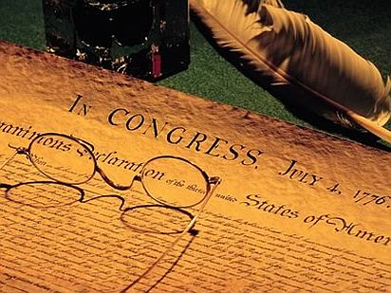
Web Quest Activities
Watch this first!!! Follow the lyrics!!!
http://www.youtube.com/watch?v=A_56cZGRMx4&feature=fvwrel
The Declaration- What it says…
http://bensguide.gpo.gov/3-5/documents/declaration/index.html
Reading of the Declaration- Celebrities
https://www.youtube.com/watch?v=jYyttEu_NLU
Creating the Declaration- click the links under “sections”
http://www.loc.gov/exhibits/creating-the-united-states/creating-the-declaration-of-independence.html
Editing the Declaration
http://www.loc.gov/teachers/classroommaterials/presentationsandactivities/activities/rough-draft/
Liberty’s Kids- the 1st Fourth of July (video)
http://www.youtube.com/watch?v=eccgj5u_Ydc
Signing the Declaration
http://www.archives.gov/exhibits/charters/declaration_join_the_signers.html
King George III speaks to parliament after independence declared
http://www.history.com/this-day-in-history/king-speaks-for-first-time-since-independence-declared
Learn About Independence- Read then play games
http://www.congressforkids.net/Independence_declaration_1.htm
Complete games by clicking on “show what you know”
Then go on the next activity and complete its’ game

