Slide 1
Warm Up- Spiral Review
What was voted on and adopted on July 4th 1776? Describe the events leading up to this adoption.
1) Warm Up

Slide 2
The American Revolution: 1776-1783
4-8 The Early Years

Slide 3
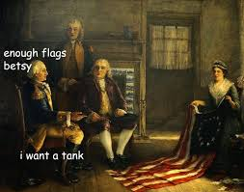
The Opposing Sides
After D of I, war for independence was unavoidable
Both sides thought war would be short
Brits thought would crush Patriots
Patriots thought Brits would give up after few losses
First glance…
Brits overwhelming advantage
Best navy in world
Experienced, well-trained army
Much larger population
Brits: 8+ million
Colonists: 2.5 million
Wealth of a worldwide empire
Patriot Disadvantages
Lacked regular army
Most militia (volunteers)
No navy
Lacked experience, guns, and ammo
Not all colonists supported the cause
Some were neutral
Some were Loyalists
2) First thoughts of war were…

Slide 4
The Loyalists (or “Tories”)
3) Loyalists.
Those who remained loyal to the crown
As many as 20-33% of colonists
Some changed sides during war (whoever was closest)
Loyalist strength varied by region
Strongest in the South
Weakest in NE
Why…
Some remained members of Anglican Church (king is leader)
Jobs depended on the crown
Many feared the disorder
Son vs. father, brother vs. brother, family vs. friends
Thought problems w/ crown were trivial
Others couldn’t understand what the problem was (communication?)

Slide 5
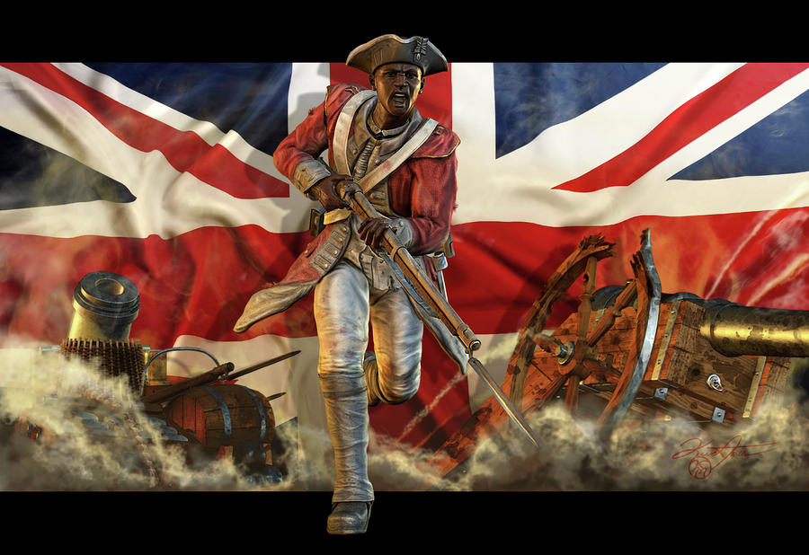
African Americans in the War
Some blacks sided w/ loyalists too!
At beginning Brits promised all enslaved Africans that fought for the crown would become free!
Many answered the call
In time some ended up freed in Canada
Others freed and sent back to Africa
Colony of Sierra Leone
West coast of Africa

Slide 6
Patriot Advantages
4) Patriot Advantages
Possessed some advantages too!
Fought on own ground
Knew the terrain
It was theirs!
Great determination; personal stake in the result
Greatest advantage was their leader… G-Dub!
Few could match his courage, honesty, and determination
British disadvantages
Brits mostly hired army, and mercenaries…
Hessian Mercenaries
German soldiers for hire
They don’t really care about cause; just money
Forced to fight in far away land
Forced to ship soldiers and supplies 1,000’s of miles
5) British Disadvantages

Slide 7
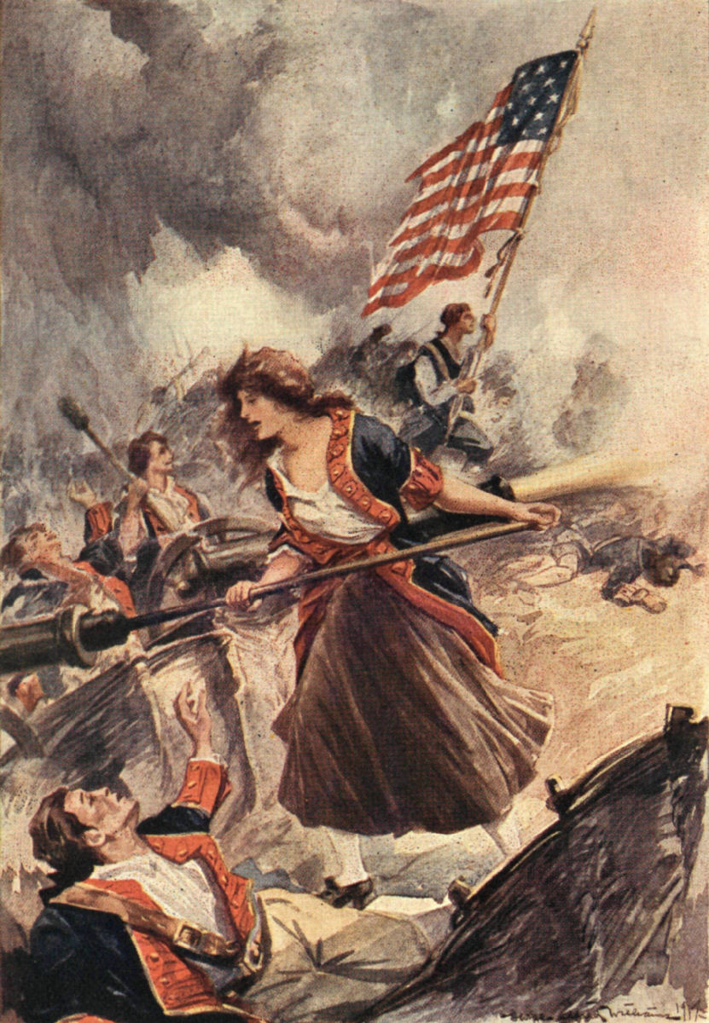
Raising an Army
6) Why was it so hard for G-Dub
These new Americans used liberty and freedom as basis of argument to throw off England
Result…
Unwilling to grant full power to Congress
Makes it difficult to enlist soldiers and raise money for war effort
Militia played important role but…
Still huge need for well trained army who could fight anywhere
States had to recruit
At first…
Soldiers signed 1-year contracts
Washington appealed for longer terms
Some did sign longer, but most signed 1-year contracts
Why problem… constantly have to retrain
Some women even fought
Margaret Corbin of PA
Went w/ husband when he signed up
When he died, she took his place
Mary Ludwig Hayes McCauley also went w/ husband
Soldiers called her “Molly Pitcher” b/c she would bring pitchers of water to the battle
Deborah Sampson disguised herself as a man and enlisted

Slide 8
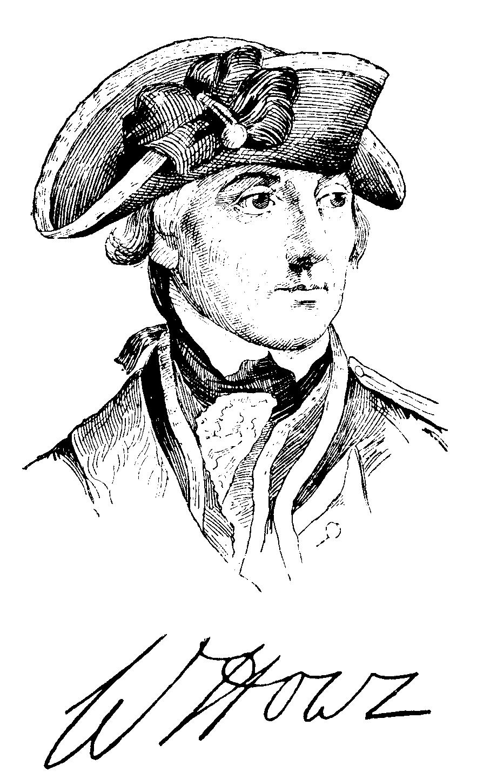
Fighting in New York
Most early battles involved few troops
Bunker Hill
Brits- 2,200 men
Patriots- 1,200 men
Brits knew need more troops to win quickly
During summer of 1776
Brits sent 32,000 troops across to NY
British commander General William Howe
Hoped sheer size would scare Patriots enough to win
Sadly mistaken

Slide 9
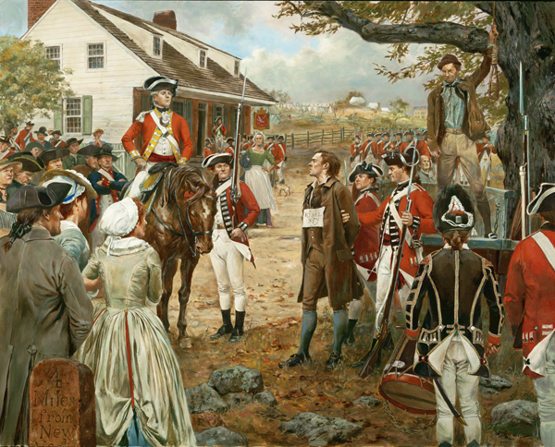
Defeat on Long Island
7) Nathan Hale’s quote
Although Washington and Patriots had fewer than 20,000 men
Determined to fight
Aug. 1776- Battle of Long Island
Outnumbered and outmaneuvered Patriots suffer serious defeat
Although Patriots brave…
Very few supplies
Many without socks, shoes, coats, and blankets
Tough in NY autumn, worse in NY winter
Nathan Hale-
Becomes hero of Long Island
Former-teacher from CT
Volunteers to spy on Brits as Dutch schoolteacher
Brits discover him; sentenced to death
Last Words…
“I regret that I have, but one life to lose for my country!!!”

Slide 10
A Low Point
After loss at Long Island
G-Dub retreats to Manhattan
By late-Nov. retreat across NJ then into PA
By winter of 1776-
Cause near collapse
Size of Continental Army shrinking fast
Some terms of service up- went home
Others ran away
W/O new soldiers cause would surely crumble!

Slide 11
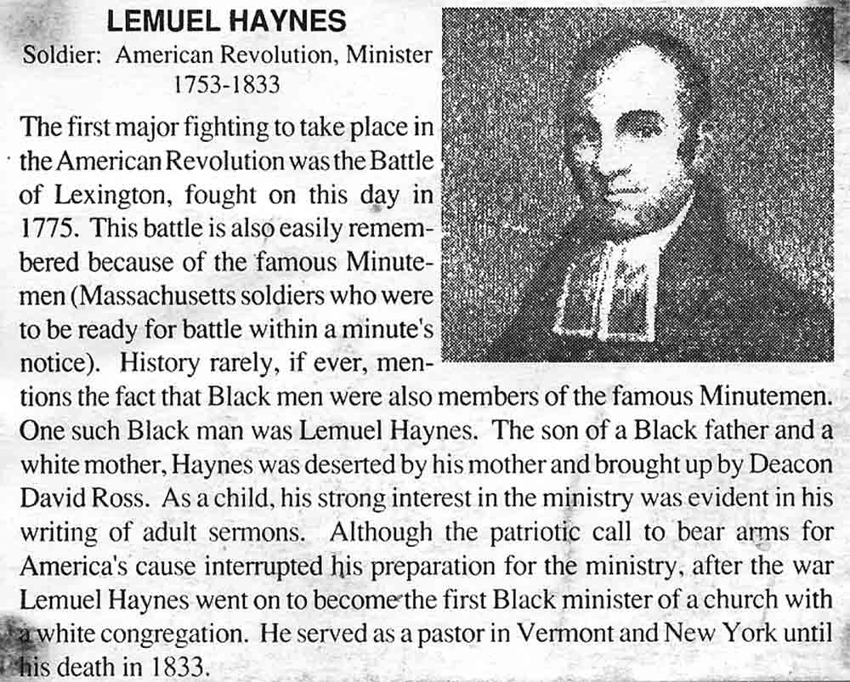
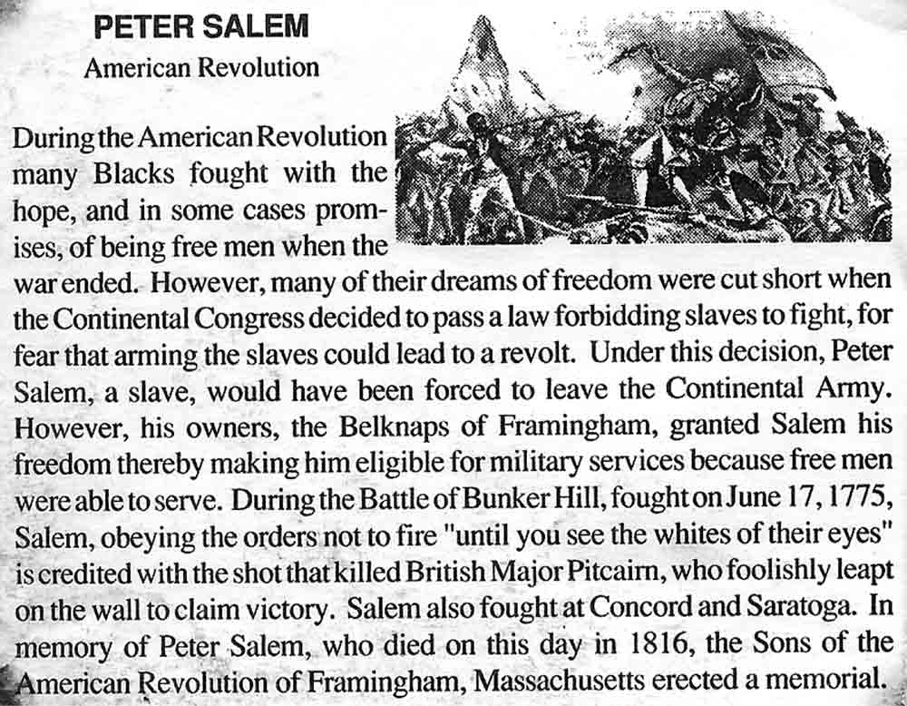
African Americans Join the Fight
Patriots Gain
G-Dub begs Congress to enlist freed men
Early on…
South convinces Congress not to
Many scared of handing blacks guns!?!
Southern states feared revolts
As need grew, some states ignored ban
Some fought as early as Concord and Lexington!!!
RI raises all-black regiment in 1778
By end, every state except SC has black soldiers
Estimates of 5,000+ black soldiers for Patriots
Fought for same reasons, and same cause
Some runaway slaves too, or those fighting in exchange for freedom
Don’t know that “all men created equal,” doesn’t mean them!
8) Why not SC?

Slide 12
American Victories in New Jersey
Brits settled in NY for winter of 1776
Didn’t fight in winter; at least, did not expect to fight
Left some troops in Trenton & Princeton, NJ
Stationed across the Delaware River from the Brits, G-Dub sees his chance!
Christmas night 1776, 2,400 Patriots sneak across river
Attack at dawn
Capture 900+ Hessians
Even more important were supplies needed
Leads them toward Princeton, NJ and wins there too!!!
http://www.youtube.com/watch?v=NTUsDukkGro
http://www.youtube.com/watch?v=mTaMvO2j7Y0
5:05-5:30, 7:15-8:30
9) How did they defeat them in Trenton?

Slide 13
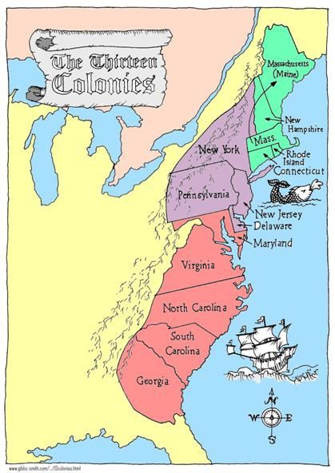
A British Plan for Victory
British battle plan for 1777
Gain control of the Hudson River; cutting off NE from rest of colonies
3-pronged attack
Gen. John Burgoyne-8,000 troops south from Canada
Lt. Col. Barry St. Leger east from Lake Ontario
Gen. William Howe north from NYC
Meet @ Albany and destroy Patriot force
10) Main goal of 3 prong plan

Slide 14
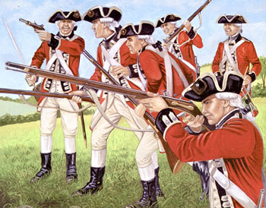
The British Capture Philadelphia
Howe planned to take Philly B4 marching to Albany
American Capital
Sept. 1777- win 2 battles near capital
Then takes Philadelphia
Forcing Congress to flee
Washington attacks the Brits @ nearby Germantown in response
G-Dub is forced to withdraw but…
delays Howe enough that he can’t meet up w/ Burgoyne and St. Leger @ Albany… yet!
Decides to spend winter in Philly
Alright Philadelphia, we got ‘ya surrounded! Come out w/ your cheese steaks in the air!!!

Slide 15
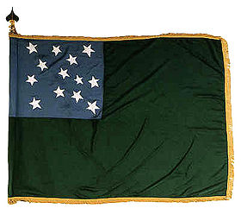
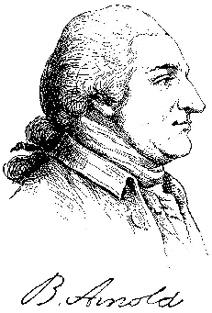
Patriots Slow the British
Problems delay Brit plans on Albany
August 1777- St. Leger’s advance halted by Benedict Arnold
Forced to retreat
Gen. Burgoyne not doing well either
July 1777- Burgoyne takes Fort Ticonderoga
But…
He’s a fancy General
Likes good food, and fine clothing
Travels w/ 30 wagons of luxury goods
Extra baggage
+ Dense forests
+ Patriots chopping down trees to block paths
= VERY SLOW MOVEMENT
In need of food and supplies he sends 800 men to take supplies from nearby Bennington, VT
Brits bright red jackets make easy targets for Green Mountain Boys
VT militia
Having lost lg. part of army and now desperate for supplies
Burgoyne retreats to town of Saratoga, NY in October
‘Green Mountain Boys’ flag

Slide 16
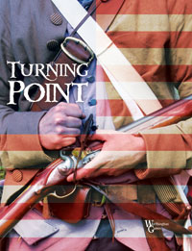
The Battle of Saratoga
11) 3 prong failed… why
@ Saratoga, Burgoyne expected Brit forces from West and South to join
But…
St. Leger was stopped @ Fort Stanwix, NY
Howe still in Philly
Plus…
Patriot troops under Gen. Horatio Gates blocked Burgoyne’s path to south
Burgoyne surrounded by army of Patriots 3x the size of his!!!
17 October 1777- Butt Kickin’ Time!!!
Burgoyne surrenders!
5,700 Brits hand over weapons to Patriots
While band plays “Yankee Doodle!”
British plan to separate NE from rest of colonies fails
Turning Point in the War!!!
Soon after, General William Howe resigns as Commander of British Troops
Replaced by General Henry Clinton
12) Significant because…

Slide 17
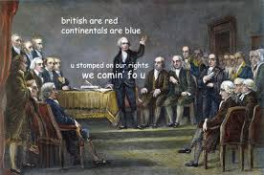
Exit Ticket
13) Exit Ticket!
The Patriots now have swung the momentum of the war in their favor. What are several contributions that got them there?

