Slide 1
A More Perfect Union: 1777-1791
5-2 Convention and Compromise

Slide 2
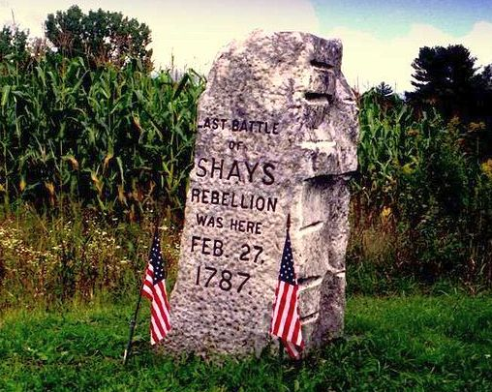
Something’s Amiss
#4
#3
#2
#1
Mid-1780’s-
All states faced debt problems
People had little $ but…
State kept levying high taxes
Avg. family owed $200/year
More than most made in a year!
Couldn’t pay… holdings auctioned off or jailed
Mass. Farmers begged for debt relief but were refused so… they rebelled
Shays’ Rebellion
Daniel Shays – war vet & leader of rebellion
Commanded 1,500 men
Jan. 1787-
Shays men marched & attacked federal arsenal
Defended by 900 militia who quickly put down rebellion
Lost but…
Won sympathy w/ people
Future uprisings could spell danger for new nation
Need to meet about fixing the national gov’t if they were to survive!
Notes:
Liberty’s Kids- We the People (

Slide 3
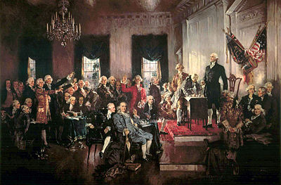
Convention is Called
#7
#6
Sept. 1786-
Series of events began to worry most
Delegates of 5 states meet in Annapolis, MD.
Do we need to fix this new gov’t?
Lead by James Madison & Alexander Hamilton of NY… call for delegates to meet in Philly to discuss changes to ‘Articles’
At first, most believe new gov’t just fine but…
News of rebellions like Shays’ leads to doubters
Delegates from all but RI meet in Philly in summer of 1787
RI doesn’t want to even discuss changes
b/c of unanimous clause, think nothing can be done w/o them

Slide 4
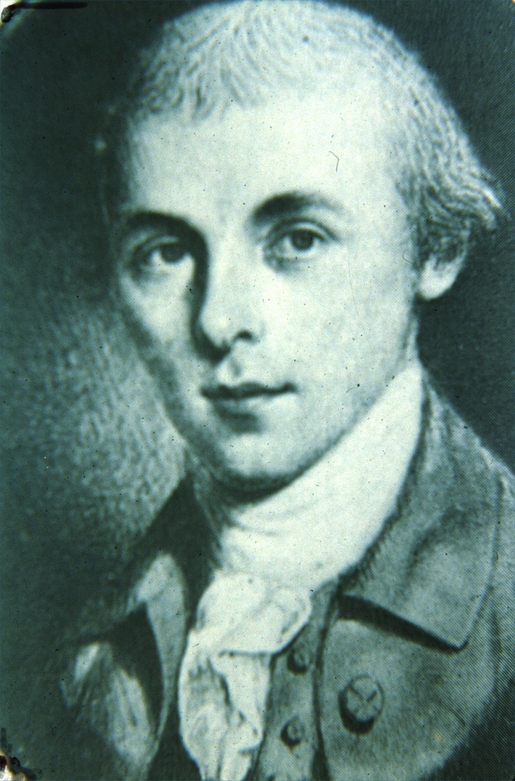
The Delegates Assembles
May 1787- 55 delegates arrive @ Constitutional Convention
Very impressive group
50% lawyers
Others were planters, merchants, doctors, legislators
75% were delegates from Continental Congress
G-Dub, Ben Franklin, James Madison lead list of delegates
All now referred to as Framers or Founding Fathers
Jefferson, and Adams were overseas and couldn’t attend
Patrick Henry refused to attend,
“smelled a rat in Philadelphia, tending toward monarchy.”
Also, did not reflect US population
No natives, Africans, or women
Didn’t consider them citizens; not invited
Most arrived w/o clue of what to expect
Are we amending or creating new???
Fear overblown gov’t but knew needed gov’t to protect citizen’s rights
So… needed to be strong but not too strong
James Madison, known as “Father of the Constitution”

Slide 5
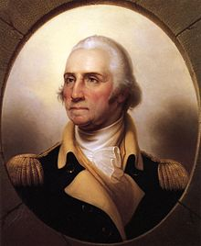
In the Beginning…
#8
1st Job- elect president for convention
George Washington was most respected & admired
Made easy choice; elected unanimously
Next task …
Decided on rules
Delegates wanted freedom to voice honest opinions
Decided all discussions would remain secret!
Windows were locked and doors guarded
Now get down to business

Slide 6
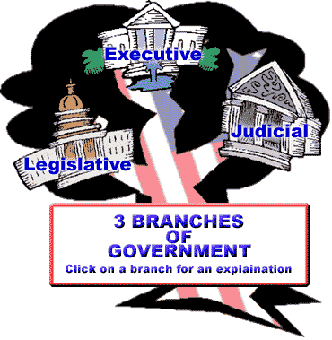
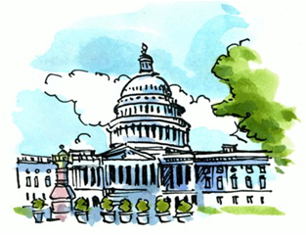
The Virginia Plan
29 May 1787-
G-Dub recognizes Edmund Randolph of Virginia
1st Speaker of convention
Offers idea for whole new gov’t!
Later known as The Virginia Plan
Created by Madison and VA delegates while waiting for mtgs. to begin
Called for 3 branches of gov’t to ensure no one too much power
Legislative- write laws
Bicameral Legislature
2 houses
Reps based on population of states
Executive- enforce laws
Lead by chief executive
Judicial- interpret laws
Lead by high court
Plan leads to weeks of debate
Big states like it
More reps legislature
Small states don’t
Worried lg. states would end up ruling
#9
The Virginia Plan
Part 1
(The 3 Branches)
#10
Part 2
2 Houses of Congress
(but both based on population)
Notes:
DisEd- The Virginia Plan (1:27)

Slide 7
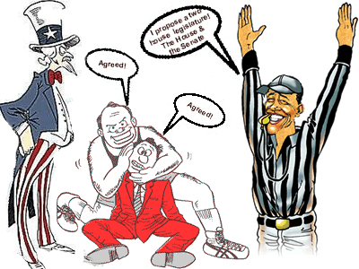
The Great Compromise
15 June 1787-
NJ proposes alternate plan
Called for legislature only but w/…
1 state, 1 vote
Increased power for Congress to tax, & regulate trade
Very similar to Articles of Confederation w/ more power
19 June 1787- 2 plans voted on
Virginia Plan wins meaning…
Scrapping of current ‘Articles”
Rest of June delegates argue about representation in the legislature
Committee formed to create compromise
Solution…
Great (or Connecticut) Compromise
Senate- equal reps for all states
Small states happy
House of Representatives- reps based on population
Large states happy
Another week of arguing, but…
Passed on 16 July 1787
#11
Notes:
DisEd- The Great Compromise (2:18)

Slide 8
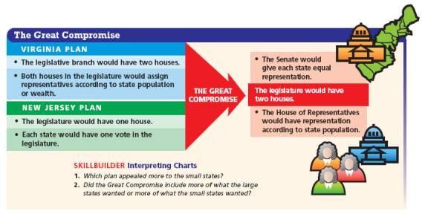

Slide 9
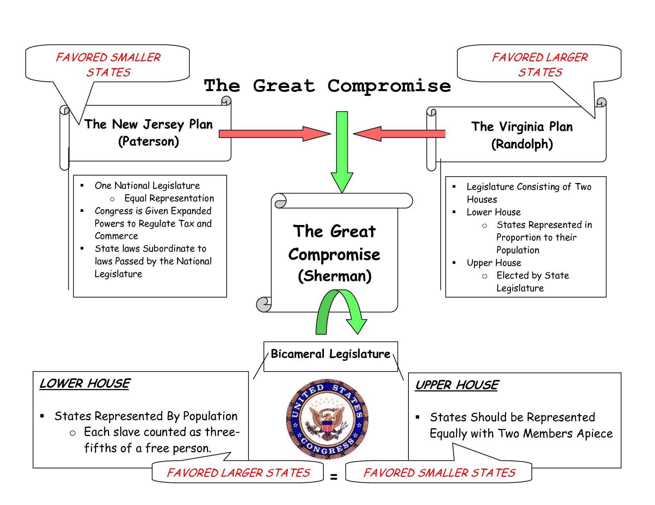
(Paterson)
(Madison)

Slide 10
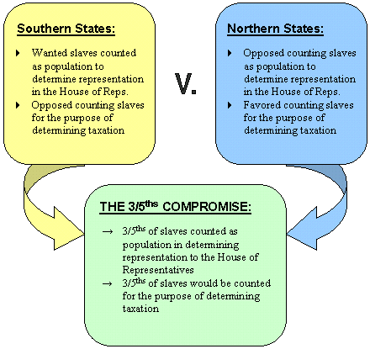
Slavery and the Constitution
House of Reps based on population… who gets counted?
South wants slaves counted for reps, but not for taxes
North argues can’t have it both ways
“3/5’s Compromise” is reached
Each slave would count for both reps & taxes, but only at ratio of 3 out of every 5
Slave trade leads to another heated debate
Slavery outlawed in north, & new NW Territories
Import of NEW slaves also outlawed in north and some southern states
Most want this extended to all states but south refused
SC & GA said would refuse any plan if slavery banned
29 August 1787-
Congress rules could not ban import of new slaves
Finally banned 1808
#12

Slide 11
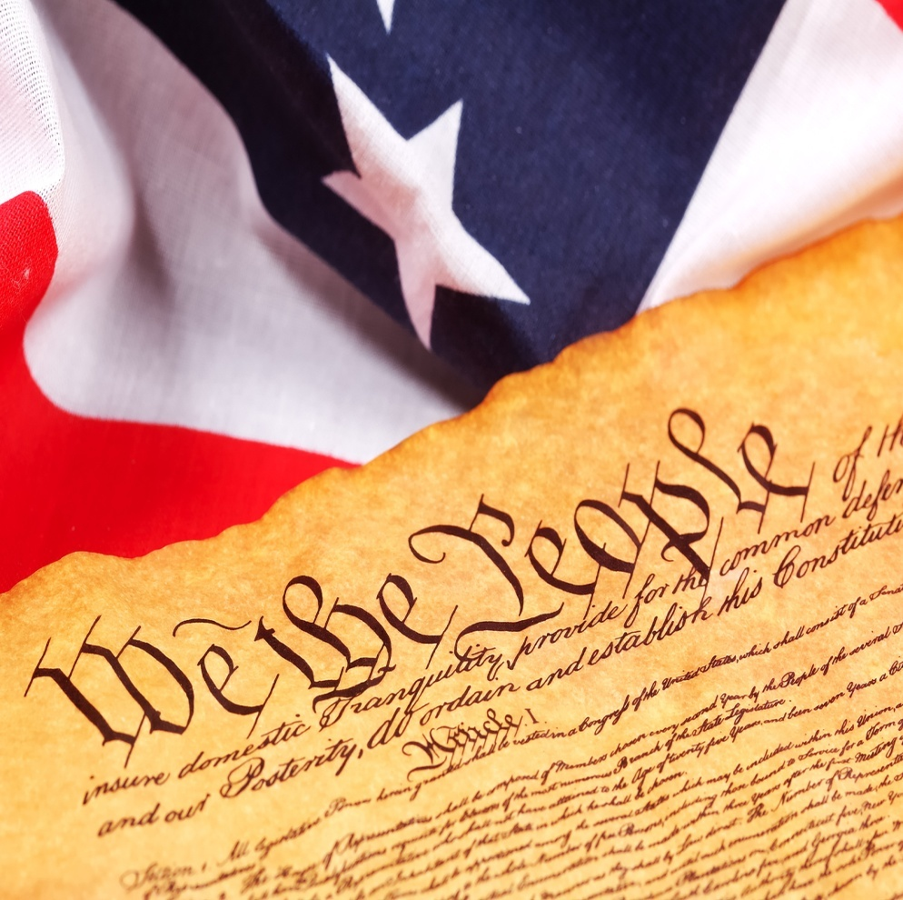
The End is Near!?!
New Constitution would place few limits on Congress’ power to regulate trade
Most happy that federal gov’t would regulate trade
But…
Says nothing of Native Americans
Neither foreign nation nor part of separate states
Convention would meet into September
15 September 1787- Constitution voted on by delegates
16 September 1787- written out onto four (4) sheets of thick parchment
17 September 1787- 52 of 55 delegates sign it
Then sent out to states for approval
#13

