Slide 1
Warm Up: Spiral Review
Warm Up!
What guarantees us our Rights?
What keeps one branch of government from taking too much power?

Slide 2
A New Nation (1789-1800)
5-5 The First President

Slide 3
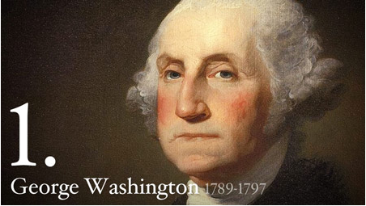
President Washington
2) Washington becomes…
After the Constitutional Convention…
Washington looked forward to quite retirement
Instead citizens elect him President… unanimously!!!
Only President where this occurs!!!
30 April 1789- Washington takes Oath of Office in NYC
Becomes 1st US President under Constitution
14 other Presidents before
But during Revolution & under Articles of Confederation
Many fearful of Presidency
Feared may try to become King
But…
Trusted G-Dub!
G-Dub aware of difficulties in front of him
Decisions would shape nation forever
Lots to do, but most importantly…
Decisions to make about structure of government
Notes:
Oddities of the 1st Election (4:06)

Slide 4
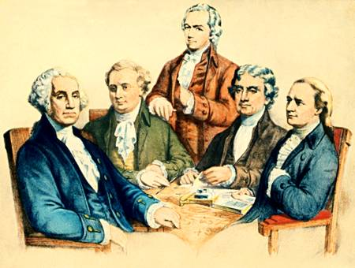
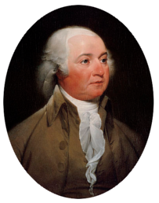
The First Congress
3) Visual Vocab: Cabinet
Summer of 1789- Congress creates 4 departments of Executive Branch
Washington appoints All-Star Team to head depts
State Dept- handle relationships w/ other nations
Thomas Jefferson- Secretary of State
Treasury Dept- handle financial issues
Alexander Hamilton- Secretary of Treasury
War Dept- handle nation’s defense
Henry Knox- Secretary of War
Attorney General- handle gov’ts legal affairs
Edmund Randolph
Become known as Cabinet- President’s Top Advisors
Other Powerful Positions
John Adams- Vice President
John Jay- Chief Justice of Supreme Court
G-Dub meets w/ them regularly
Even though they are Washington's Advisors…
Created by Congress
Heads approved by Senate
Should POTUS be able to replace them if he chooses???
Congress split on decision
VP Adams- breaks the tie in favor of POTUS
Wat Up All-Star Team!
Alexander Hamilton- Treasury
Henry Knox-War
Thomas Jefferson- State
4) All-Star Team
Ed Randolph- Attorney General
John Adams- VP
Notes:
The Presidents (6:55-8:25)

Slide 5
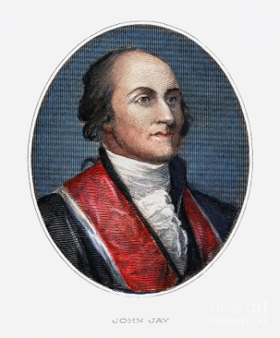
Judiciary Act
Constitution briefly mentions Supreme Court
Leaves details up to Congress
Sides split between…
a Nat’l Court System
a State Court System
Compromise met w/ Judiciary Act of 1789
Establishes Federal Court System…
13 District Courts
3 Circuit Courts
State Laws would remain but…
Federal Court has power to reverse state laws if necessary
Supreme Court would be highest Court in the Land
G-Dub nominates John Jay as Chief Justice
Senate approves of John Jay
With this Act Congress has set up a strong, independent nat’l court system.
5) Judiciary Act
John Jay- Chief Justice

Slide 6
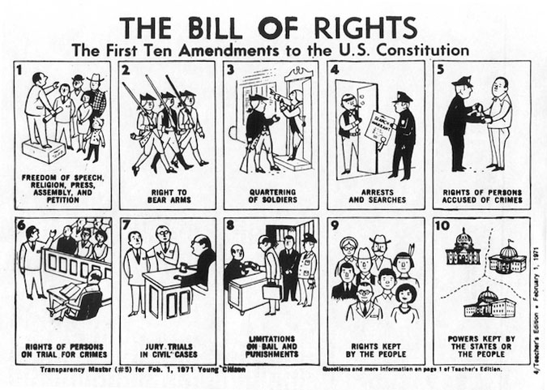
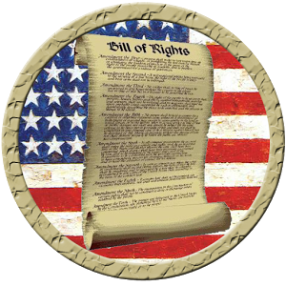
The Bill of Rights
6) Purpose?
7) Define: Amend
Americans long feared central gov’t…
Feared become too powerful
To protect against this many wanted a list of rights and freedoms that could not be affected
Some states only ratified Constitution under this condition
James Madison introduces list of amendments in Congress
12 approved, but only 10 ratified by states
December 1791-
Bill of Rights added to Constitution
Purpose-
Limit power of central gov’t against people
Protect rights given to men by God
Notes:
Rights Rights Baby (4:43)

Slide 7
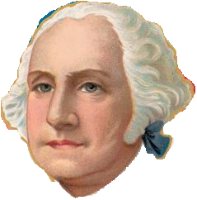
Financial Problems
Bake Sale!!! Help out our New Gov’t… Every Cupcake Helps!!!
Washington concentrated on foreign affairs and military matters
Left major majority of gov’ts financial issues to Sec of Treasury
Alexander Hamilton
Faced serious financial problems
Huge national debt, amount country owes, and only growing!!!
Has to find way to improve USA’s financial rep
And…
Strengthen nation at same time

Slide 8
Financial Problems
8) Hamilton’s Plan
Hamilton’s Plan
Opposition to the Plan
1790- A. Hamilton proposes…
Fed Gov’t pay debts owed by Confederation Gov’t to other nations and citizens
States fought for independence, so Nat’l Gov’t should pay for their work
Believed that this would give states strong interest in success of Nat’l Gov’t
Congress agrees that should pay off debt to other nations
But…
Not to its own citizens
Price of living in a free nation
During Revolutionary War…
US issued bonds, or paper IOU’s for money borrowed from individual citizens
Bond Owners feel betrayed by new gov’t who would default on loans
South upset b/c they borrowed much less money than others
Argued they would have to pay debts of North

Slide 9
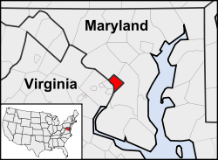
Compromise Results in a Capital
9) Compromise
Support for Hamilton’s Plan hinges on compromise
South would remove objections if…
New Nat’l Capital be located in the South
Special district to be established b/t Virginia and Maryland along banks of Potomac River
Capital would move from NYC to Philly until new city could be laid out
Creates District of Columbia
Capital named Washington, DC

Slide 10
Building the Economy
10) Definitions!
The Fight Over the Bank
Tariffs & Taxes
1792- only 8 banks in the entire nation!!!
All est. by state gov’ts
Alexander Hamilton wants to unite them & make a nat’l bank
James Madison & Thomas Jefferson
Argue nat’l bank would be unconstitutional, or inconsistent w/ the Constitution
Constitution doesn’t specifically say Congress could do this
Washington sides w/ his Sec of Treasury A. Hamilton
Signs bill, or proposed law to create the nat’l bank
Most make living by farming
Hamilton’s believes industry & manufacturing would make economy stronger
Proposes tariff, or tax on imports
Encourage people to buy American
Encourage Americans to move toward industry
Protect American industry from foreign goods
South against this b/c little industry to protect
But…
Hamilton wins over Congress
By 1790-
90% of USA’s income due to revenue from tariffs
Final part of Hamilton’s Plan centers around nat’l taxes
Gov’t needs additional funds to operate & pay interest on nat’l debt
Ex- tax on whiskey distilled in states
Hamiton’s Plans give nat’l gov’t many new powers
Opponents feel nat’l gov’t may be too strong now!

Slide 11
Exit Ticket
11) Exit Ticket
How did the founding fathers, yet again, use compromise to help fix our nation?

