Slide 1
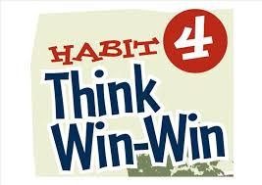
Warm-Up Spiral Review
Warm-Up!
How did the founding fathers, yet again, use Habit 4 (compromise) to help fix our nation?

Slide 2
A New Nation (1789-1800)
5-6 Early Challenges

Slide 3
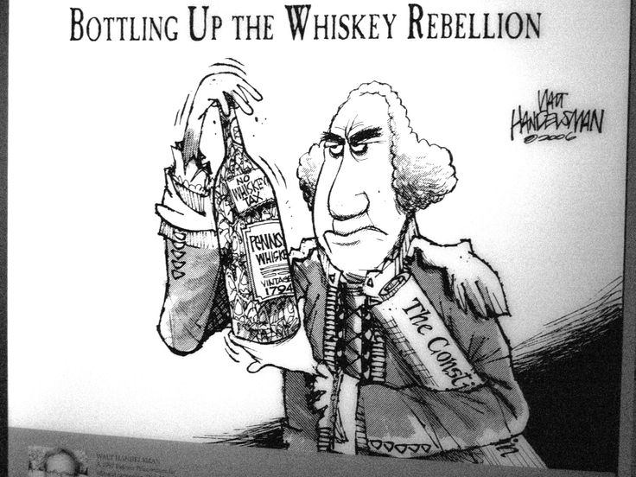
The Whiskey Rebellion
Barter?
Hamilton’s taxes lead to rebellion in western PA
Why the special tax on whiskey!?!?!
Most lived by bartering, or exchange of goods and services
Never had cash!
How could they pay tax on whiskey???
Protests mostly peaceful- until July 1794
Fed tax collectors came to enforce tax
Attacked by the large mob
Called… The Whiskey Rebellion
Alarmed leaders
Washington decided to crush rebellion
Serve notice to people who opposed gov’t
Would have to do so peacefully & lawfully
Shows gov’t will use force to maintain order
Video Facts (5)
Notes:
How Booze Built America (2:42)

Slide 4
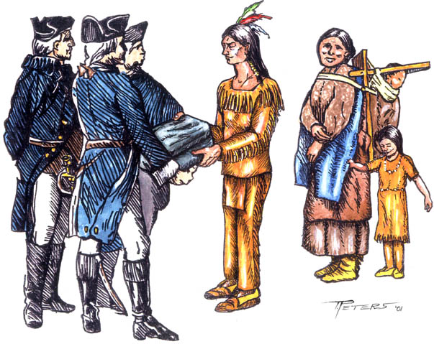
Struggle Over the West
Also have problems in West
Natives denied that US has any authority over them
Turned to Britain & Spain for help
G-Dub is worried about their intentions
Begins to sign treaties w/ Natives to get Brits & Spanish out
But…
Can’t get own citizens to follow them though
Fighting breaks out in late 1791
Washington sends army into NW Territory lead by General Arthur St. Clair
His army badly defeated in Nov. 1791 by Miami Tribe
600 soldiers killed
Americans encourage alliance w/ France to help defeat Brits, Spanish, Natives
Brits don’t want French involved
Could re-enter NA and fur trade
1794- Brits push natives to end it quick B4 French arrive
Attack and destroy all US settlements west of App. Mts.

Slide 5
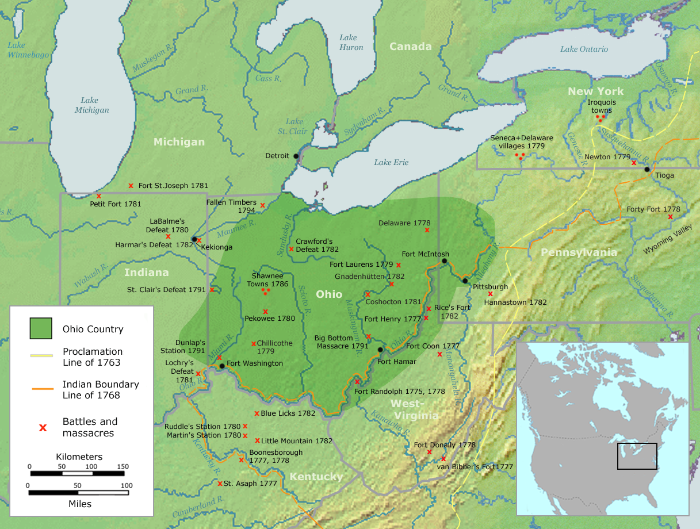
Battle of Fallen Timbers
Video Fact
Main Ideas (10)
Natives demand all settlers north of Ohio River leave
Washington sends another army lead by General Anthony Wayne to challenge
August1794
Wayne’s Army defeats 1,000+ Shawnee near present-day Toledo, OH
Battle of Fallen Timbers
Crushes native hopes of keeping their land
1795- Treaty of Greenville
Natives agree to surrender most of present-day Ohio
Gain from Treaty?
Notes:
Battle of Fallen Timbers (8:34)

Slide 6
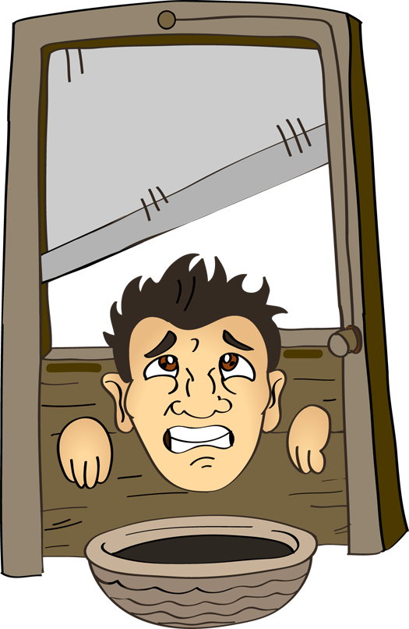
Problems with Europe
Et toi?
1789- French Revolution begins
Embodied many of the ideals of Amer Rev
1793- turns very bloody
King Louis and Queen Marie beheaded
1,000’s more executed!!!
Extreme Violence begins to turn US opinion against the revolution
Others see it as a copy of the US & its freedoms
1793- Britain & France go to war
Southerners sympathized w/ France
Jefferson sided w/ French
Reasoned a French win would drive Brits out of NA
Northerners sided w/ Brits b/c used Brits to buy our manufactur4ed goods
Hamilton & Adams sided w/ Brits
Washington wanted US to be neutral, or not take sides
As time goes, becomes increasingly difficult to be neutral

Slide 7
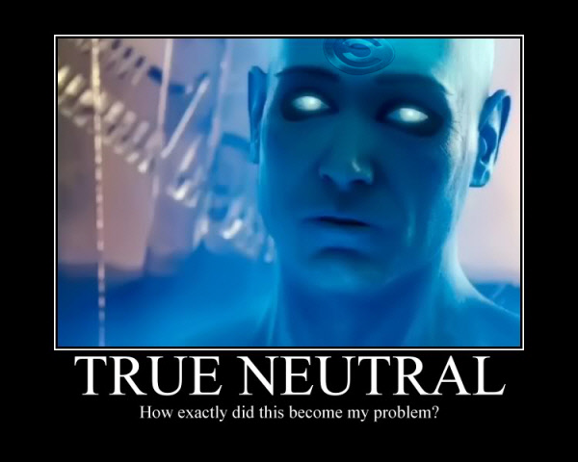
Washington Proclaims Neutrality
Proclamation of Neutrality says what?
April 1793-
French try to get US involved
Send Edmond Genêt to recruit Americans to attack Brit ships
Genêt is able to sign up few hundred US sailors to serve on Fr. Ships
Ships would seize Brit ships & cargo
22 April 1793
G-Dub passes Proclamation of Neutrality
Prohibits US citizens from fighting for another country
Barred French & Brit warships from US ports
Brits begin taking US ships who trade w/ French
Force US crews into Brit Navy
Called impressments
Greatly infuriates Americans!!!
Pushes US closer to war w/ Britain
Define?
Notes:
Proclamation of Neutrality (2:37)

Slide 8
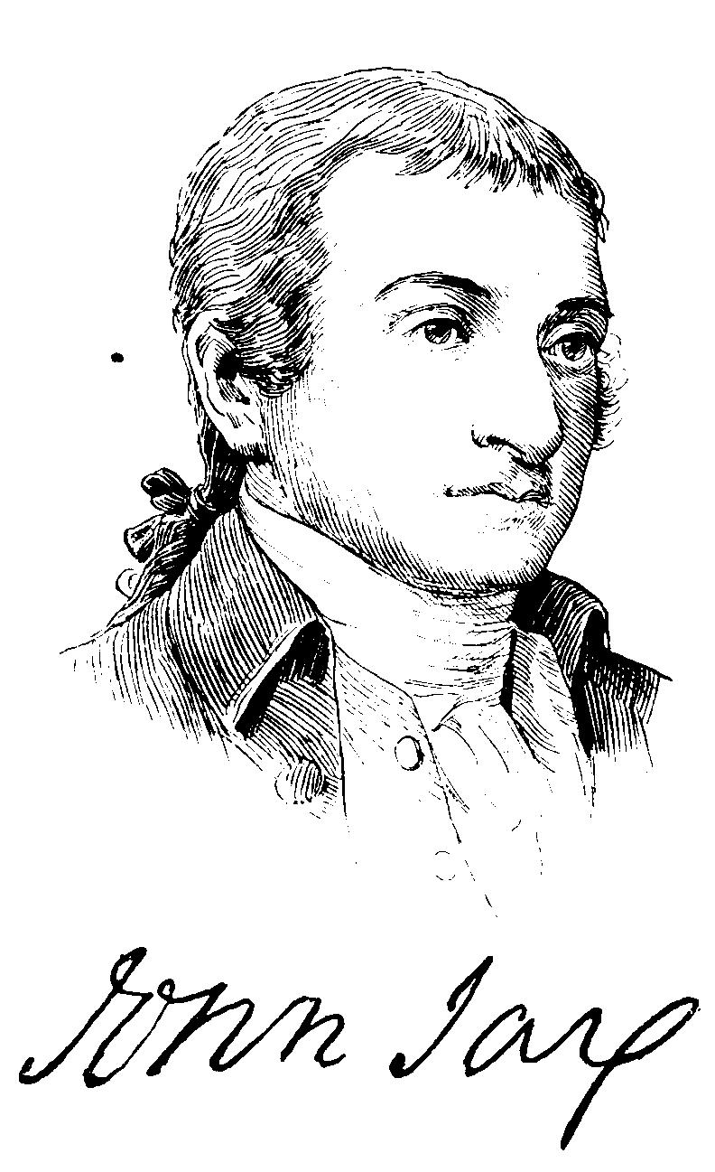
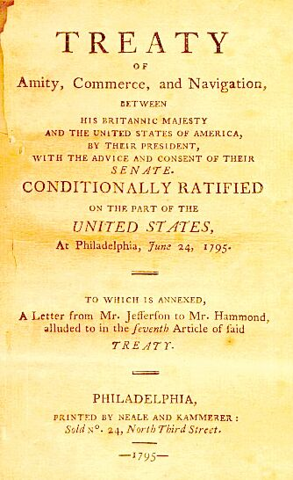
A Controversial Treaty
Problem with Jay’s Treaty?
Washington makes 1 last attempt at peace w/ Britain
Send Chief Justice of Supreme Court John Jay to negotiate w/ Brits
Brits willing to listen
War w/ US make it harder to fight French
US is England’s best market for products
Jay’s Treaty
Brits agree to withdraw from US
Pay for US ships seized
Allow US trade w/ Caribbean
Wipes out US debt to England
Few Americans approve b/c it doesn’t deal w/ issue of impressments
G-Dub approves and Senate ratifies

Slide 9
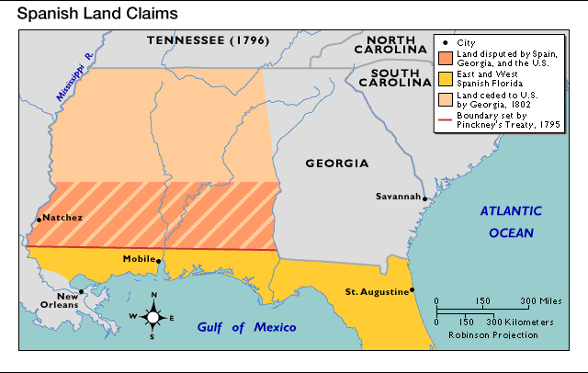
Treaty with Spain
Terms of Pinckney’s Treaty
Jay’s Treaty signals alliance of US & Brits
Spain knows together they could force Spain out of NA
Thomas Pinckney is sent by Washington to try & settle issues w/ Spain
1795- Pinckney’s Treaty
Gives US free navigation of Mississippi River
Gives US rights to trade in New Orleans too
Gives Spain Florida back
Draws northern border of FL as well

Slide 10
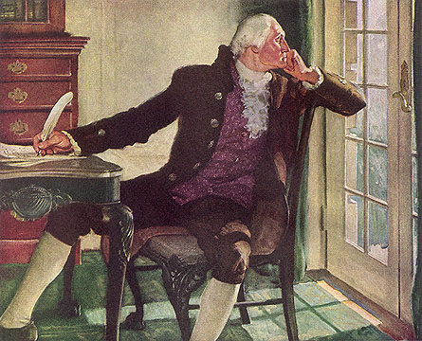
Washington’s Farewell
Washington’s Biggest Fear When Leaving
G-Dub suffering from a variety of ailments
64 years old
September 1796-
G-Dub announces retirement
Will not seek 3rd term as POTUS
Sets precedent, or unofficial rule / tradition for future Presidents
No more than 2 terms per President
Leaves feeling troubled about how he leaves nation
Fearful of the growth of political parties
Called them evil
Fearful of getting involved in foreign affairs
Notes:
Washington’s Farewell (4:11)

Slide 11
Essential Question- Exit Ticket
Exit Ticket
Listing as many as possible, what challenges did G-Dub face as POTUS?

