Slide 1
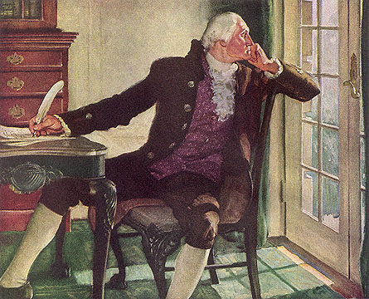
Warm-Up: Spiral Review
Warm-Up
Listing as many as possible, what challenges did G-Dub face as POTUS?

Slide 2
A New Nation (1789-1800)
5-7 The First Political Parties

Slide 3
Opposing Views
Why?
Washington called by many, “nation’s greatest leader”
But… still has detractors
Mostly by supporters of Thomas Jefferson
Trying to discredit G-Dub’s & Hamilton’s policies
1790’s- Americans beginning to divide into opposing groups
Beginning of political parties
Many believed political parties were “to be avoided”
Washington denounced them
Warned they would divide the nation
Hamilton & Jefferson often took opposing sides on issues facing the Cabinet
Disagreed on everything form finance to foreign affairs
Only fitting they would become the leaders of the 1st parties

Slide 4
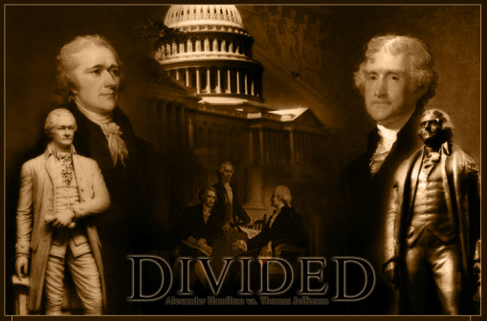
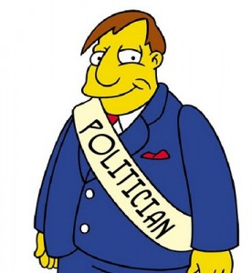
Political Parties Emerge
2 Parties?
1 Paragraph Video Summary
Soon differences becoming hard to ignore
By 1795- 2 very different parties taking shape
Federalist
Originally party of Constitutional supporters
Now people who supported policies of Washington and Hamilton
Stood for strong federal gov’t
Admired Britain for its’ stability
Favored by banking and industry
Strongest support in NE & wealthy Southern plantation owners
Democratic-Republicans
Began late 1791
Thomas Jefferson & James Madison becomes leaders
Believed in limited federal gov’t power
Feared strong federal gov’t threatened endangered people’s freedoms
Supported France not G-Dub’s “Pro-British” policies
Ideals appealed to small farmers, urban workers (the non-wealthy)
The Middle Colonies and poor South
I’ll Do Whatever You Want … If U Vote for Me!
Notes:
Ist political parties (4:30)

Slide 5
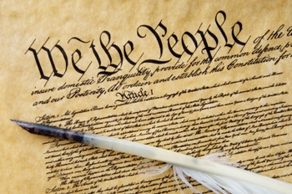
Views of the Constitution
Visual Vocab-
Implied Powers
Main difference b/t 2 parties…
Basis and amount of federal gov’t power
Federalists
Believed fed. gov’t had implied power, powers not specifically forbidden in the Constitution
Common sense powers to complete the tasks given to federal gov’t
Democratic-Republicans
Believed in strict interpretation of the Constitution
If powers not specifically given, then can’t take them
Only power absolutely necessary

Slide 6
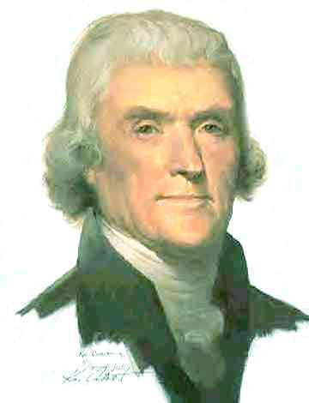
The People’s Role
Compare / Contrast
Differences b/t parties even deeper
Sharply opposing views on role of ordinary people in gov’t
Federalists
Supported representative gov’t
Elected people rule in the people’s name
Not wise to allow citizens deep involvement
Public office should be held by honest, educated, land-owning men
Poor, un-educated men too easily swayed
Dem-Reps
Feared strong, fed gov’t controlled by just a few would be dangerous to freedom
Believed liberty only safe in hands of every man
“I am not among those who fear the people; they, and not the rich, are what we depend on for our continued freedom.”

Slide 7
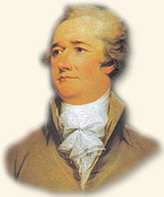
Washington’s Dilemma
Where’s the Beef?
Washington tried to get his 2 advisors to work out their differences
No matter how hard he tried…
It was too late
1793-
Thomas Jefferson was so unhappy he resigned as Sec of State
1795-
Alexander Hamilton resigns as well as Sec of Treasury
2 rival groups and their ideals moved further apart
That’s it… I’ve had it!!! I resign!!!
No U Don’t!!! I’m Gunna Resign!!!

Slide 8
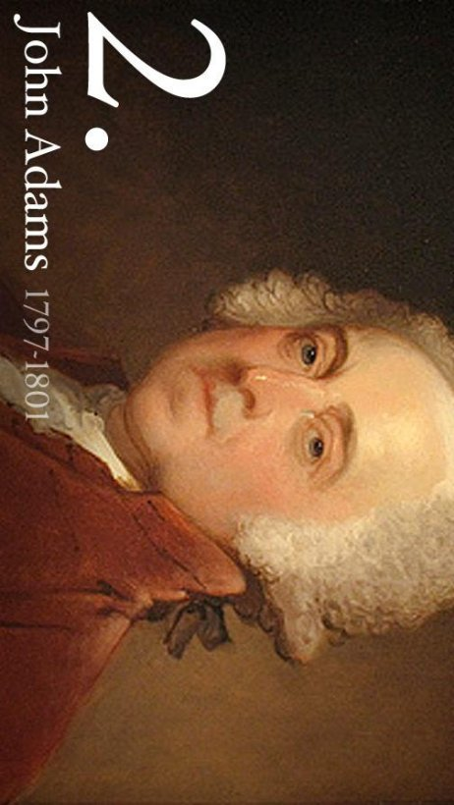
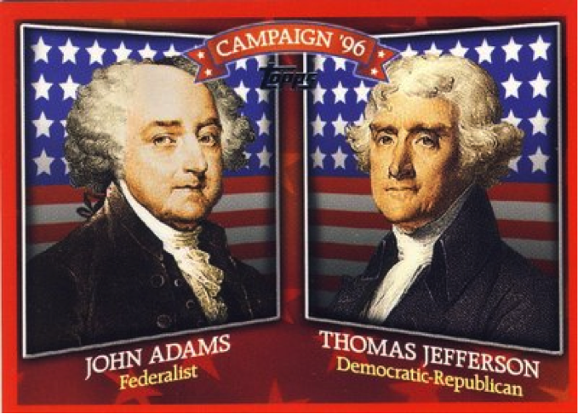
The Election of 1796
Results?
Election of 1796
1st time candidates run as members of a party
Both parties held caucuses
Leaders of party choose 1 candidate to represent the party as a whole
Federalists
John Adams and Charles Pinckney
Democratic-Republicans
Thomas Jefferson and Aaron Burr
2 candidates began as good friends, soon became bitter rivals
Adams received 71 electoral votes
Jefferson received 68 electoral votes
Strangest Part???
Under Constitution at that time, second-place voter-getter becomes VP
Federalist President w/ a Democratic-Republican Vice President
Take office 4 March 1797

Slide 9
President John Adams
Brain Pop- Video Facts
XYZ Affair
The XYZ Affair
Undeclared War with France
Inherits a fight w/ France
French believe Jay’s Treaty was attempt to help Brits in war w/ France
Began seizing US ships as punishment
Adams wants to avoid war
Fall of 1797-
Sends US reps to France to talk
French Prime Minister refuses to meet w/ them
Pawns off onto 3 powerless agents
Demand a bribe for France to avoid war
US reps refuse and inform Adams
Adams so angry and insulted he refuses to even refer to 3 agents by their names
Calls them X, Y, and Z when informs Congress of what happened
Adams urges Congress to prepare for war
Congress responds by starting program to strength armed forces
est. Department of the Navy
Start building warships
Increase size of standing army
Pull Gen Washington out of retirement to command
1798-1800
US & Fr. Ships clash constantly
Even though war not formally declared!!!
Sept. 1800-
Adam’s reps negotiate peace treaty in
Many Americans now view France as an enemy
b/c Dem-Reps had been friendly w/ Fr.
Refuse to publically condemn France
Result-
Americans vote many out of office in 1798 elections
Notes:
XYZ Affair (2:41)
BrainPOP (5:48)

Slide 10
President John Adams
Explain A & S Acts
Alien & Sedition Acts
Domestic & Foreign Affairs
Threat of war w/ France made Americans more suspicious of aliens
Immigrants living in the country who are not citizens
Some questioned whether they would remain loyal if Us went to war w/ France
Federalists in Congress
Wrote strict laws in case
1798-
Pass group of laws called Alien & Sedition Acts
Rules and punishments for aliens who show disloyalty
Sedition- activities aimed at weakening a country or its’ gov’t
Fear of too strong fed gov’t seems to be coming true!!!
Dem-Reps
Wanted states to protect person’s freedoms
Stand up to Federalist tyranny
J. Madison & T. Jefferson wrote documents to protest Fed laws
Passed in Virginia & Kentucky’ called V & K Resolutions
Claimed Alien & Sedition Acts were unconstitutional
Reaffirmed power of states over fed gov’t
Focus on 10th Amendment
Those rts not specifically given to fed gov’t will be given to states
As Election of 1800 nears…
Federalists find themselves under attack
Notes:
Disney American Presidents (3:16)

Slide 11
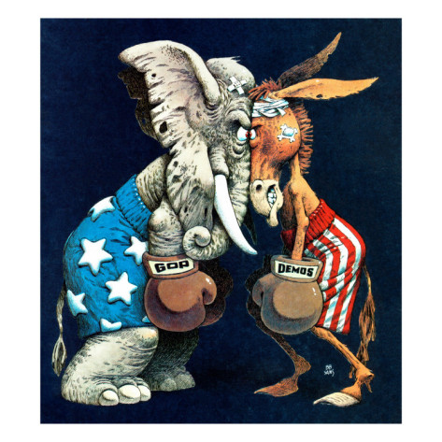
Essential Question- Exit Ticket
Exit Ticket
What were the problems created by the development of political parties?

