Slide 1
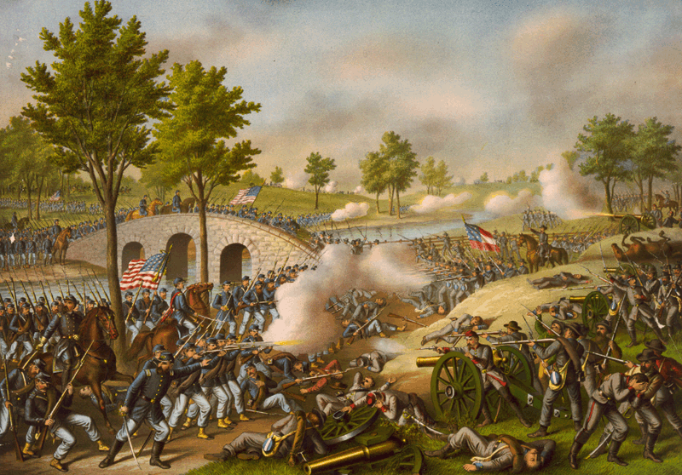
Warm-Up: Spiral Review-
Warm-Up
What effect did the Battles of Richmond Antietam have on the war?

Slide 2
The Civil War: 1861-1865
A Call for Freedom

Slide 3
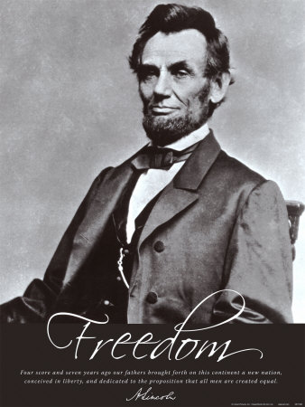
Emancipation
I. A. 1.
I. A. 2.
From the start…
North’s main goal was to preserve Union not destroy slavery
Lincoln considered slavery immoral, but…
Didn’t move against slavery
Can’t upset border states
His personal wish “all men everywhere could be free.”
BUT…
“ If I could save the Union without freeing any slave, I would do it; and if I could save it by freeing all the slaves, I would do it; and if I could save it by freeing some and leaving others alone, I would also do that.”
Some in North believed slavery was helping the Rebs
Slaves raised crops and did heavy work in camps…
Put $$$ in their pockets & food in their bellies
To Yanks, anything that hurt slavery, hurt the Confederacy

Slide 4
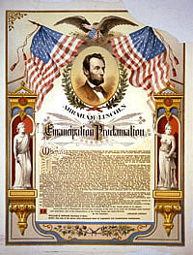
The Emancipation Proclamation
Lincoln knew what people thought, and wanted
Knew that going against slavery would make Brits & French not want to support South
Became convinced slavery was helping South
Summer 1862- he had decided to emancipate, or free slaves
Bides his time for rt. moment… after a big win!
22 Sept. 1862-
5 days after Union win @ Antietam Lincoln announces plan
1 January 1863-
Lincoln signs document freeing all slaves w/in Confederacy
I. B.

Slide 5
Effects of the Proclamation
I. C. 1, 2, 3, 4
B/C it freed slaves of Confederacy…
Actually freed no one!
South didn’t care
Lincoln knew slaves would hear about it
Hoped it would encourage slaves to rise up or runaway
Even b4 it 100,000 left for Union lines
Despite limitations, N. Blacks cheered it on
Frederick Douglas called it, “…the greatest event of our nation’s history.”
Had desired effect in Europe too!
Britain & France would never ally themselves w/ a nation allowing slavery
Confederacy out of luck
1864- Congress, not to be outdone, issues 13th Amendment
Outlaws slavery in US
Ratified in 1865
This truly freed slaves
All had to do was get South back in the Union to force them to follow it!

Slide 6
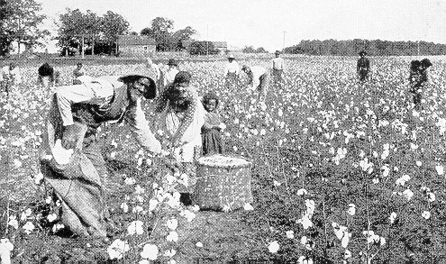
African Americans in South During War
II. A. 1&2
Early on, Lincoln against AA in Union Army
‘Emancipation’ would now allow it
When war began, 3.5 million slaves in south
30% of its’ total population
Most of it’s workforce
Worked on plantations
Iron, and slat mines
Worked as nurses too
By 1865- 1/6th had fled though
Possibility of revolt scared doo-doo out of South
Why wouldn’t allow slaves to fight- afraid to give them guns
Near end, Confederacy desperate
RE Lee convinces Davis to allow it
Too late though
War ended b4 could get regiments up and trained
3.5 Million Slaves in Confederacy
*
30% of Confederacy’s Population
*
By 1865, 1/6th Flee to Union

Slide 7
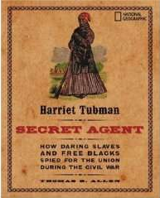
African Americans Helping the North
Different in North, but not much at first
Freed men not allowed to serve in Union Army
Disappointed many
Found other ways though
Union Navy allowed them though!
Served as guides and spys in South
Harriet Tubman was one of them!
Helped 100’s escape on Underground Railroad
Now use knowledge of trails and paths to help army and spy on Rebs too!
1862- Congress passes law to allow them to fight in army !
Freed & runaways began signing up by the 1,000’s
By the end of the war, African Americans made up nearly 10% of the Union Army
200,000+ served and 37,000 had been killed
By fighting though, taking important step in helping themselves
II. B.

Slide 8
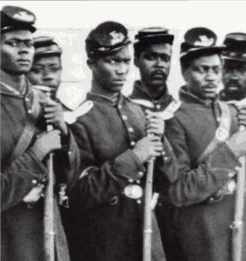
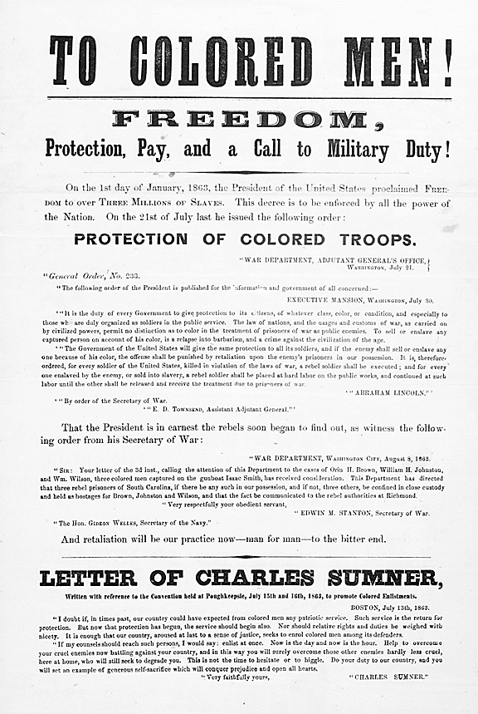
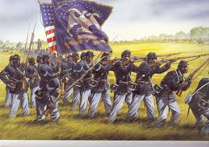
African American Soldiers
II. C. 1&2
8:50-12:28
Organized into regiments
Separate from white regiments
White commanders
Less pay than whites at first, but…
protests led to equal pay by 1864!
Most famous, 54th Massachusetts
Lead charge on Charleston, SC
Were eventually beaten and lost over 50% of men, but…
Bravery lead to respect for black regiments
Lincoln’s opponents criticized idea
South issued decries
All AA’s fighting would be taken into servitude
If AA’s caught wearing uniforms they would be hung
Any white officer leading them would be hung

