Slide 1
Warm Up: Spiral Review
1)Warm Up
Define sectionalism. If you do not recall look back into the phase 1 questions!

Slide 2
Road to Civil War: 1820-1861
7-1 “Slavery and the West”

Slide 3
The Missouri Debate
1819- slaveholding Missouri requests to join the Union
Many settlers brought w/ them enslaved blacks
By 1819- 50,000 whites & 10,000 slaves
Its state constitution allowed slavery
Nationally…
11 slave states and 11 non-slave states
A single new slave state would “upset the balance”
Balance extremely important!!!
Senate
44 members; 22 slave, 22 non-slave
Not just a moral question
North vs. South economically
Idea of someone else saying what the south must do
Grows into sectionalism- exaggerated loyalty to a region
2)Balance?

Slide 4
Adding States & Slavery Debate
4)Define
Senate proposes plan for balance
Simultaneously admit as states
Missouri (slave)
Maine (non-slave)
Becomes known as the Missouri Compromise
Also wanted to end slavery debate in territories
All states above 36’30”° N would be free states
All states below 36’30”° N would be allowed slavery
Speaker of the House Henry Clay pushes proposals through quickly by 1820
Ends the slavery debate for 25 yrs. But comes back by 1840!
Dispute of slavery in new territories
Texas (won freedom in1836 from Mexico)
New Mexico and California (still part of Mexico)
South wanted to see slave holding Texas a state
Annexation of Texas becomes main issue of 1844 Presidential Election
James K. Polk of NC wins
Makes Texas a state in 1845
Also presses for NM and Cali as well
Leads to war w/ Mexico
5) War… Again?
The Missouri Compromise
New Western Lands
Notes:
Missouri Compromise 1820 (2:19)

Slide 5
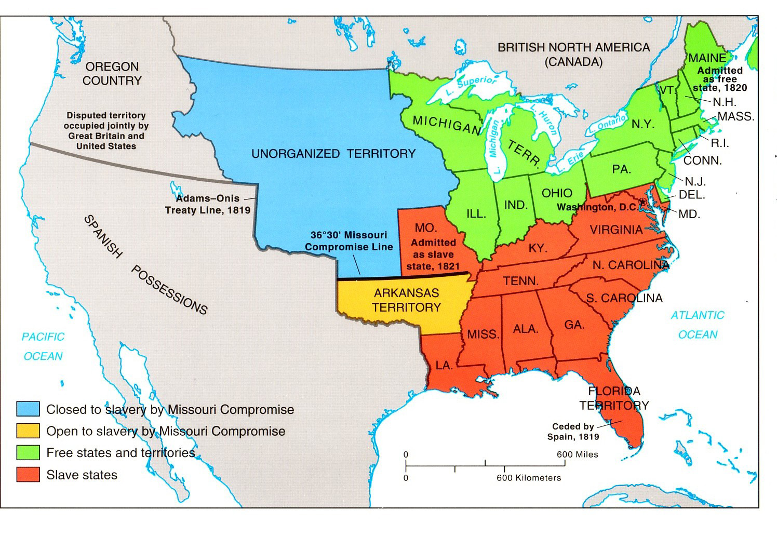
Notes:
Missouri Compromise (Drawn explanation)(3:21)

Slide 6
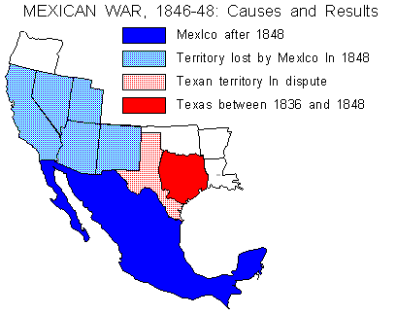
Conflicting Views
6) Which is which?
Just months after Mexican War begins…
Both sides issue proposals to allow for or ban slavery in Mexico lands if won
David Wilmot Proviso (PA)
John C. Calhoun Proviso (SC)
Neither sides proposal passes, but again becomes issue for a Presidential Election
By 1848 Election, war was over and NM and Cali territories gained
But…
No action taken in slavery debate there

Slide 7
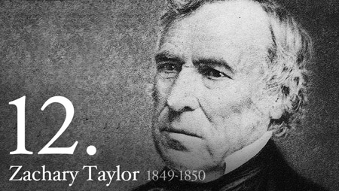
The Election of 1848
Whigs- Zachary Taylor (KY / LA)
Dems- Louis Cass (MI)
But…
Neither took stance on slavery issue
Failure to take a side angered voters
Began to look for other options
Many anti-slavery Dems and Whigs left their parties to start another
Form the Free-Soil Party
Nominate former 8th US President Martin Van Buren
Taylor wins in “Electoral” landslide
Appeals to both sides by upsetting none
But… saying nothing either!
7)Why not take a stance, result?

Slide 8
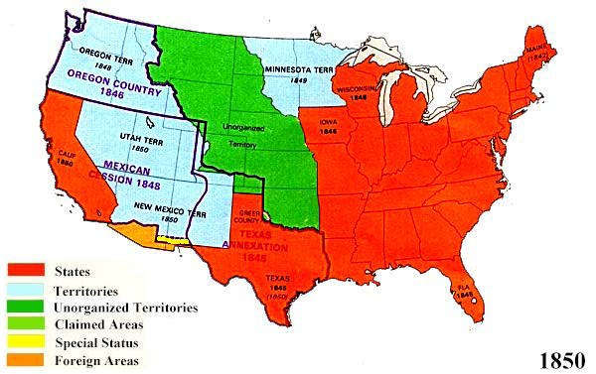
California
8) Visual Vocab
9) Visual Vocab
Once in office, Taylor urges Cali and NM to apply for statehood
Let the people of the states decide slave or free
Called… Popular Sovereignty
1850- Cali does but not NM
Statehood gets tangled up w/ other ?’s in Congress
Antislavery groups wanted DC to outlaw slavery there
South wanted a strong fugitive slave law enacted
Dispute of NM / Texas border
Biggest though is…
Balance in the Senate… again!
15 free states and 15 slave states
Cali would throw the balance
NM, Oregon, and Utah also about to apply and all leaning free
Making the slave states hugely outvoted
South begins floating idea of “seceding from the union”
Breaking away from the USA starting own country

Slide 9
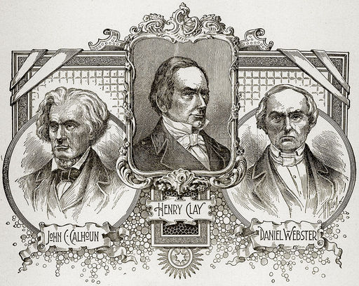
A New Compromise
10) The Parts?
January 1850- Henry Clay proposes a plan to settle all disputes in Congress
Part 1- Cali admitted as free state
Part 2- NM admitted as slave
Part 3- NM / Texas border issue would go in favor of NM (more land for them)
Part 4- slave trade (not slavery) abolished in DC
Part 5- a stronger fugitive slave law
Holy Cow! True compromise!!!
Too much common sense for gov’t though!!!
Debate rages on proposal for 7 months!!!
JC Calhoun of SC warns if Cali admitted as free… south would have to secede
Daniel Webster of MA believes good compromise and south should shut up about their idol threats of seceding!
Union was the most important thing… breaking up would leave them both susceptible to conquer

Slide 10
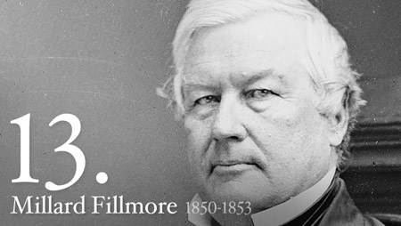
The Compromise of 1850
10) 5 parts become…
Clay’s plan could not pass as a single passage
Too much debate on certain issues
Taylor also was mad of south’s threat to leave and threatened them with war if they tried it
July 1850- Taylor dies suddenly
New President is Millard Fillmore (from Buffalo, NY)
Sen. Stephen A. Douglas (IL) takes charge to resolve crisis
Divides Clay’s Plan into parts
Congress could vote on each part separately
Congress passes all parts separately from Aug.-Sept. 1850
Together all parts known as “Compromise of 1850”
Fillmore calls these the “final settlement” in the conflict b/w North and South
But…
Not so fast buster!!!
Notes:
Compromise of 1850 for Dummies (5:01)

Slide 11
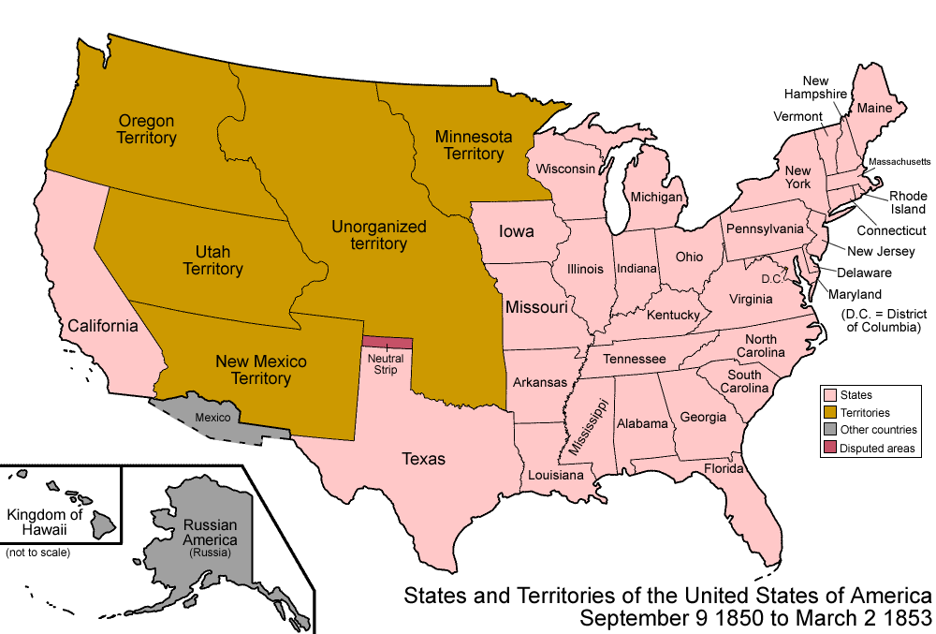
Exit Ticket: EQ Review
What are the main goals of the Missouri Compromise and Compromise of 1850 and why are they just Band-Aids?

