Slide 1
Warm Up
1) Warm Up!
Explain how the Missouri Compromise dealt with slavery.
What were the 5 parts of the Compromise of 1850?

Slide 2
Road to Civil War: 1820-1861
7-2 A Nation Dividing

Slide 3
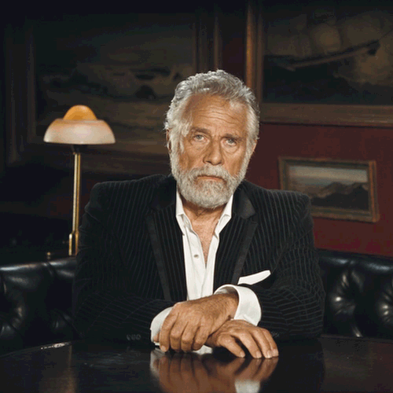
The Fugitive Slave Act
2) Did what?
No… it is not a real railroad that is underground…
Passed as Pt. 5 of Compromise of 1850
Required all citizens aware of a fugitive slave to turn them in
If don’t…
Fined, jailed, or even hanged!!!
Southerners thought it would make north recognize their rights
But…
Only convinces more to the evils of slavery
Slaveholders now stepped up their efforts to catch and return runaways
In spite of penalties…
Northerners refused to enforce the law
Underground Railroad
System of pathways and people who would help slaves escape to the north
People contributed funds to help & buy slaves’ freedom
Very few northern juries convicted those accused of helping fugitive slaves
3) Define
Background
Resistance to the Law

Slide 4
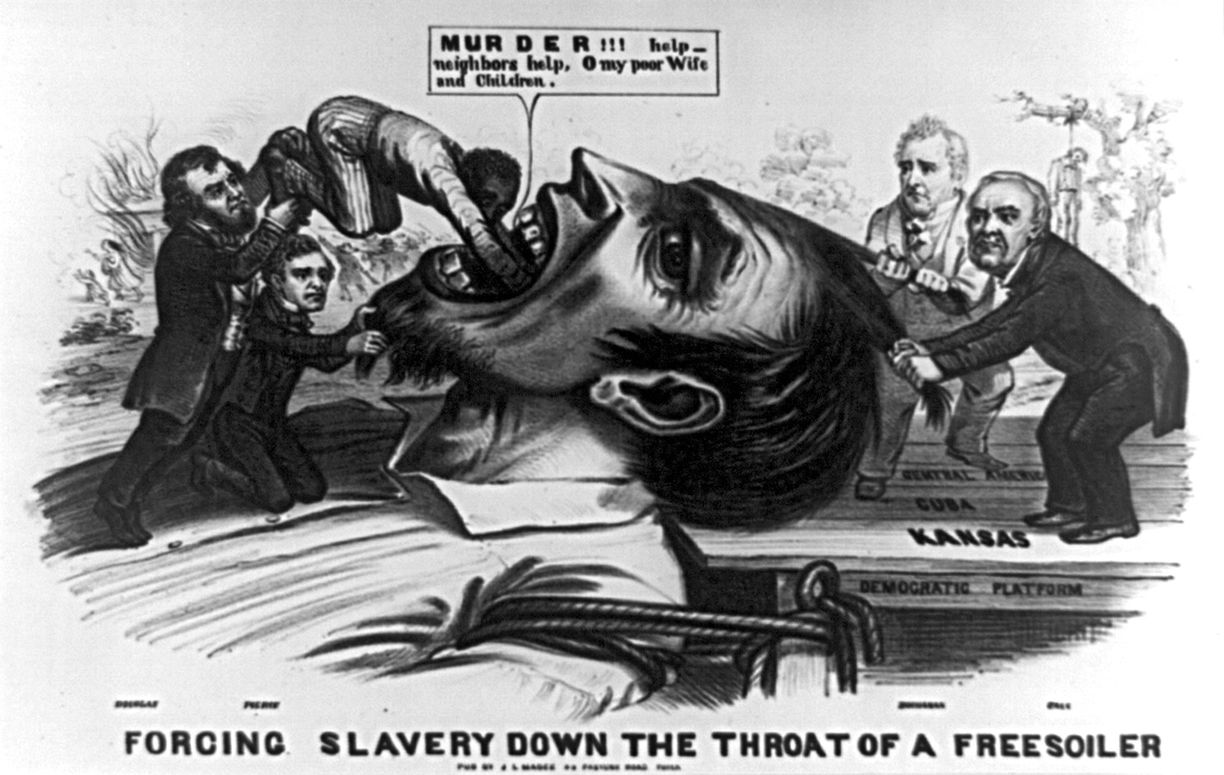
The Kansas-Nebraska Act
4) Visual Vocab
1852- Franklin Pierce (NH) becomes 14th US President
“doughface”- northerner w/ southern feelings
Intends to enforce Fugitive Slave Act
1854- slavery debate erupts again
Sen. Stephen A. Douglas (IL), author of Compromise of 1850, writes new plan for compromise
Wants to open up remainder of west
Proposes organizing land west of Missouri and Iowa
Naming them Kansas and Nebraska
Problem…
Both are above 36’30”°
Missouri Compromise says slavery not allowed then
South wouldn’t allow 2 new states as “Free”…
Throw off balance again in Senate
Douglas proposes abandoning the Missouri Compromise line and let the people of the territories decide
Becomes known as Popular Sovereignty
5) KS/NE Act proposes?

Slide 5
The Kansas-Nebraska Act
Passage of the Act
Northerners protested strongly
Breaking Missouri Compromise meant slavery in areas that had been free for 30 yrs!
North demands bill voted down
Southern support was huge
With southern support and support of President Pierce…
The Kansas- Nebraska Act passes in May 1854
Notes:
Kansas-Nebraska Act 4:33

Slide 6
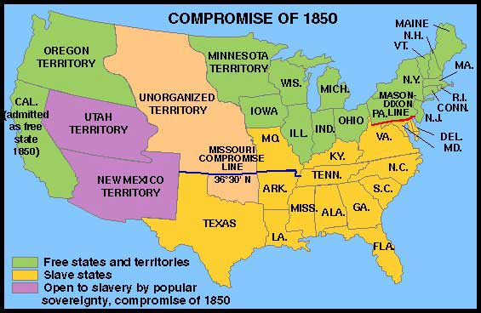
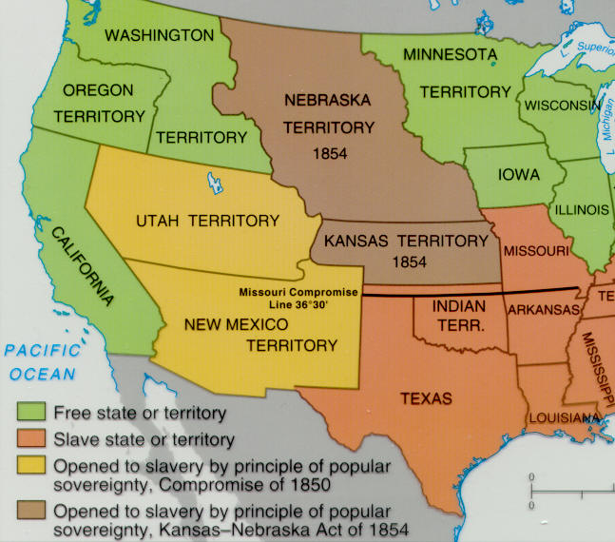

Slide 7
Conflict in Kansas
6)Visual Vocab
Pro-Slavery Rules!!! We’re in charge!!!
As soon as law passed, both sides rush support to Kansas
Pro-Slavery & Anti-Slavery groups tried to take control
1,500 people lived in Kansas
Odd but 6,000 ballots were counted!?!
Huh???
1,000’s of Pro-Slave Missourians crossed border and voted
Called “Border Ruffians”
Obviously, Pro-Slavery Mvmt. wins election
Soon after Pro-Slavery laws get passed
Anti-Slavery refused to obey them and set up their own gov’t claiming to be the real Kansas Legislature
Both sides wrote constitutions, held elections, and in Jan. 1856 both sides asked Congress to recognize them as a state
7) Why/ Can it happen now?
Anti-Slavery Rules!!! U Cheated, we’re in charge!!!

Slide 8
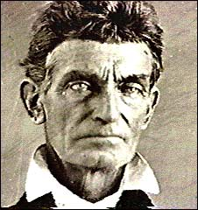
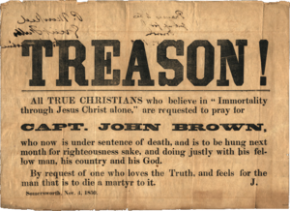
“Bleeding Kansas”
Pro and Anti-Slavery forces begin arming themselves
Violence becomes inevitable
May 1856- 800 slavery supporters attack and burn town of Lawrence, Kansas
Anti-Slavery troops soon retaliate
John Brown, extreme abolitionist, believed God had chosen him to end slavery
When he heard of the attack…
He goes nuts and he and his sons capture and kill 5 pro-slavery supporters
More violence on both sides continues for 6 months, earning the nickname, “Bleeding Kansas”
Captain John Brown
8) Bleeding Kansas
Notes:
Bleeding Kansas 4:26

Slide 9
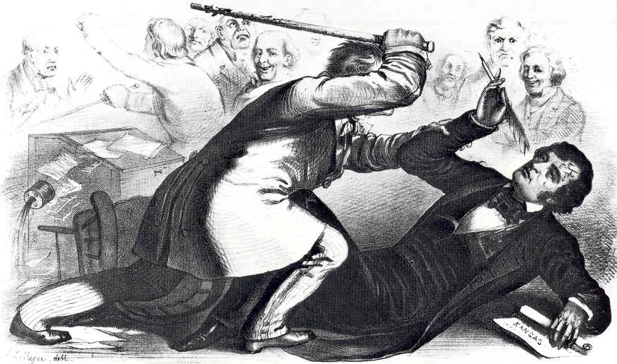
Violence in Congress
Violence in Kansas spilled over to the rest of the country as well…
Even into the Congressional Chambers!!!
Abolitionist Sen. Charles Sumner (Mass) gives speech entitled, “the Crime Against Kansas”
Lashes out against Pro-Slavery Senators, especially Andrew Butler (SC)
2 days later…
Rep. Preston Brooks (Butler’s cousin)
Walks into Senate Chamber and begins beating Sumner at his desk w/ his cane!!!
Beats him so bad, he is knocked unconscious
Injuries so severe that Sumner did not return to the Senate for 3 years!
“Brooks-Sumner Incident” and “Bleeding Kansas” revealed rising tensions and hostility b/w North and South
Soon boil over!
9)Thoughts?
Notes:
5:06 Bleeding Kansas Project

Slide 10
Exit Ticket
What do you see as the next step in this “train wreck”?
10) Foreshadow

