Slide 1
Band-Aid® Compromises
“We don’t fix the problem; we just cover it up!”

Slide 2
What is a “Compromise?”
com·pro·mise
ˈkämprəˌmīz/
noun
noun: compromise; plural noun: compromises
1. an agreement or a settlement of a dispute that is reached by each side making concessions.
"an ability to listen to two sides in a dispute, and devise a compromise acceptable to both"
synonyms: agreement, understanding, settlement, terms, deal, trade-off, bargain; Moremiddle ground, happy medium, balance
verb
verb: compromise; 3rd person present: compromises; past tense: compromised; past participle: compromised; compromising
1. settle a dispute by mutual concession.
"in the end we compromised and deferred the issue"
synonyms: meet each other halfway, come to an understanding, make a deal, make concessions, find a happy medium, strike a balance;
"we compromised"
archaic- settle (a dispute) by mutual concession. "I should compromise the matter with my father"
2. accept standards that are lower than is desirable.
"we were not prepared to compromise on safety"

Slide 3
The Greatest Soda-Pop EVER!!!
5 Choices
Coca-Cola
Pepsi
Cheerwine
Mountain Dew
Dr. Pepper

Slide 4
The Greatest Sport EVER!!!
5 Choices
Soccer
Football
Baseball
Hockey
Basketball

Slide 5
The Greatest Type of Music EVER!!!
5 Choices
Country
Rock
Metal
Pop / Modern
Hip Hop / Rap

Slide 6
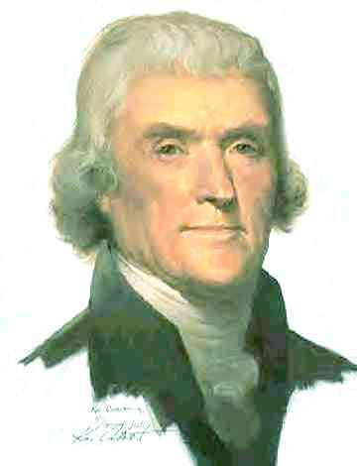
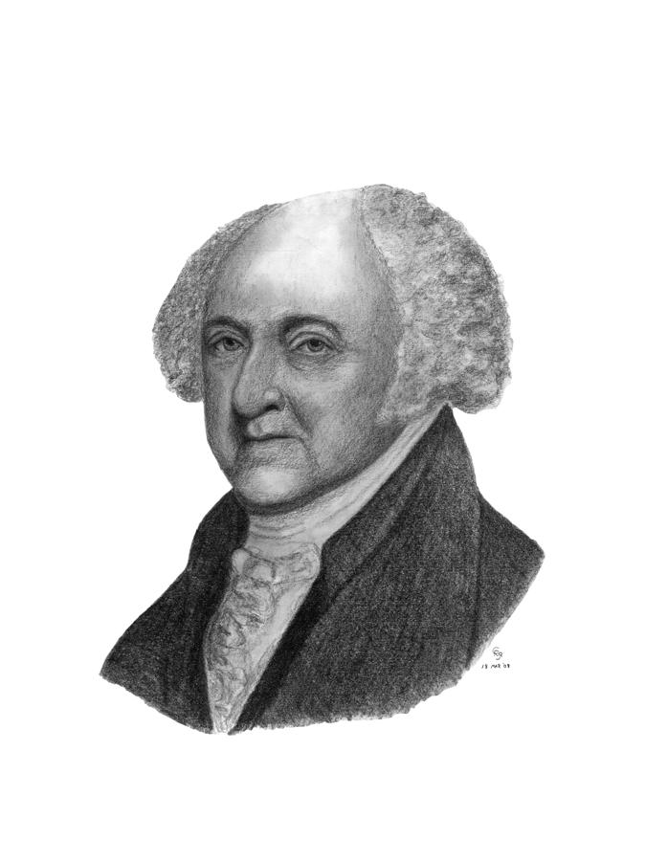
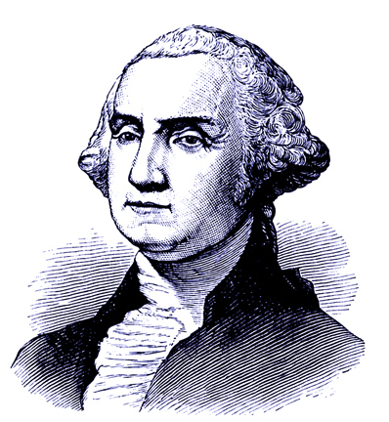
The Greatest Founding Father EVER!!!
5 Choices
George Washington
Ben Franklin
Thomas Jefferson
John Adams
John Hancock

Slide 7
The Greatest TV Network EVER!!!
5 Choices
Sit Com
Cop Shows
Life Dramas
Documentaries
Sports Recap

Slide 8
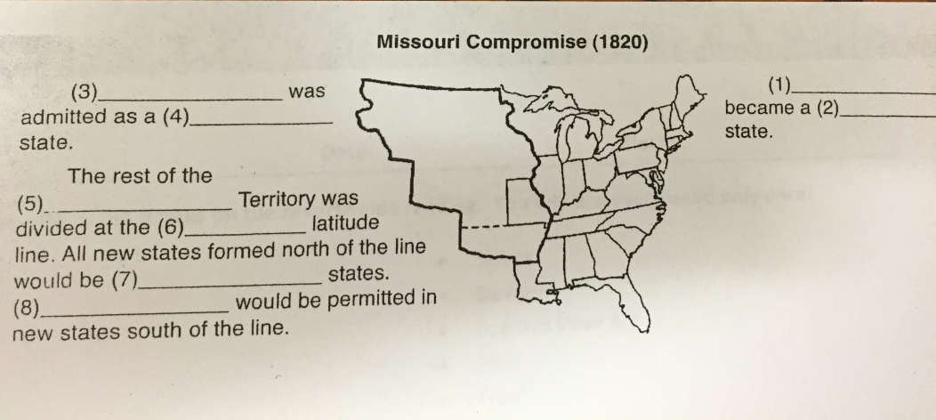
By Yourself…
Complete the Fill-In the Blanks CCR Wkst.
Do the TOP ONLY!!!
Missouri Compromise (1820)
Use the Word Bank on the Back!!!

Slide 9
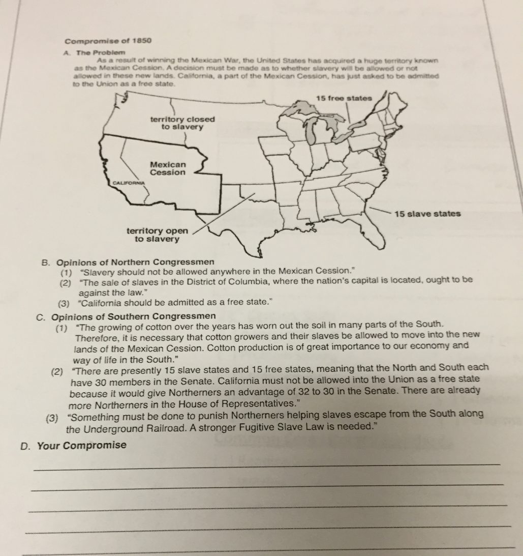
With Your Group…
Discuss the “Problem” presented on the “Compromise of 1850” CCR Wkst.
Examine the 2 contradicting opinions
As a group…
Decide what your compromise would be and record it onto your wkst.

Slide 10
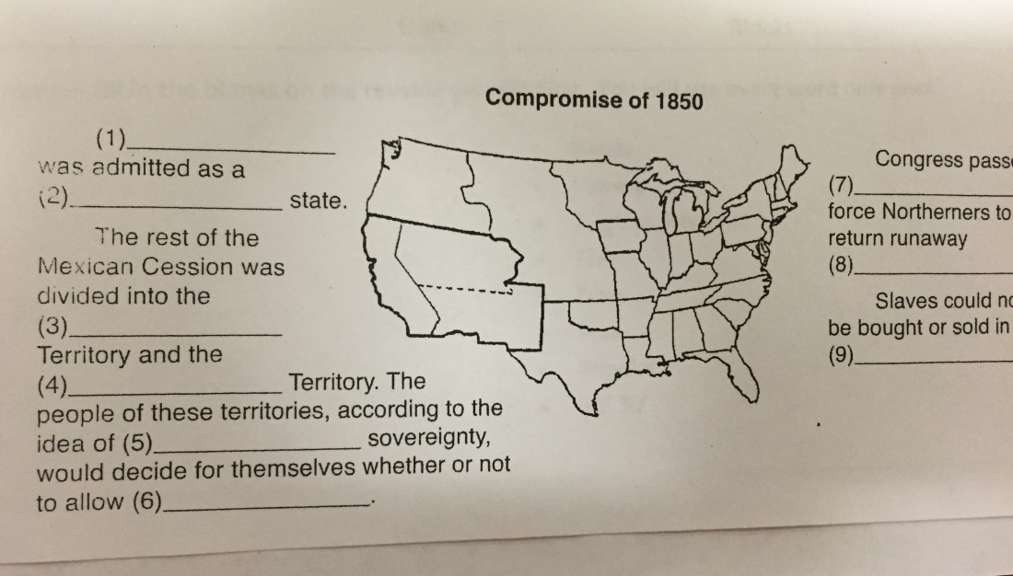
By Yourself…
Complete the Fill-In the Blanks CCR Wkst.
Do the Bottom ONLY!!!
Compromise of 1850 (1850)
Use the Word Bank on the Back!!!

Slide 11
As a Group… Come Up w/ a Compromise on These Current Questions
Your 1st Topic is…
Gay Marriage
Decision & Why???

Slide 12
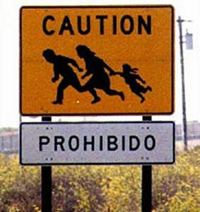
As a Group… Come Up w/ a Compromise on These Current Questions
Your 2nd Topic is…
Illegal Immigration
Decision & Why???

Slide 13
As a Group… Come Up w/ a Compromise on These Current Questions
Your 3rd Topic is…
Gun Control Laws
(Ban on Assault Rifles & Handguns)
Decision & Why???

Slide 14
As a Group… Come Up w/ a Compromise on These Current Questions
Your 4th Topic is…
Legalization of Marijuana
Decision & Why???

Slide 15
As a Group… Come Up w/ a Compromise on These Current Questions
Your 5th Topic is…
Abortion
Decision & Why???

