Slide 1
Warm-Up: Spiral Review
1) Warm Up!
The Missouri Compromise, Compromise of 1850, the Kansas-Nebraska Act, Bleeding Kansas, & the Brooks-Sumner Incident are all examples of or results of Band-Aid© Compromises.
Define what a Band-Aid© Compromise is, what literary term are these examples of, and what are they’re purpose.

Slide 2
a Nation Dividing: 1820-1861
7-6 Challenges to Slavery

Slide 3
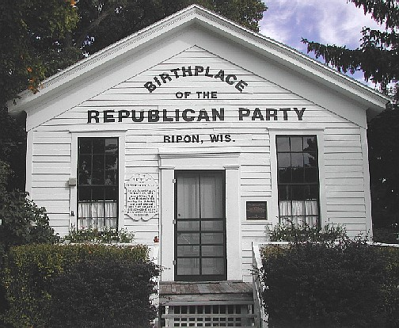
A New Political Party
2) Repubs?
Many events were driving the North and South further apart
After the Kansas-Nebraska Act, the Democratic Party began to split
Northern Dems left b/c of slavery
Slavery destroyed the Whig Party
1854- Anti-Slavery Whigs and Dems joined w/ Free-Soil
Created the Republican Party
Republicans challenged Pro-Slavery mvmt.
Wanted to ban the expansion of slavery into new territories
Quickly won over North
Won control of H of Reps!
But…
almost NO support in South
Northern Dems were quickly becoming extinct as the party became almost soley Southern

Slide 4
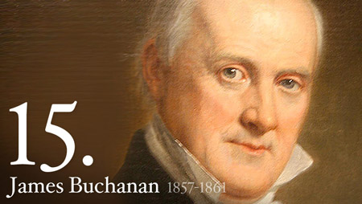
The Election of 1856
3) Why?
Dems and new Republican Party met again in Presidential Election of 1856
Whigs didn’t even offer a candidate!
Repub- John C. Frémont
Fame as explorer of West
“Free Soil, Free Speech, Frémont”
Dems- James Buchanon (PA)
Big on popular sovereignty
Vote divided on sectional lines
Buchanon won entire south!
Dominating Electoral College
Frémont didn’t receive a single vote below Mason-Dixon
But carried 11 of 16 free states

Slide 5
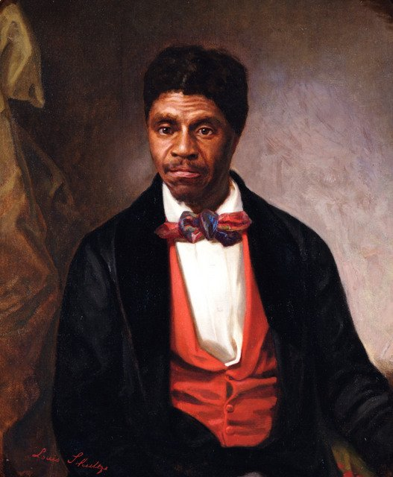
The “Dred Scott” Case
4) U Choose?
Dred Scott was a slave
Bought by doctor in Missouri (slave-state)
1830’s- Dr. moves his fam and Scott to Illinois & later Wisconsin (both free states)
Later return to Missouri
Doctor dies
1846- anti-slavery society convinces Scott to sue for his freedom
How? Why?
b/c he lived on free soil for 10+ yrs. he was therefore free
Transitive Property !!!
(and you thought math would never help you in life!)
Case takes 11 years but reaches the Supreme Court
Case attracted enormous attention
Many hoped court would solve the question of slavery for good
6 March 1857-
2 days after President Buchanan is inaugurated…
Court makes it decision

Slide 6
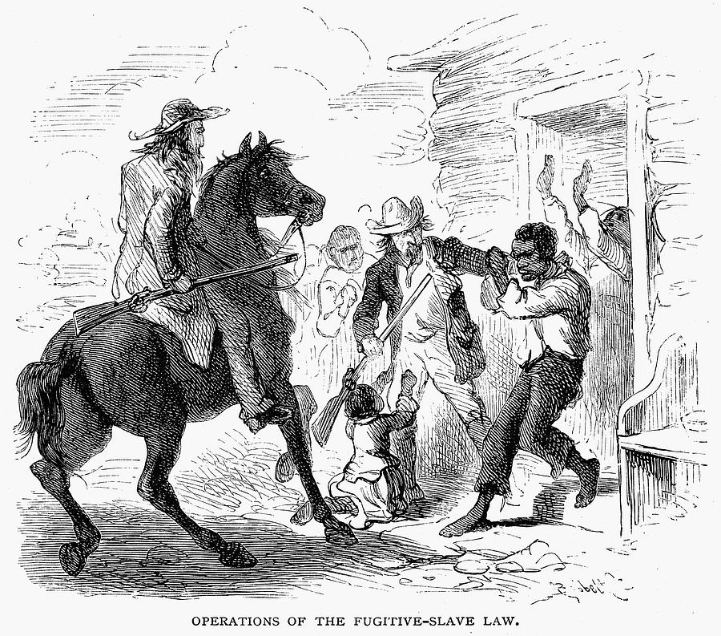
The Court’s Decision
5) 3 Parts?
Chief Justice Roger B. Taney announces his decision
Part 1- Scott was a slave
Had no rights as citizen; therefore no right to bring lawsuit at all
Part 2- Scott living on free soil doesn’t make him free
Slave is property & 5th Amendment outlaws Congress taking property w/o due process
Part 3- Congress can’t prohibit slavery in any territory!
Missouri Compromise was unconstitutional!
36’30”° line not allowed
Popular sovereignty illegal too!
Not even voters could prohibit slavery b/c infringe on the rights of others
Big Picture… according to Taney…
The Constitution actually protected slavery!!!
Dred Scott vs. Sanford
Notes:
Dred Scott vs. Sandford Finger Puppet Show (3:53)

Slide 7
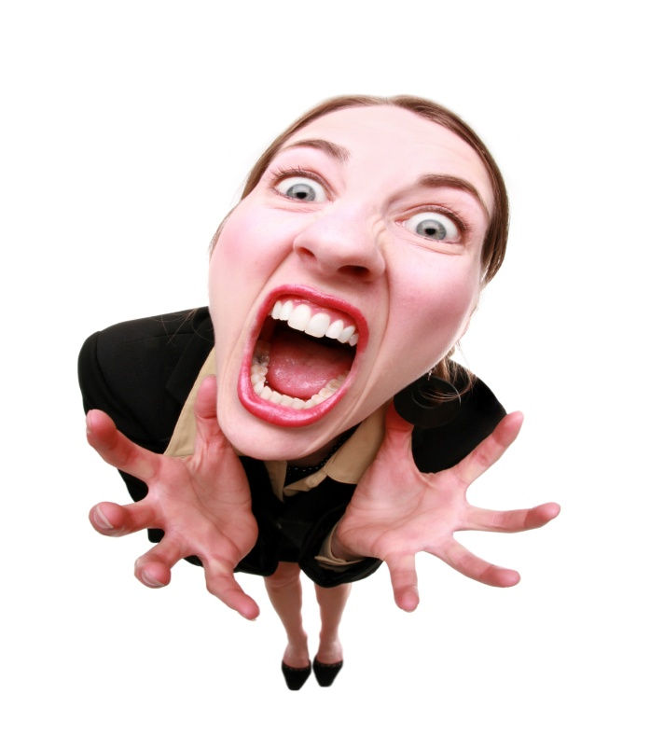
Reaction to the Decision
6) Foreshadow
Rather than settling the issue…
Divides the country even further!
Southerners were pumped!
Reaffirmed what they already believed
Nothing legally done to prevent slavery
Republicans outraged!
Called decision…
“a wicked and false judgment”
“the greatest crime” ever committed in the nation’s courts!
Southern slave-owners were excited… Abolitionists were outraged!!!

Slide 8
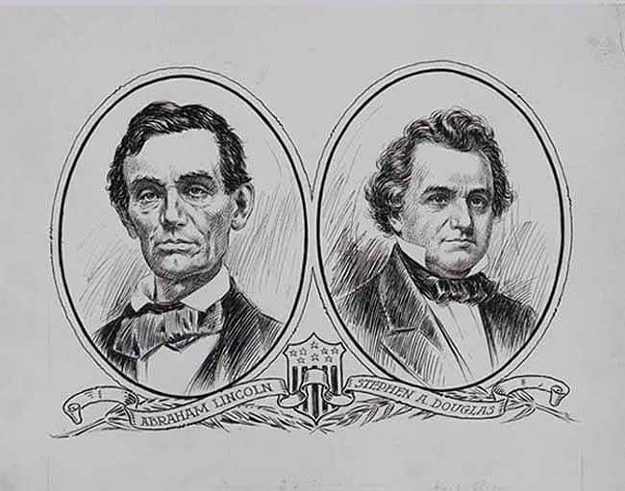
Lincoln and Douglas
Senate race of Illinois of 1858
Dems- Stephen A. Douglas
Incumbent
Considered strong Pres candidate
Successful lawyer
Elected to H of R in 1842
Elected to Senate in 1846
Disliked slavery but didn’t like the headache
Thought answer was popular sovereignty- people decide
Rep- Abraham Lincoln
Almost unknown
Poor, backcountry
Intelligent, ambitious, successful lawyer
Little formal education, but great political instincts
Saw slavery as immoral, but…
Knew no easy way to eliminate it
Knew it should not be spread

Slide 9
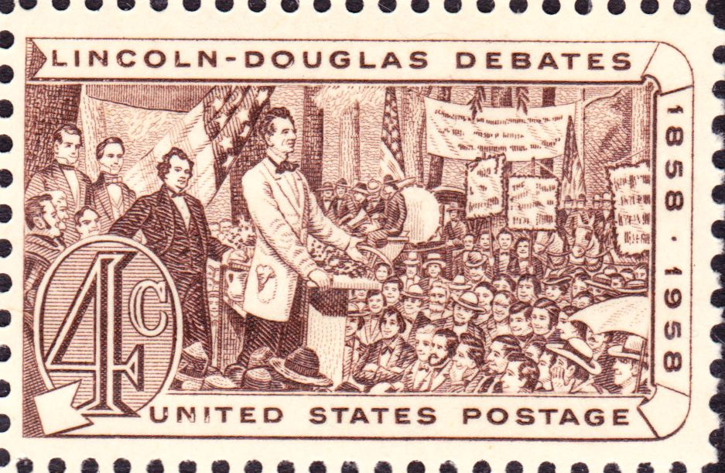
The Lincoln / Douglas Debates
7) Big Picture for Abe?
Lesser-known Lincoln challenges Douglas to series of debates
2 meet 7 times from August to October of 1858!!!
1,000’s come see the debates
Key topic…
Slavery, Duh!
Douglas claimed Lincoln wanted African-Americans to be fully equal to whites
Lincoln denied this but…
Said that slavery and its institution was wrong
After the debates, Douglas narrowly won the election but Lincoln gained something much bigger…
A national reputation!
Notes:
Lincoln / Douglas Debates- Angry Town Hall (11:46)

Slide 10
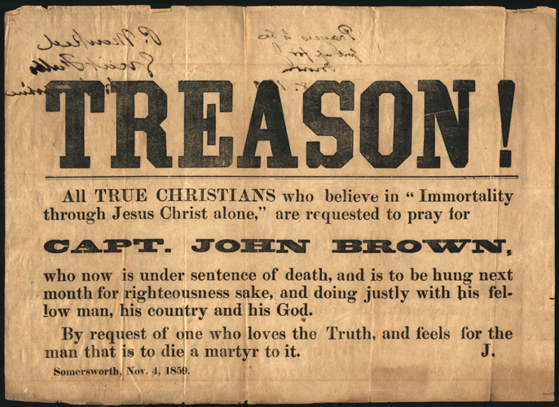
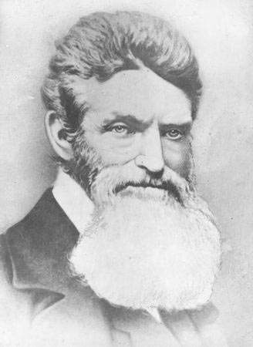
The Raid on Harpers Ferry
8) Hero or Villain?
After the 1858 elections…
South feels threatened by growing Republican power
16 October 1859- John Brown & 18 others raid a federal arsenal
@ Harpers Ferry, Virginia
Brown hoped to start a rebellion by arming slaves
They were quickly defeated
Brown was convicted of treason and murder
Sentenced to hang…
His execution caused an uproar in the Anti-Slavery circles
He died a martyr, a person who dies for a great cause
Becomes a rallying point
Can you smell it???
The nation is on the brink of disaster!!!
Notes:
Raid on Harper’s Ferry (4:07)

Slide 11
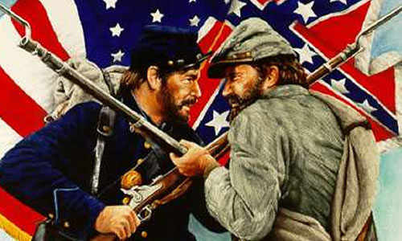
Essential Question: Exit Ticket-
9) Exit Tix?
Foreshadow-
Where is all of this leading?

