Slide 1
Warm Up/Spiral Review
Warm Up
Table
What is the Dred Scott ruling and the growth of the Republican Party leading to?
Complete the Table…

Slide 2
a Nation Dividing: 1820-1861
7-7 “Secession and War”

Slide 3
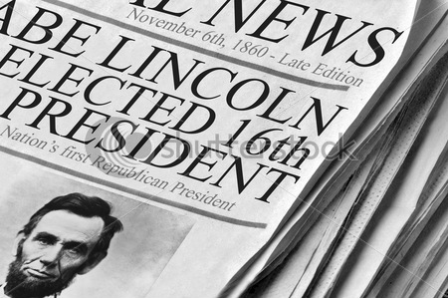
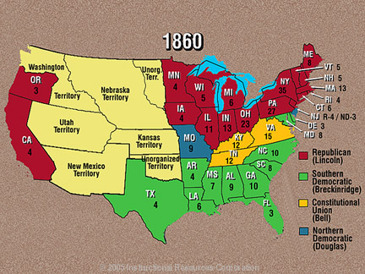
The Election of 1860
3) Record Candidates
Would the Union break?
Would slavery destroy this country?
It caused breakup of Dems…
N. Dems- Stephan A. Douglas (Il)
Supporter of Pop. Sovereignty
S. Dems- John C. Breckinridge (KT)
Pro-Slavery Mvmt.
Constitutional Union Party
John Bell (TN)
NO Stance on slavery
Rep- Abraham Lincoln (Il)
Slavery cant be expanded
South feared Lincoln win would lead to slave revolt
w/ Dems split…
Lincoln wins clear majority!
Wins popular vote and EC vote
Vote along sectional lines
Lincoln’s name didn’t even appear in most southern ballots!!!
Swept all northern states
Breckenridge sweeps south
Bell takes most border states
Douglas wins only Missouri and half of NJ
More populated north simply outvoted the south
Lincoln’s victory was short-lived
Country he was chosen to lead would soon disintegrate
4) How did Lincoln win?
Lincoln Nominated
Lincoln Elected
Notes:
Election of 1860 (2:33)

Slide 4
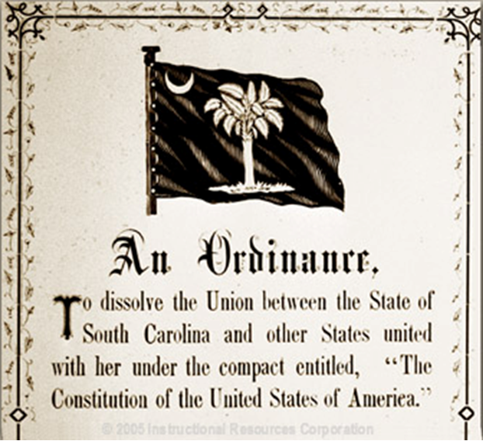
The South Secedes
5) What state do you think?
Lincoln & Republicans…
Promised not to disturb slavery where it already existed
South didn’t trust them though
Thought southern rts. Not protected
20 December 1860- south threat becomes reality
SC votes to secede, break away from the Union

Slide 5
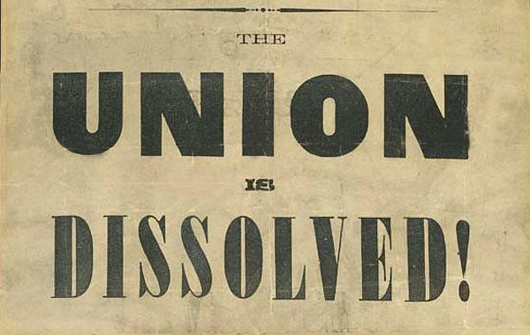
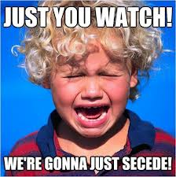
Attempt at Compromise
6) Why no more compromises?
Even after SC seceded…
Many still wanted to preserve the Union
How?
As south debates withdrawal…
Others frantically trying to reach compromise
18 Dec 1860-
Sen. Crittenden (KY) offers amendments to Constitution
Key Idea-
Protect slavery now and forever below 36.30° N
New territories admitted would have right to be slave-state
Republicans said unacceptable!
Just won election saying slavery not extended and now ‘re reversing that!?!
South rejected too
“We spit upon every plan to compromise.”
“No human power can save the Union.”

Slide 6
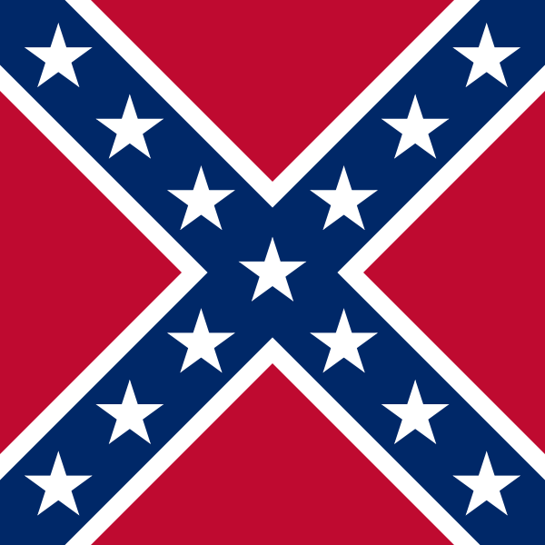
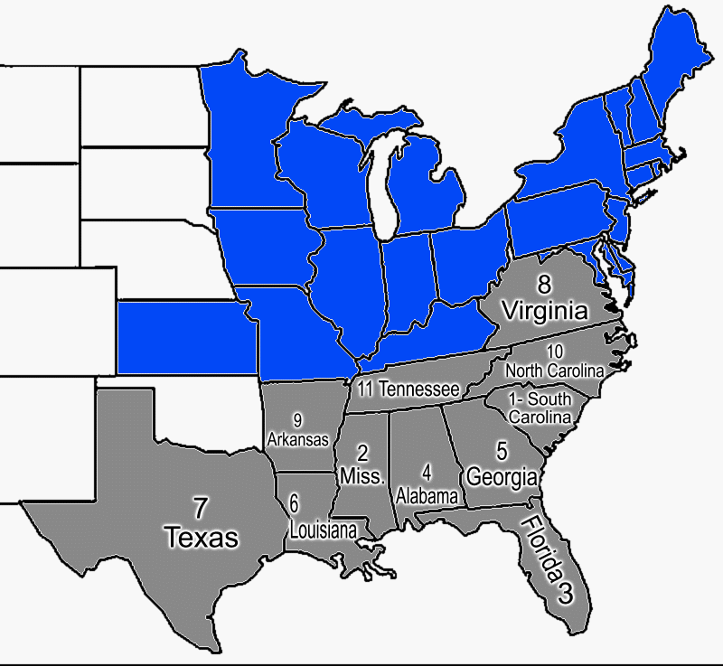
The Confederacy
7) New Nation?
Feb. 1861-
TX, LA, Mis, AL, FL, GA, SC had all seceded
4 Feb 1861-
Delegates from these meet in Mobile, AL
Form new nation
Called…
The Confederate States of America
Chose Sen. Jefferson Davis of Mis as President
Justified secession by saying states entered into Union voluntarily
Defined Constitution as contract & said since gov’t broke contract by denying them equal rts…
They have the rt. to voluntarily leave the contract and the Union
Notes:
Stop Animation Secession of the South (1:16)

Slide 7
Reaction to the Secession
Most Southerners welcomed secession!
People rang church bells for every state that left, shot canons and guns off, cheering in the streets
Some not so sure
Hated seeing the destruction of the Union
N. Abolitionists said good riddance!
If Union only saved by compromising on slavery, then let it die!
Most Northerners believed Union had to be saved
Lincoln asked whether the minority had the right to destroy the gov’t if they chose?
Not on his watch!!!
Some cheered in the streets; most wept at their feet! :(
8) Reactions?

Slide 8
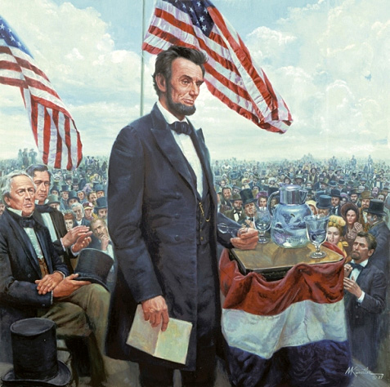
Presidential Responses
After reading this excerpt,
who would Lincoln say is to
blame for a Civil War?
Lincoln elected but not inaugurated yet (not for another month)
Buchanan still Pres!
2 months earlier…
Buchanan tells Congress South has no right to secede, but…
Had no power to stop them
(Lame Duck)
Many awaited Lincoln’s inauguration to see what say and do
What would VA, NC, KY, TN, MO, AK do as well?
Decided to stay, but decision not final!
If force used to bring back south, rest secede
Lincoln mixed toughness and peace in speech
Said secession would not be permitted, but pleaded w/ South to reconsider
Think of the consequences of your actions
9) Analyze
"Plainly, the central idea of secession, is the essence of anarchy..."
"In your hands, my dissatisfied fellow-countrymen, and not in mine, is the momentous issue of civil war. The Government will not assail you. You can have no conflict without being yourselves the aggressors. You have no oath registered in heaven to destroy the Government, while I shall have the most solemn one to 'preserve, protect, and defend it'." -- March 4, 1861 - Lincoln's First Inaugural Address

Slide 9
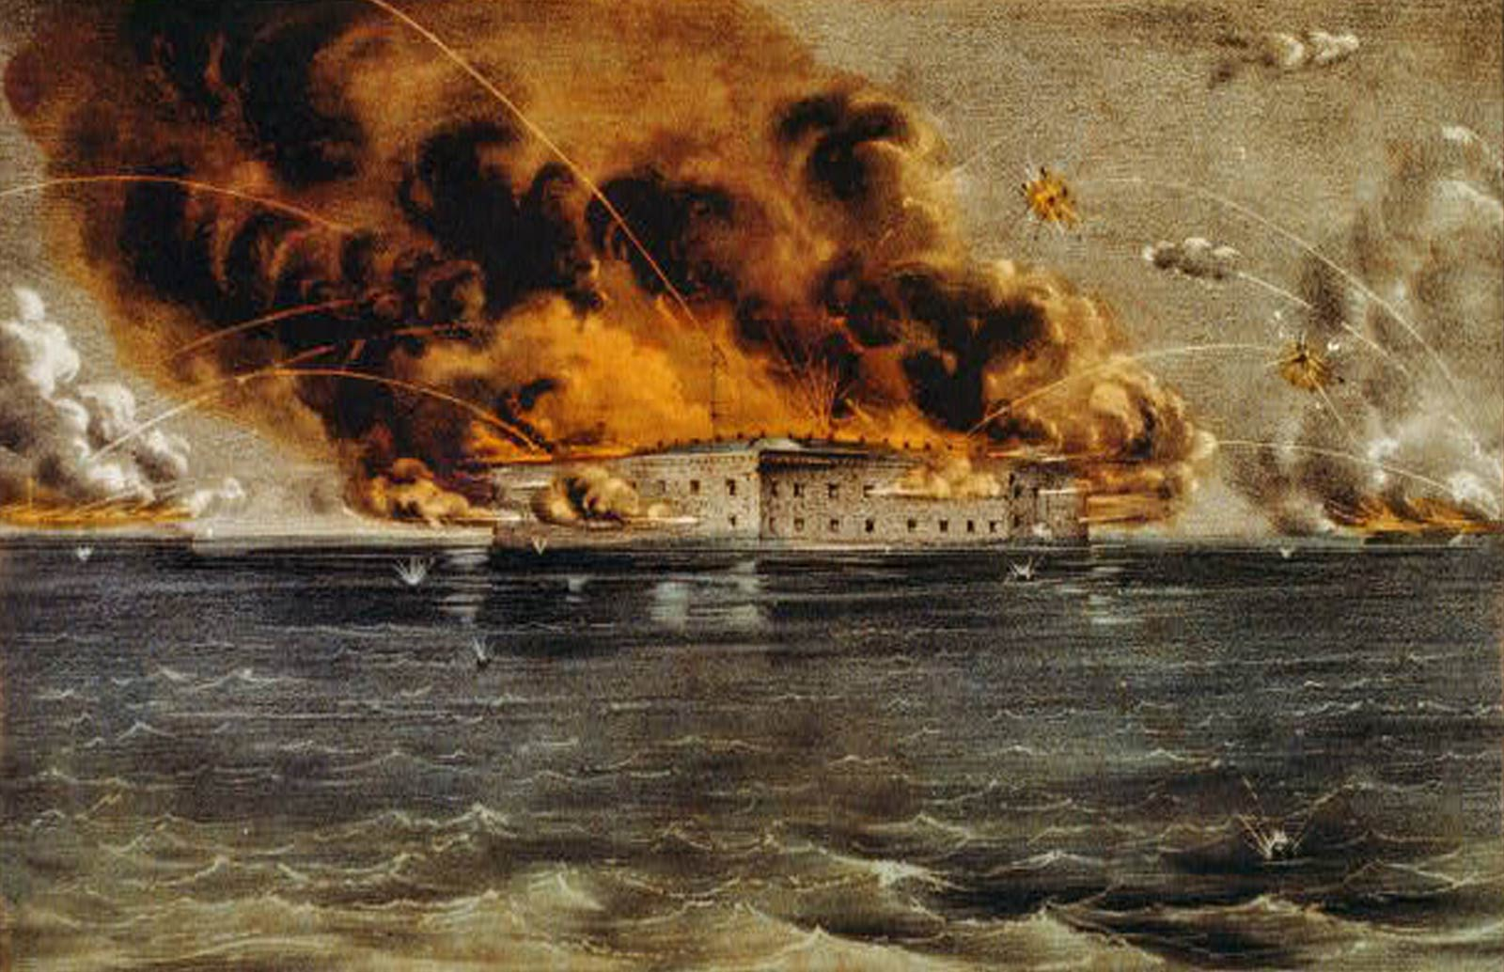
Fort Sumter
South soon tested Lincoln’s words
Confederate forces seized US forts w/i their states
Lincoln didn’t want a war but…
Letting them keep the forts would encourage them more!!!
5 March 1861-
Lincoln receives word that Fort Sumter in Charleston Harbor was low on supplies & the Confederates were demanding their surrender!

Slide 10
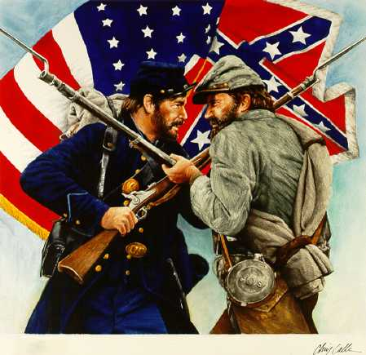
The War Begins
Lincoln sends message to SC Gov. Francis Pickens
Told him he was sending unarmed expedition w/ supplies to Fort Sumter
Promised that Union forces would not do anything unless they were fired upon
Now decision of the war in Confederate laps!
Confederate President Jefferson Davis makes fateful decision!
Orders rebel forces to attack Sumter b4 supplies arrive
12 April 1861-
Rebel guns began to fire on Fort Sumter
Union Capt. Abner Doubleday witnessed it
The guy who later invents baseball!
Union forces held for 33 hours, but in the end the Confederates were too much
14 April 1861-
Union forces surrender Fort Sumter
1,000’s of shots fired but no deaths on either side!!!
News of attack unites the North
VA, NC, TN, AK also secede after Confederate victory
10) What happens at Sumter
Notes:
The Battle of Fort Sumter
5:05

Slide 11
Essential Question: Exit Ticket-
11) Exit Ticket
How did we get to the point of secession?
What happened at Fort Sumter to start the war?

