Slide 1
Warm Up: Spiral Review
1) Warm Up
Fill in the table listing the goals and strategies that both the North and South had for the Civil War.

Slide 2
The Civil War:
1861-1865
7-9 The Early Years

Slide 3
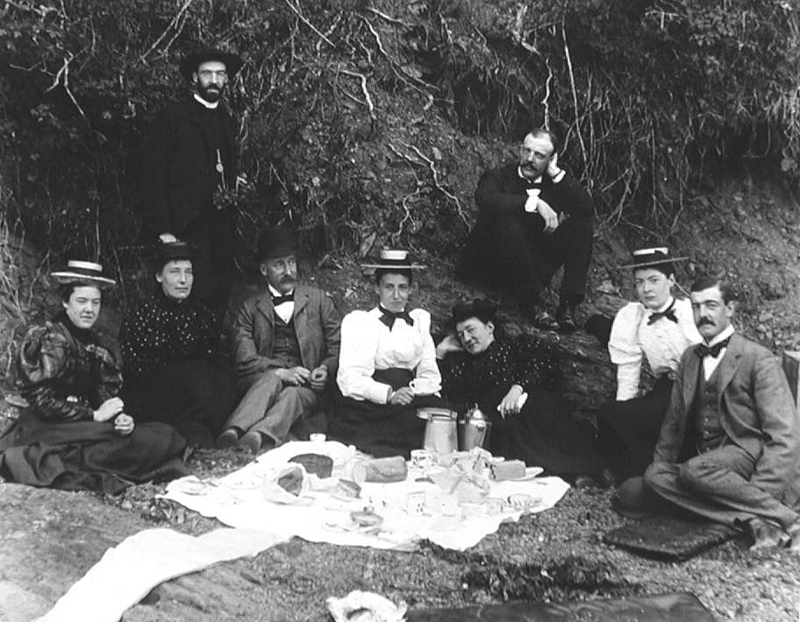
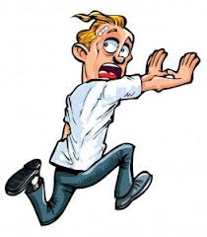
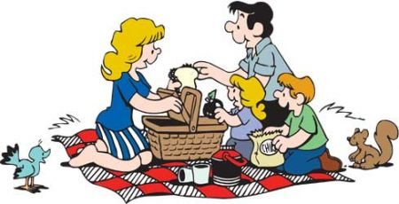
The First Battle of Bull Run (Manassas)
2) Battles named how?
21 July 1861
  Citizens and families ride the 25 miles from DC to picnic and watch the 1st Major Battle
  Fought in N. Virginia
  5 m from town of Manassas Junction
    Rebels used nearest town to name battles
  Near Bull Run Creek
    Yankees used closest creeks and rivers to name battles
35,000 inexperienced Yankee soldiers Gen. Irvin McDowell
20,000 inexperienced Rebels lead by Gen. PGT Beauregard
  Yankees attack!!!
  Drove the rebels at first, but…
    Rebels rallied
  Reinforcements lead by Gen. Thomas Jackson arrive
    Jackson’s rebels seen holding out heroically “like a stone wall”
    General Thomas “Stonewall” Jackson
  Rebels counter attack & break the Yankee lines
    Rebel yell!!!
    Terrified, Yankees drop everything & ran… right into the fleeing civilians!
Peace-Out!!!
Out of my way picnicker!!!
3) 1st major battle? Result?

Slide 4

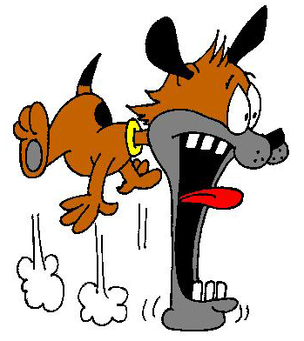
A Shock for the North
4) Next US General?
The outcome shocked the North!
  Began to get that it may be a long, bloody, costly war
Discouraged but still determined…
  Lincoln calls for more volunteers
    Requested total of 1 million soldiers
  Sign 3-year papers
    Appoints Gen. George B. McClellan to train, organize, and lead Union Army

Slide 5
War at Sea
5-7) Visual Vocab
Enforcing the Blockade
The MONITOR vs. the MERRIMACK
B4 Bull Run…
  Lincoln ordered the blockade
    Prevent South from exporting goods & importing aid or supplies
  When war began, North not enuff ships to cover 3500 miles coast line
    Blockade Runners were Reb ships that could run in and out of the blockade
  North built more ships to complete blockade
    Reduced 2/3rds of Reb trade
    Guns, shoes, coffee, nails, salt short supply throughout war
Rebs couldn’t let blockade go unchallenged
  Took old Union ship called Merrimack and covered it w/ iron plates
8 March 1862- Merrimack attacks US ships
  Union wooden ships no match for Ironclad
  Shells bounced of its’ sides!!!
Union builds 1st real iron ship called, Monitor
9 March 1862- 2 ships face off!
  Neither could sink the other, but…
  Union able to keep Merrimack in harbor so can’t get other US ships
  Marked beginning of new type of navel warfare

Slide 6
War in the West:
Early Victories for the North
8&9) Grant’s Nickname, why?
1 of North’s goals to control Miss. R.
  Split Confederacy & control supply mvmt.
    Grant put in charge of this
16 Feb. 1862- Grant takes Fort Donelson on Cumberland R.
  Reb Commander @ Donelson asked Grant what were his terms of surrender…
    “No terms except unconditional & immediate surrender can be accepted.”
  “Unconditional Surrender” Grant becomes his nickname
Grant’s wins on the rivers open path for Union to take TN, MS, AL, & KT!!!
  Makes him the new hero of the North

Slide 7
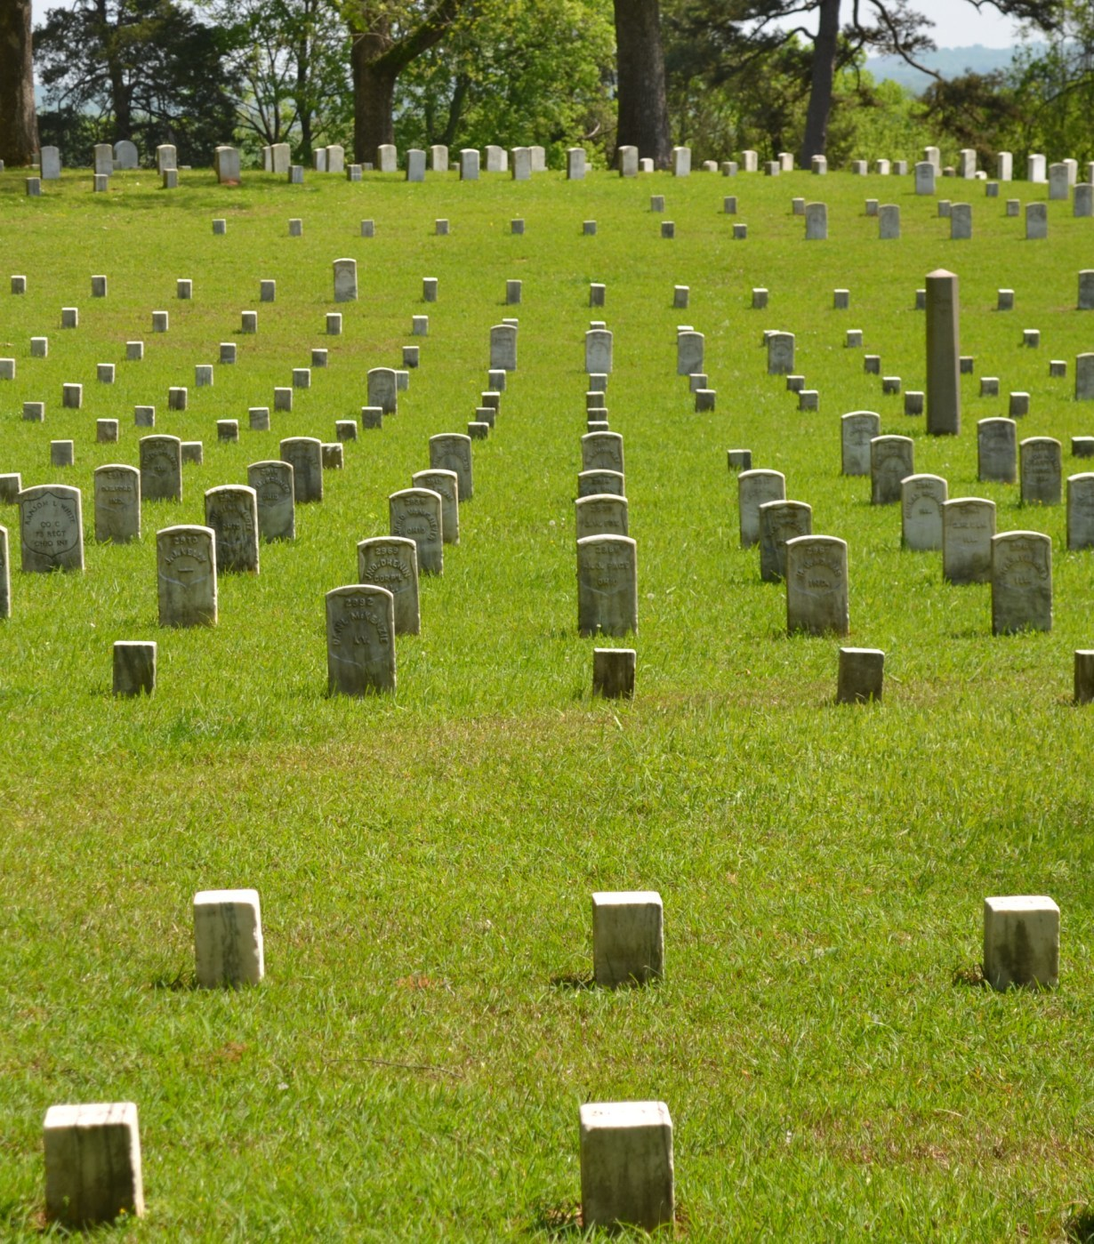
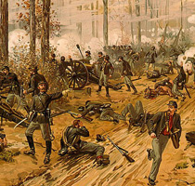
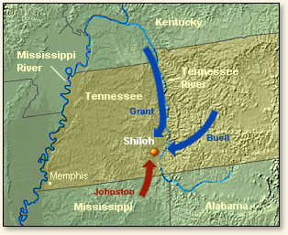
The Battle of Shiloh
10) Named for& Result
April 1862-
  Grant & 40,000 Yankees went south along TN. River toward Corinth, MS (important RR junction)
  20 m. b4 was Shiloh Church (camped there)
    More Union forces from Nashville, TN on way
6 April 1862- Rebs attack b4 aid to arrive
  Lead by Gens. Beauregard and Johnson…
  Rebs drive Grant and Yanks back to TN River!
  But…
    25,000 Yanks from Nashville finally arrive!
    Gunboats on river start shelling Rebs too!
    Rebs retreat back to Corinth
Even though only 2 days…
  Losses for both sides extremely high!
    Total 20,000 men died at Shiloh Church
    1 of bloodiest battles in the war!
After narrow win @ Shiloh, Yanks take Corinth on May 30th
Take Memphis, TN on June 6th
North well on way of controlling Miss. River
The losses at Shiloh were enormous. Together the two armies suffered 20,000 casualties!
“that was too shocking… too horrible to bear.”
~unnamed Confederate Soldier

Slide 8
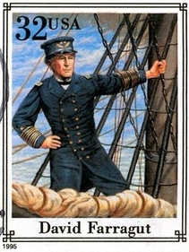
New Orleans Falls
11) Importance?
25 April 1862- North another important win
US Navy under Farragut capture New Orleans, LA
  Largest city in the South!
Farragut
  Of Spanish decent
  Grew up in the South, but…
    Stayed loyal to Union
New Orleans at mouth of Miss. River
  South can no longer carry goods to sea anymore
  No $$$
  No $$$ = No supplies
Farragut and Grant’s victories gave Union control of almost entire Mississippi River!!!

Slide 9
War in the East:
McClellan Trains & Union Defeat at Richmond
12) McClellan
14) Visual Vocab
After Bull Run, war in East was split
Generals turned attention to training new recruits
  Union Gen. McClellan leads training
    Completely trains, reorganizes, and drills new Union troops
  However, scared to put them in battle
    Feared not ready
  Finally, March 1862… new Army of the Potomac was ready!!!
    Its goal was to capture the Confederate capital of Richmond, VA
Instead of moving on Richmond directly (like Lincoln wanted)
  McClellan moves huge army to SE of city by ship
  Better fortified by sea
McClellan spends weeks slowly attacking to the water side of city
  Allows Rebs time to strengthen defenses of city
  Lincoln constantly on McClellan to act!
  Slowly they moved toward capital
  Finally meet Rebs at end of June!!!
    Known as Seven Days’ Battles
Robert E. Lee commands Rebs defending the city
  JEB Stuart and 1,200 cavalry ride completely around Union force
    Gathering intel about Union army
  Lee attacks and drives them all the way back to the river
Took only 7 days to go back to the river, where it took almost 4 months to get there!
13) Richmond

Slide 10
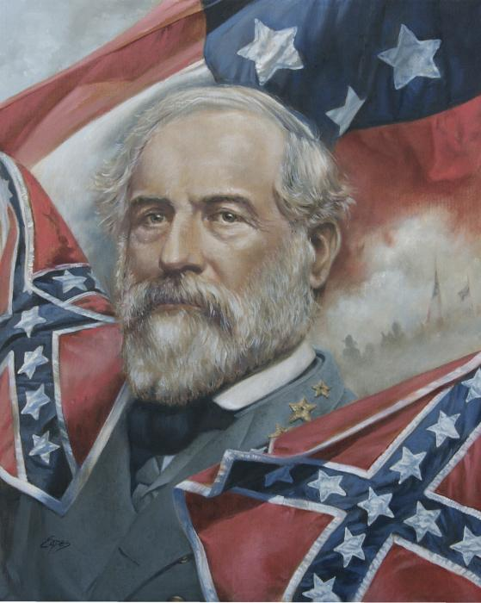
Sad Eyes in the Union
Reports of loss depress the North
Wins in west good, but…
  wanted the capital
  Lincoln has to call for 300,000 more volunteers
Some positive though,
  McClellan still only 25m. from Richmond
    Unfortunately, McClellan never engages Lee again though
    Is ordered by Lincoln to come back and join under Gen. John Pope
2nd Battle of Bull Run (or Manassas)
  Rebels win again!
  Richmond no longer threatened
  Win / Win Situation
Plus, Lee now only 20m. From DC!

Slide 11
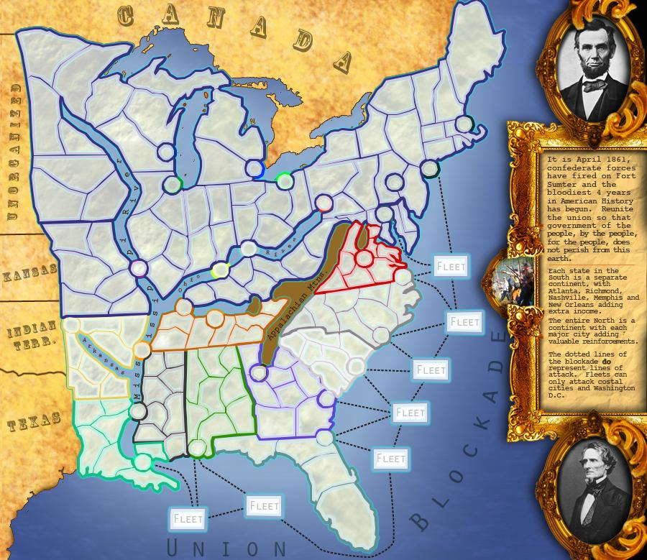
Battle of Antietam
15) Claim to Fame?
After these wins, Con. Pres. J. Davis orders offensive into Maryland
  Hoped another win would convince Brits and French to join in
Sept. 1862- Lee marches into Maryland
  McClellan & 80,000 Yanks followed
18 Sept. 1862- Union soldiers find a copy of Lee’s plans in field!
  Now Yanks knew Lee’s exact plans
  Learned Lee’s army divided into 4 parts
  Tells McClellan there is opportunity to overwhelm each part piece by piece, but…
  McClellan too cautious and slow!
    Waits 4 days b4 finally attacks
    Allows Lee to gather his forces together near Sharpsburg, MD
Battle of Sharpsburg (or Antietam)
  Creek Yanks named it after
  17 Sept. 1862- Yanks and Rebs meet
    Single bloodiest day in the entire war!!!
      At end, 6,000 dead and 17,000 seriously wounded
  Day after the battle, Lee withdraws to VA
    Yanks win!!!
McClellan ordered by Lincoln to follow and destroy, but doesn’t
  Lincoln disgusted… could have ended the war right then!!!
  Lincoln replaces McClellan with Gen. Ambrose Burnside as Commander of Union Army
Now war would rage on for 3 more years

Slide 12
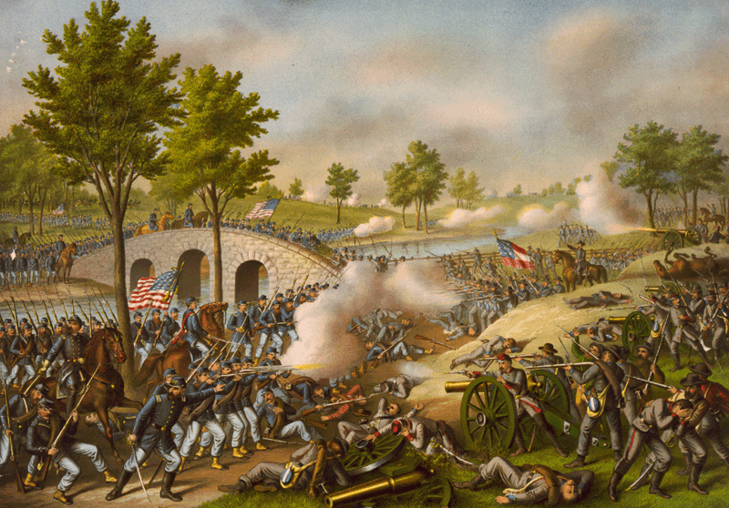
Exit Ticket
What effect did the Battles of Richmond Antietam have on the war?

