Slide 1
Reshaping the Nation: 1865-1877
8-2 Intro to … RECONSTRUCTION

Slide 2
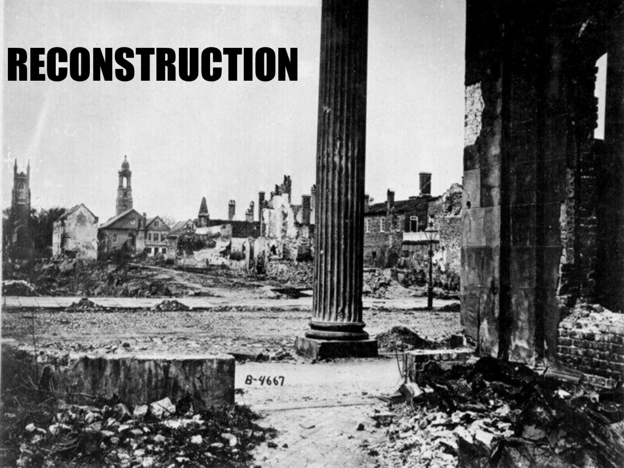
Webquest… Explore
https://www.blendspace.com/lessons/C431CNC2Rg-eIA/reconstruction
Explore the Reconstruction Era by completing the Webquest above.
Read, watch the video clips, and answer the questions
Be sure to answer the questions in number order!!!

