Slide 1
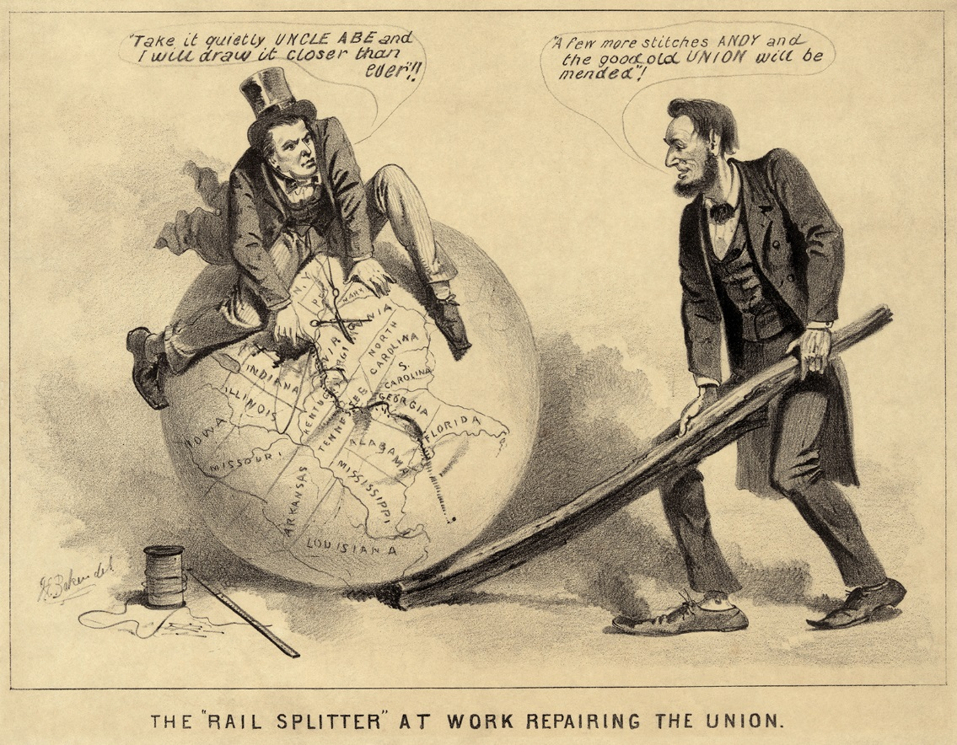
Warm Up: What would you do?
Now that the Civil War is over, what would you do as president to “reunite” the nation?
1) Warm Up

Slide 2
Reconstruction & Its Aftermath
8-3 Reconstruction Plans

Slide 3
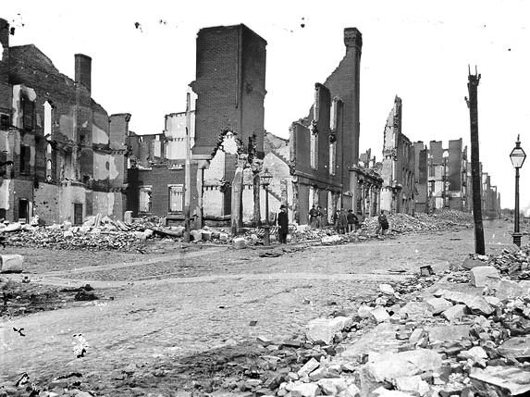
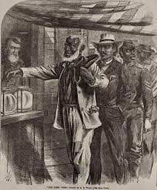
Reconstruction Debate
2) Visual Vocab
Civil War saved the Union but shook nation to its core
Attempt to reunite nation left them w/ many ?’s
Should southerners be punished or forgiven?
What rts. should be granted to freedmen?
The term given to newly freed slaves
How can nation be re-united?
War left South in shambles
Towns cities in ruins
Plantations burned
Roads, bridges, RR’s destroyed
258,000 rebels died… those who returned not themselves
Rebuild their lives w/o any resources and few worthy men
Everyone agreed they needed to rebuild south
Disagreed bitterly how to do it
Period of rebuilding called “reconstruction”

Slide 4
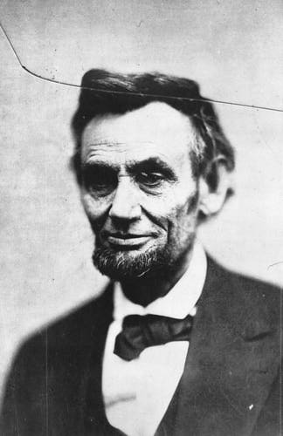
Lincoln’s Plan
3) Chart
Lincoln offered the 1st plan
Dec.1863- called “10% Plan”
If… 10% of voters of state took oath of loyalty to Union… state form new gov’t (banning slavery)
He believed punishing would serve no purpose… only delay healing of nation
Offered amnesty, or a pardon to all white southerners (except Confed. Officers) willing to swear oath of loyalty to Union
Supported giving rt. to vote to educated AA’s or ones who served in the Union Army
But… wouldn’t force the south to give them all the rts.
1864- LA, TN, AK agreed to Lincoln’s Plan
Caught in middle though when Congress refused to back Lincoln’s deal
Thought south should be punished
4) Visual Vocab

Slide 5
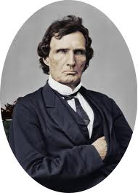
A Rival Plan
5) Radical Republicans
Group of Republicans in Congress thought Lincoln’s plan too nice
Thought Congress should control Reconstruction
Called Radical Republicans b/c favored more radical, extreme approach
Leader… Thaddeus Stevens
Declared south should be broken
Congress voted to deny seats to any states reconstructed under Lincoln’s plan
Began to create their own plan

Slide 6
The Wade-Davis Bill
Chart
July 1864- Congress passes Wade-Davis Bill
Much harsher than Lincoln’s plan
1st- majority of whites had to swear allegiance
51% not 10%
2nd- Only those men could vote for reps in Congress
3rd- Former Rebels couldn’t hold public office
4th- Had to adopt state gov’t that abolished slavery
Only when all conditions met…
They could be readmitted to Union
Lincoln refused to sign bill
Wanted new gov’ts fast and order restored
But…
He knew though he would have to compromise w/ Radical Republicans

Slide 7
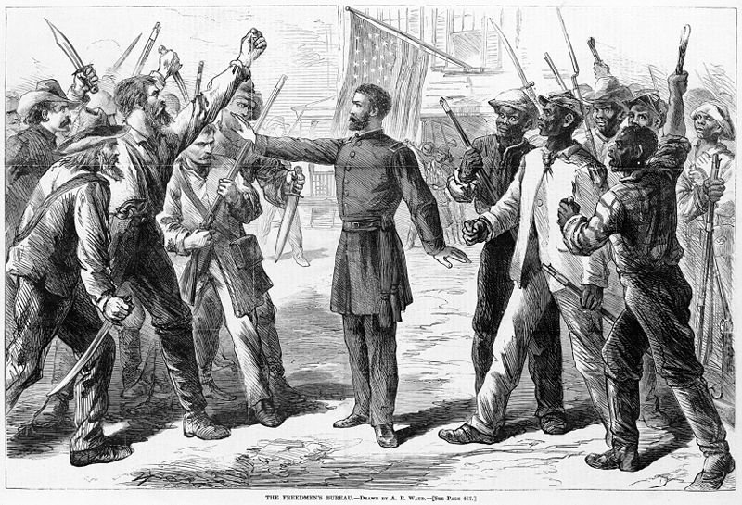
The Freedman’s Bureau
Other issue of reconstruction going much better
March 1865- Congress and Lincoln create gov’t agency called Freedmen’s Bureau
Played important role in helping AA’s make the transition from slavery
Provided food, clothing, and medical aid
Est. schools and helped set up AA universities
Helped freedmen acquire land (abandoned or seized by Union army)
40 acres and a mule
6) Why important?

Slide 8
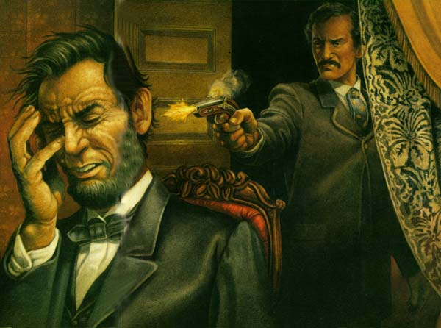
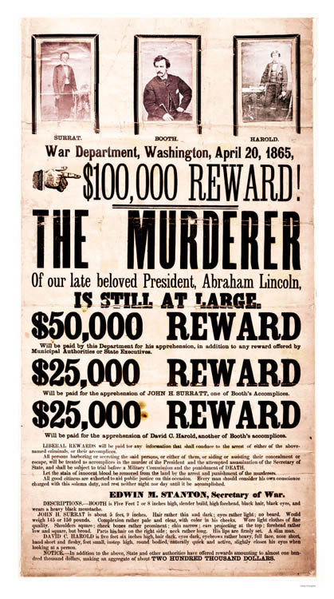
Lincoln Assassinated!
7) When/where?
14 April 1865- Lincoln & wife, Mary Todd
Went to Ford’s Theatre to see play, Our American Cousin
5 days after Lee surrenders
4 yrs. To the day of fall of Fort Sumter to start the war
John Wilkes Booth, actor and Rebel spy
Enters into presidential booth undetected
Shot Lincoln in back of the head
Leapt from box onto stage, shouts Sic Temper Tyrannous, Latin for Thus Always to Tyrants
Escapes in to chaos
Aides carry Lincoln across street to Patterson house where he dies a few hours later
Booth escapes into VA b4 being caught by Union army on April 26th
Refuses to surrender and is shot to death in a barn
Booth was mastermind in plot to kill all high gov’t officials at same time
Court convicted 8 of the conspirators and saw 4 of them hanged
8) The events
Notes:
Lincoln Assassination Eyewitness (Feb 9, 1956) (5:29) on poster
The Assassination of Abraham Lincoln (5:55) on picture

Slide 9
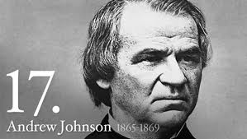
A New President
Part of the plot to be killed too, but wasn’t
VP under Lincoln
Democratic Senator from TN
Only southern senator to stay in Congress after secession
Soon after taking office revealed his plan for reconstruction
Resented to slaveholders who destroyed the south
Wanted them punished
Radical Republicans thought he would create a plan they would like but…
He believed in giving the states the power to make the decisions
And he was no friend to the African American
9) New Prez

Slide 10
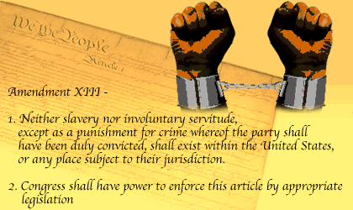
“Restoration”
Chart
May 1865- Johnson announces his “Restoration” plan
Part 1- southerners granted amnesty after swear oath to Union
Part 2- Rebel Officers and officials could be pardoned
Had to apply in person to the President
Part 3- only whites who swore oath and were pardoned could vote
Part 4- allowed new state gov’ts to decide on voting rts for blacks
Part 5- states had to have convention where they denounced secession and must abolish slavery
Had to ratify, sign into law the 13th Amendment
Abolishes slavery in all states
By end of 1865 all rebel states had done these things except TX
President Johnson declared “restoration” almost complete

Slide 11
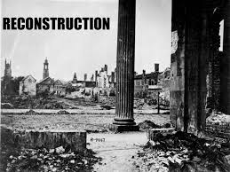
Exit Ticket: Essential Question
How did Lincoln’s death change the course of “Reconstruction?”

