Slide 1
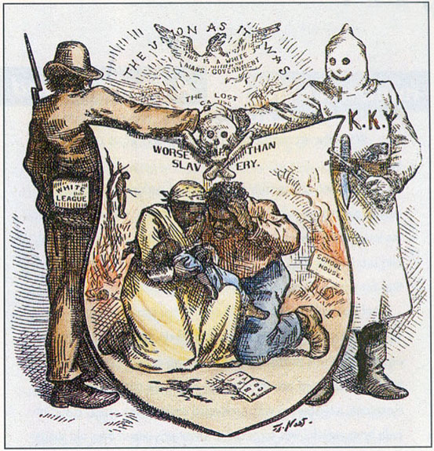
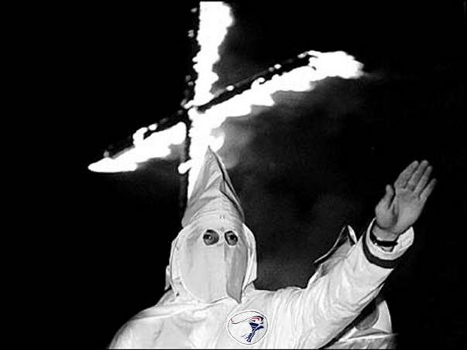
Warm Up: Digital DBQ
1) Warm Up!

Slide 2
Reconstruction & Its’ Aftermath
8-7 The End of Reconstruction

Slide 3
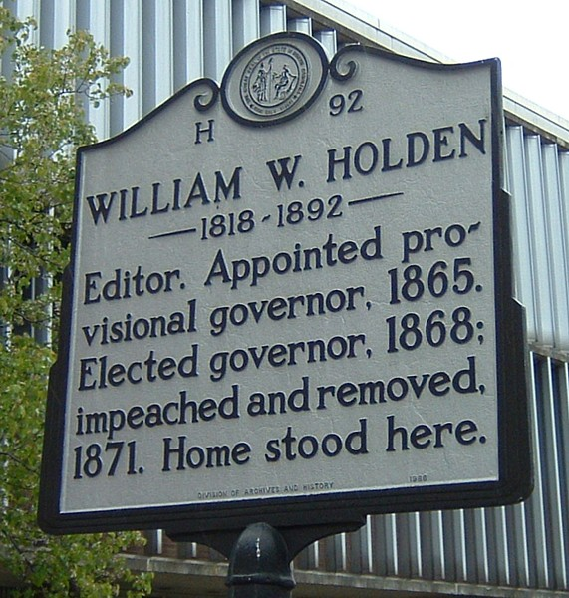
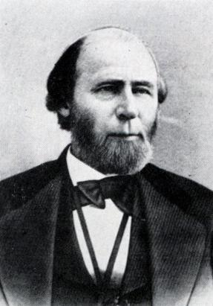
Setting the Stage
2) Scalawag?
Holden the Scalawag
1868-1871- new Repub. Gov. of NC William Woods Holden
Period known as time of “pillage and plunder”
He & friends involved in many dishonest dealings
Scandals widely publicized by Conservatives
This & the 20 AA’s in the NC Assembly really angered the Conservatives
Began to seek way to end what they called, “oppressive & corrupt gov’t”
Return to Conservative (Democrat) control in NC

Slide 4
The Spread of Terror in NC
Under Holden, some grew rich
Funds marked 4 repairing RR’s found way into pockets of dishonest Repub Scalawags
Bribery & fraud not uncommon under Holden
Frustrated Conservatives turned to KKK
Klan members broke up Repub. mtgs.
Used fear to intimidate honest Repubs.
Threats, beatings, murder all used to scare away Repub vote
KKK so successful, Repub lost control of 13 counties in NC in just few months
As 1870 election neared- terrorism increased
26 Feb 1870-
Wyatt Graham (AA Repub leader) &
John W. Stephens (white Repub leader)
Kidnapped by Klan & hung from tree in town square
3) Conservatives? Where do they turn where?

Slide 5
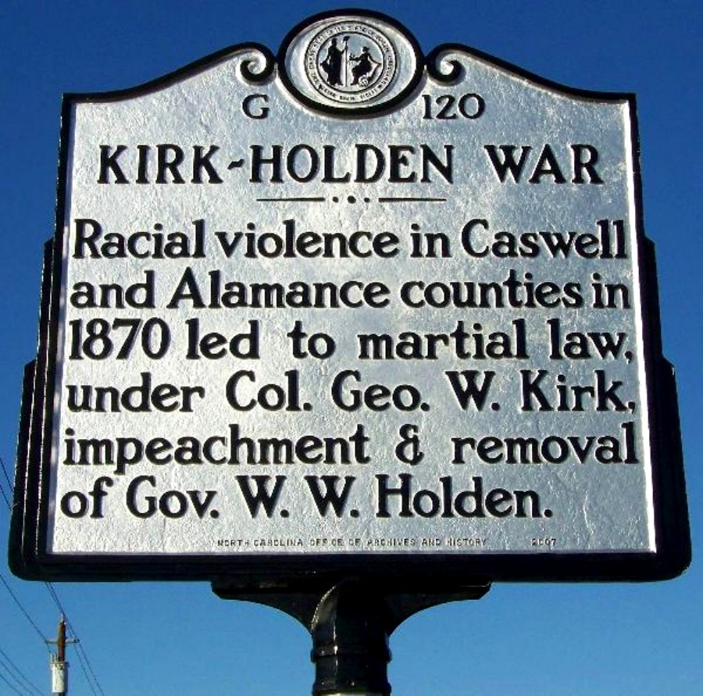
The Kirk-Holden War
4) Why?
NC Gov Holden reacts quick to 2 murders
Places NC under martial law, use state militia to control (calls in the army)
NC now under control of Gov. Holden & Colonel George W. Kirk
Kirk led Union troops in Civil War
Now controls NC militia to arrest Klan members
Kept them prisoner @ his camp
Gov. Holden ignored their claims of being held unlawfully
Becomes known as The Kirk-Holden War
Finally judge orders them released for violating due process
Conservatives (southern white Dems) took control of State Assembly
Klan achieved its’ goal
Holden forced to let out prisoners & disband militia
5) K-H War

Slide 6
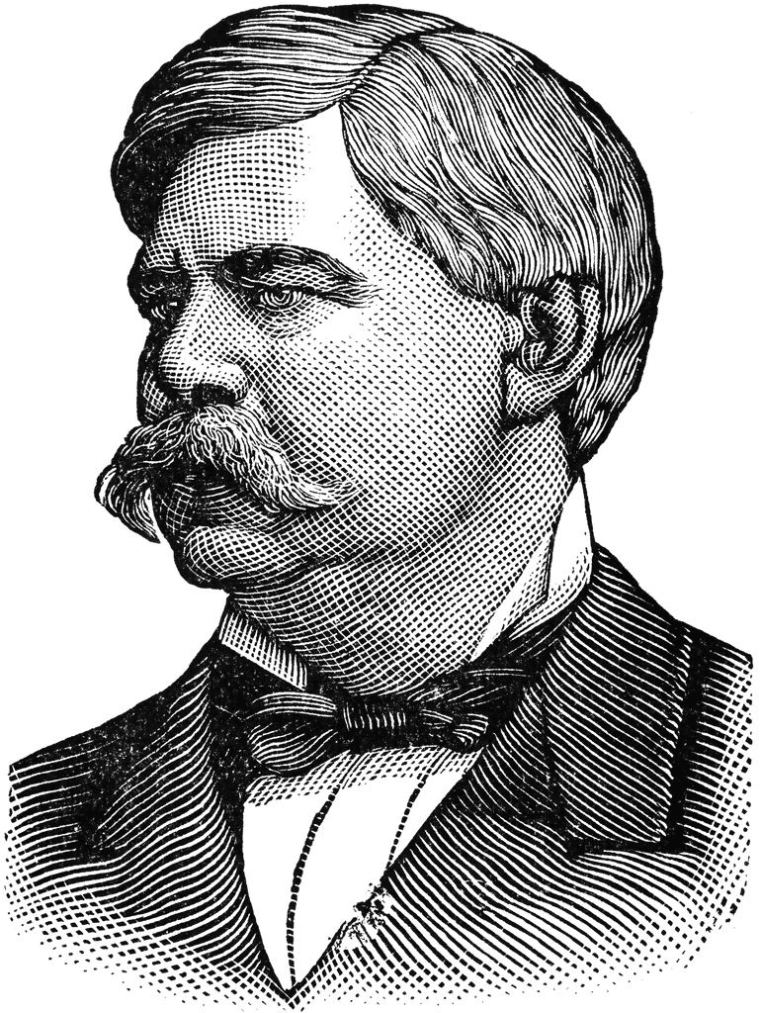
The Conservatives Regain Control
6) Holden Out!
Conservative Dems begin calling 4 Holden 2 B impeached b/c of his actions
Trial lasts b/t Feb 2 – March 23, 1871
Charged w/ 8 crimes
Convicted on 6 & removed from office
1875- new elections held
58 Dems, 58 Repubs, 3 independents
Started passing laws
Set 1-yr residency requirement b4 vote
Stop the carpetbaggers
Est segregated school system
Gave new gov’t power 2 change reconstruction laws back 2 pre-war rules
Conservative Dems quickly elect own governor
Go back to secessionist Zebulon B. Vance in 1877
Many rejoiced saying, “home rule has been restored!”
Zebulon B. Vance
7) Laws

Slide 7
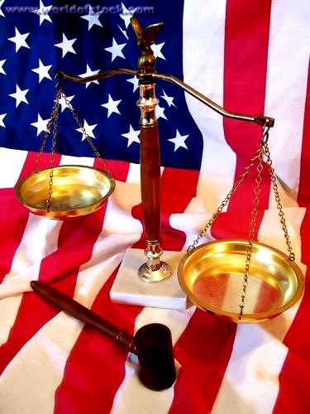
The Impact of Reconstruction on NC
Reconstruction ENDS w/ return of Conservative Dems
But has lasting impression
AA’s claim place as true citizens
Some reunite w/ families
Own land, businesses
Educate themselves
Become part of political scene
Voting & taking office
But restrictions under conservatives grind these to halt
Whites benefitted too!
Poorer whites begin to participate
Power of rich, former slave-owners is broken during
Even after Conservatives regain power don’t change everything back to pre-war settings
Keep guaranteed voting for all men
Got rid of wealth restrictions 4 voting too

Slide 8
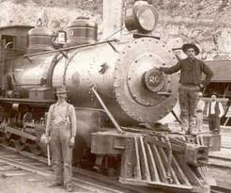
Social Improvements
During Reconstruction created system of universal public education
Even if still segregated!
Established state agencies 2 help people
Poor, orphaned, mentally disabled, or if in prison
Actively encouraged industry
Diversify their economy
Esp building of RR’s
Growth of RR’s would connect other industries and is leading us into a revolution!
Textiles, tobacco, & furniture making
8) RR & Industry

Slide 9
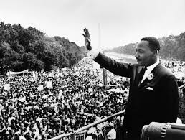
Reconstruction’s Legacy
9) Struggles
1876- nation united again!
1877- President Rutherford B. Hayes withdrew army from south
South still scarred from war
Most were poor
Made little progress in farming (w/o slaves)
Businesses & industries didn’t thrive
Some gave up & moved north 4 better opportunities
By 1877- Repubs had lost interest in helping AA’s
Now on own vs. Conservative south
Stripped of many new rts they had just gained
Many moved north
Even there not treated equally, but better than in south
Equality won’t occur until 1960’s 100 years after the Civil War!!!
Finally start to win battle against discrimination

Slide 10
Exit Ticket
10) Exit Ticket
What legacy did reconstruction leave behind? (How did it have an effect on history?)
Notes:
The Presidents 1865-1885 Andrew Johnson to Arthur (History Channel) (1:03:22)
18mins to about 29 mins.

